Slide 1
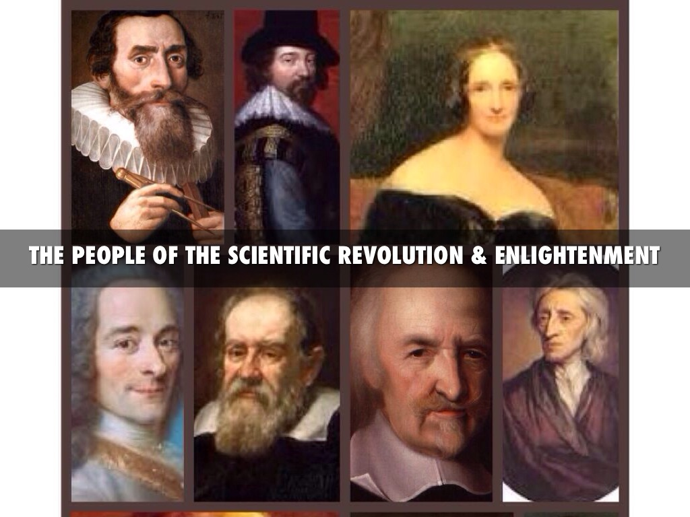

Technology, Production and Global Division of Labor
Notes:
NOTE:
To change the image on this slide, select the picture and delete it. Then click the Pictures icon in the placeholder to insert your own image.

Slide 2

Production
Agriculture
Animal Husbandry
Service: Tertiary
Industry
Agrarian Society
Feudal Society
Manor Economy
Hydraulic Society
Asiatic Mode of Production
Oriental Despotism
Post-Industrial Society
De-industrialization
Industrial Society, Modern Society
Industrialization
Modernization
Affluent Society
Nomadic Society
The Silk Road: traders on the road
Golden Age: From Genghis Khan on
Speed and Height

Slide 3
Five economic sectors
the primary sector which includes agriculture, mining and other natural resource industries;
the secondary sector covering manufacturing, engineering and construction;
a tertiary sector for the service industries,
the quaternary sector for intellectual activities involving education and research,
the quinary sector reserved for high level decision makers in government and industry.
Read more: http://www.businessdictionary.com/definition/economic-sector.html

Slide 4
The Scientific Revolution and Industrial Revolution
The Dark Age and the Black Death
1540, George Joachim Rheticus, Narratio Prima, first argument for heliocentrism.
Copernicus, De Revolutionibus orbium Coelestium (On the Revolutions of Heavenly Spheres), 1543
Scottish ingenuity James Watt's steam engine
Isaac Newton
The Industrial Revolution

Slide 5
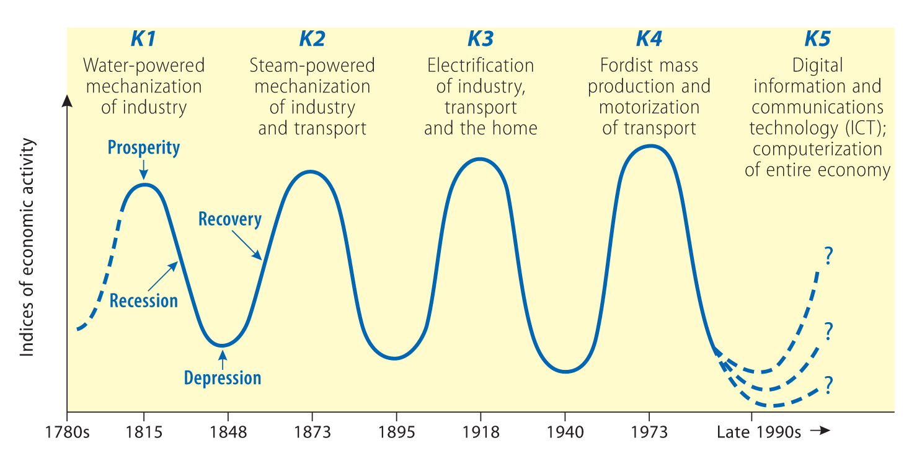
Figure Kondratiev long waves
Source: based, in part, on Freeman and Louçã, 2001: Table II.1

Slide 6
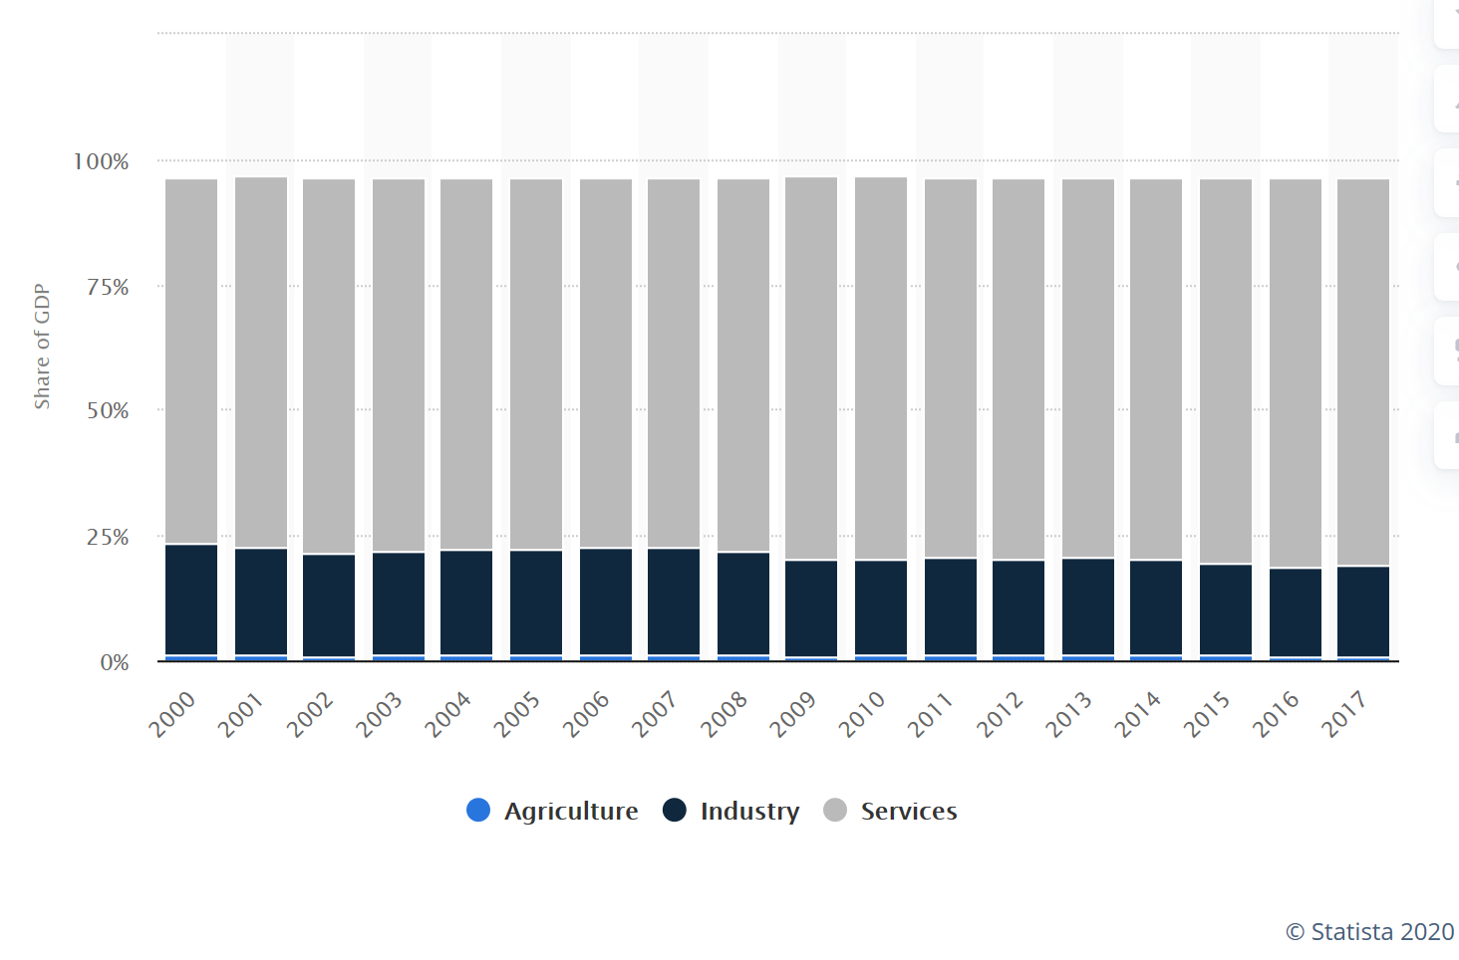
Distribution of gross domestic product (GDP) across economic sectors in the United States from 2000 to 2017 https://www.statista.com/statistics/270001/distribution-of-gross-domestic-product-gdp-across-economic-sectors-in-the-us/

Slide 7
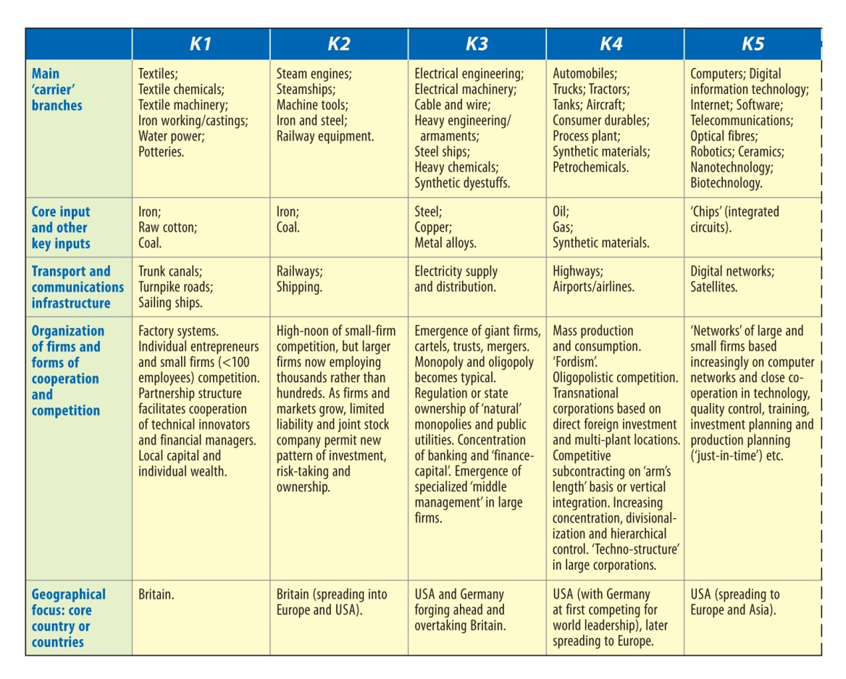
Figure Key characteristics of successive K-waves
Source: based, in part, on Freeman and Perez, 1988: Table 3.1; Freeman and Louçã, 2001: Table II.1; Perez, 2010: Table 1

Slide 8
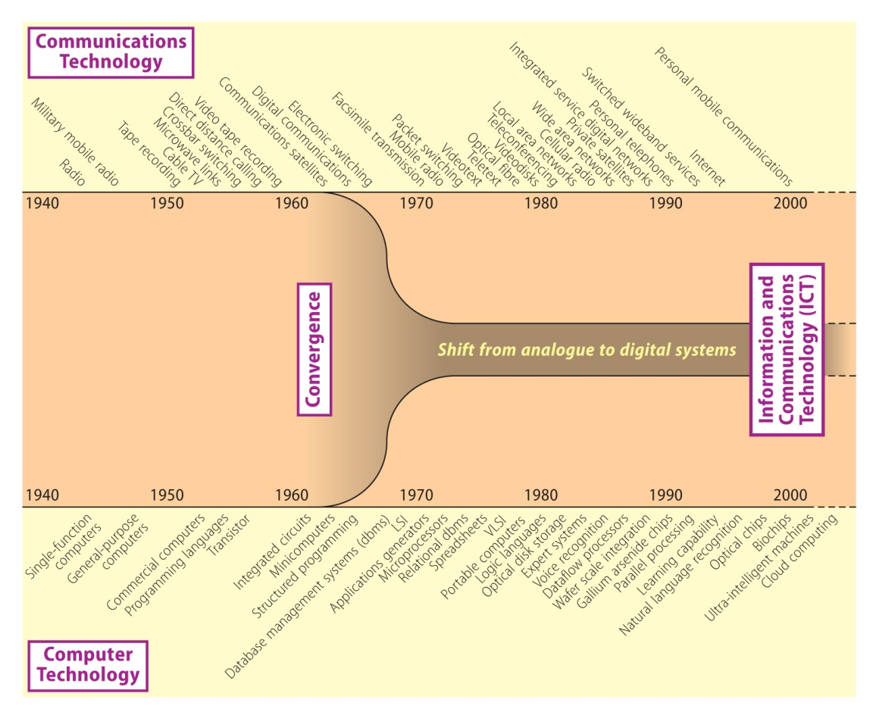
Figure Information and communications technologies: a process of convergence
Source: based, in part, on Freeman, 1987: Figure 2

Slide 9
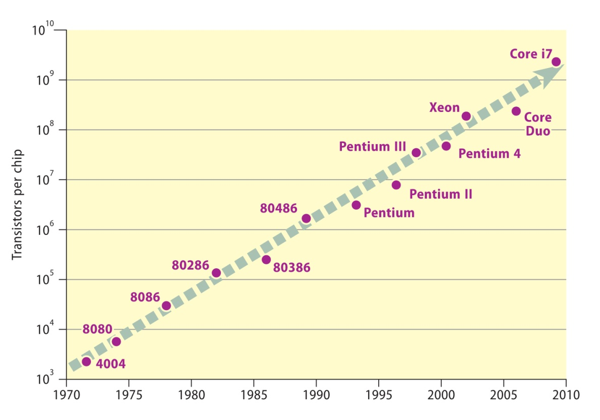
Figure Exponential increase in the capacity of microprocessors

Slide 10
The Moore’s Law
In 1965, Gordon E. Moore—co-founder of Intel, perceived that the number of transistors on a microchip doubles every two years, though the cost of computers is halved. Moore's Law states that we can expect the speed and capability of our computers to increase every couple of years, and we will pay less for them. The growth of technology is exponential.

Slide 11
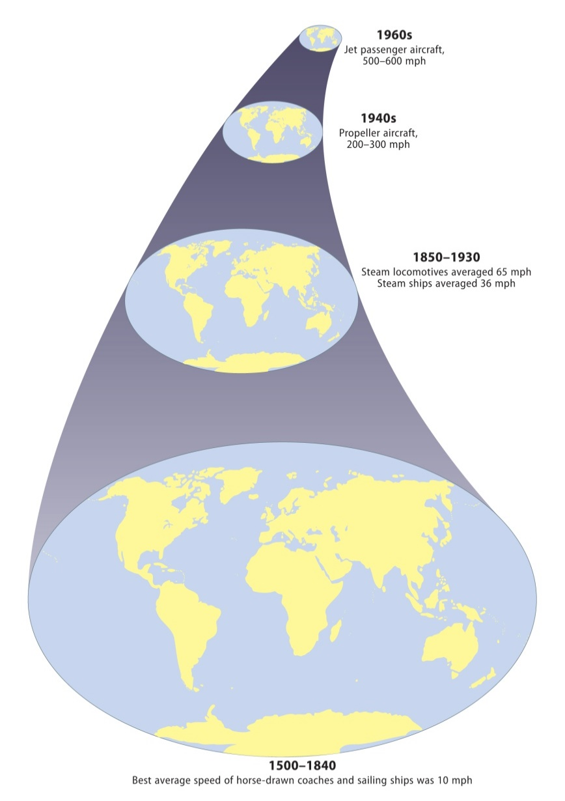
Figure Global shrinkage: the effects of transportation innovations on ‘real’ distance
Source: based on McHale, 1969: Figure 1

Slide 12
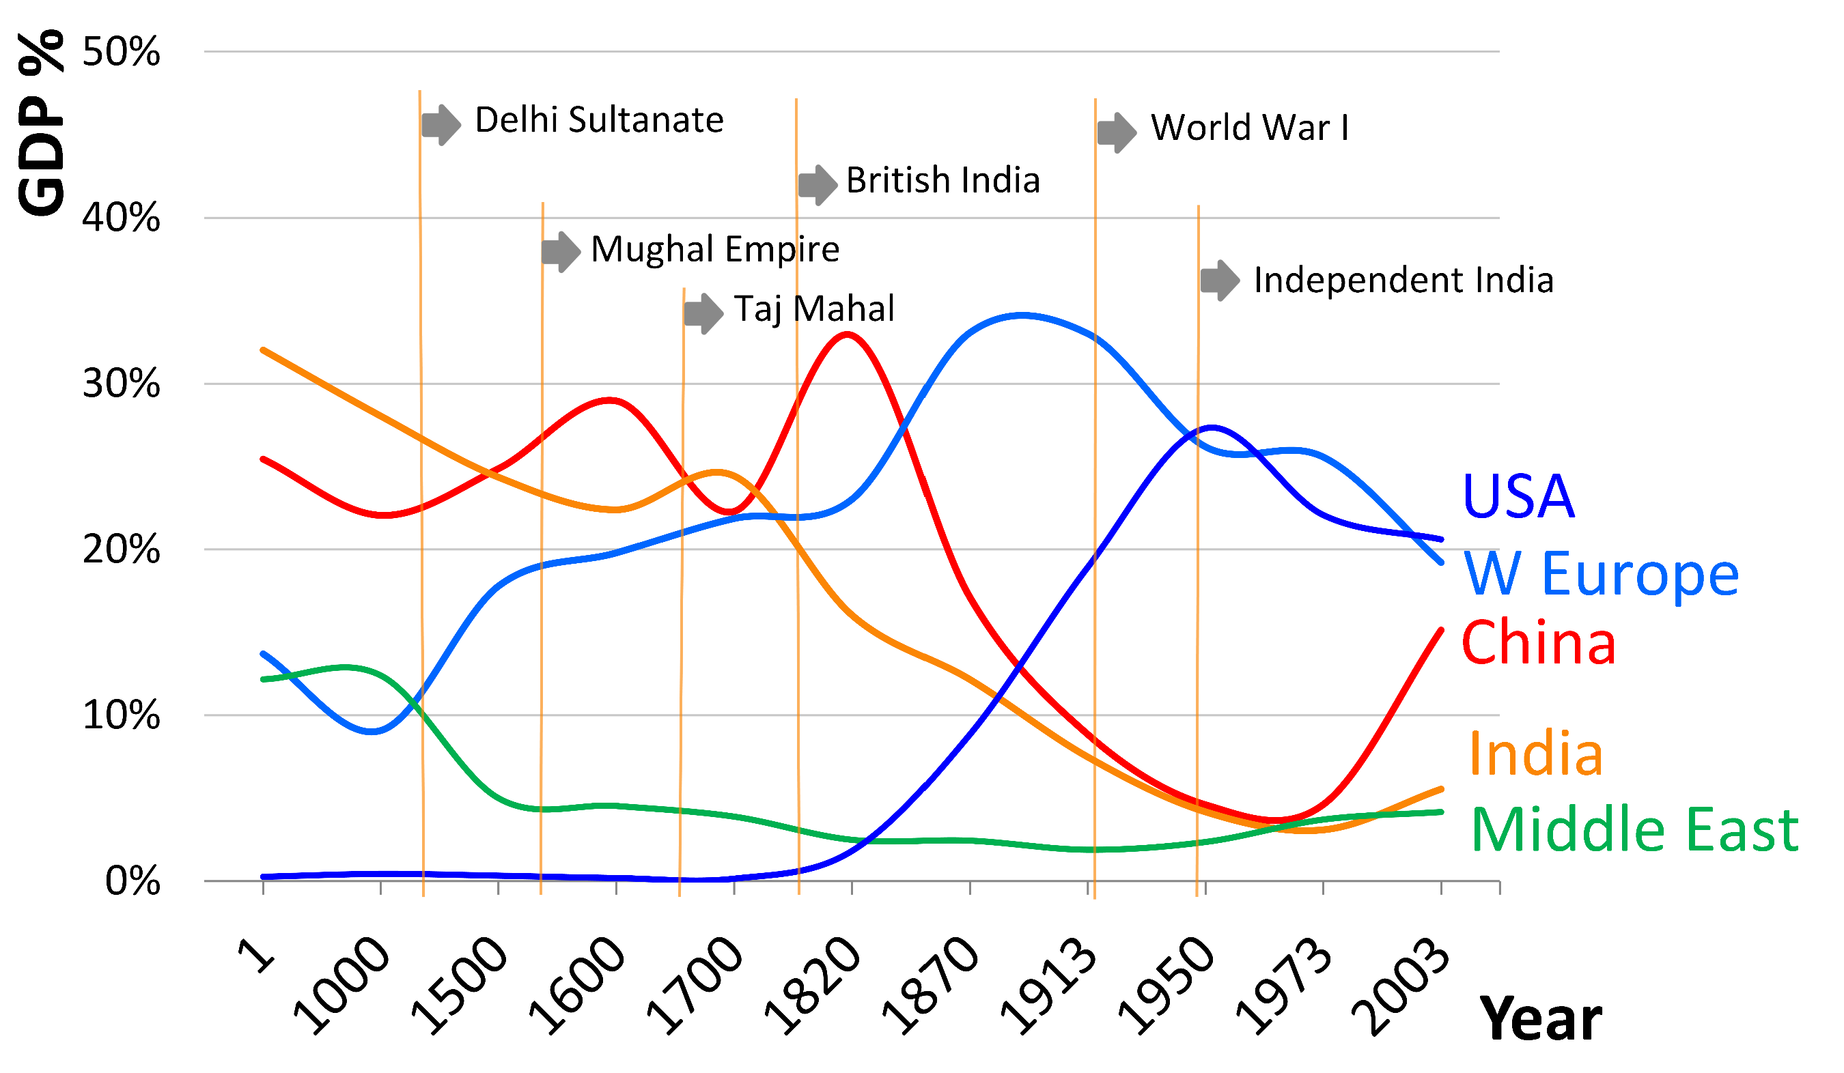
https://upload.wikimedia.org/wikipedia/commons/f/f0/1_AD_to_2003_AD_percent_GDP_contribution_of_India_to_world_GDP_with_history.png

