Slide 1
Theory and theorizing IPE
Why does theory matters in IPE?
Notes:
NOTE: Want a different image on this slide? Select the picture and delete it. Now click the Pictures icon in the placeholder to insert your own image.

Slide 2
What Is Theory?
Theory: Normative/Positive, Value-laden/Value-free (neutral)
Ontology: the nature of being and existence; what aspects need to be explained
Epistemology:
Methodology:

Slide 3
Traditional Trichotomy: Robert Gilpin
Mercantilist: Economic nationalism and protectionism
Realism-Mercantilism-Statism-Economic Nationalism
Sovereign-at-Bay Model: economic interdependence and decline of nation-state
Idealism-Liberalism
Dependency/Dependencia
Marxism-Structuralist-World System-Critical theory

Slide 4
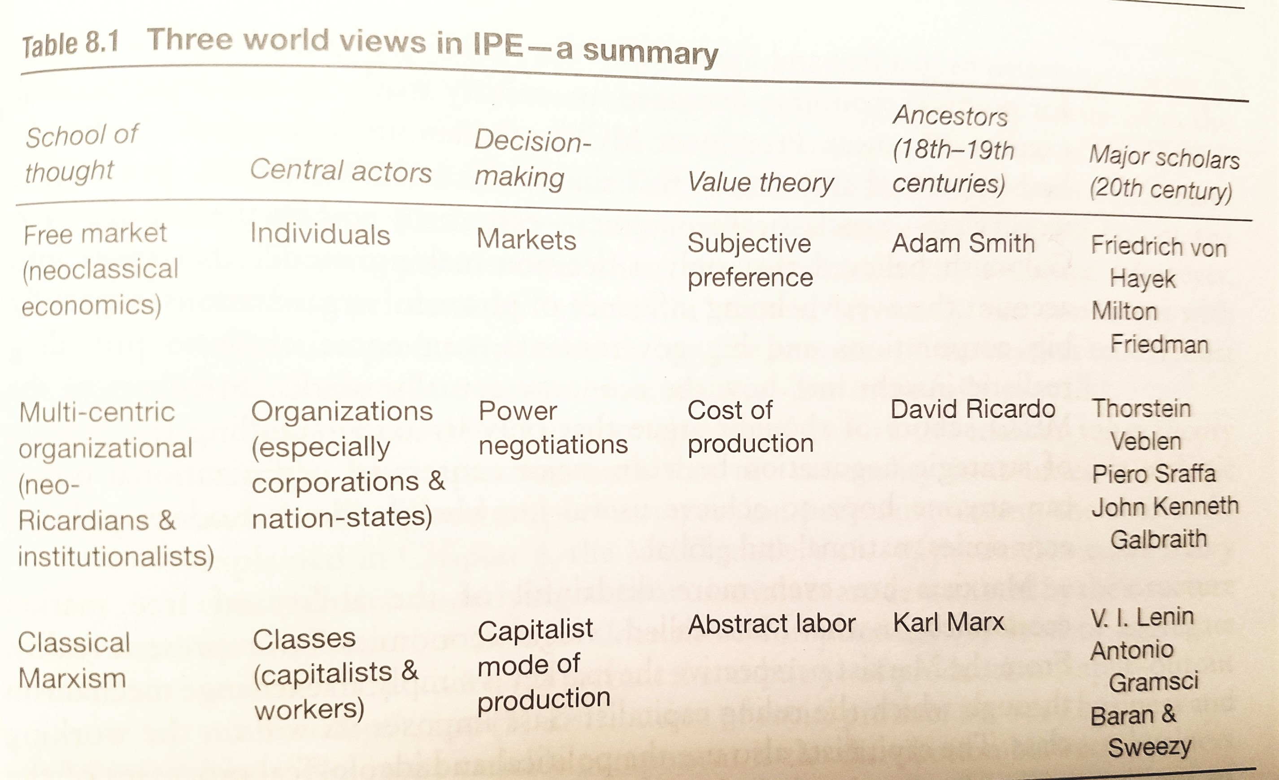

Slide 5
American School vs. British School Orthodox School vs. Heterodox School/ “America’s left-out”
American School
British School
Ontology
Agenda
Purpose
Openness
Epistemology
State-centric
State behavior, system governance, US perspective
Positive/explanation
Mainly economic & political science
Rigorous empirical testing
Methodological individualism, or methodological nationalism; rationalism
Individuals, states, social forces, historical structures
Very broad
Normative
Broadly inclusive
Qualitative, historical, interpretative
Holistic approach; holism; reflectivism

Slide 6
