Slide 1
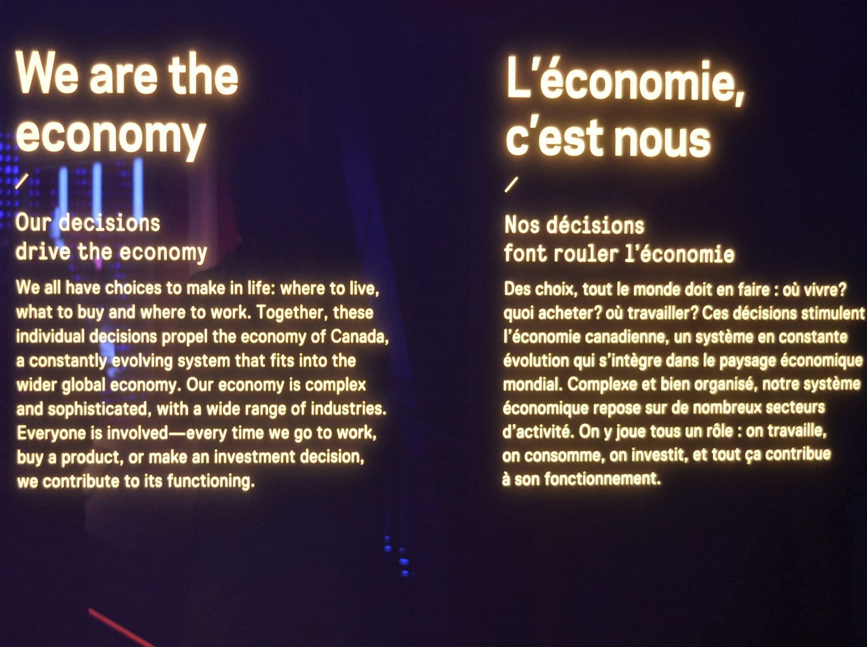
What Is IPE?
The Structure of IPE Class
An Introduction and Overview
Notes:
NOTE:
To change the image on this slide, select the picture and delete it. Then click the Pictures icon in the placeholder to insert your own image.

Slide 2
Defining IPE or GPE
The Textbook Definitions
Stephane Paquin (p. 5):
“Researchers agree that IPE is concerned with international politics and international economics, that is to say, politics and economics beyond state borders. IPE focuses especially on the power relations between the world of states and that of economic actors on the international scene. Nowadays, the most cited definition of IPE comes from one of its founding fathers, Robert Gilpin, who has spent his career at Princeton University. From him, IPE is ‘the reciprocal and dynamic interaction in international relations of the pursuit of wealth and the pursuit of power.’”
International Political Economy vs. Global Political Economy
The orthodox considers IPE a subdiscipline of international relations;
Those with a more multidisciplinary conception of IPE (the heterodox) prefer the term “global political economy”.

Slide 3
The Beginning……
International Political Economy (IPE) covers the "intersection area" between world politics and international economics.
Susan Strange, a British scholar, published an article, “International Economics and International Relations: A Case of Mutual Neglect”.
Robert Keohane and Joseph Nye, Jr. in June 1971 published a special issue of the journal International Organizations.

Slide 4
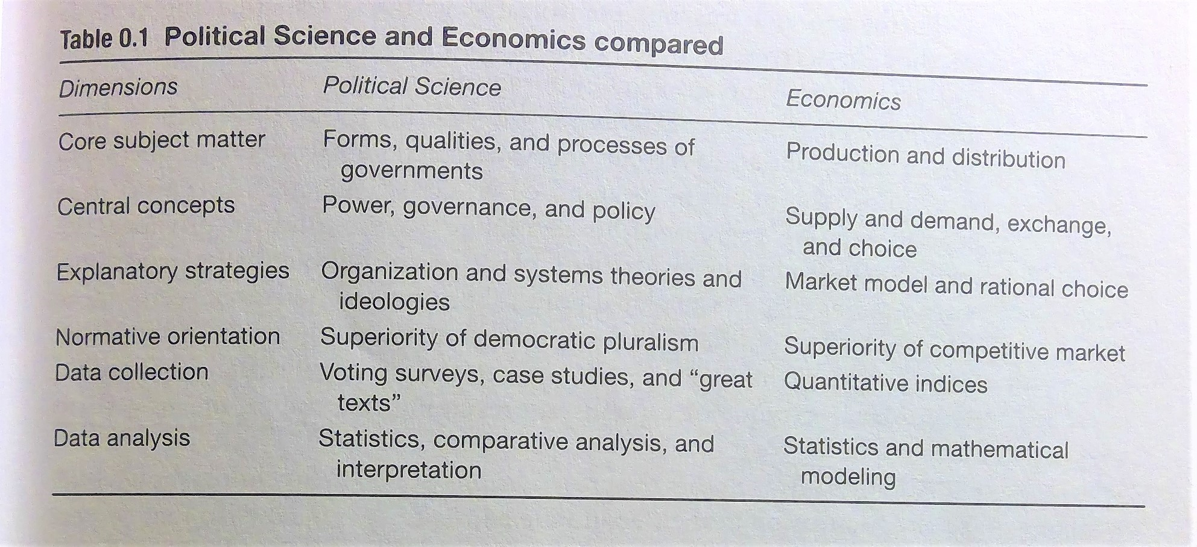
Raymond Miller, International Political Economy: Contrasting World Views (2008, p. xv)

Slide 5
Realist Conception vs. Liberal/Pluralist Conception
Thomas Oatley:
“International political economy studies the political battle between the winners and losers of global economic exchange.”
2. IPE “studies how politics shape developments in the global economy and how the global economy shapes politics.”
Joseph Grieco and G. John Ikenberry: State power and World Economy: The International Political Economy:
Its “central concern involves the reciprocal relationships between state interests and power on the one hand, and world market structures and economic dynamics on the other. ”
“How these dual logics of state and market operate and how their interactions are shaping the world political economy today.”
David Balaam & Bradford Dillman, Introduction to IPE (2014)
“The interdisciplinary social science that examines the dynamic interactions between markets, states, and societies, and how the tensions and conflicts between these areas both affect and reflect conditions outside the nation-state and society.” (p. 548)
The International Political Economy “refers to what we study—commonly referred to as subject area or field of inquiry that involves tensions among states, markets, and social actors.”—a variety of actors.
“The acronym IPE connotes a method of inquiry that is multidisciplinary. IPE fashions the tools of analysis of its antecedent disciplines so as to more accurately describe and explain the ever-changing relationships between governments, businesses, and social forces across history and in different geographical areas.”—Political, economic, societal dimensions.

Slide 6
Comprehensive and Eclectic Approach: A Synthesis
John Ravenhill, Global Political Economy (Oxford, 2014, p. 18)
“Global political economy is a field of inquiry, a subject matter whose central focus is the interrelationship between public and private power in the allocation of scarce resources.”( MX: At international/global level and with global implications)
“Diversity in ontology, epistemology, and methodology continues to characterize the international study of global political economy.” (p. 21-22)

Slide 7
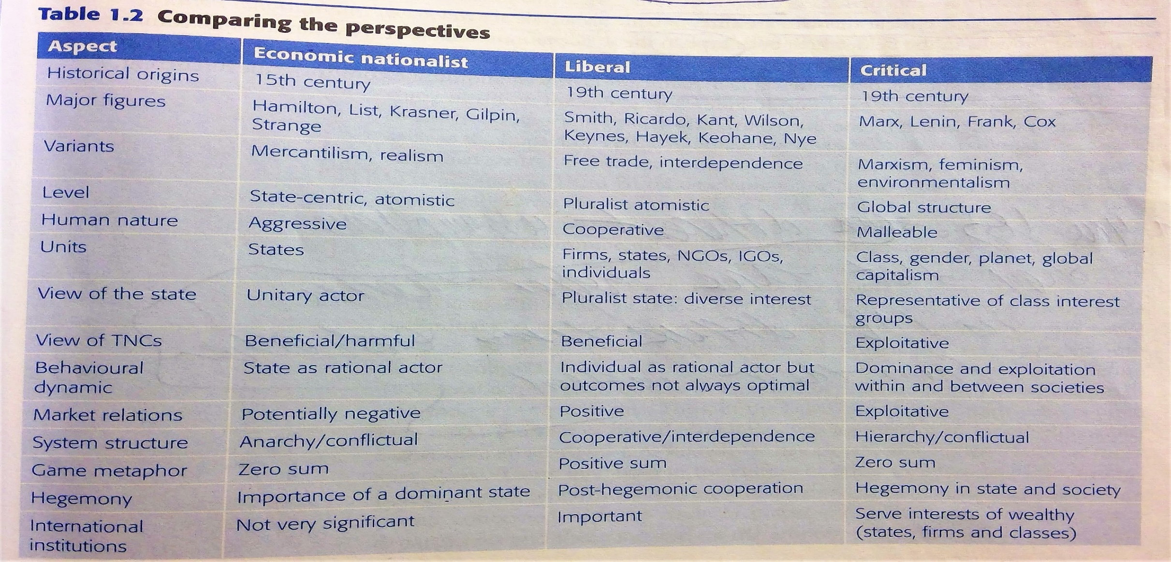
Major IPE Perspectives Compared, Robert O’Brien & Marc Williams (Palgrave, 2013, p. 20)

Slide 8
Structure of IPE
Temporal and Spatial Review of Economic Societies: Globalization and The Birth of Capitalism
Theoretical Approaches: From Smith to Marx, From Hamilton to Susan Strange
Structure of IPE
Production: Division of Labor, From Workshop to MNCs
International Trade
Money and Finance: Financial Crisis
Poverty and Development
Environment/Ecology and Green IPE
The Global Governance and Its Evolution and Future

