Slide 1
Monetary Policy and Exchange Rate
Society-centered Approach and State-centered Approach
Notes:
NOTE:
To change the image on this slide, select the picture and delete it. Then click the Pictures icon in the placeholder to insert your own image.

Slide 2
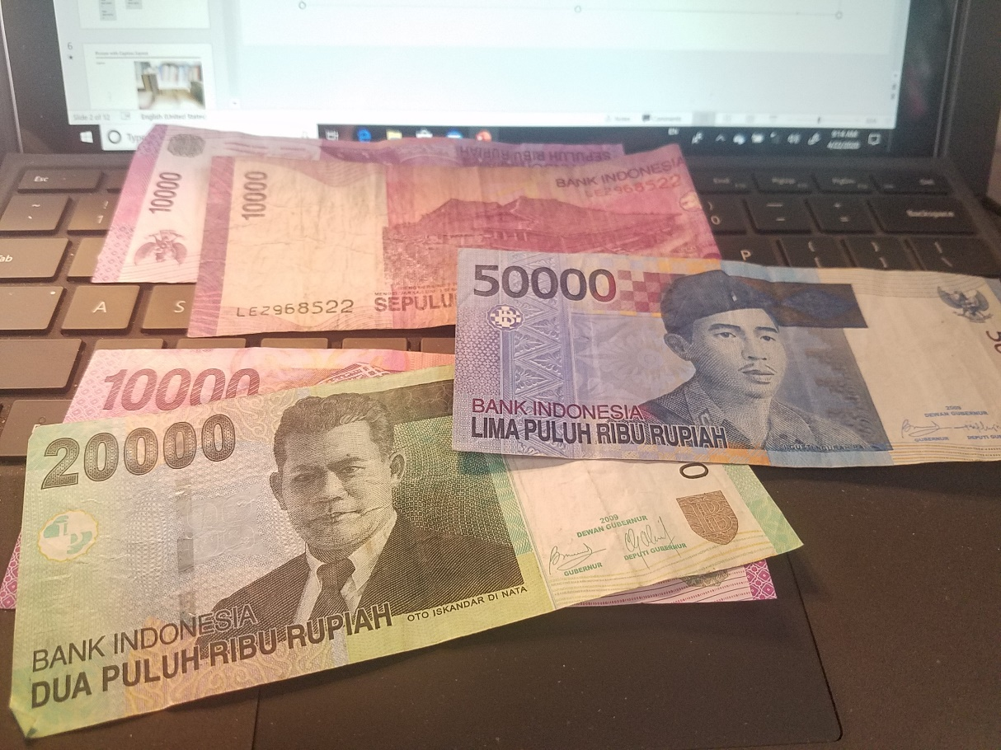
Introductory Remarks
If I tell you I am a millionaire, do you believe it? You may tell me, show me your money. Here I am showing you that I just took out some bills I did not spend up and show you here (in a total of 100,000) :
Now do you believe that I am a millionaire? The correct answer is: Yes, I am a millionaire, but in terms of what currency?
Here I am showing the currency in Indonesia: Rupiah, today’s exchange rate is 1 Indonesian Rupiah = 0.000065 US Dollar. It means if you have $65 in you pocket, you could be a millionaire in Indonesia. So why not bring several hundred dollars to spend a weekend in Bali?

Slide 3
Introductory Remarks—continued
I have noticed that many Asian countries have currencies with big, big numbers. Today (4/22/2020) we have the following exchange rate in selected Asian countries:
1 Japanese Yen = 0.0093 US Dollar | 1 Chinese Yuan = 0.14 US Dollar
1 Indian Rupee = 0.013 US Dollar | 1 Taiwan Dollar = 0.033 US Dollar
1 Malaysian Ringgit = 0.23 US Dollar | 1 Singapore Dollar = 0.70 US Dollar
1 Philippine Peso = 0.020 US Dollar | 1 Vietnamese Dong = 0.000043 US Dollar
1 Bangladeshi Taka = 0.012 US Dollar | 1 South Korean Won = 0.00081 US Dollar
1 Myanmar Kyat = 0.00069 US Dollar | 1 Indonesian Rupiah = 0.000065 US Dollar
Why do so many Asian countries keep large denominations in their currency? Because Asians are good at math? You may think about the export-led strategy in Asia, in which cheap exchange rate has been used as one of NTBs to boost export and discourage import, or to attract foreign tourists but discourage its own citizens to travel and spend aboard.

Slide 4
Big Mac Index (All price in USD)
UBS (headquarters Switzerland), the world 's leading financial group, has released the 2018 version of the "Big Mac Index".
How much do you have to pay to buy McDonald's Big Mac in your country? Although it is a simple comparison, but It's good to measure prices because the same product is sold all over the world.
Source: https://www.jmstats.com/big-mac-index-japan/
Switzerland 6.54 | Sweden USD 5.84 | United States 5.51 | Euro area 4.74 | Brazil 4.4
Singapore 4.28 | South Korea 4.03 | Japan 3.5 | Peru 3.2 | China 3.1
Vietnam 2.82 | Mexico 2.57 | Hong Kong 2.55 | India 2.51 | South Africa 2.32
Russia 2.09 | Egypt 1.75

Slide 5
Introductory Remarks—continued
Since different currencies can be so different based upon exchange rate, The Economist magazine in United kingdom introduced a Big Mac Index, wherever you go, if you find a MacDonald’s, you can gauge the cost of living in that place and the value of the currency there. Based upon that, you can also have rough ideas about this country’s living standard, difference from the U.S., its competitiveness in global market, its economic future, etc.
The flexibility of exchange rate, strong currency vs. weak currency, low or high interest rate, high inflation rate or low inflation, for all these purposes, an independent central bank (autonomy) or a subservient central bank, are determined by different countries based upon both societal factors and state’s goals.

Slide 6
Society-centered Approach
Electoral Approach
Fiscal and monetary policies have distributional consequences for different parts of the society. As enfranchisement advanced since the 19th century, especially through the lowering and final elimination of property requirement, farmers and working class were included into the electoral process. More left-wing parties (socialist or communist parties) became influential in politics and macroeconomic policy making.
We can observe: As employment has become a major concern for government, expansionary economic policy, which means to increase liquidity in the market and allow inflation for expansion, will be embraced by more politicians, especially left-wing politicians who represent the working class more than the right-wing parties who world keep low inflation rate to safeguard the monetary assets of money class (bankers, for example) .
We can also often observe that left-wing governments tend to tolerate higher inflation rate for expansionary economy; right-wing governments tend to tighten money supply to control inflation and to preserve the value of financial assets.
We can also observe that in an electoral cycle just before the election, the incumbent party or president tends to cut interest rate, increase liquidity (cash flow) to boot economic growth and create jobs.
Think about how President Trump has had clashes with Jerome Power, the Fed Chairman, for lowering interest rate. Trump wanted a lower interest rate to stimulate economic growth.

Slide 7
Society-centered Approach--continued
Partisan Approach:
Leftist parties are less likely to maintain a fixed exchange rate; conservative governments are more likely to establish and maintain a fixed exchange rate.
Expansionary policies will reduce domestic interest rates and raise domestic demand. Such policies will in turn cause capital outflows and increasing imports. Capital outflows and a widening current-account deficit will in turn lead to foreign exchange market imbalances and a weakening currency.
Restrictive monetary policies are less likely to generate capital outflows or to increase domestic demand, As a result, conservative governments are likely to maintain a strong currency.
Interest Group Approach and Sectoral Approach
Four interest groups/sectors: import-competing producers (e.g., automobile) , export-oriented producers (e.g., Boeing), nontraded-goods producers (e.g., real estate), the financial service industry (e.g., Wall Street). You can strongly feel that export-oriented producers and the financial service industries have had tremendous influence over the monetary policy. However, Trump is from the nontraded-goods industry. Do you see why globalization and financial liberalization is not his like?

Slide 8
Sectoral Exchange-Rate Policy Preferences
 |  | Preferred Degree of | Exchange-Rate Stability (Fixed vs. Flexible)
 |  | High | Low
Preferred Level of | High |  | Nontradable-goods Industry Financial Services
the Exchange Rate (Strong vs. Weak Currency) | Low | Export-oriented Industries | Import-competing Industries Financial Industries
Source: Oatley, p. 266

Slide 9
State-centered Approach
Different States/Governments have chosen different exchange rate regime for their countries.
U.S.: Flexible Exchange Rate, the Federal Reserve as the Central Bank uses policy tools to control or influence the exchange rate and the value of U.S. dollar. Overall, the U.S. relies more on the market mechanism.
Fixed Exchange Rate: Some countries have adopted U.S. dollar as their currency (for example, Panama) or have chosen to peg their currency with U.S. dollar at a fixed exchange rate (for example, Argentina, Thailand, Hong Kong and China once fixed their currencies with U.S. dollar. A currency board is a monetary authority which is required to maintain a fixed exchange rate with a foreign currency. For this purpose, many countries have to save a hard currency as reserve currency to ensure that the holders of their notes and coins can convert them into the reserve currency. Huge foreign exchange reserve to defend their local currencies has become a major feature of almost all East Asian countries after the 1997 Asian Financial Crisis.
In 2015, China started using a basket of currencies to track its currency value and make adjustment based upon several currencies (I once worked together with a member of the Monetary Policy Committee of the People’s Bank of China and tried to understand how many and what currencies are in the basket, I was told that it is a top state secret. I can guess that there are probably less than 10 currencies but more than 8, including US Dollar, Japanese Yen, Euro, Singapore Dollar, Russian Ruble, South Korean Won, British Sterling, Australia Dollar, India Rupee).

Slide 10
The Central Bank: Autonomy and Credible Commitment
A central bank, reserve bank, or monetary authority is an institution that manages the currency, money supply, and interest rates of a state or formal monetary union, and oversees their commercial banking system.
In contrast to a commercial bank, a central bank possesses a monopoly on increasing the monetary base in the state, and also generally controls the printing of the national currency, which serves as the state's legal tender.
A central bank also acts as a lender of last resort to the banking sector during times of financial crisis. Most central banks also have supervisory and regulatory powers to ensure the stability of member institutions, to prevent bank runs, and to discourage reckless or fraudulent behavior by member banks.
Central bank independence refers to the freedom of monetary policymakers from direct political or governmental influence in the conduct of policy.

Slide 11
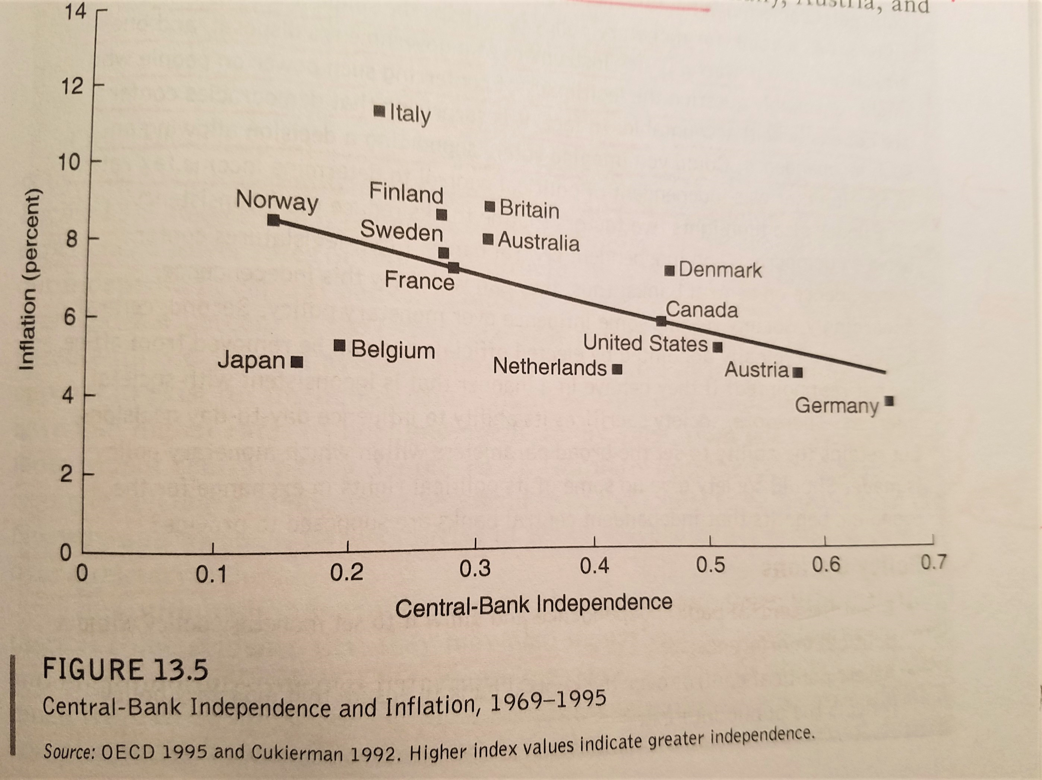
Empirical findings are that the autonomy of central banks has a positive impact in lowering the inflation rate.
Source: Oatley, pp. 285.

Slide 12
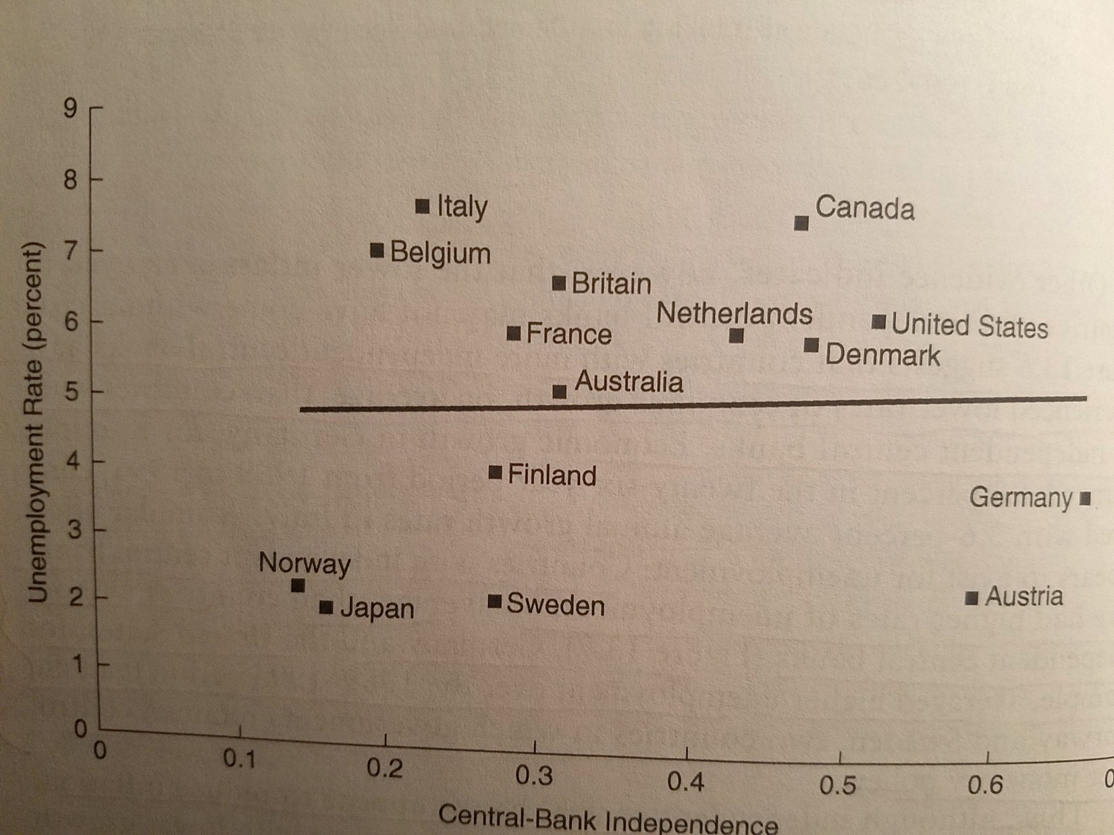
Countries with independent central banks have had higher rate of unemployment, on average, than countries without independent central banks.
Source: Oatley, pp. 287-288

Slide 13
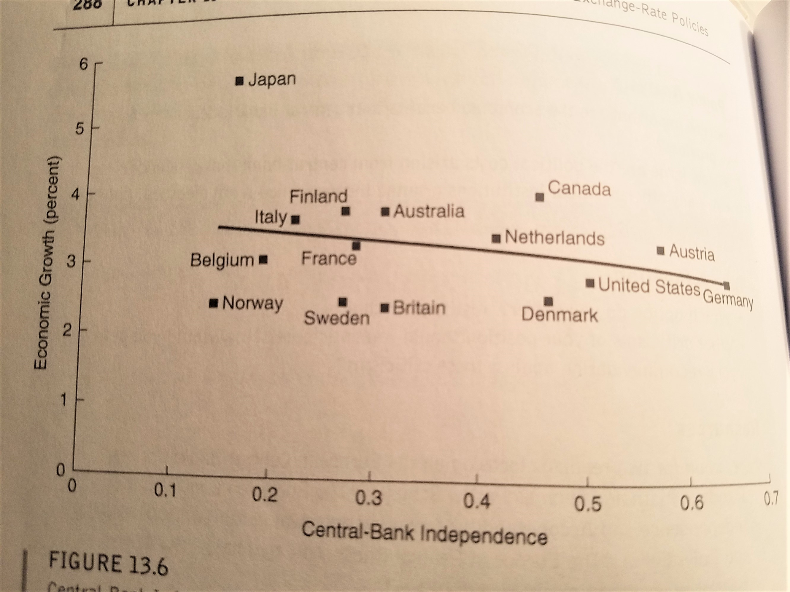
Countries with more independent central banks have experienced lower rates of economic growth, on average, than countries without independent central banks.
Oatley, pp. 287-288

Slide 14
Comments on Central Banks
Central Banks play important in helping economy grow and stay healthy. Also recollect what we discussed before on Niall Ferguson’s “Square of Power” that argues, both the British hegemony and American hegemony (instead of French or Soviet ones) could be attributed to the financial power of the U.K. and U.S., which this financial power was built on one corner of the power square: the credibility and skill of the central banks (the Bank of England and the Federal Reserve).
In my research article, “China’s Financial Crisis in the Making: Soft Budget Constraint, Overdraft and the Missing Credible Commitment” (2018) (see my website: https://slideheaven.com/chinas-financial-crisis-in-the-making-soft-budget-constraint-overdraft-and-the-m.html) I have used China as a case study to illustrate the importance of central bank and the state in creating and maintaining credibility for monetary order and incentive for economic development. In this article, I predicted that China would enter a financial crisis very soon. I believe that my prediction had been validated by the unfolding political economy in China and the world. In this article I have shown how the state for its own interest and the interest of ruling oligarchy has abused its power over financial and monetary affairs. One major power is seigniorage—the power to print fiat money. China has been the No. One country (if we ignore the tiny and failed Lebanon) in printing money.

Slide 15
My Experience in India
As I have discussed about the Central Bank and its independence, in many countries, especially Third World countries, the government can be very powerful and adopt whatever monetary policy it wants. It seems that you do not see the role played by the bankers. For example, I often traveled to India, so I kept many Indian Rupee Bills of 1000 and 5000, the two largest denominations in the system. Two years ago I went back to India and tried to use my Indian money, I was warned by the merchants to take them back and hide them. I asked why? They told me that Prime Minister Modi had banned the circulation of 1000 and 500 bills, so it is illegal to use and to keep them! So I have to keep them as souvenir!

Slide 16
Here We Come Home!
Probably you have heard that on several occasions President Trump has complained about Jerome Powell, the Chairman of the Federal Reserve, the central bank of the United States. One major point of contention is that President Trump believed the interest rate should be lowered to sustain the economic growth rate, so it could help Trump’s reelection. Probably you can guess that as a realtor/developer from nontraded industries, President Trump is not like Michael Bloomberg or Robert Rubin (the former secretary of treasury under Clinton and Chairman of the Board at Goldman Sachs) to care much about the stable exchange rate and low inflation rate. He cares more about the employment rate and economic growth rate. You can understand now, the independence and the autonomy of the Fed, if it does not help increase economic growth rate and decrease unemployment rate, President Trump could not care less about it!
One big lesson is: Trump, as a brick and mortar developer, does not understand international finance and monetary policy that much. So, if you mess up with money, you mess up with the economy, especially in the highly financialized economy of the United States in the globalized 21st century.
God Bless America!

Slide 17
I See Rainbows over there! Stay Safe and Hopeful!

Slide 18
This one and the previous one were taken at Niagara Falls,
New York.

Slide 19
In Ohio, on my way to Chicago!

Slide 20
In Watertown, as I was driving to Thousand Islands at St. Lawrence River between U.S. and Canada.

