Slide 1
Political Culture and Asian Values

Slide 2
Confucianism
Several “C”s in China
Chinese Characters (Ideograms), Chopstick (Cuisine), Confucianism, Connections (guanxi), Communism (CCP) and Collectivism
Confucius: Kongzi (551-479? BC)
Teachings:
Humaneness (Ren), Righteousness (Yi),Ritual Decorum (Li), Filial Devotion (Xiao), Virtue (or Moral force, de)

Slide 3
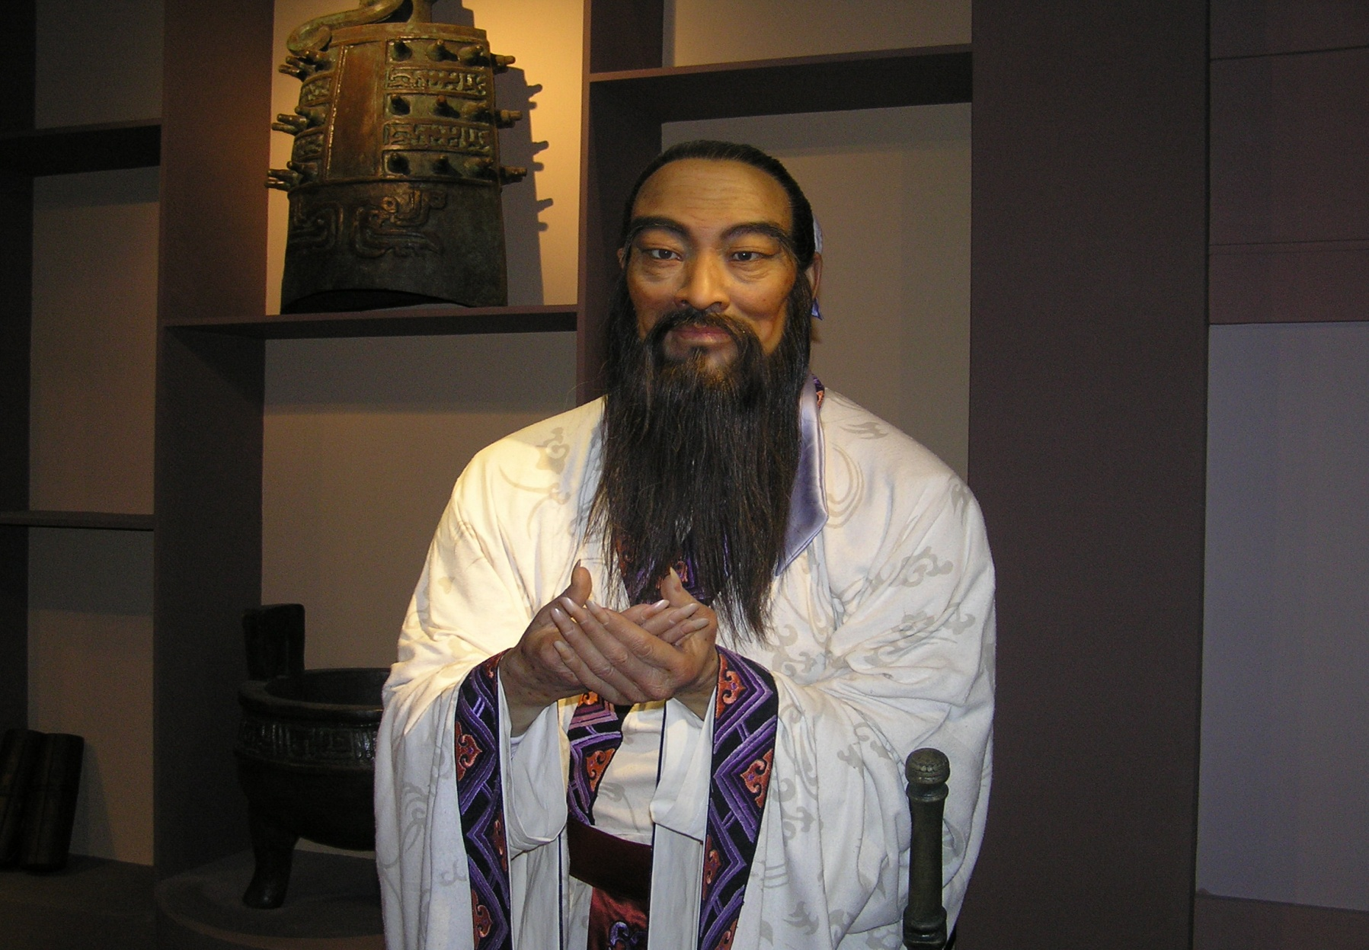
Confucius, image from China’s National Museum

Slide 4
Confucianism--continued
Family-State-Tianxia (World)
Five relationships:
Emperor-Ministers
Father-Son
Husband-Wife
Older Brother-Younger Brother
Friend-Friend
The Mandate of Heaven (Tianming)
“All under Heaven” (Tianxia Order)
Authoritarian vs. Humanistic Interpretation of Confucianism

Slide 5
The Spread of Buddhism
500 BC: Sakyamuni (Gautama Siddhartha, 566-486 BC), Buddha, ‘the enlightened one”
Third Century BC: Missionaries spread Buddhist faith to Southeast Asia, Central Asia and China.
67 AD: Marked the beginning of the spread of Buddhism in China when Indian monks came to Luo Yang.
Around 100 AD: Spread into North China
Tibetan Buddhism in the 7th Century and Mongolia
Indian Traders and Monks spread Buddhism throughout Southeast Asia and South China
Between the 3rd and 8th centuries, Buddhism spread to Japan, Korea and Vietnam.
Two Branches of Buddhist Order: Theravada (Lesser Vehicle) and Mahayana (Greater Vehicle). Vajrayana, adding to Mahayana.

Slide 6
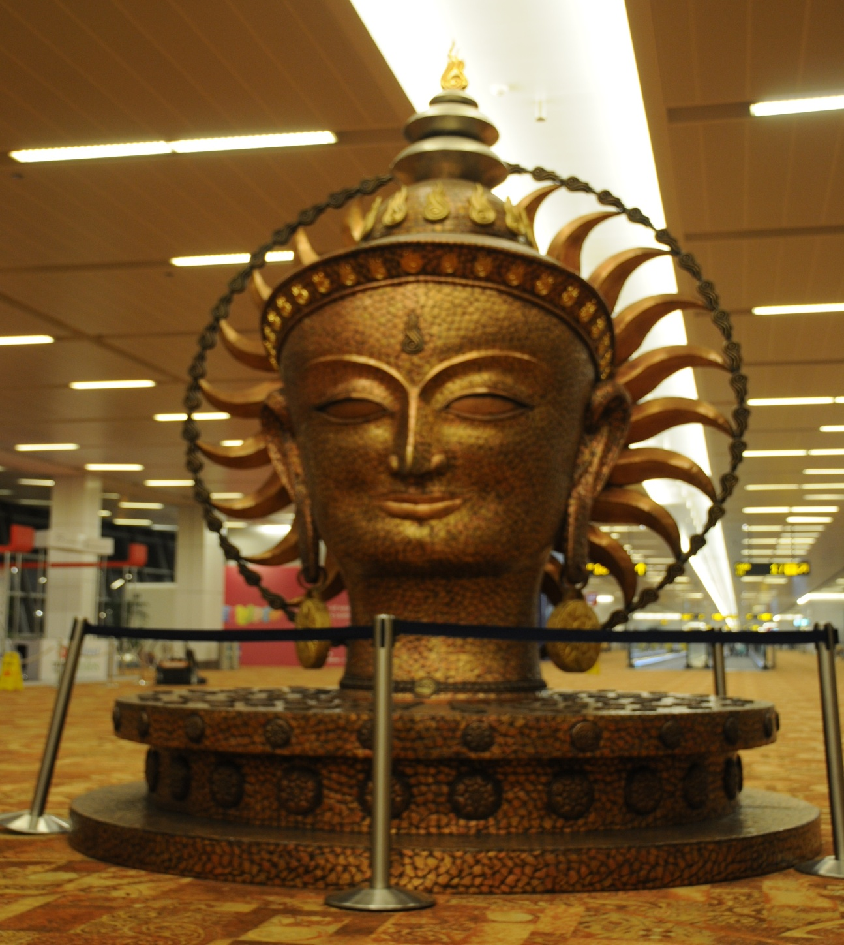
Buddha at New Delhi International Airport

Slide 7
Buddhist Teachings
Three Jewels: Buddha, Dharma, Samgha
Ten Virtues (body, mouth and mind)
Three good actions of body: not destroying life; not taking what has not been given; refraining from improper sexual practices
Four good actions of speech: not telling falsehoods, not using abusing language; not slandering others; not indulging in irrelevant talk.
Three good actions of mind: not being covetous; not being malicious; not holding destructive beliefs.
Suffering, Samsara, Reincarnation, Enlightenment, Nirvana.

Slide 8
Common Themes of Social Culture
Cardinal Importance of the family
Anti-individualism, submission to group
Respect for hierarchy; Maintaining social control through rituals
Avoidance of disorder: Performance for consensus, avoiding confrontation and shame
Social relations and gift-giving culture
Importance of social ritual in maintaining social harmony
Rise of Nationalism and the Western influence

Slide 9
Asian Way: Values and Culture
Top Asian Personal Values Hard Work Respect for Learning Honesty Self-discipline Self-reliance | Top American Personal Values Self-reliance Hard Work Achieving Success in Life Personal Achievement Helping Others Honesty
Top Asian Societal Values Orderly Society Accountability of Public Officials Openness to New Ideas Freedom of Expression Respect for Authority | Top American Societal Values Freedom of Expression Personal Freedom Rights of the Individual Resolution of Conflicting Political Views through Open Debate Think for Oneself Accountability of Public officials
Source: David I. Hitchcock, Asian Values and the United States, How Much Conflict?
Cited from: John Naisbitt, Megatrends Asia (Simon and Schuster, 1996), p. 54.

Slide 10
Cultural Characteristics in Japan (Summarized by Collinwood, pp.33-36)
Imitative
Preventive
Pragmatic
Obligative
Inquisitive

Slide 11
Asian Values: A debate
Lee Kuan Yew and “Singaporean Model”
“Culture Is Destiny—a conservation with Lee Kuan Yew” by Fareed Zakaria, 1994
The Case of Michael Fay (1994)
Malaysian Prime Minister Mohamad Mahathir
Kim Dae-Jung, “Is Culture Destiny? The Myth of Asia’s Anti-democratic Values” (1994)
Suharto: Java Consensual politics

Slide 12
Beijing Consensus and China Model
Joshua Cooper Ramo: “The Beijing Consensus: Notes on the New Physics of Chinese Power” (2004)
Debating Chinese “Exceptionalism”
Particularism vs. Universalism
Perspectives on Feminism

