Slide 1

International Finance: Basic Principles and
Key Institutions
Notes:
NOTE:
To change the image on this slide, select the picture and delete it. Then click the Pictures icon in the placeholder to insert your own image.

Slide 2
Introductory Remarks
Recall our discussion on global division of labor and the globalization of production, one key question is that regarding the mobility of factors of production, capital and labor are mobile, how can they meet on a land? Since under the increasing control over nationality/citizenship and national boarders, free emigration/immigration have become more difficult in comparison to the pre-WWI era, the free flow of capital had become a major factor to organize global production.
In our discussion on trade, we have mentioned that the manipulation of exchange rate has become a measure of NTBs. Why and how?
In our discussion on the failure of ISI strategy, both trade deficit and budget deficit can be big issues for the developing countries. How can they trigger a balance of payment crisis in the Third World?
Trump’s trade war, has a big price tag. But, if we know that the total volume of world exports in 2019 is less than 19 trillion dollars (see the graph next page), in contrast, “the foreign exchange or forex market is the largest financial market in the world – larger even than the stock market, with a daily volume of $5.1 trillion.” Then we have to ask how can Trump or American economy gain if a trade war could cause bigger losses in the forex market and stock market crashes worldwide?
These questions lead us to the center piece of my IPE class: the international finance.

Slide 3
The Ascent of Money
Money: Gold, Bi-metallic (e.g., Gold-Silver) System, Paper/Fiat Money
Money is a commodity widely accepted as a means for exchange. Gold was not born into the status as money (sea shell, cattle, other precious stones/metals once were used as money in different societies at different stages of history), but gold naturally is most suitable for money (It is an element, stable in the world, divisible but indestructible, easy to carry, store, and examine, etc.)
Money has four important functions:
A medium for exchange
A measure of value
A standard of deferred payment: credible so its value will not be less.
A store of value.
As economy expanded, gold became short of supply; silver, copper and other metals were introduced into circulation. Eventually paper money was born (first in China during Song Dynasty). The fiat money is often supplied by the government or public authority that make people have faith in them as a legal tender in exchange.

Slide 4
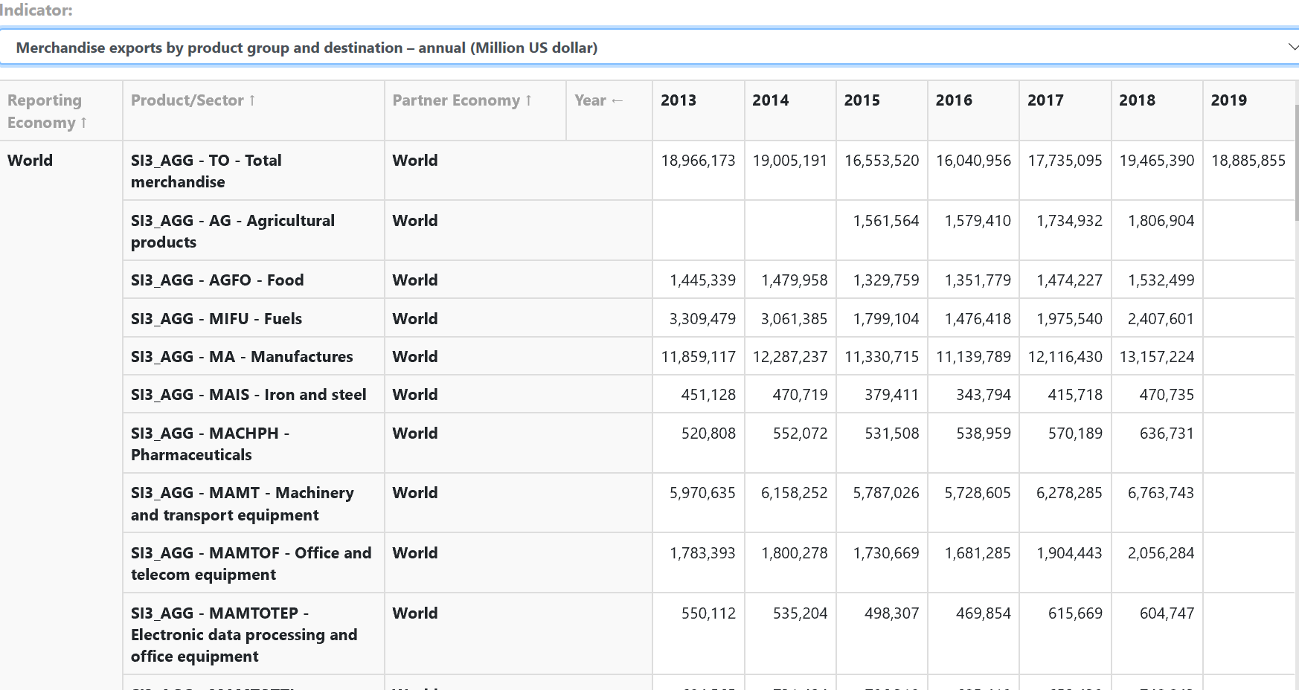
https://timeseries.wto.org/, International trade statistics, merchandise of exports of the world, million dollars; accessed on 04/12/2020.

Slide 5
The Ascent of Money--continued
Seigniorage: Government can charge a fee or extract wealth from producing coins or printing paper money at the government mint. This can be an “exorbitant privilege” for the government to take wealth from the society without taxation.
Foreign Exchange: In international market, since different countries have issued their own money, so the money of foreign countries is needed. Different monies are bought and sold at the foreign exchange market or through money exchanger.
Stock Market, Debt, Bonds, Credit: All were created to assist the function of a market economy.
Niall Ferguson’s Square of Power: Modern Powers need the following four agencies to manage money.

Slide 6
Balance of Payments
BOPs is part of national accounts reflecting the payments (- minus in the table as debit) by residents in this country and their receipts (+ plus as credit) from foreigners in international transaction.
The BOPs include both the current account and capital account. But often people focus on the current account.
Current Accounts: Part of it includes Goods and Services due to international trade
Capital and Financial Account: shows the lending and borrowing of money (capital) between the country and the world.
Money Inflow and Money Outflow
Equilibrium, Deficit and Surplus
Balance of Payment, Imbalance of Payment, and Payment Adjustment

Slide 7
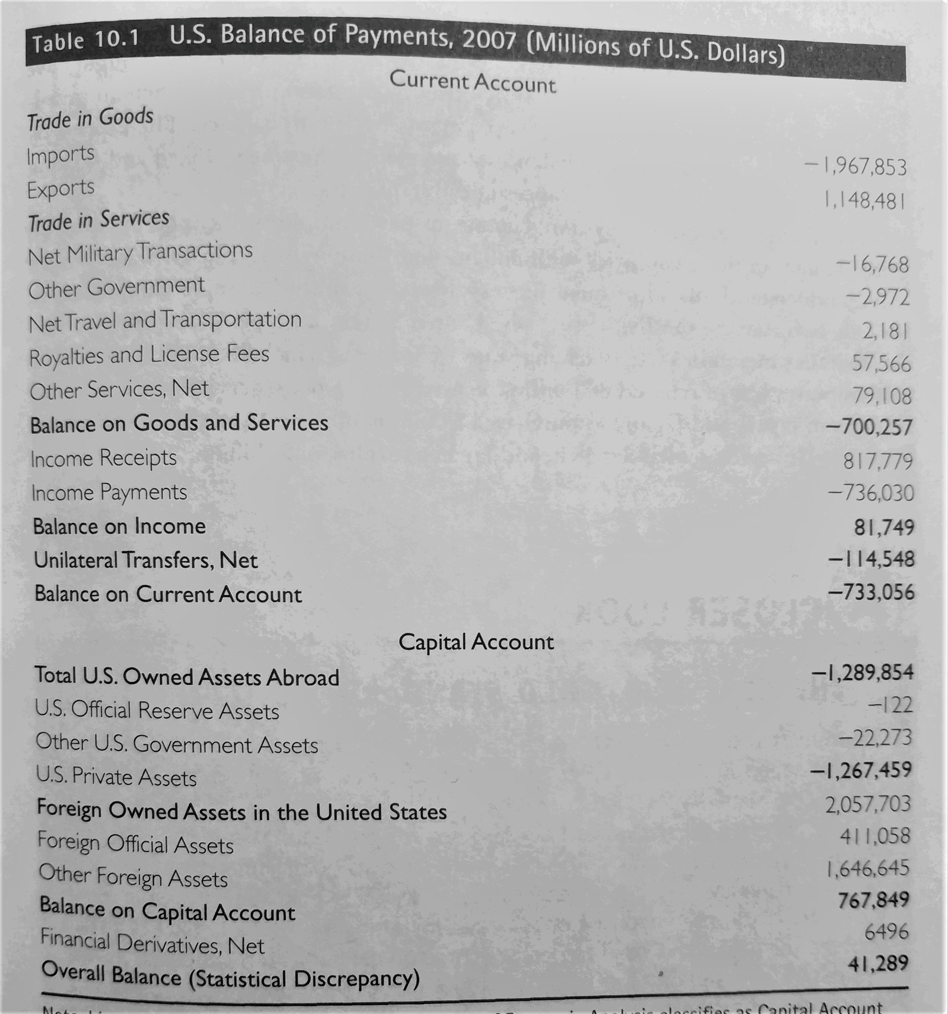
By using the Table of U.S. BOPs (2007) from our textbook, the balance of payments always balance itself. Under the Current Account we can see a huge deficit (negative number, -733.056 Millions), which can mean that Americans spent too much to import, or the U.S. government sent out money as military payments. Under the Capital Account, it becomes inevitable that Americans had to borrow in order to balance the payments. Foreign money can flow into U.S. as FDI, purchases of government bonds, etc. Now you can understand why Americans have consumed a huge amount of goods made in China and also have borrowed a huge amount of debts from China.

Slide 8
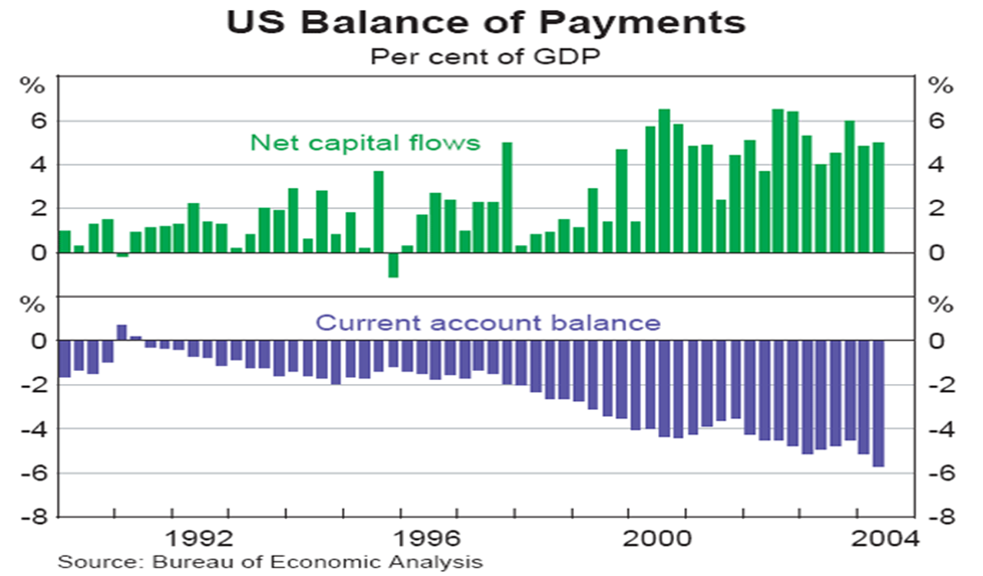
Balance of Payment

Slide 9
From U.S. example, you can see a chronic deficit in the Current Account since the 1970s, the U.S. has also borrowed money from the world. Since the U.S. dollar has been the dominant currency of the world and the federal government has maintained a good standing in credit, so foreign countries have been willing to lend money to U.S., either to purchase U.S. bonds, or to keep U.S. dollar as foreign currency reserve.
However, for all other less privileged countries, especially poor developing countries, they are forced to keep their exports to earn foreign currency in order to pay for their imports. These countries often face balance of payments crisis.
As we have discussed before, many Third World countries had to keep expanding their exports, and create Export Processing Zones to attract FDI. The World Bank had done some help by offering low-interest loans to the Third World. Once some Third World countries are in a balance of payments crisis, the IMF often steps in to bail out the suffering country by lending out foreign currency.
The major function of the World Bank is to offer capital to developing countries in their modernization process. The IMF was designed to stabilize the foreign exchange rate in the global economy.

Slide 10
Bretton Woods System (1944)
Two Major Architects:
Harry Dexter White, U.S. Secretary of Treasury
John Maynard Keynes
The Keynes and White Plans
Harry Dexter White: Pro-price stability; John Maynard Keynes: Pro-growth Plan; A Compromised, plan was accepted, but more of U.S. Version

Slide 11
Bretton Woods System (1944)--continued
Three Major Institutions:
1. International Monetary Fund (IMF): Its aims are to encourage stability of exchange, maintain orderly exchange procedures among member nations, and sustain a multilateral system of payments and eliminate foreign exchange restrictions.
2. The World Bank (IBRD, International Bank for Reconstruction and Development)
Its functions are to provide long-term loans for reconstruction, especially in the developing countries.
3. The International Trade Organization (ITO was aborted, replaced with an Ad Hoc GATT: General Agreement of Tariff and Trade in 1947)

Slide 12
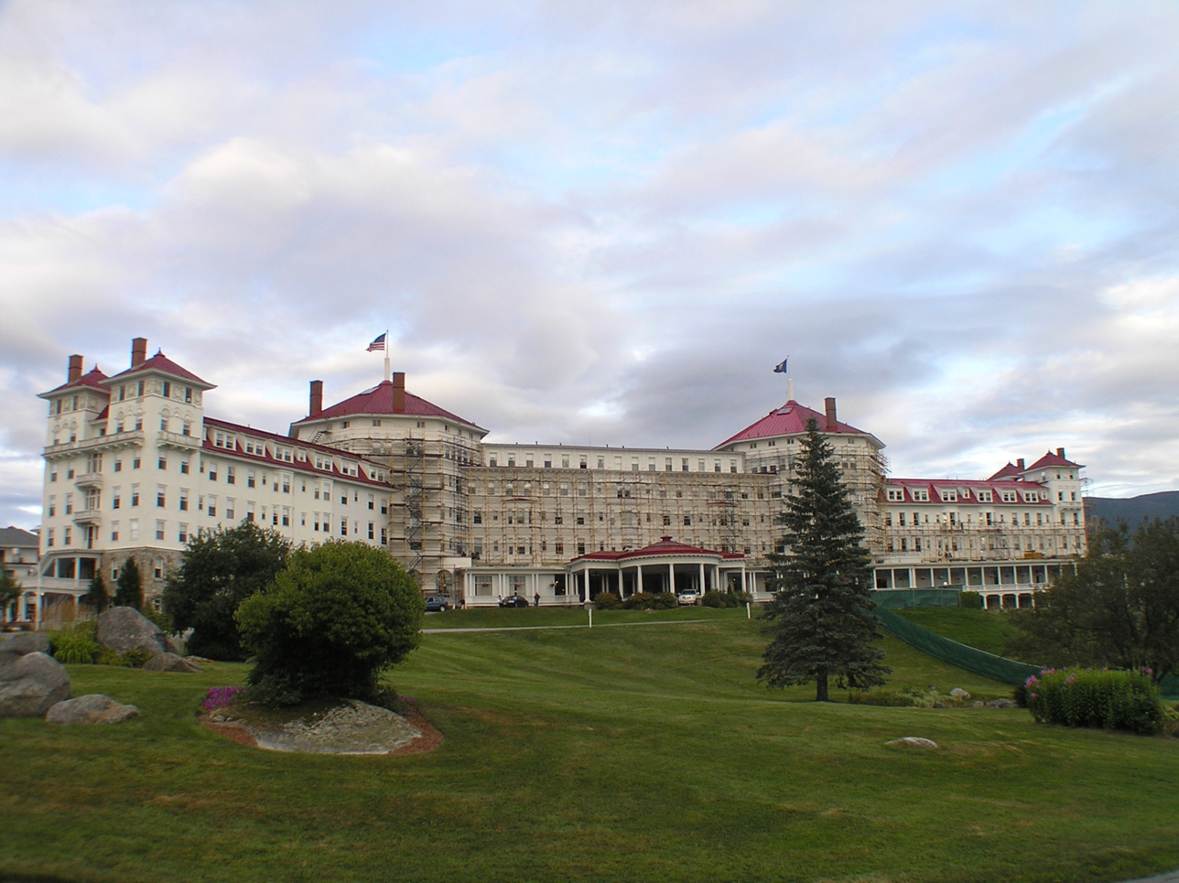
In 1944 before the end of WWII, under the U.S. leadership, 44 countries gathered at the Hotel Mount Washington to create the key institutions for the future international economic order. These key institutions are often called the Economic UN, indicating their importance in global political economy.

Slide 13
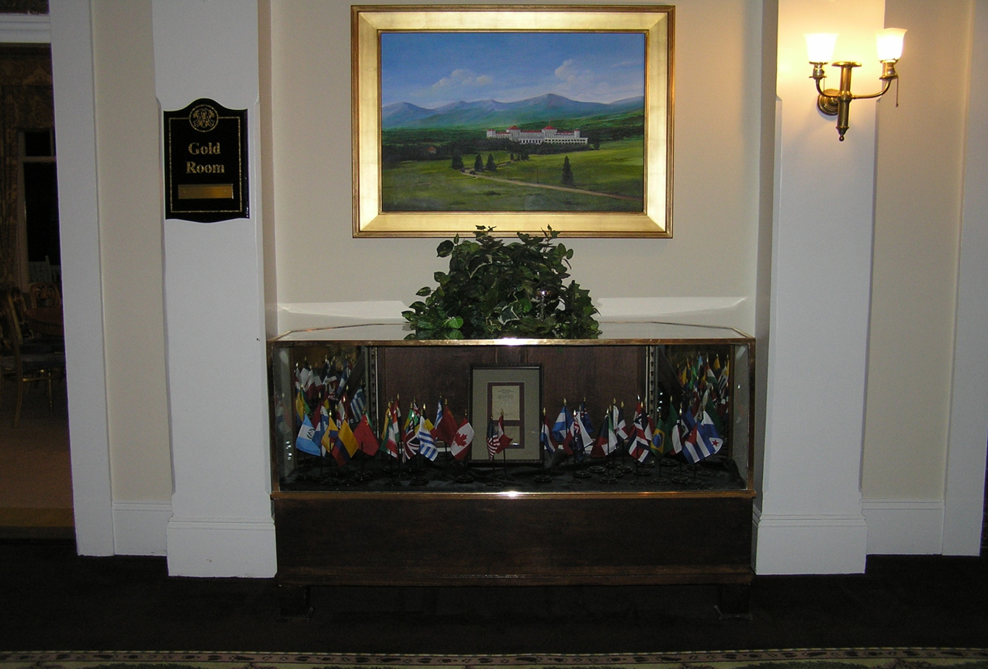

Slide 14
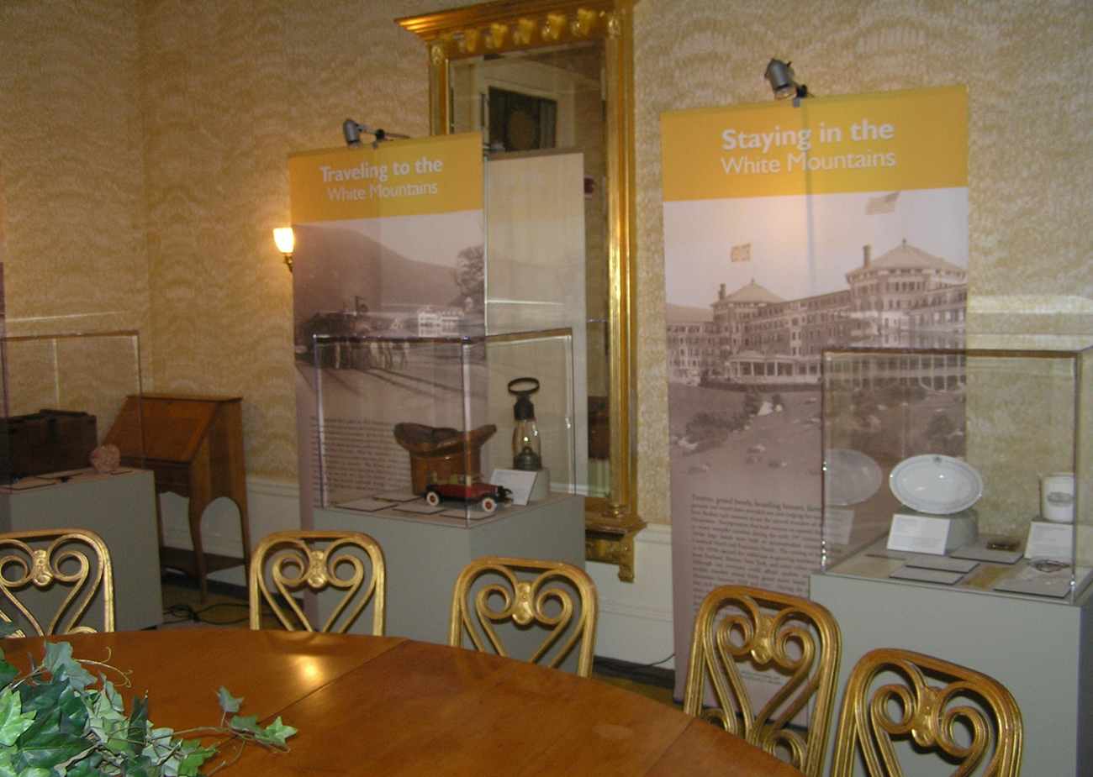

Slide 15
Major Pillars and Doctrine of Bretton Woods System
U.S. Dollar as the Dominant Vehicle Currency: Good as Gold
One major lesson the victor countries after WWII from the previous war was not to punish the defeated countries into financial bankruptcy. The U.S. took the responsibility to help Europe recover (the World Bank originally was tailored more towards the recovery in Europe, and later shifted its focus to the Third World as Europe had recovered). One role as discussed in the Hegemonic Stability Theory that U.S. took was to stabilize the exchange rate by fixing dollar on gold at the formula of $35 per ounce. Other currencies were pegged with U.S. dollar. Although this was not the gold standard that the British Empire once adopted, it was said that since U.S. dollar was as good as gold, the exchange rate was fixed.
The reason that U.S. had the ability to make such a pledge was that after WWII, U.S. held between 60%-70% of the world’s gold supply. Meanwhile, U.S. accounted for more than a quarter of global GDP (see next Graph).

Slide 16
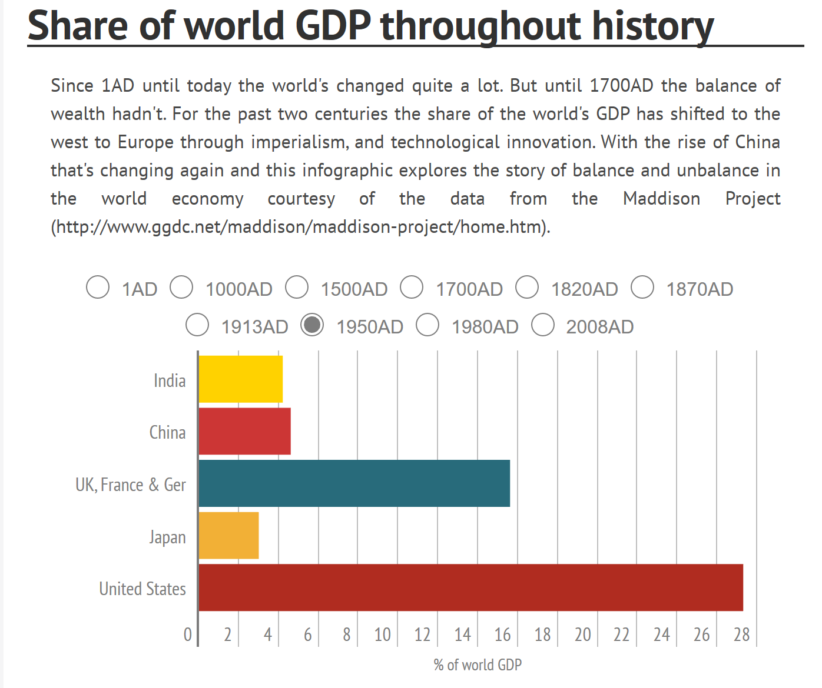
Source: https://infogram.com/share-of-world-gdp-throughout-history-1gjk92e6yjwqm16

Slide 17
Doctrine of Bretton Woods System--continued
A Great Compromise: Global Keynesianism— “Embedded Liberalism”
U.S. offered the exchange rate stability and respected its allied countries to pursue economic autonomy at home, especially the creation of welfare states in Western Europe. In other words, U.S. promoted trade liberalization worldwide (at least among its allies against the Soviet Bloc during the Cold War), at the same time, gave room to welfare state at home. The global liberalism was therefore believed embedded in the home front doctrine of Keynesianism. Embedded Liberalism: From Laissez Faire to Government Intervention, had Economic, Political and Strategic Purposes: Truman Doctrine, Containment Policy against the Soviet-led communist bloc.
The Marshall Plan and the Asian Marshall Plan
To help Europe recover from war ruins, U.S. enacted the Marshal Plan (the brainchild of U.S. Secretary of State George C. Marshall) in 1948 and provided more than $15 billion (equivalent to 128 billion in 2020) to finance rebuilding efforts on the continent.
Till the end of 1953, the US provided grants and credits amounting to $5.9 billion to Asian countries, sometimes it is called the Marshall Plan in Asia.

Slide 18
One major contribution from the IMF to the post-WWII economy is the stabilization of foreign exchange rate. The fixed exchange rate, plus the autonomy in economic decision-making and the control of capital created a stable environment for the war-devastated countries in Europe and Asia to recover and develop. Both West Germany and Japan experienced economic miracles: the Rhine Miracle and the Tokyo Miracle respective in 1950s and 1960s.
Major financial crisis was also absent during this period of time.
However, since the 1960s, as West Germany and Japan started to challenge American hegemony in global economy, as well as many economic changes happened to the U.S. in the 1960s and 1970s, the Bretton Woods system started to experience strains. Next time, we will focus on these intrinsic, internal, and external contradictions and developments, so we can understand the collapse of the Bretton Woods system.
As we have watched the Episode I in The Commanding Heights TV series, we can move on to watch the Episode III, so we will have a better background for our future discussion.

Slide 19
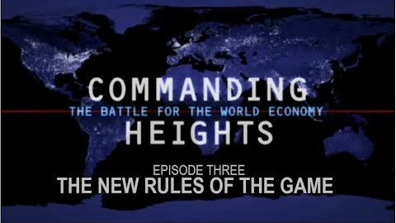
Commanding Heights: The New Rules of the Game- Episode Three (Official Video)
I will not post ppt on Wednesday, April 16. Please watch this two hour video.

Slide 20
Question to think about on the Episode 3: Commanding Heights
To read the full transcript, story-line, and watch extra interviews, please go the the PBS website as follows:
http://www.pbs.org/wgbh/commandingheights/lo/index.html.
One important question: How did President Bill Clinton play a big part in pushing for globalization, trade liberalization and financial liberalization? What are some major justifications that this Democrat president used for his policy? How has Bill Clinton overlapped with both Bush Senior and Junior?
Why did the U.S. help to bail out Mexico in the 1994 Mexican financial crisis? Why did the Asian Financial Crisis happen? Why didn’t the U.S. respond as fast as in 1994 Mexican crisis?
To what extent the September 11th terrorist attacks were related to the process of globalization?
What made another financial crisis inevitable in 2008? Any lessons can we draw from the 1990s?

Slide 21
For me, Niall Ferguson, a historian of finance, is one of the most brilliant and prolific scholars on the topic of international political economy. His books are accessible for smart readers without the specific training in finance. I strongly recommend his TV series, The Ascent of Money to you! As we are in the remote teaching/learning mode, Ferguson’s contribution to our learning is a god-send!
His last episode on the U.S.-China relationship, or a marriage of convenience under the name of Chimerica, is illuminating for our understanding the competition and tensions between the U.S. and China, two great powers vying for the leadership role in the 21st century. Judging from the current moment, we have to say: Chimerica has already been dead on its way to the delivery room! RIP, Chimerica!

Slide 22

The Ascent of Money: A Financial History of The World by Niall Ferguson Epsd 1-5 Full Documentary

Slide 23
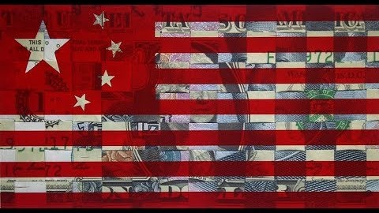
The Ascent of Money [Part 6] - Chimerica

Slide 24
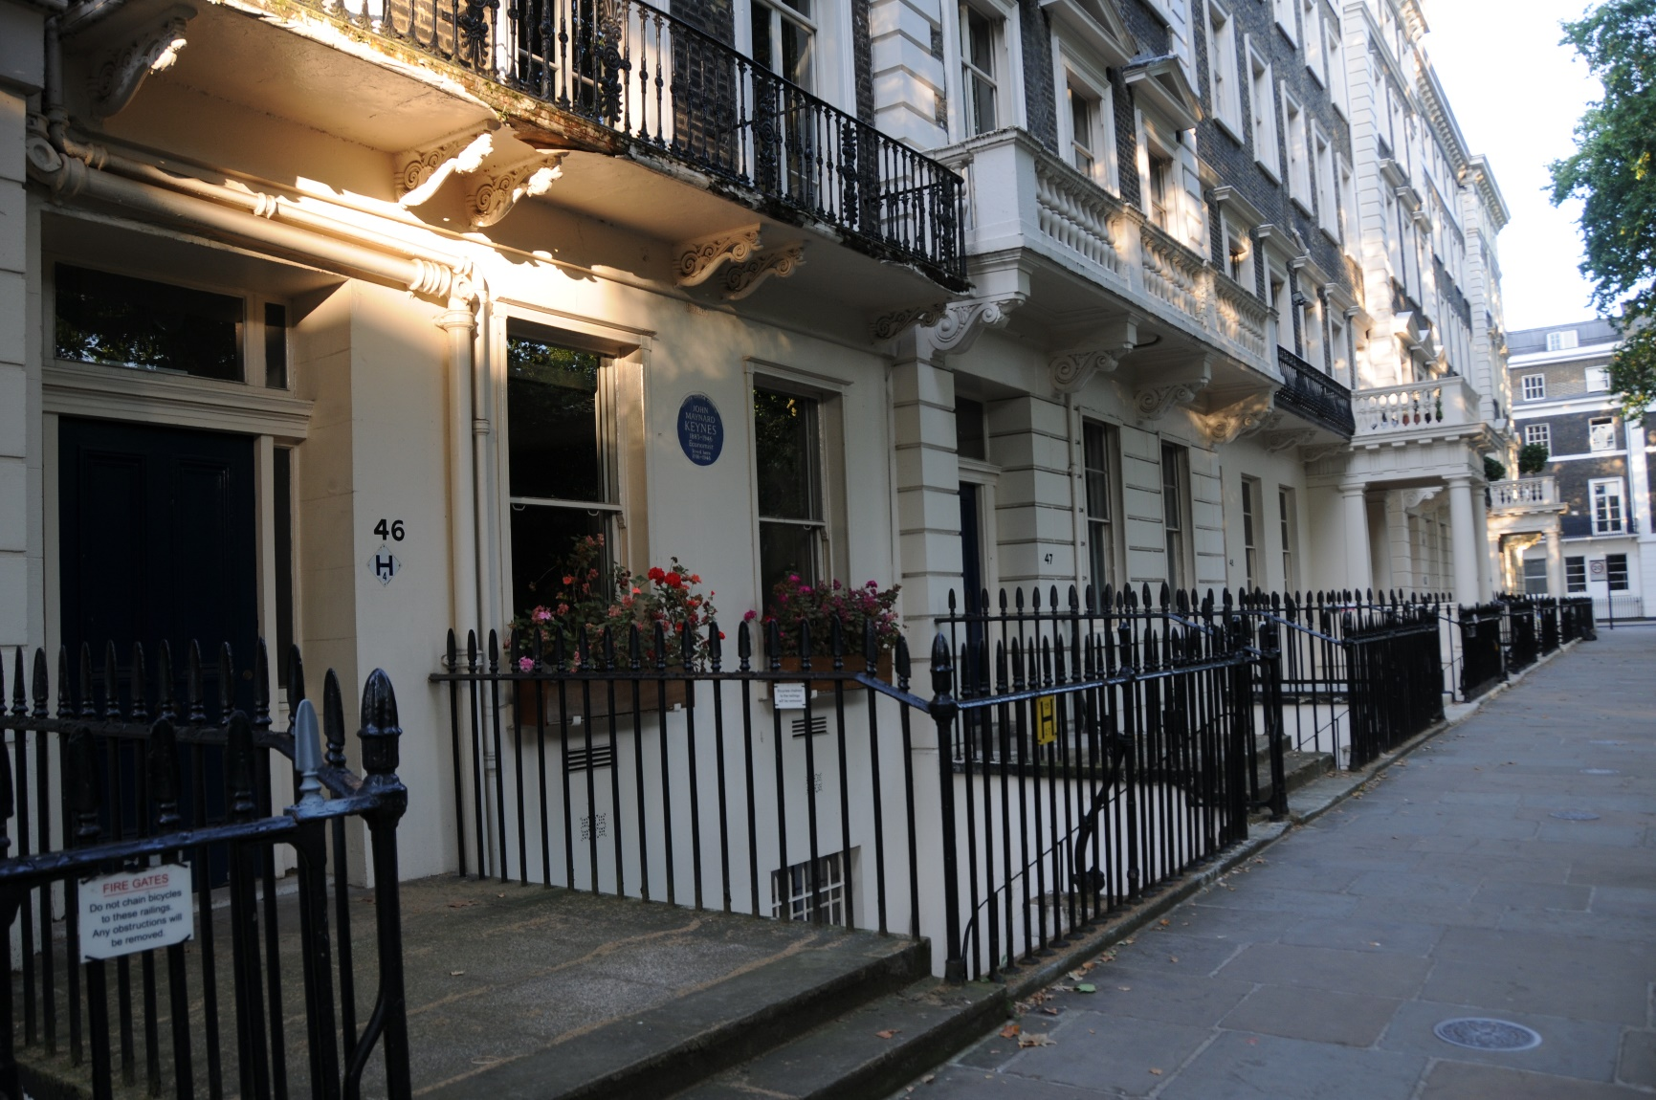
Adieu, with beautiful pictures from my focus!
John Maynard Keynes lived in this townhouse in London, when he was teaching at the London School of Economics and Political Science.

Slide 25
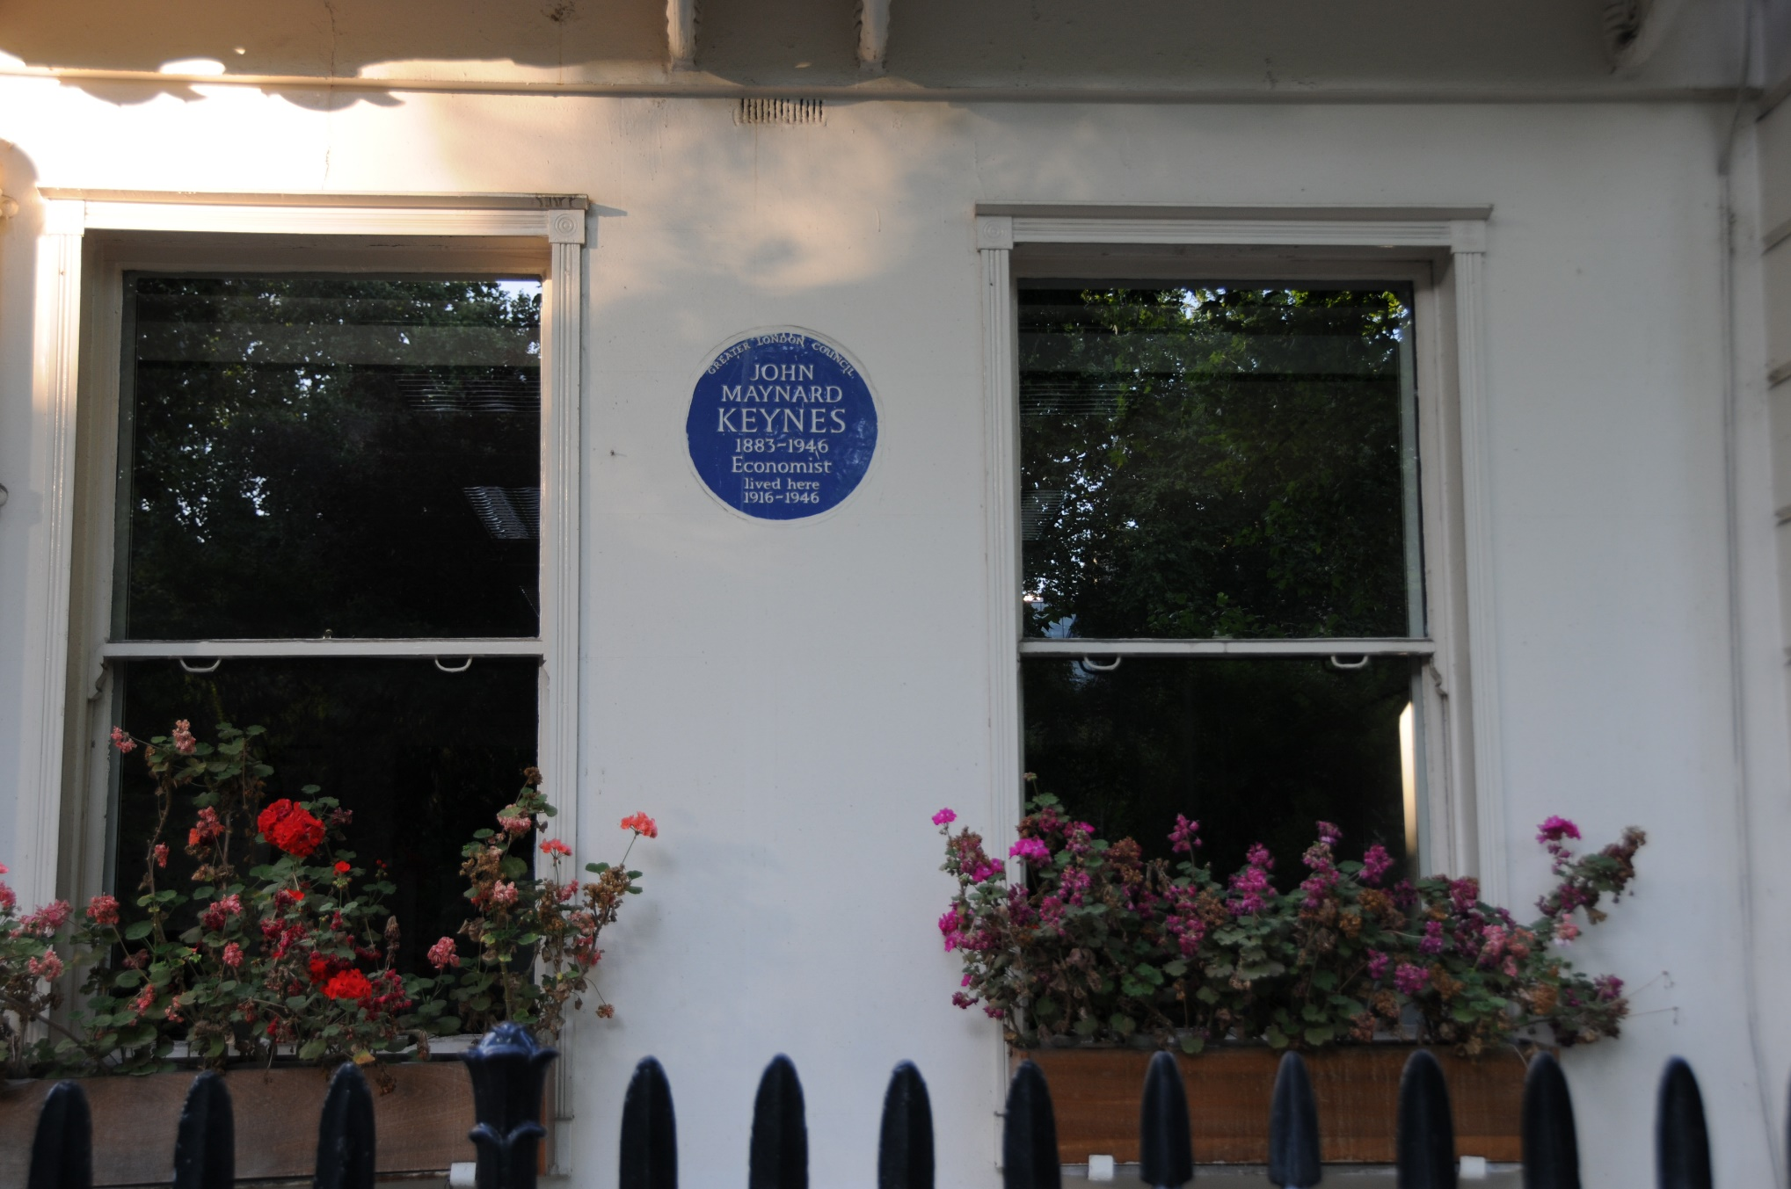

Slide 26
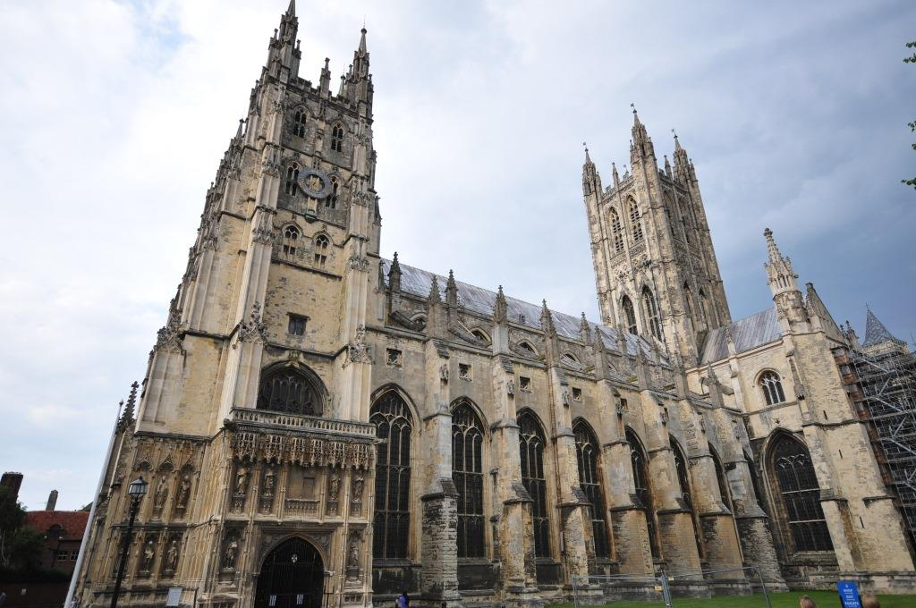
The cathedral at Canterbury, England.

Slide 27


Slide 28
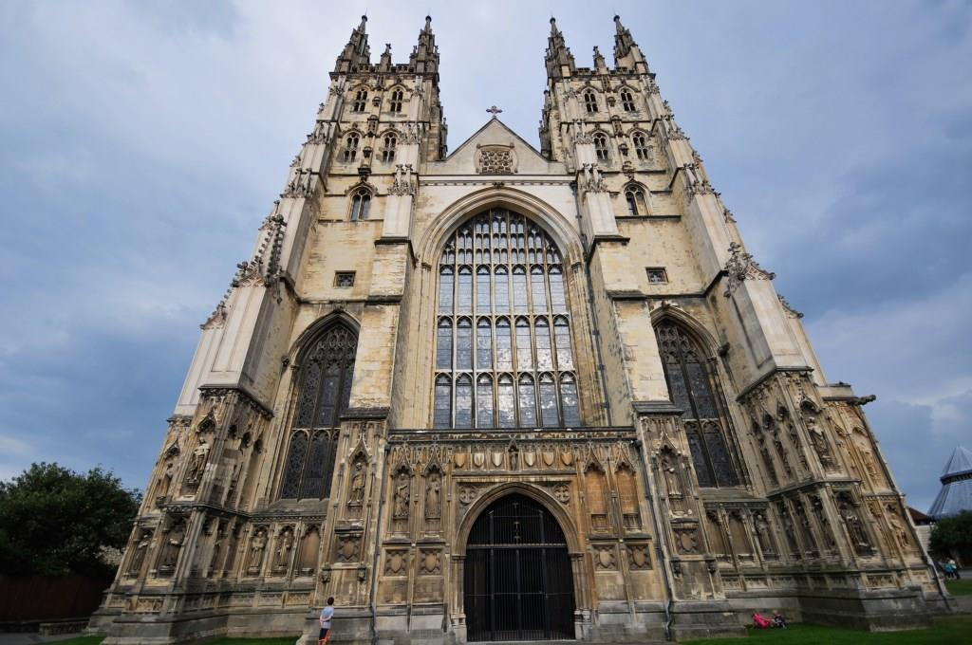
Canterbury Cathedral, England

