Slide 1
Debt Crisis and Asian Financial Crisis
Developing Countries in Global Financialization
Notes:
NOTE:
To change the image on this slide, select the picture and delete it. Then click the Pictures icon in the placeholder to insert your own image.

Slide 2
Introductory Remarks
When I entered college,in 1981, Mexican president José López Portillo was a familiar name to me, because he developed a very close relationship with China and often lashed out at U.S. under the Reagan Administration. From 1976 to 1982 with the discovery of massive oil reserves and the tripling of oil production, Mexico achieved the status of the world's fourth biggest oil producer. This black gold and Mexican economic growth for the past four decades emboldened Portillo to have uncontrolled government spending, massive foreign borrowing, and an ambition to surpass the U.S. to become a global power. Of course, the last goal did not materialize. Mexico fell into a debt crisis and the middle-income trap until today.
I traveled to Thailand and Malaysia in 2004 when I was a visiting research fellow at the National University of Singapore. In Thailand I could see unfinished cement columns for speed-train supposed to connect the international airport and downtown Bangkok but be used for advisement. In downtown Kuala Lumpur, out of my hotel room I could see a big hole of unfinished construction site, in the most expensive location in the city. All these eyesores were created by the 1997 Asian Financial Crisis. It took almost 10 years for many countries to clean up the ruins due to the crisis. The picture I used for my title page was taken as I traveled to Indonesia in 2012 and saw the ruins of a house left after a volcano eruption. Financial crisis is like an eruption of volcano.

Slide 3
The Debt Crises (1982)
Define: In early 1980s, many Latin American countries were in deep debt and could not service even the interest payments of their debts owned to mainly Western commercial banks.
How Did the Debt Crises Happen? “The spark for the crisis occurred in August 1982, when Mexican Finance Minister Jesús Silva Herzog informed the Federal Reserve chairman, the US Treasury secretary, and the International Monetary Fund (IMF) managing director that Mexico would no longer be able to service its debt, which at that point totaled $80 billion. Other countries quickly followed suit. Ultimately, sixteen Latin American countries rescheduled their debts, as well as eleven LDCs in other parts of the world (FDIC 1997).”
Three Phase Cycle
Overborrowing
Crisis
Adjustment
Between 1975 and 1982, Latin American debt to commercial banks increased at a cumulative annual rate of 20.4 percent. This heightened borrowing led Latin America to quadruple its external debt from US$75 billion in 1975 to more than $315 billion in 1983, or 50 percent of the region's gross domestic product (GDP). Debt service (interest payments and the repayment of principal) grew even faster as global interest rates surged, reaching $66 billion in 1982, up from $12 billion in 1975.

Slide 4
Debt Crisis (1982)—continued
To make a long story short: as we have discussed on ISI model in Latin America, Latin American countries borrowed heavily from commercial banks such as Citi Bank, Chase, and others. The availability of lush money in commercial banks was due to the recycled “Euro dollars” in European banks, which were a result of huge “petro-dollars” earned by oil-producing countries (especially OPEC members in the Middle East) who deposited their money in European Banks.
Awash with money, Western commercial banks encouraged Third World countries, especially Latin American countries, to borrow money for financing their development.
As we have discussed before, the relationship between foreign capital and economic development is very complicated. The safe capital is from Foreign Aid (bilateral or multilateral) that is from official government assistance (You cannot believe that Japan has been the biggest official foreign aid donor to China’s development) or concessional lending programs from the World Bank and International Development Agency.

Slide 5
Debt Crisis (1982)—continued
Private capital flows carry much higher risk. They can be debt-based flows or equity-based flows. Sometimes they can be fixed investment, or portfolio investment. The big danger for Latin American countries was that they borrowed heavily on floating (or variable) interest rate. When the global economy was doing well, the developed countries could keep importing and consuming, the developing countries could keep exporting and making foreign currency to pay back their debt.
But in 1979 and early 1980s, three shocks occurred:
The rising interest rates in the U.S. and Europe. Recall our discussion on Reaganomics, tightening money supply under Milton Friedman’s prescription, the relationship between trade deficit and budget deficit (the double deficits’ impact upon interest rate)
Recession in the West: Recall the chicks were thrown into garbage can in Commanding Heights documentary?
Oil prices rose. Although OPEC countries are developing countries, but most Third World countries are oil importers. The rising price of oil hurt those non-oil producing countries who had to face the dropping prices of primitive commodities they exported.

Slide 6
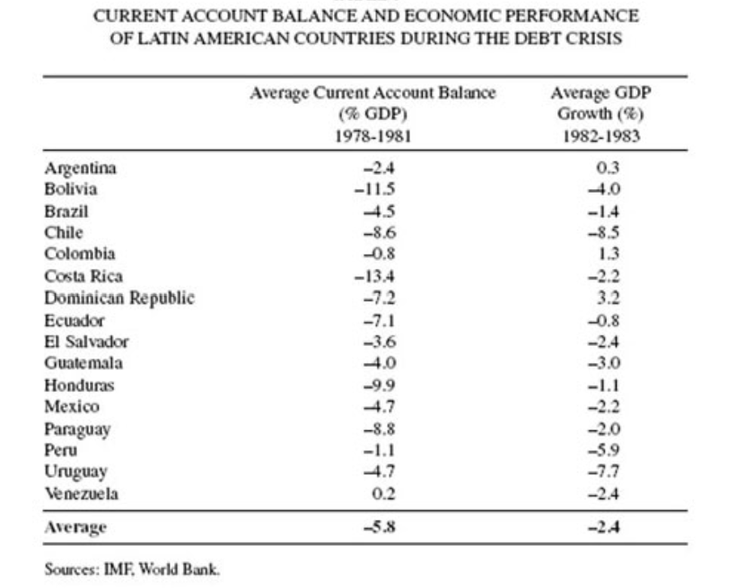
In Latin America, Current Account Balance crises, economic crises prompted the debt crises.
https://scielo.conicyt.cl/scielo.php?script=sci_arttext&pid=S0717-68212008000100003

Slide 7
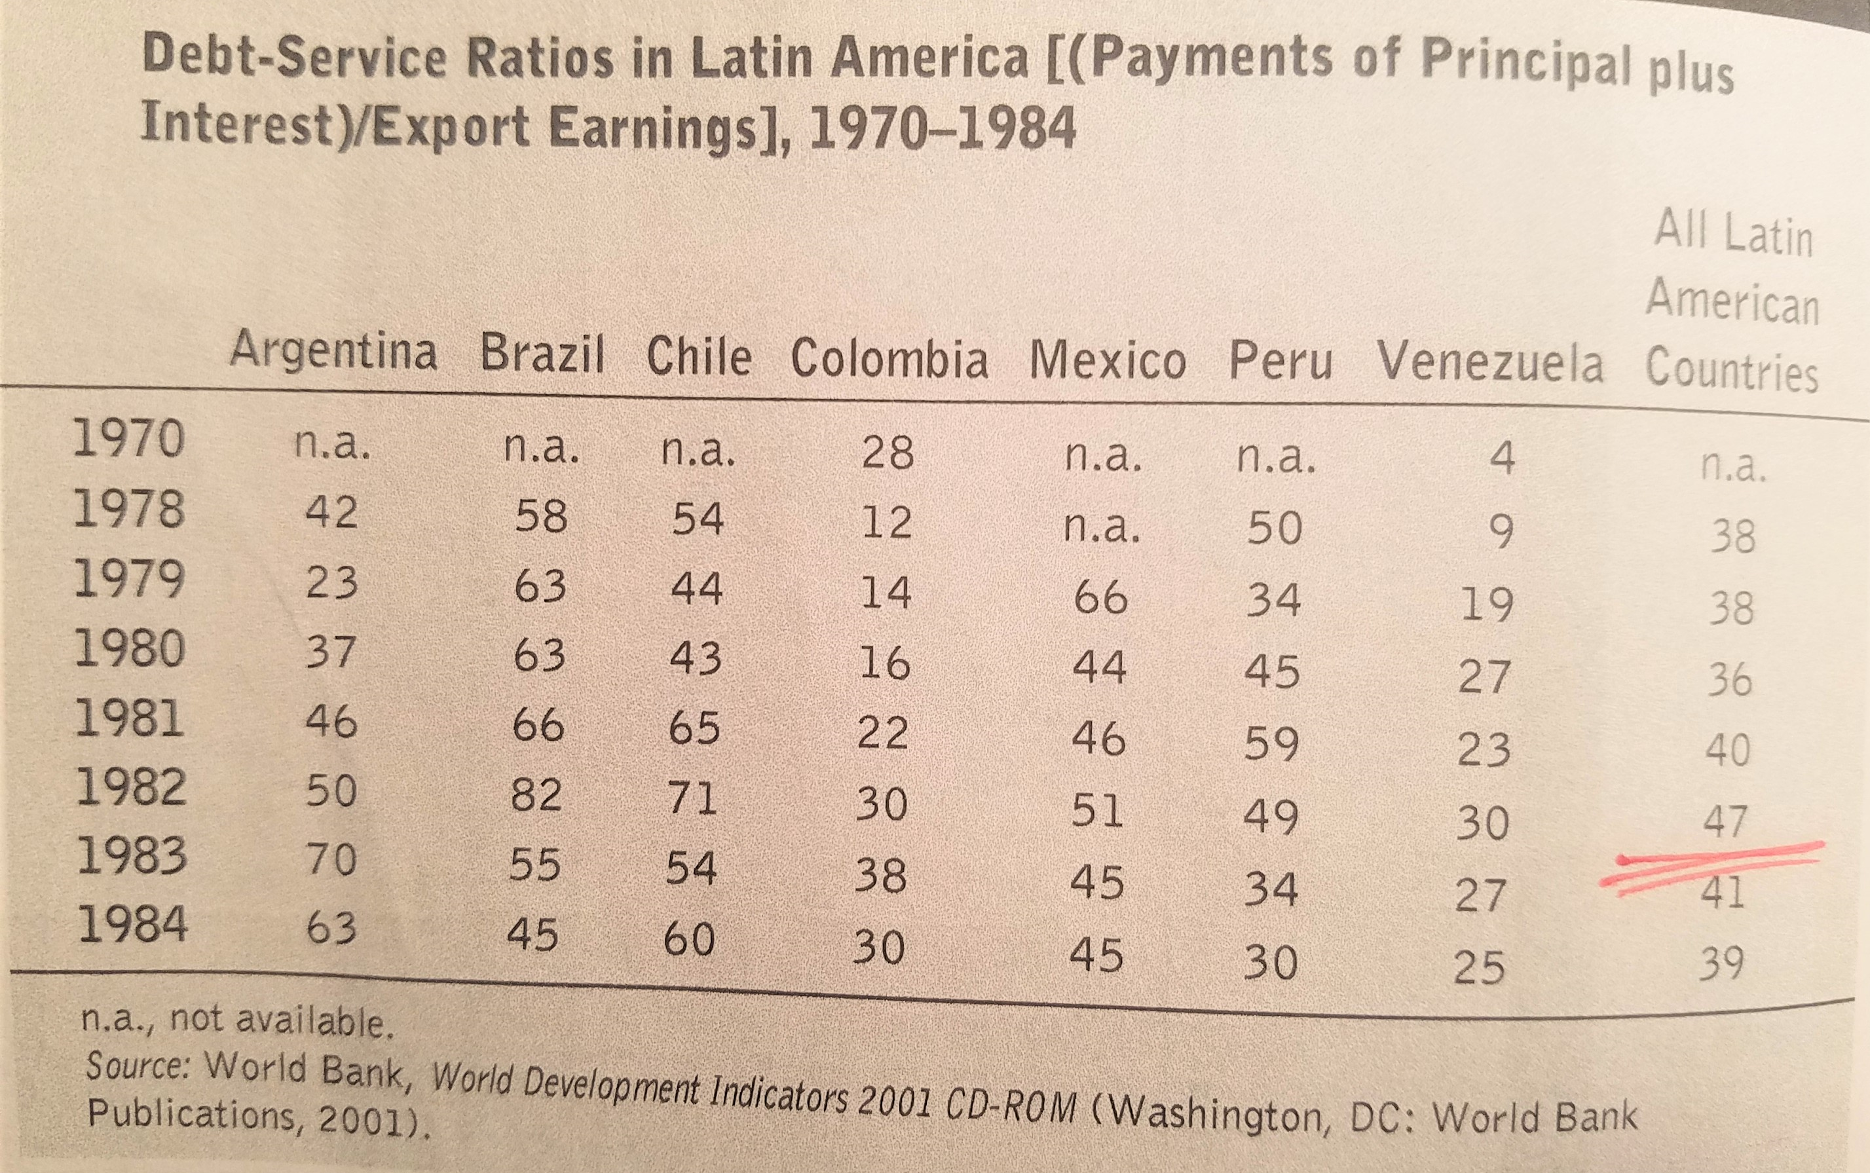

Slide 8
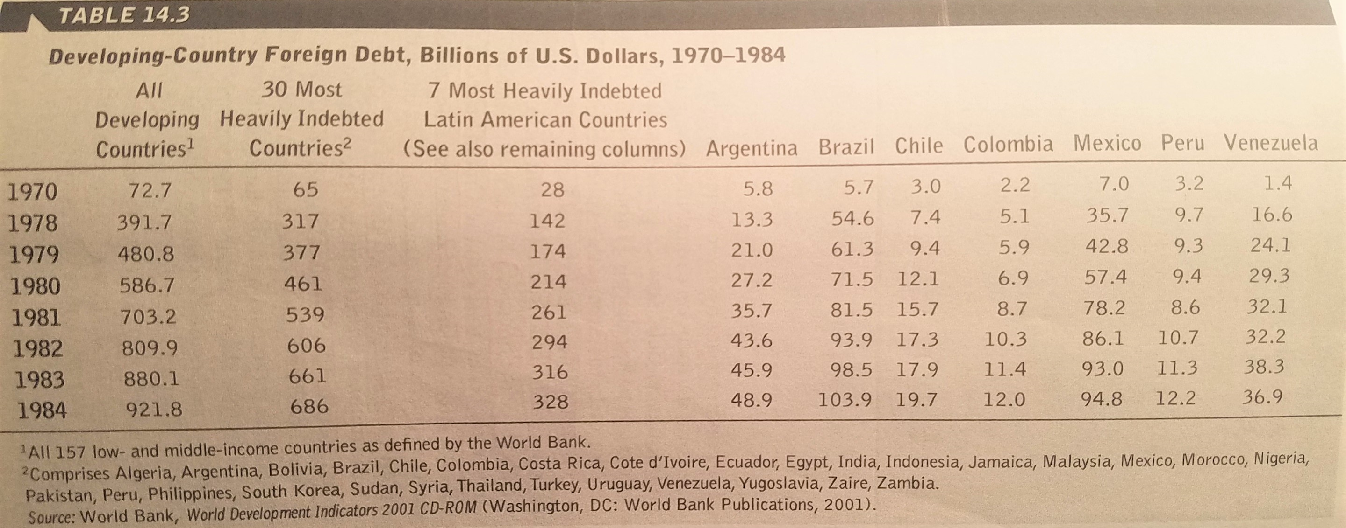

Slide 9
Why Debtor Countries Could Not Default?
John Maynard Keynes once said: “If you owe your bank a hundred pounds, you have a problem. But if you owe a million, it has.”
Latin American borrowing from US commercial banks and other creditors increased dramatically: At the end of 1970, total outstanding debt from all sources totaled $29 billion, by the end of 1978, that number had skyrocketed to $159 billion. By 1982, the debt level reached $327 billion. By 1982, the nine largest US money-center banks held Latin American debt amounting to 176 percent of their capital; their total LDC debt was nearly 290 percent of capital.
If Latin American countries had a collective default on their debts, they would bring down almost all important commercial banks in the U.S.. Then why did they not default?
The syndicated loan provided by a group of lenders and is structured, arranged, and administered by one or several commercial banks or investment banks known as lead arrangers: “Default one, default all.” It applies to individuals, too! Be careful!
Good coordination of creditors: They could overcome free-rider’s choice among themselves.
State intervention, especially from the U.S. Reagan Administration that, despite its laisses faire and “getting the government off our back” rhetoric, used state power to force Latin American countries and the commercial banks to compromise.
Prisoners’ dilemma among debtor countries: U.S. and banks persuaded big countries (e.g., Mexico, Brazil) not to coordinate a collective action against the banks.

Slide 10
Solutions for 1982 Debt Crisis
The United States acted as the “international lender of last resort,” led a cooperative rescue effort among commercial banks, central banks, and the IMF. Under the program, commercial banks agreed to restructure the countries’ debt, and the IMF and other official agencies lent the LDCs sufficient funds to pay the interest, but not principal, on their loans.
Banks began to establish loan loss provisions for their LDC debt. The first was Citibank, which in 1987 established a $3.3 billion loss provision, more than 30 percent of its total LDC exposure. Other banks quickly followed Citibank’s example.
Secretary of the Treasury Nicholas Brady proposed a plan that established permanent reductions in loan principal and existing debt-servicing obligations. Between 1989 and 1994, private lenders forgave $61 billion in loans, about one third of the total outstanding debt. In exchange, the eighteen countries that signed on to the Brady plan agreed to domestic economic reforms that would enable them to service their remaining debt.
In return, the LDCs agreed to undertake structural reforms of their economies and to eliminate budget deficits. Conditionalities and Structural Adjustment Programs (SAPs).
The 1980s were remembered as “the lost decade” for Latin America (see the grapg at the next page).
(Source: https://www.federalreservehistory.org/essays/latin_american_debt_crisis)

Slide 11
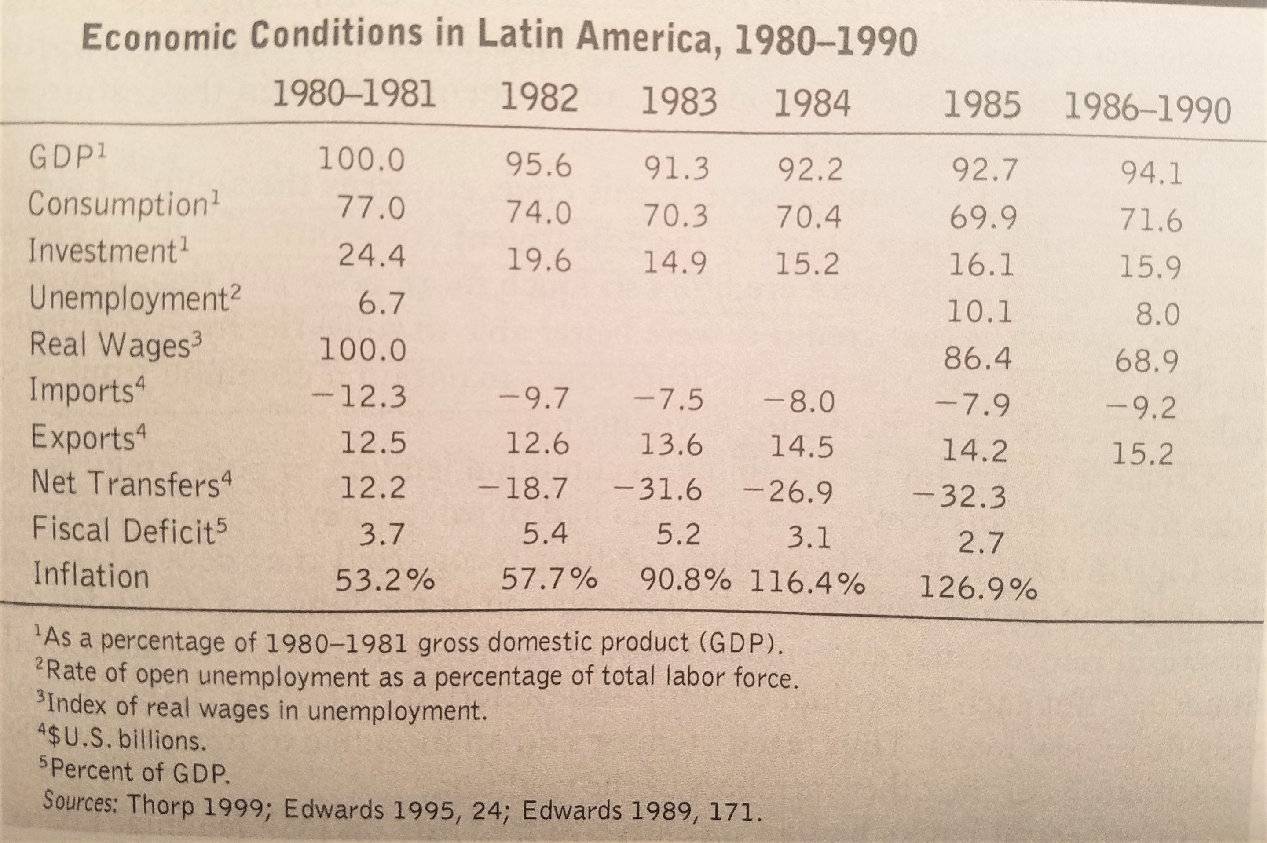

Slide 12
1997 Asian Financial Crisis
If we say that 1982 debt crisis was the first big financial crisis after the collapse of the Bretton Woods System, unfortunately, we have seen more financial crisis thereafter. The 1994 Mexican crisis was another major one and thanks to American timely bailout under the Clinton Administration it did not become a global contagion. But the Mexican society did suffer a lot and paid a high price, including the 1994 Zapatista uprising and the 1995 Zapatista crisis in Chiapas. Meantime, Mexico transformed from a single party (PRI) authoritarian system into a competitive democracy.
The 1980s debt crisis had impact upon the Communist/Socialist bloc, too. The rise of Solidarity movement, the martial law under General Jaruzelski, Poland’s huge external debt and its appeal to the West for new loans, all helped the West to leverage change in Poland. No wonder Poland was the first communist country to see the collapse of its own regime.
In 1997 Thailand started to have current balance account crisis, both U.S. and IMF did not rescue it as soon as U.S. did to Mexico in 1994. The U.S. thought it could afford to neglect since Thailand did not have the same importance to U.S. as Mexico did. But it was wrong, the crisis in Thailand caused a contagion—the 1997 Asian Financial Crisis.

Slide 13
East Asian Financial Crisis
Scope: First in Thailand, as the government announced not to defend its pegging of Thai Baht with U.S. dollar, the Thai currency lost 15% of its value immediately. Currency declines spread rapidly throughout East Asia, in turn causing stock market declines, capital flight, housing bubble bursting, bank failures, reduced import revenues, economic decline, and anti-government upheavals.
Causes: as we have discussed before, the fixed exchange rate as Thailand pegging its currency with U.S. dollar can offer investors a confidence in local currency. Hot money kept pouring into Asia. In 1990s as U.S. economy boomed under Bill Clinton (economic growth had averaged 4.0 percent per year and lasted 116 consecutive months) and the dollar value rose up, this made Thailand’s currency rise up too, this hurt Thai export and current account balance. This invited speculative attacks. Investors went to panic and started to flee from Asia, a contagion caused the liquidity crisis.
Significance: East Asian region had been regarded as a successful model in economic development. Its sudden collapse affected China, Japan, and the United States, a global contagion was possible.

Slide 14
The IMF Diagnosis (https://www.imf.org/external/np/exr/ib/2000/062300.htm)
The crises that began in Thailand with a series of speculative attacks on the baht unfolded after several decades of outstanding economic performance in Asia. Although the circumstances varied among the countries concerned, the difficulties stemmed primarily from a combination of macroeconomic imbalances (even though government budgets were broadly in balance and inflation rates were modest), external developments, and weakness in financial and corporate systems. The external imbalances were a reflection both of strong private capital inflows and of high domestic private investment rates, and were exacerbated, prior to the crisis, by appreciation of the U.S. dollar to which the currencies of the countries concerned were formally or informally pegged.1
The weaknesses of the financial and corporate sectors contained several elements, including pre-existing weaknesses in financial institutions' portfolios; unhedged foreign currency borrowing that exposed domestic entities to significant losses in the event of domestic currency depreciation; excessive reliance on short-term external debt; and risky investments against the backdrop of bubbles in stock and property prices. These elements had been building up in an environment of large private capital inflows and rapid domestic credit expansion in liberated financial systems, where implicit government guarantees (in addition to those entailed in exchange rate pegs) remained pervasive, and supervision and regulation were not up to the challenges of a globalized financial market.
In these circumstances, a change in market sentiment could and did lead into a vicious circle of currency depreciation, insolvency, and capital outflows, which was difficult to stop. Contagion spread rapidly in the region after the devaluation of the baht, as other countries were perceived by investors as facing similar weaknesses that cast doubt on their credit-worthiness. By the time the crises had run their course, a large proportion of the financial institutions and corporations in the affected countries were bankrupt.

Slide 15
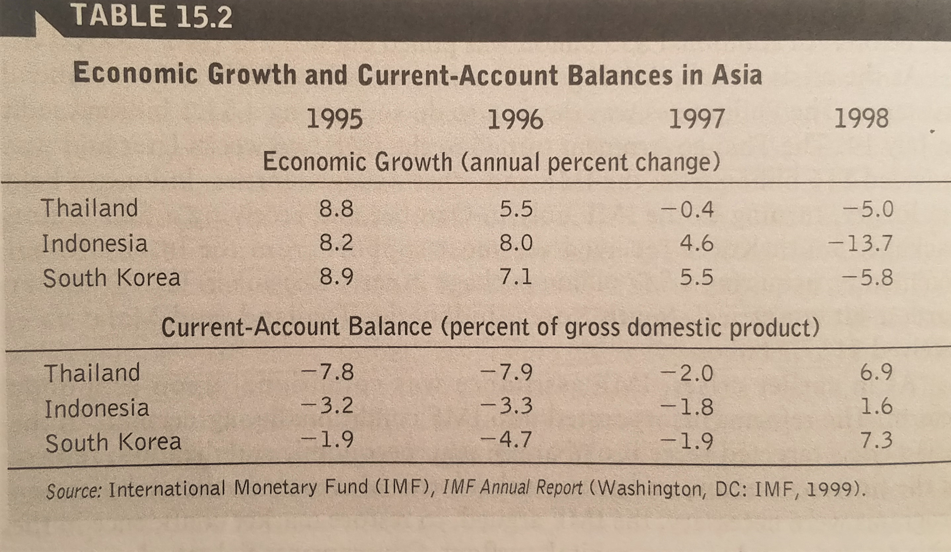

Slide 16
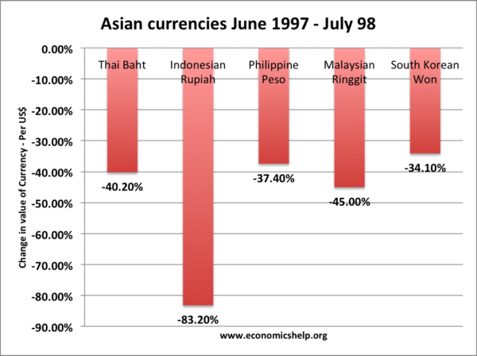
Think about this graph: Based upon exchange rate, a country could lose one third to more than 80% of a country’s wealth. If you are indebted to foreign banks, it means your debt burden would possibly increase by 100%. This explains why many local banks and real estate development companies went bankrupt.
Source: https://www.economicshelp.org/wp-content/uploads/2012/11/asian-currencies-600x448.png

Slide 17
East Asian Financial Crisis: Solutions
IMF responded with a bailout. Some US$35 billion of IMF financial support was provided for adjustment and reform programs in Indonesia, Korea, and Thailand.
U.S. was in its good economic situation and did offer help. The Clinton Administration led a global effort to re-capitalize the International Monetary Fund to allow it to more effectively deal with crisis and also insisted that the G-7 develop a set of measures to restore confidence in the world financial system.
China just recovered its sovereignty over Hong Kong in July and did not want to see the collapse of Hong Kong dollar. By throwing its national foreign currency reserve to defend Hong Kong dollar, the Chinese government thwarted the attack upon Hong Kong dollar by financial speculators. Eventually the crisis receded.
The U.S.-China cooperation led to the future talk of G-2.
Asian countries started devaluing their currencies, allowing flexible exchange rate, imposing capital control especially for short-term hot money.
Many countries also started anti-corruption political reforms. In Indonesia a regime change happened.

Slide 18
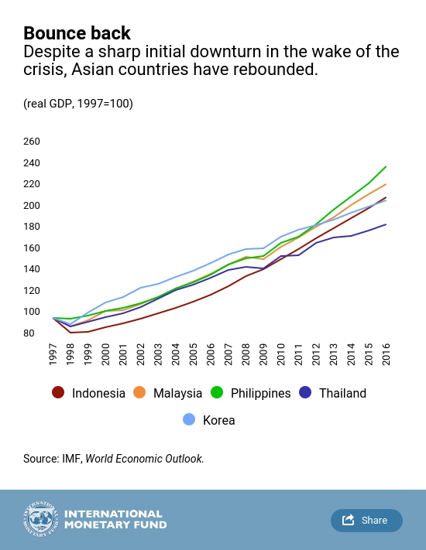
Overall, East Asian region was much luckier than Latin America and rebounded very fast. In the following two decades, it remained the most robust region in terms of economic growth in the world.
Source: https://blogs.imf.org/2017/07/13/what-we-have-seen-and-learned-20-years-after-the-asian-financial-crisis/#post/0

Slide 19
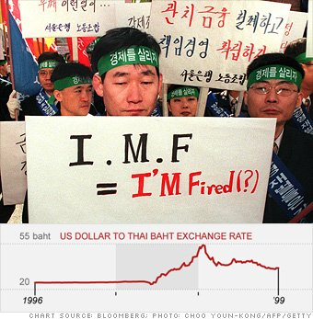
Possible IMF Reforms: Lessons Learned from 1997 Asian Financial Crisis
Strengthen the quality and impact of IMF surveillance
Inducing changes in the composition of capital flows (e.g., encouraging long-term FDI).
Introducing contingent debt contracts or other hedging against macroeconomic risks (for example, exchange rate change).
Addressing informational imperfections and distorted incentive on the supply side of international capital flow.
Revamping debt resolution procedures (e.g., possible debt-cancellation for HIPCs (The heavily indebted poor countries).
Strengthening the framework for development aid and official non-concessional lending with lower interest rate or better grace period.

Slide 20
Asian Defense against Future Financial Crisis and Its Unintended Consequences
“Never again!” This is the bitter lesson that Asian countries collectively learned from the 1997 Financial Crisis. To be prepared for the future onslaught of financial attacks, Asian countries adopted two important measures:
Accumulating a huge foreign currency reserve (See Graphs for 2013 and 2017 data in Asia). China was a big owner of foreign currency reserve (see the increases in the graph).
Creating regional monetary cooperation. Asian countries started the Chiangmai Initiative (CMI), a multilateral currency swap arrangement among the ten members of the Association of Southeast Asian Nations (ASEAN), the People's Republic of China (including Hong Kong), Japan, and South Korea. Japan proposed that Asia needs to develop an Asian monetary fund. Great power rivalries between Japan and China, opposition from United States concerning increased Asian autonomy have delayed this process.
Economists and decisionmakers believe that the huge foreign currency reserve created a global capital glut, offered cheap credit and were responsible for the housing bubbles in the West. In other words, Asian countries’ insurance measures might have caused the future 2008 Financial Crisis.

Slide 21
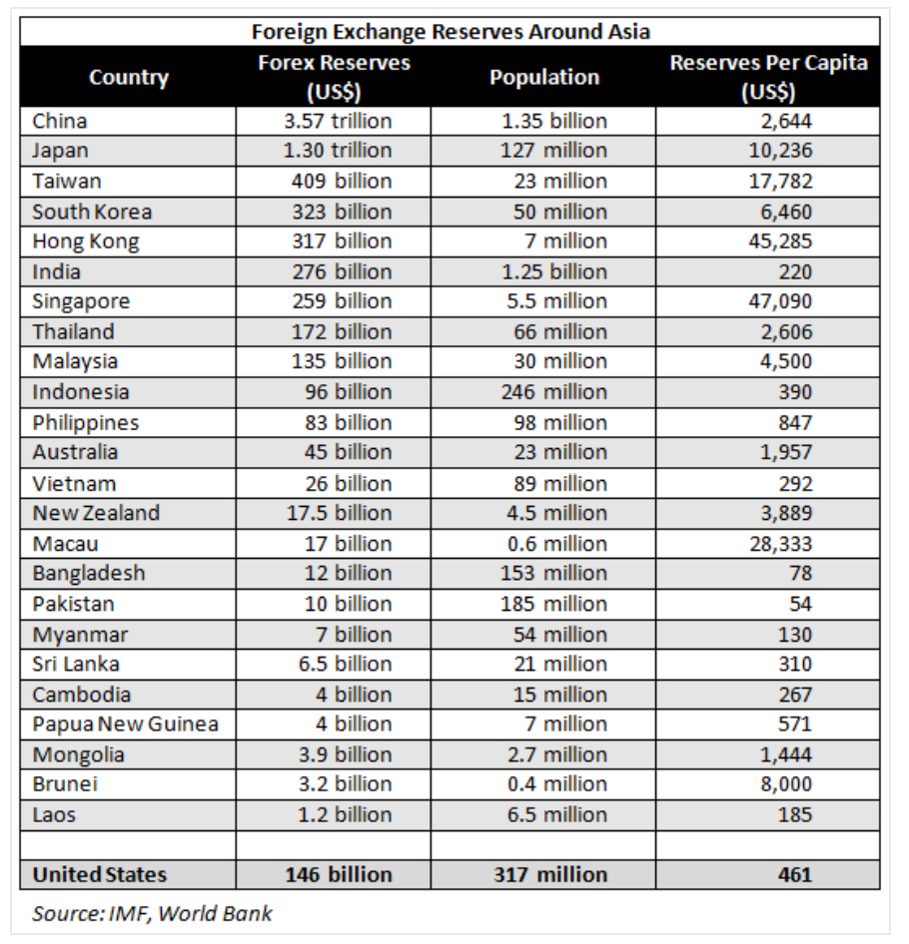
2013 Data
Source: https://www.asiabriefing.com/news/2013/10/asia-can-afford-u-s-default/

Slide 22
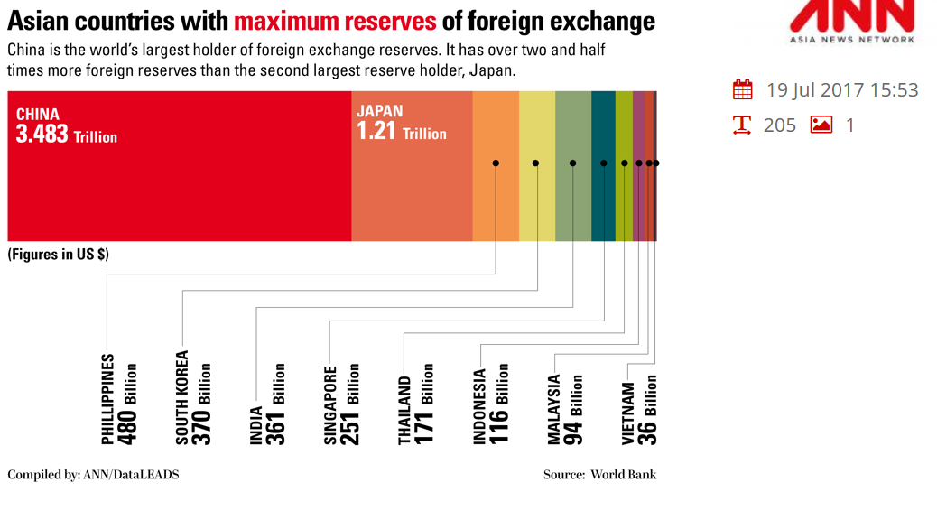

Slide 23
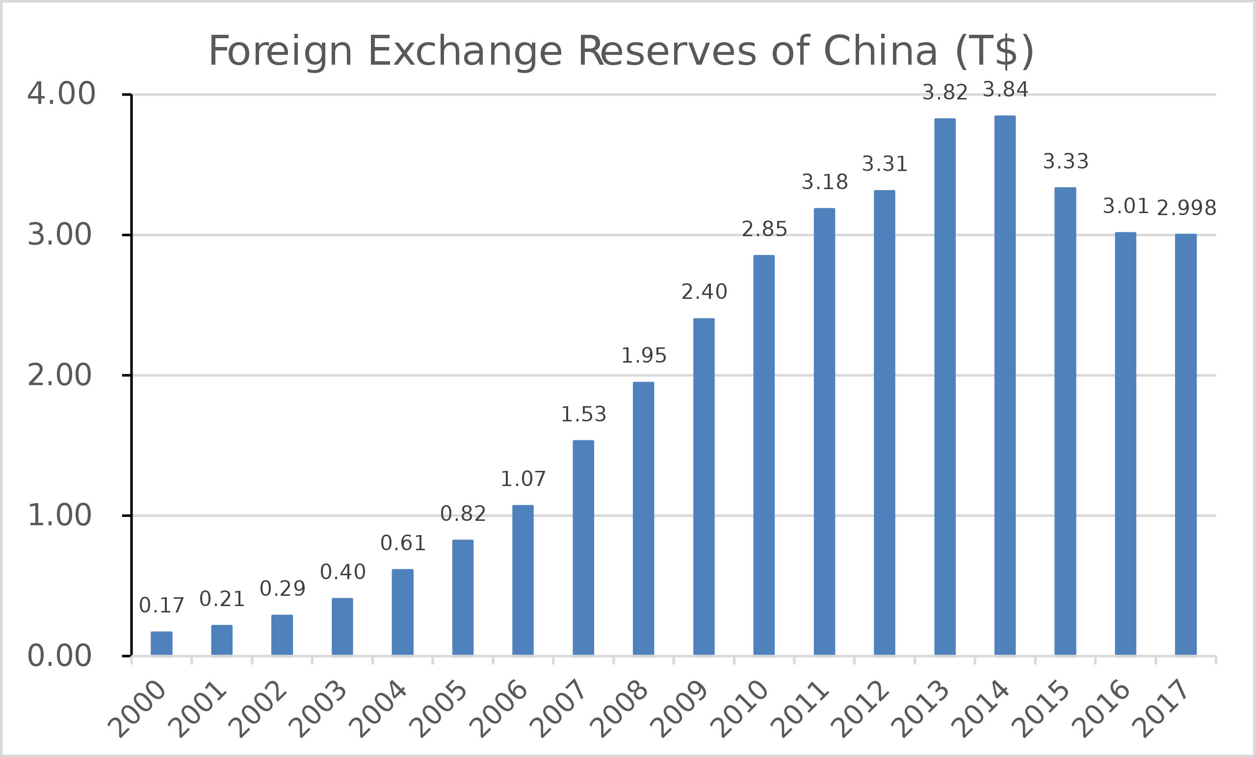
In Trillion U.S.$.
Source: https://en.wikipedia.org/wiki/Foreign-exchange_reserves_of_China#/media/File:Foreign_exchange_reserves_of_China.svg

Slide 24
Causes of Hunger
Underdevelopment and Food Crisis
External and Structural Reasons
The Failure of NIEO and the Millennium Development Goals
Two Faces of Development: “Social Distancing” vs. “Social Sharing”
Internal Factors:
Population
Bad Government: Corruption
Unfreedoms

Slide 25
Final Reflection
I conclude this session with the issue of food crisis and hunger. As we have seen even in the richest country on the earth, U.S. has just witnessed close to 50 million people facing food shortage. Worldwide, 135 million people had been facing acute food shortages, but now with the coronavirus pandemic, 130 million more could go hungry in 2020 [Arif Husain, chief economist at the World Food Program, a United Nations agency]. Altogether, an estimated 265 million people could be pushed to the brink of starvation by year’s end.
Financial crisis is like the eruption of volcano, burying, killing and hurting millions. I remember that during the 2008 financial crisis the coffee farmers in Central America could not sell their coffee anymore, so they could not have money to purchase food (Also, U.S. subsidy to corn farmers for ethanol production at home made the corn price unreachable for many poor farmers in Latin America) . Instead, they fed their babies with coffee, resulting hyper-stimulated but hungry crying babies!
I hope all of us are able to weather the storm successfully and at the same time if resources allow we can think of crying babies in far away land. We are afraid of that coronavirus kills people, we should also be afraid of that hunger kills people. But most important of all, the hatred that some people are stirring up against “others” can kill, too! On this point, I recommend my freshly released essay to you: “Quadruple Fears: In the Perfect Storm” !

Slide 26
https://aaari.info/quadruple-fears-in-the-perfect-global-storm/
I have said a lot about CSI, CUNY, Staten Island, New York, US, China and the world! Enjoy and please share!

