Slide 1
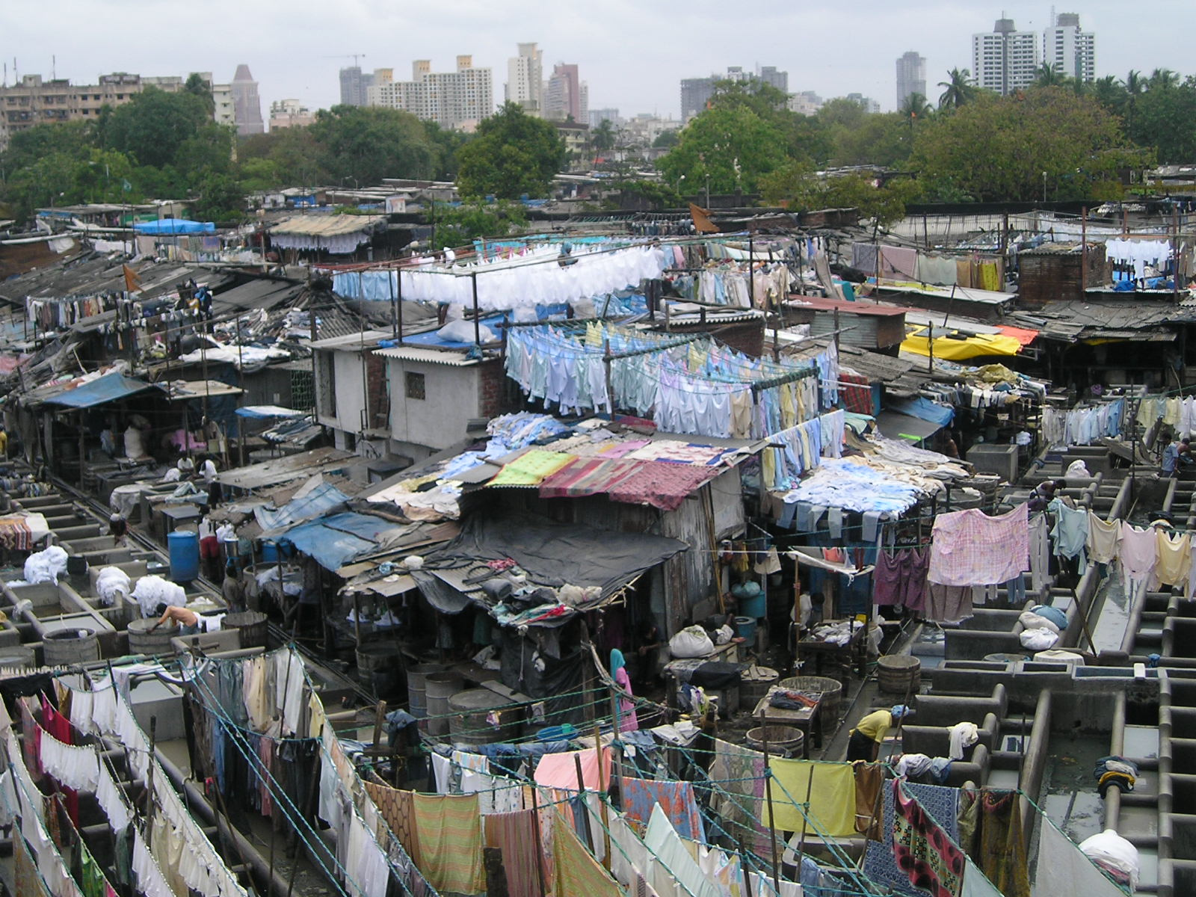
International Trade and Development
The North-South Divide
https://www.teoalida.com/world/india/
Notes:
NOTE:
To change the image on this slide, select the picture and delete it. Then click the Pictures icon in the placeholder to insert your own image.

Slide 2
Puzzles
Just imagine that New York, the third largest economy in U.S. (after the U.S. and California), has been desperate to secure ventilators amid the global coronavirus pandemic. The price for a ventilator once was kept below US$3,000, this year the federal government purchased at more than US$10,000, and NY governor Cuomo purchased from China at more than US$ 20,000. Have we asked this question: among 200 countries affected by the pandemic most are poor countries, how can they afford to compete against the richest country in the world for ventilators?
The North-South divide: It has become a convenient term to describe the huge gap between rich countries (most industrialized countries are in the Northern atmosphere) and poor countries (almost all of them share one common legacy of colonialism). Actually, you can find an internal North-South divide in may countries. Think about: U.S., France, Mexico, Brazil, China, India, Italy, Great Britain, Korea (Two Koreas), Taiwan, Vietnam…. Even within the state of New York, we can probably find a North-South divide. Can we feel such a divide in Manhattan? On Staten Island?

Slide 3
Poverty: a Snapshot
Please look at the snapshot of a UN table on poverty, and ask: Do I have any personal knowledge about these countries in the following partial table? If I am not from these countries, I have no family members or relatives from these countries, I have no friends from these countries; then ask this question: Am I using any product from these countries? I have confidence to say that almost 100% you will find a label “Made in _____”, you can fill this blank with one of these countries.
We are related to poverty. And we maybe part of the causal link of poverty in global political economy.

Slide 4
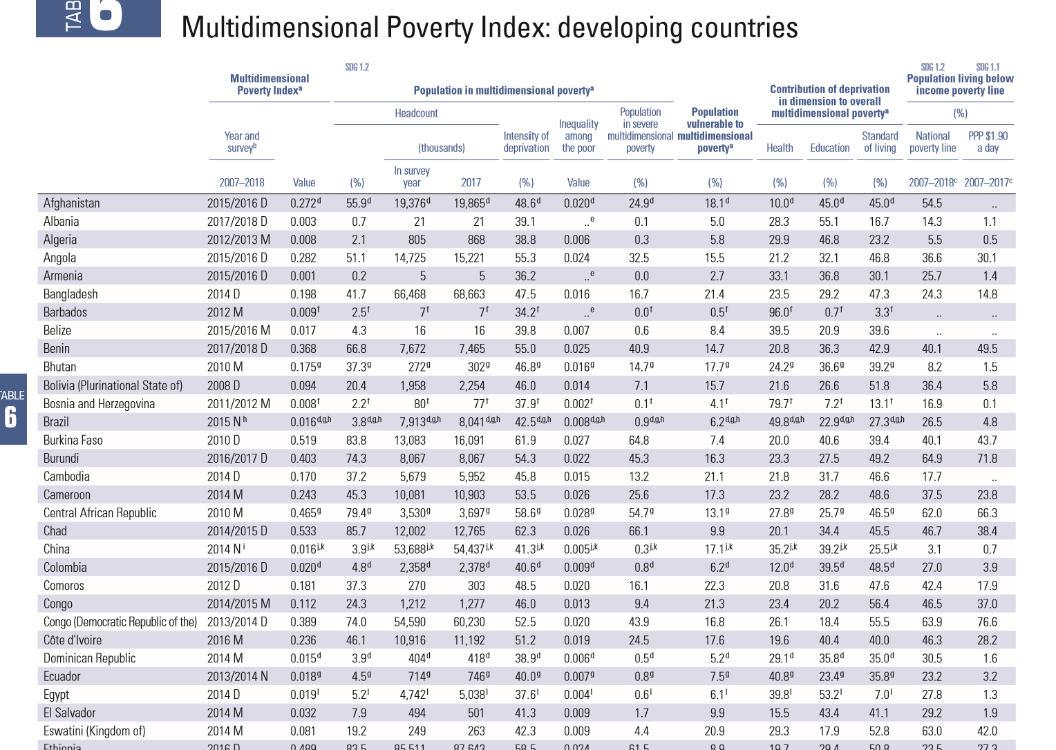

Slide 5
Multidimensional Poverty Index: developing countries, 2019
You can have a glimpse of Global Poverty from the following UN report.
Human Development Reports by United Nations Development Programme
http://hdr.undp.org/en/content/table-6-multidimensional-poverty-index-developing-countries
If you have no time to peruse these reports and graphs, please watch the following video clips in order to have a visual image of poverty and the multidimensional definition of poverty around the world:

Slide 6
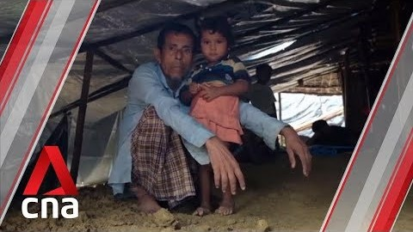
1.3 billion people worldwide 'multidimensionally poor': UN report

Slide 7
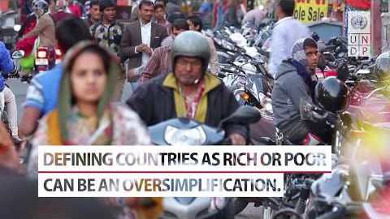
2019 global Multidimensional Poverty Index

Slide 8
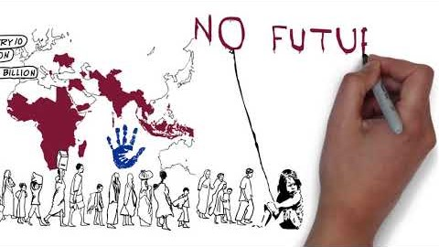
Global MPI 2018: Poverty is expensive

Slide 9
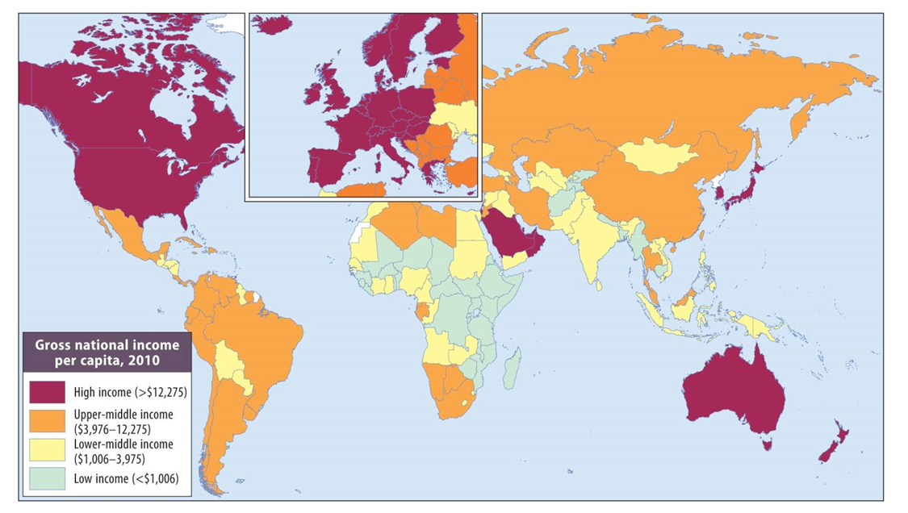
The huge global unevenness in per capita income
The North-South divide in terms of income is vividly colored. Australia, New Zealand are exceptions that prove the rule. Can you find them on map?
Source: based on World Bank, 2012: Table 1; Peter Dicken, Global Shift.

Slide 10
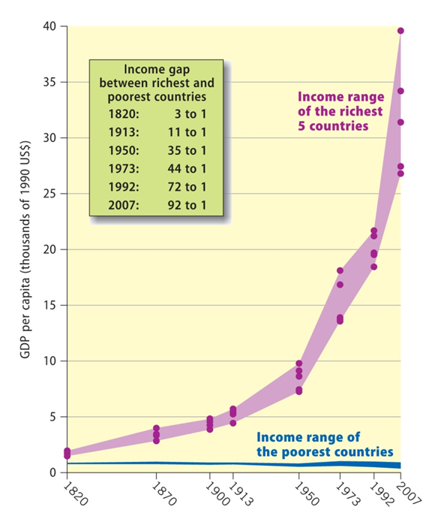
The widening income gap between countries
Source: based on UNDP, Human Development Report, 1999: Figure 1.6; World Bank, 2009b: Table 1; Peter Dicken, Global Shift.

Slide 11
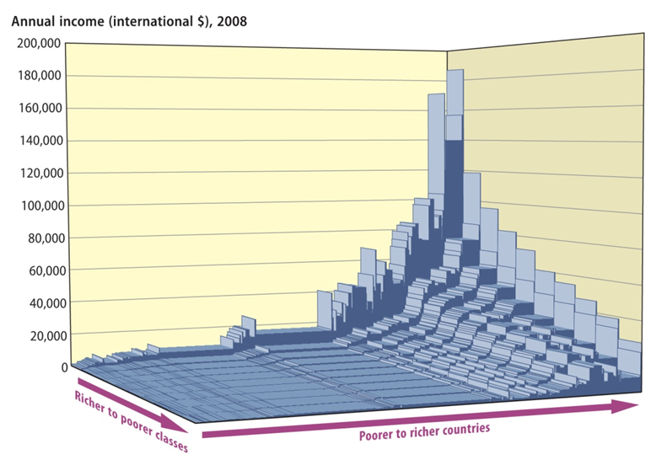
Global distribution of per capita income
Pay attentions to two vectors:
International inequality and
Class inequality
Source: graph compiled by Bob Sutcliffe (December 2009); Peter Dicken, Global Shift.

Slide 12
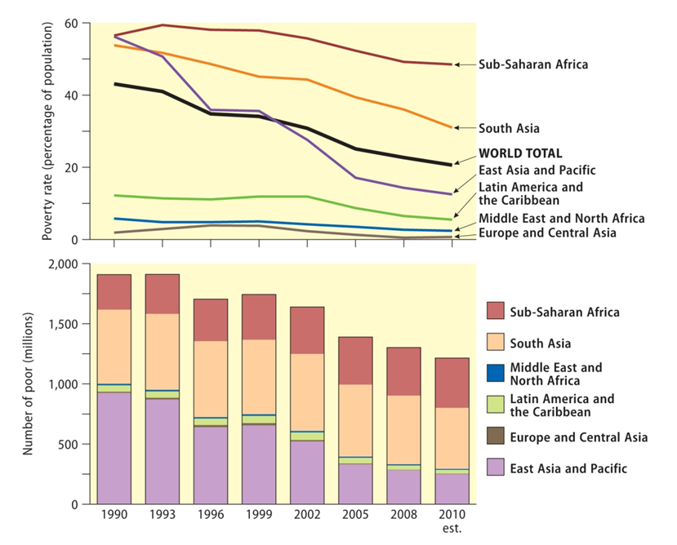
Changing geography of the world’s poorest population
The encouraging signs are that the overall trend worldwide is the decrease of the percentage of the poor in the general population; in East Asia and Pacific region, the achievement has been significant. As India has been doing well in economy, South Asia looks promising. But Sub-Sahara Africa needs more progress.
Source: based on data in World Bank, World Development Indicators, 2013: Table 2.8; Peter Dicken, Global Shift.

Slide 13
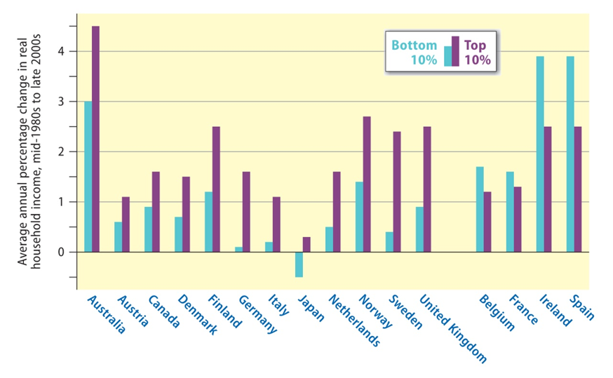
The top end wins: changes in the incomes of the top and bottom segments of the population
The dominant trend among the rich countries is that the rich class gains faster that the poor class.
Source: based on OECD, 2011: Table 1; Peter Dicken, Global Shift.

Slide 14
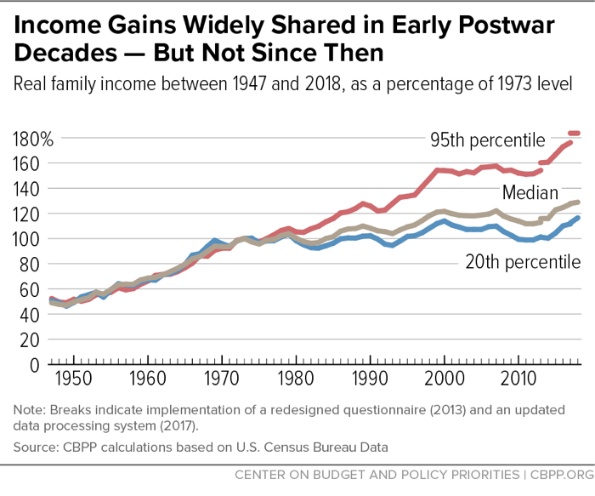
A Guide to Statistics on Historical Trends in Income Inequality
January 13, 2020, by Chad Stone, Danilo Trisi, Arloc Sherman, Jennifer Beltrán https://www.cbpp.org/research/poverty-and-inequality/a-guide-to-statistics-on-historical-trends-in-income-inequality
Inequality is a life and death issue in the Third World, but it is also a burning signature problem in the richest country in the world: the U.S. We can see a process of “Third Worldization” in our society.

Slide 15
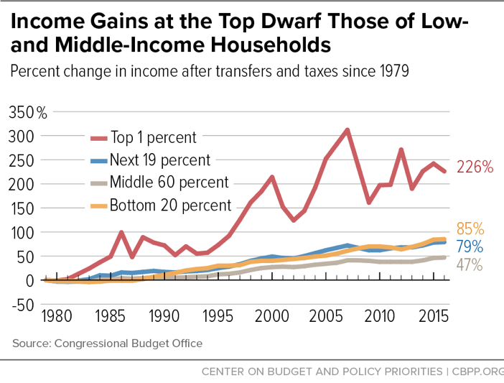

Slide 16
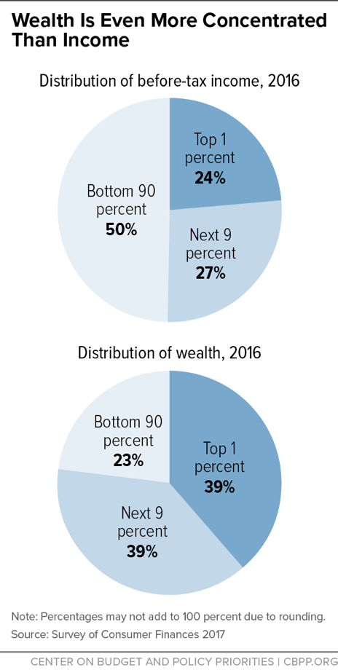
Wealth Is More Unequal Than Income in U.S.
A family’s income is the flow of money coming in over the course of a year. Its wealth (sometimes referred to as “net worth”) is the total stock of assets it has as a result of inheritance and saving, less any liabilities. Wealth is much more highly concentrated than income, and concentration at the top has risen since the 1980s.

Slide 17
Modernization Theory and Its Challengers—Dependency Theory
Modernization Theory in the 1940s-1950s
W. W. Rostow: Stages of Economic Growth: The Non-Communist Manifesto (1960)
Accumulation of capital
Preparation for Take-off
Launch and Economic Take-off
Mature Economy
Mass Consumption
The modernization school advised the Third World countries to follow the footprints of the West to finish the modernization process as the above prescribed stages.
Dependency Theory in the 60s and 70s
In 1960s a group of Latin American economists first questioned the applicability of modernization theory in Third World countries—Recall our discussion on Marxist approach in theoretical section: core vs. periphery.
In 1965 movement for NIEO (New International Economic Order) demanding for: more foreign aid, preferential system (not asking reciprocity from the poor countries), price-stabilization, market access and economic autonomy (especially regarding FDI and MNCs)
1973 Oil Shock and OPEC offered incentive and capacity to pressure the West.

Slide 18
Engel’s Law: Income Elasticity of Demand
Engel's Law is an economic theory introduced in 1857 by Ernst Engel, a German statistician, stating that the percentage of income allocated for food purchases decreases as income rises. As a household's income increases, the percentage of income spent on food decreases while the proportion spent on other goods (such as luxury goods) increases.
Source: https://www.investopedia.com/terms/e/engels-law.asp.
Income elasticity of demand measures the responsiveness of demand for a particular good to changes in consumer income. The higher the income elasticity of demand in absolute terms for a particular good, the bigger consumers' response in their purchasing habits—if their real income changes.
We can infer that as people’s income increase, they will spend more money on luxury goods, but their spending on necessity goods will not increase proportionally in relation to their increase. [It is easier to imagine that poor families spend a larger portion of income on food than rich families, not the absolute amount, but percentage in the total income].
We can see that luxury goods have higher income elasticity of demand, necessity goods have a lower elasticity. As economy grows, we can see the price for manufacturing goods go up, meanwhile, price for primary commodities tend to go down.

Slide 19
Singer-Prebisch Theory (the Prebisch–Singer hypothesis): Terms of Trade
Built upon Engel’s law, the Prebisch–Singer hypothesis (also called the Prebisch–Singer thesis) argues that the price of primary commodities declines relative to the price of manufactured goods over the long term, which causes the terms of trade of primary-product-based economies to deteriorate.
Clearly for Raul Prebisch, who was the leading voice for NIEO and dependency theory working in the UNCTAD, if rich Western countries are specialized in producing manufacturing and luxury goods, and the developing countries specialized in primary commodities, there is an inbuilt structural disadvantage against the development of Third World countries.
Consequently, Third World countries, especially those in Latin America, demanded for NIEO, Import-substitution Industrialization, and the stabilization of commodity prices through indexing to manufacturing goods or organizing commodity cartel (OPEC for oil, etc.).

Slide 20
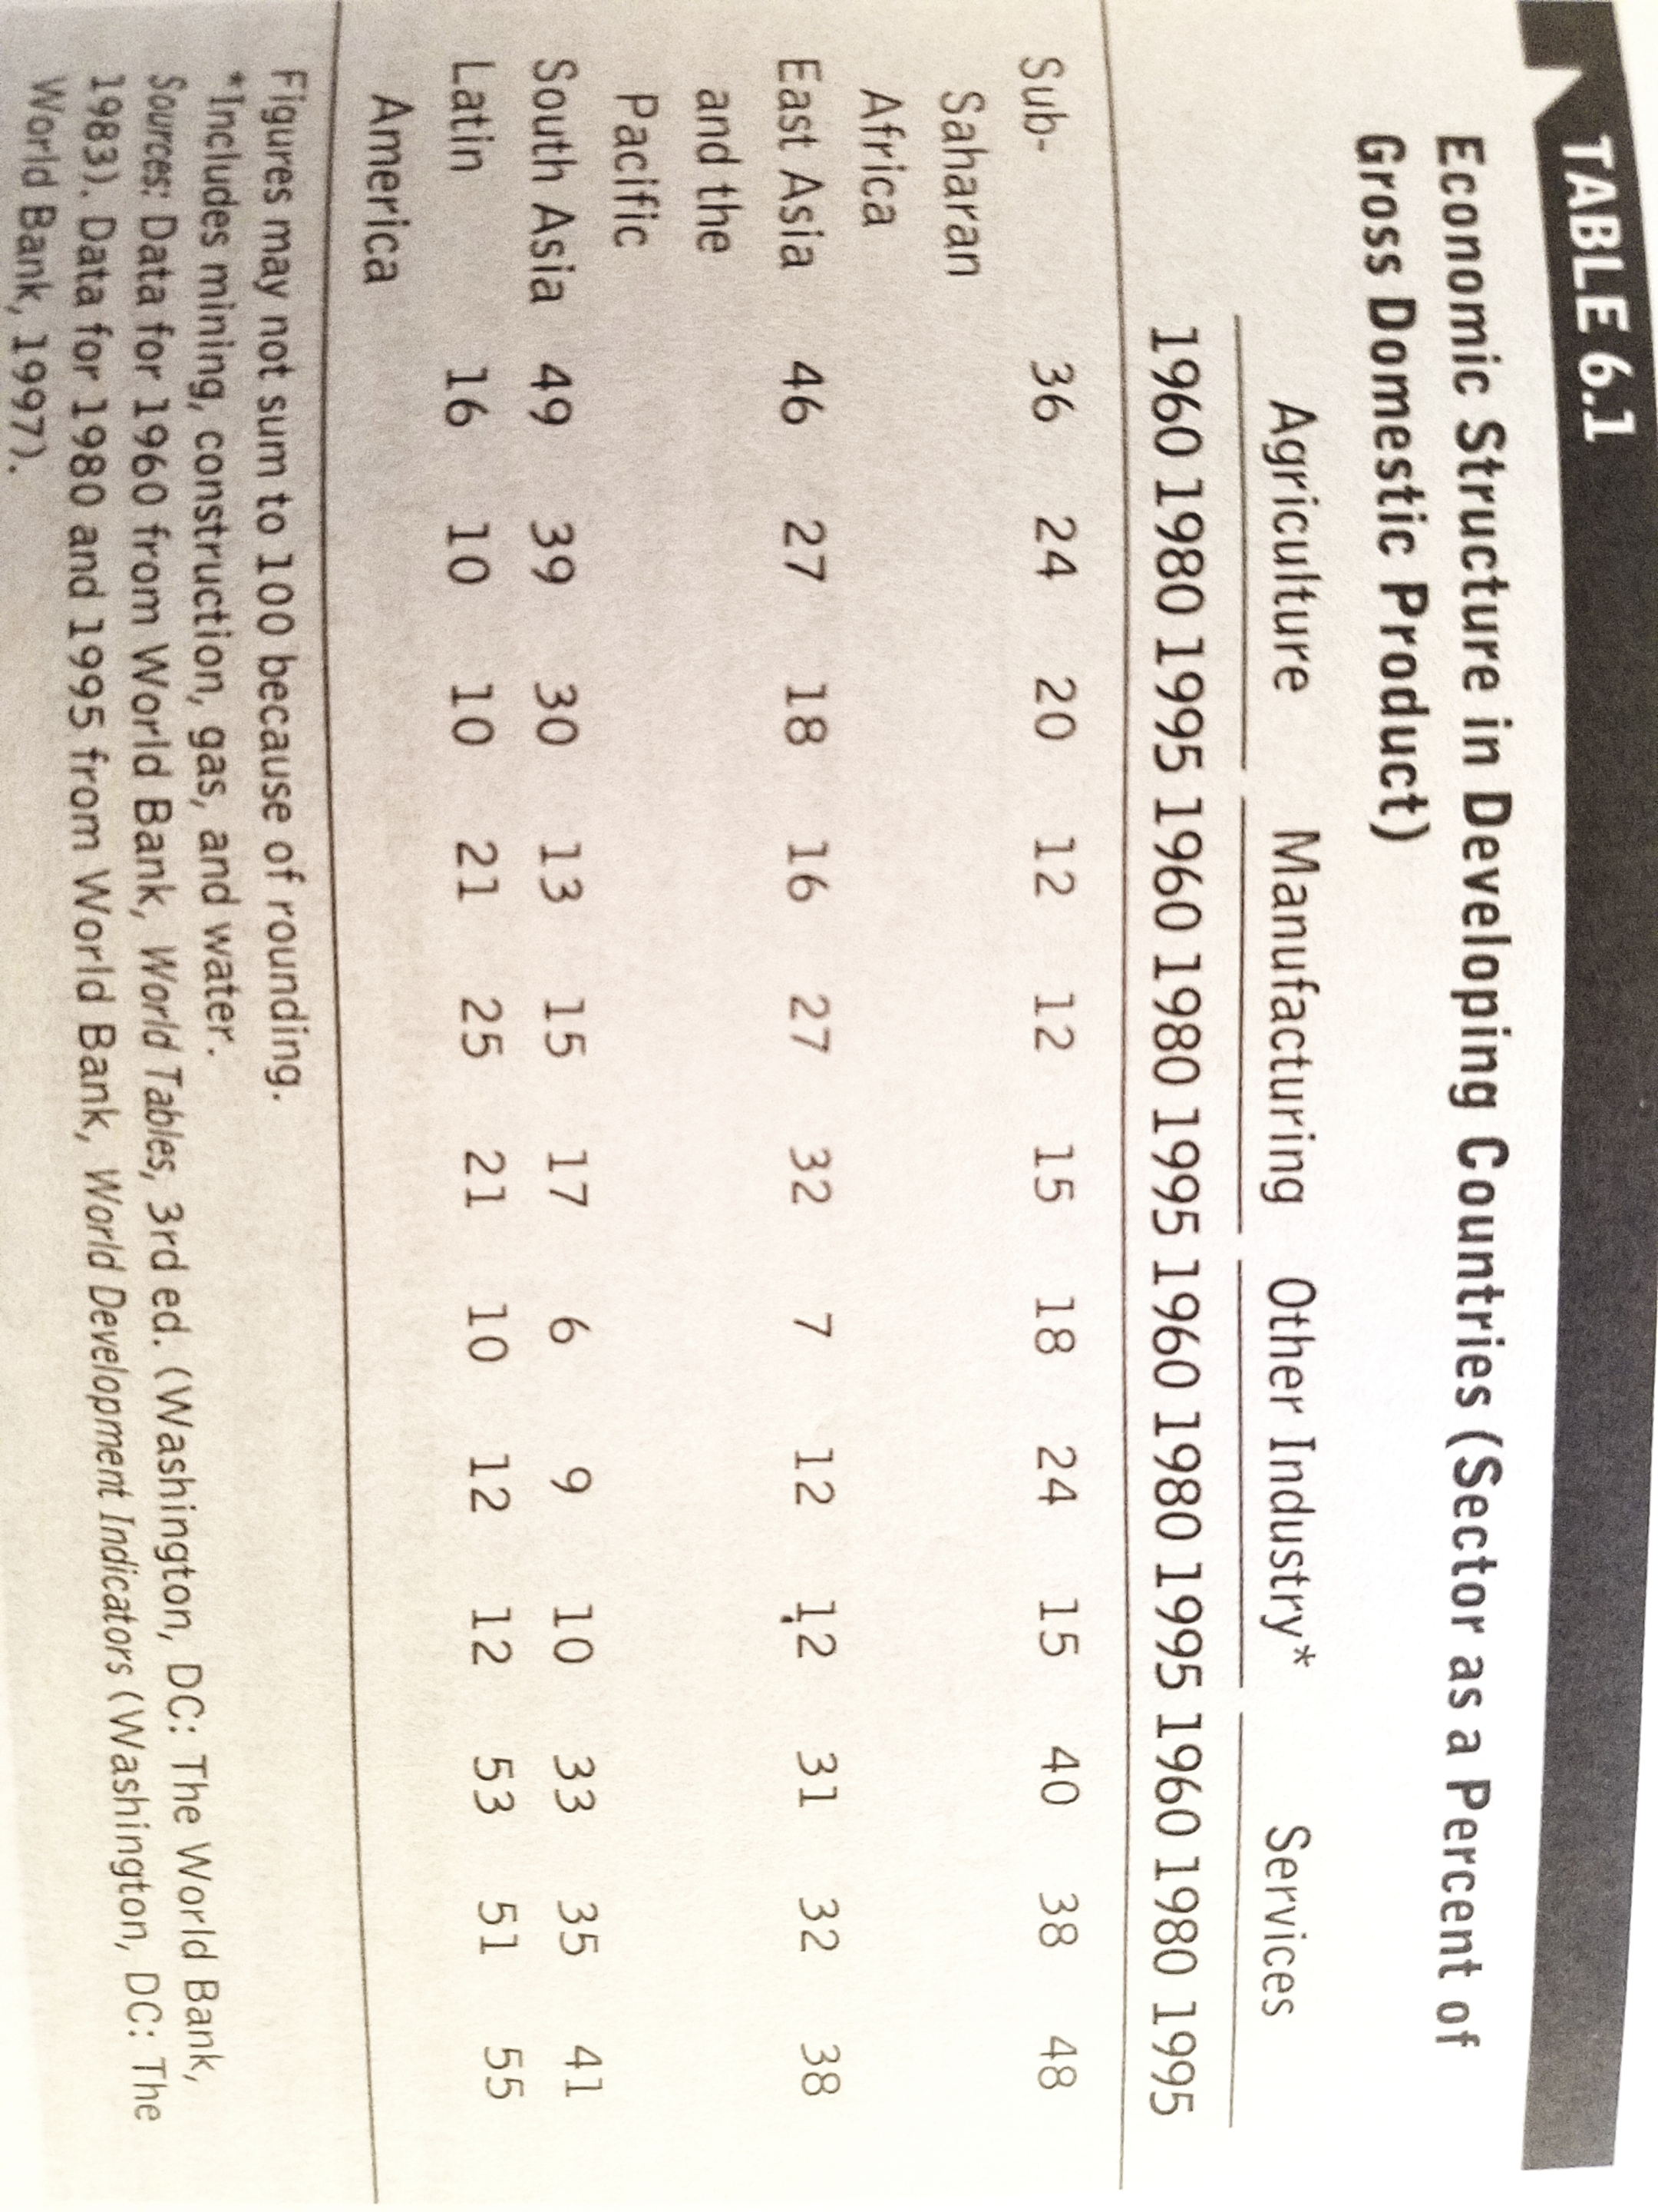
This table from our textbook highlights how Third World countries have a high percentage of agriculture, namely the production of primary commodities.

Slide 21
Import Substitution Industrialization (ISI): Experiment and Failure
In Latin American countries, as illustrated by Mexico and Brazil, they took the historical opportunity created by the World War Two to start industrialization.
ISI strategy requires government intervention in many ways: to protect the domestic market, to invest or to offer subsidy, to nationalize industries and create state-owned enterprises, etc.
Several problems ensued:
Without strong pressure from foreign competition, the domestic production was slow in improving efficiency and quality.
Due to relying on the state support, bureaucracy permeated in industries. The infant industries that were expected to grow into maturity and independence became more infantilized and had no future to be competitive.
ISO started with importing machinery to produce manufactured goods, so many Latin American countries ran trade deficit to pay for machines from the West; at the same time, the capital-intensive manufacturing sector tend to produce fewer jobs, its impact upon the national economy of developing countries was mixed.

Slide 22
As Latin American countries followed ISO, their imports of expensive technology and the weak role in expanding jobs created two common problems for those countries: high trade deficit , budget deficit and government’s deep debt; the high unemployment rate in the country. If an economic crisis hits the Western countries that they started to cut down their consumption of primary commodities, Third World countries had more difficulty to export, to earn foreign currency to service their debt. In response, more countries wanted to produce and export more to make the end meet. This increase in production amid global crisis would further dampen the price of primary commodities and cause a collapse of commodity price. Third World countries fell deeper into the vicious circle.
The outbreak of the debt crisis in early 1980s forced Third World countries to beg the West for bailout and help. Under the right-winged neoliberal Thatcher’ and Reagan’s intransigent policy, the NIEO collapsed.
Meantime, in East Asia, a group of newly industrialized countries followed the Japanese model—the East Asian developmental state—and had economic miracles in the “Four Little Tigers” (or Four Little Dragons: South Korea, Singapore, Taiwan and Hong Kong). The East Asian countries followed the so-called Export-led strategy to their success: on the one hand, they participated in global market to pressure their industries to become more competitive and globalized; on the other hand, the labor intensive industries created more jobs and a foundation for moving up in the global division of labor.

Slide 23
This is a graph I made for my book, The Dual Developmental State: Development strategy and institutional arrangements for China’s transition (Ashgate, 2000; Routledge 2017), which lays out the different strategies and explains their differences from the ISO.

Slide 24
Concluding Remarks
Global poverty and global inequality are conspicuous scourge in international political economy. It certainly has a moral dimension, which I have always emphasized in my class by relating to Adam Smith’s two gifts to the humanity.
Poor countries have one common trauma—colonial experience, which cannot be overemphasized, of course it is not fatal, to the development in the former colonies, either. Singapore and Hong Kong, both were former British colonies, have surpassed their colonial master nation—Great Britain in economic development based upon GDP per capita.
Many Third World countries have not achieved development, but continuous underdevelopment, especially in Sun-Saharan Africa and those small, land-locked countries. Unfortunately, in many Western countries we can see the process of Third Worldization—even in urban ghettos and Appalachian rural townships in the U.S.
Some countries, and with an increasing number of them, have turned their economies around and achieved economic miracles. The most encouraging part of the world in the monsoon Asia: Four Little Tigers, Four Cubs (Indonesia, Thailand, Malaysia, and the Philippines), China, India and Vietnam included. They offer lessons on how to utilize the global market and their smart and flexible state intervention and guidance.

Slide 25

Stay positive, healthy and optimistic! Share with you my shots on road in India:

Slide 26
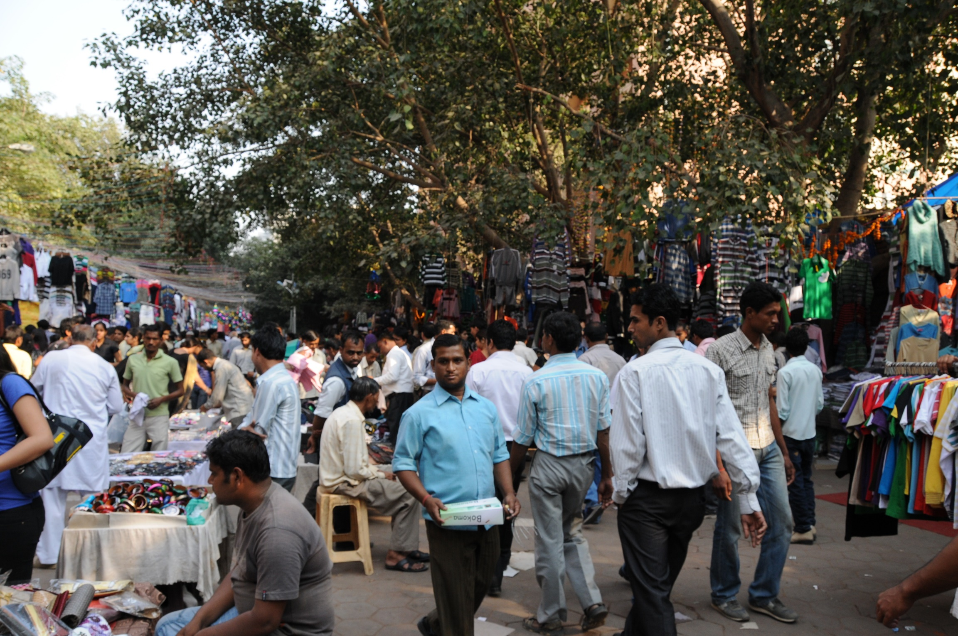

Slide 27


Slide 28
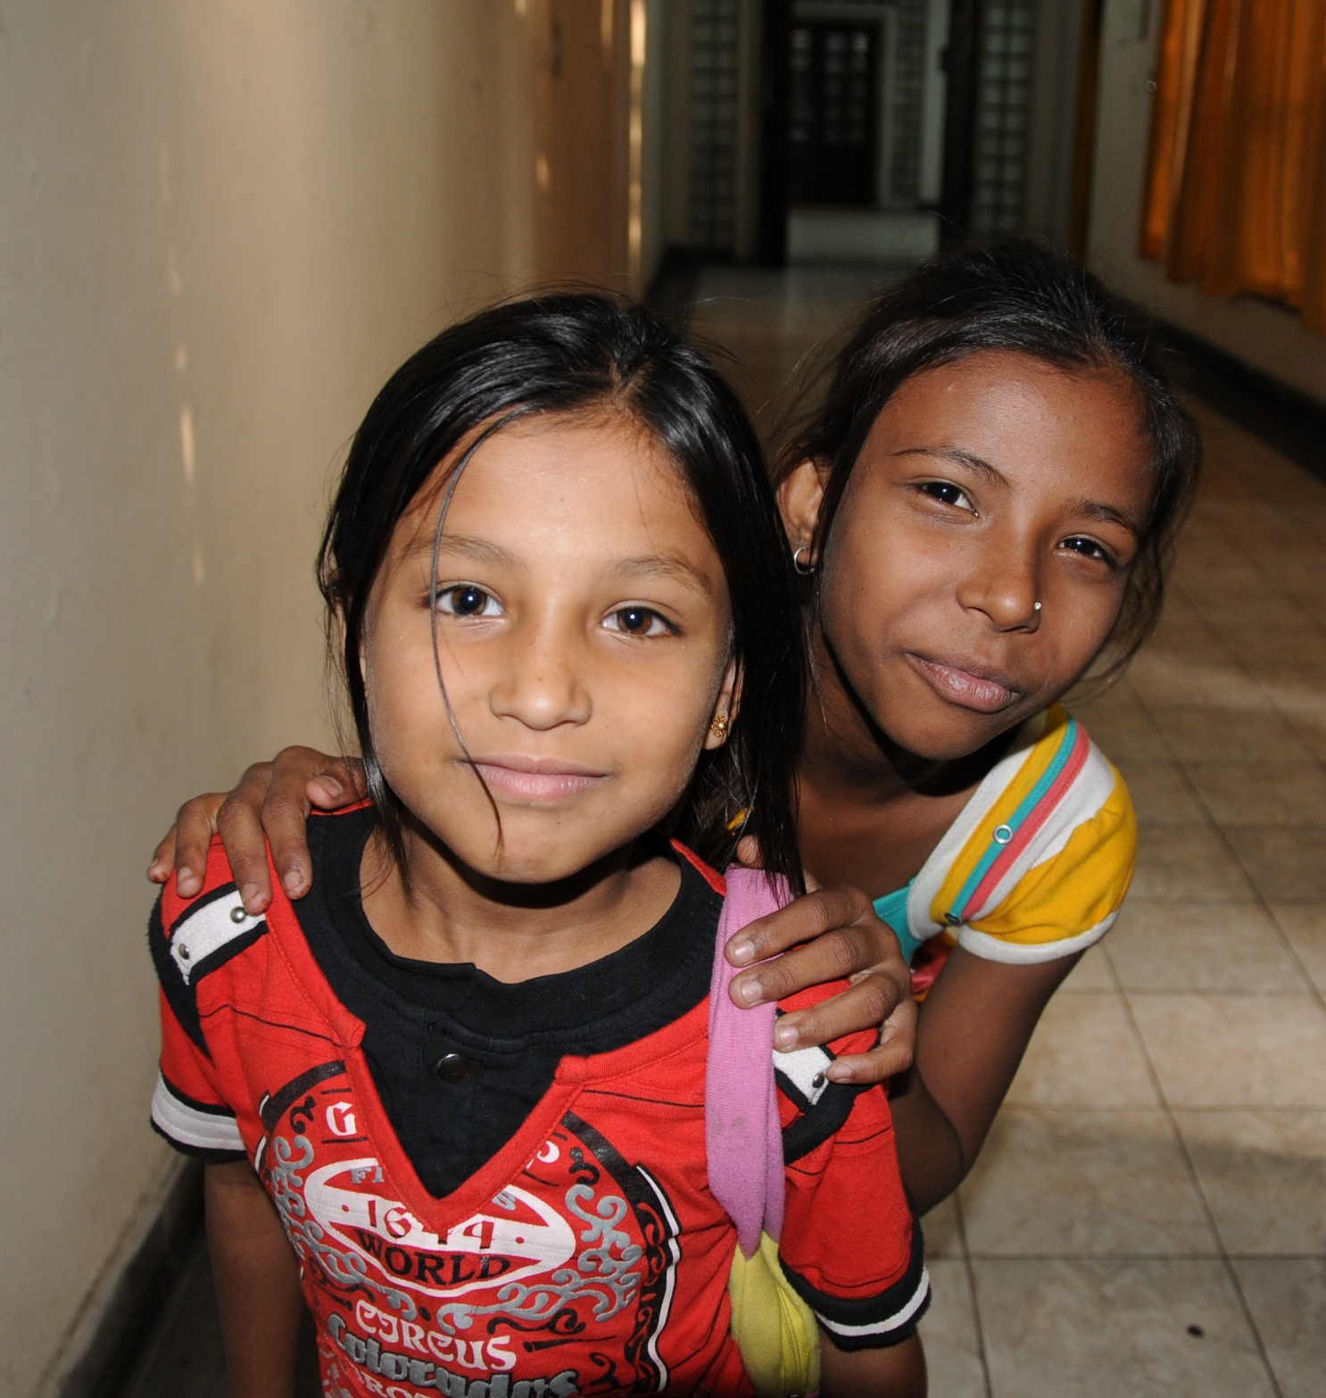

Slide 29


Slide 30


