Slide 1
Mercantilism, Statism, Realism, Nationalism
This Photo by Unknown Author is licensed under CC BY-SA-NC
Notes:
NOTE:
To change the image on this slide, select the picture and delete it. Then click the Pictures icon in the placeholder to insert your own image.

Slide 2
Classic Mercantilism
The body of thought evolved since the 16th century and the mercantilist doctrine centered on “the power of the state” (Arthur Sheldon, p. 436)
A strong central authority
The interest of individuals subservient to those of the state
State regulations over wage, interest, industry, protective devices and restrictions: tariff.
Emphasis on “treasure”—the accumulation of precious metal, gold and silver.
Balance of Trade: surplus of trade over imports.
Regulation of Industry and manufacturing: protection for infant industry.
Alexander Hamilton and Friedrich List

Slide 3
Alexander Hamilton: Report on Manufacture, Dec. 5, 1791
The Importance of Industry over agriculture
Tariffs issued in moderation would raise revenue to fund the nation, to encourage domestic (or national) manufacturing and growth of the economy by applying the funds raised in part towards subsidies (called bounties in his time) to manufacturers.
1. Protect domestic infant industries until they could achieve economies of scale and then could compete with more established firms abroad
2. Raise revenue to pay the expenses of government
3. Raise revenue to directly support manufacturing through bounties (subsidies)
Subsidies would be used to:
1. Encourage the spirit of enterprise, innovation, and invention within the nation
2. Support internal improvements, including roads and canals to increase and encourage domestic commerce
3. Grow the infant United States into a manufacturing power independent of control by foreign powers through reliance on their goods for domestic and especially defense supplies

Slide 4
Musical: Alexander Hamilton

Slide 12
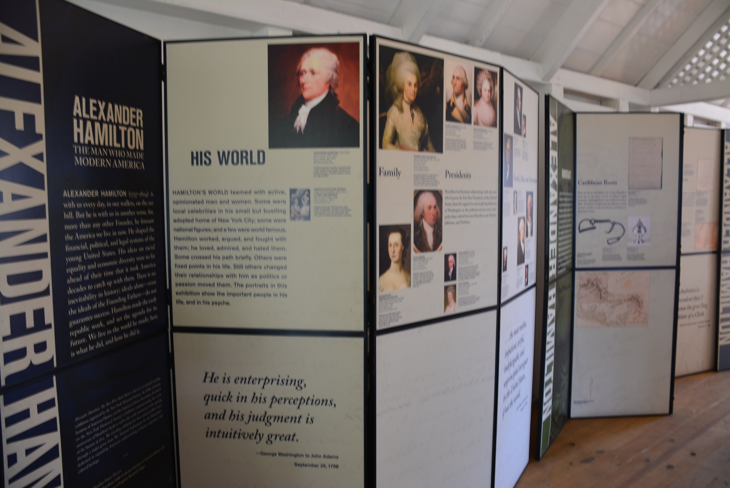

Slide 17
Friedrich List, 1789-1846

Slide 18
Best known for his book The National System of Political Economy (1841) in which he criticized the Smithian school of free trade as inimical to the economic development of the nation, in particular the less well-developed German national economy. In his view, protection was to be a temporary stage on the way to a true system of free trade between equal nation states. During the 1820s, he lived in Pennsylvania, where he contributed to the pro-tariff debates in the United States.

Slide 19
Catch-up Strategy (a Forced March) for the Late-comer Modernizing Countries
Historical stage and backwardness
Structural constraint from the early birds—Old Modernized Countries
Three Generations:
Early Birds: UK, then US and France
Late-comers: Germany, Russia, and Japan
Late-late comers: China, India, Brazil, etc.
Dependency Theory in Latin America and the Developmental State Theory in Asia
The East Asian Developmental State
The China Model and the Beijing Consensus

Slide 20
The Rise of Neomercantilism
In mercantilism, the government strengthens the private owners of the factors of production. These four factors of production are:
1. Entrepreneurship
2. Capital goods
3. Natural resources
4. Labor
Neomercantilism fits in well with their communist governments.
The Great Recession aggravated a tendency toward mercantilism in capitalist countries. For example, in 2014, India elected Hindu nationalist Narendra Modi.¹⁵﻿ In 2016, the United States chose populist Donald Trump for the presidency. Trump's policies follow a form of neo-mercantilism.

Slide 21
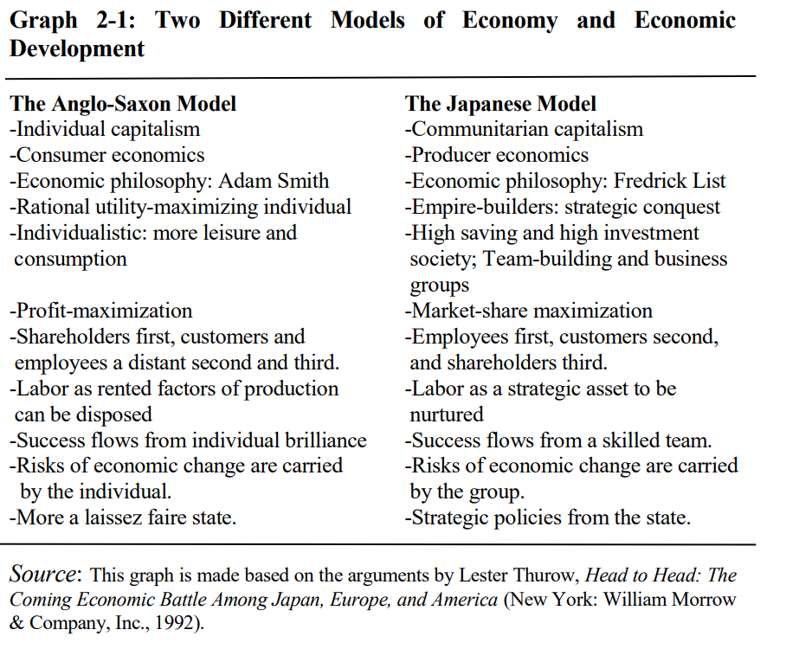
Ming Xia, The Dual Developmental State, 2000, p. 36.

Slide 22
Ha-Joon Chang: “Bad Samaritans” and “Kicking Away the Ladder”
R= Numerous and important restrictions on manufactured imports existed and therefore average tariff rates are not meaningful.
1. World Bank (1991, p. 97, Box table 5.2) provides a similar table, partly drawing on Bairoch's own studies that form the basis of the above table. However, the World Bank figures, although in most cases very similar to Bairoch's figures, are unweighted averages, which are obviously less preferable to weighted average figures that Bairoch provides. 2. These are very approximate rates, and give range of average rates, not extremes. 3. Austria-Hungary before 1925. 4. In 1820, Belgium was united with the Netherlands. 5. The 1820 figure is for Prussia only. 6. Before 1911, Japan was obliged to keep low tariff rates (up to 5%) through a series of "unequal treaties" with the European countries and the United States. The World Bank table cited in note 1 above gives Japan's unweighted average tariff rate for all goods (and not just manufactured goods) for the years 1925, 1930, 1950 as 13%, 19%, 4%.

Slide 23
Ha-Joon Chang, Bad Samaritans: The Myth of Free Trade and the Secret History of Capitalism, 2008, p. 16.
In 1841, a German economist, Friedrich List, criticized Britain for preaching free trade to other countries, while having achieved its economic supremacy through high tariffs and extensive subsidies. He accused the British of “kicking away the ladder” that they had climbed to the world’s top economic position: [i]t is a very common clever device that when anyone has attained the summit of greatness, he kicks away the ladder by which he has climbed up, in order to deprive others of the means of climbing up after him.
Today there are certainly some people in the rich countries who preach free market and free trade to the poor countries in order to capture larger shares of the latter’s markets and to pre-empt the emergence of possible competitors. They are saying ‘do as we say, not as we did’ and act as ‘Bad Samaritans’, taking advantage of others who are in trouble.

Slide 24
Trump’s Nationalism/Mercantilism in International Economics
Now Mr. Trump is bringing mercantilism back. The New York billionaire is challenging the last 200 years of economic orthodoxy that trade among nations is good, and that more is better.
He is well on his way to becoming the first Republican nominee in nearly a century who has called for higher tariffs, or import taxes, as a broad defense against low-cost imports.
From: “On Trade, Donald Trump Breaks With 200 Years of Economic Orthodoxy” By Binyamin Appelbaum, The New York Times, March 10, 2016.
Trump advocates expansionary fiscal policies, such as tax cuts, to help businesses.﻿ He argues for bilateral trade agreements that are between the two countries. If he could, he'd enforce unilateral agreements. They allow a stronger nation to force a weaker nation to adopt trade policies that favor it. Trump agrees that multilateral agreements benefit corporations at the expense of individual countries. These are all signs of economic nationalism and mercantilism. Mercantilism opposes immigration because it takes jobs away from domestic workers.﻿ Trump's immigration policies followed mercantilism. For example, he promised to build a wall on the border with Mexico.
https://www.thebalance.com/mercantilism-definition-examples-significance-today-4163347.

Slide 25
Assessment of Mercantilism: Pros and Cons
Static perspective: Division of labor, specialization, economy of scale, globalization
Developmental perspective: Development, Catch-up, Fairness and Equality in Global economic Development.
Globalization without Globalism: Globalization in Search of A Soul: Cosmopolitan Ideal and Fraternity.

