Slide 1
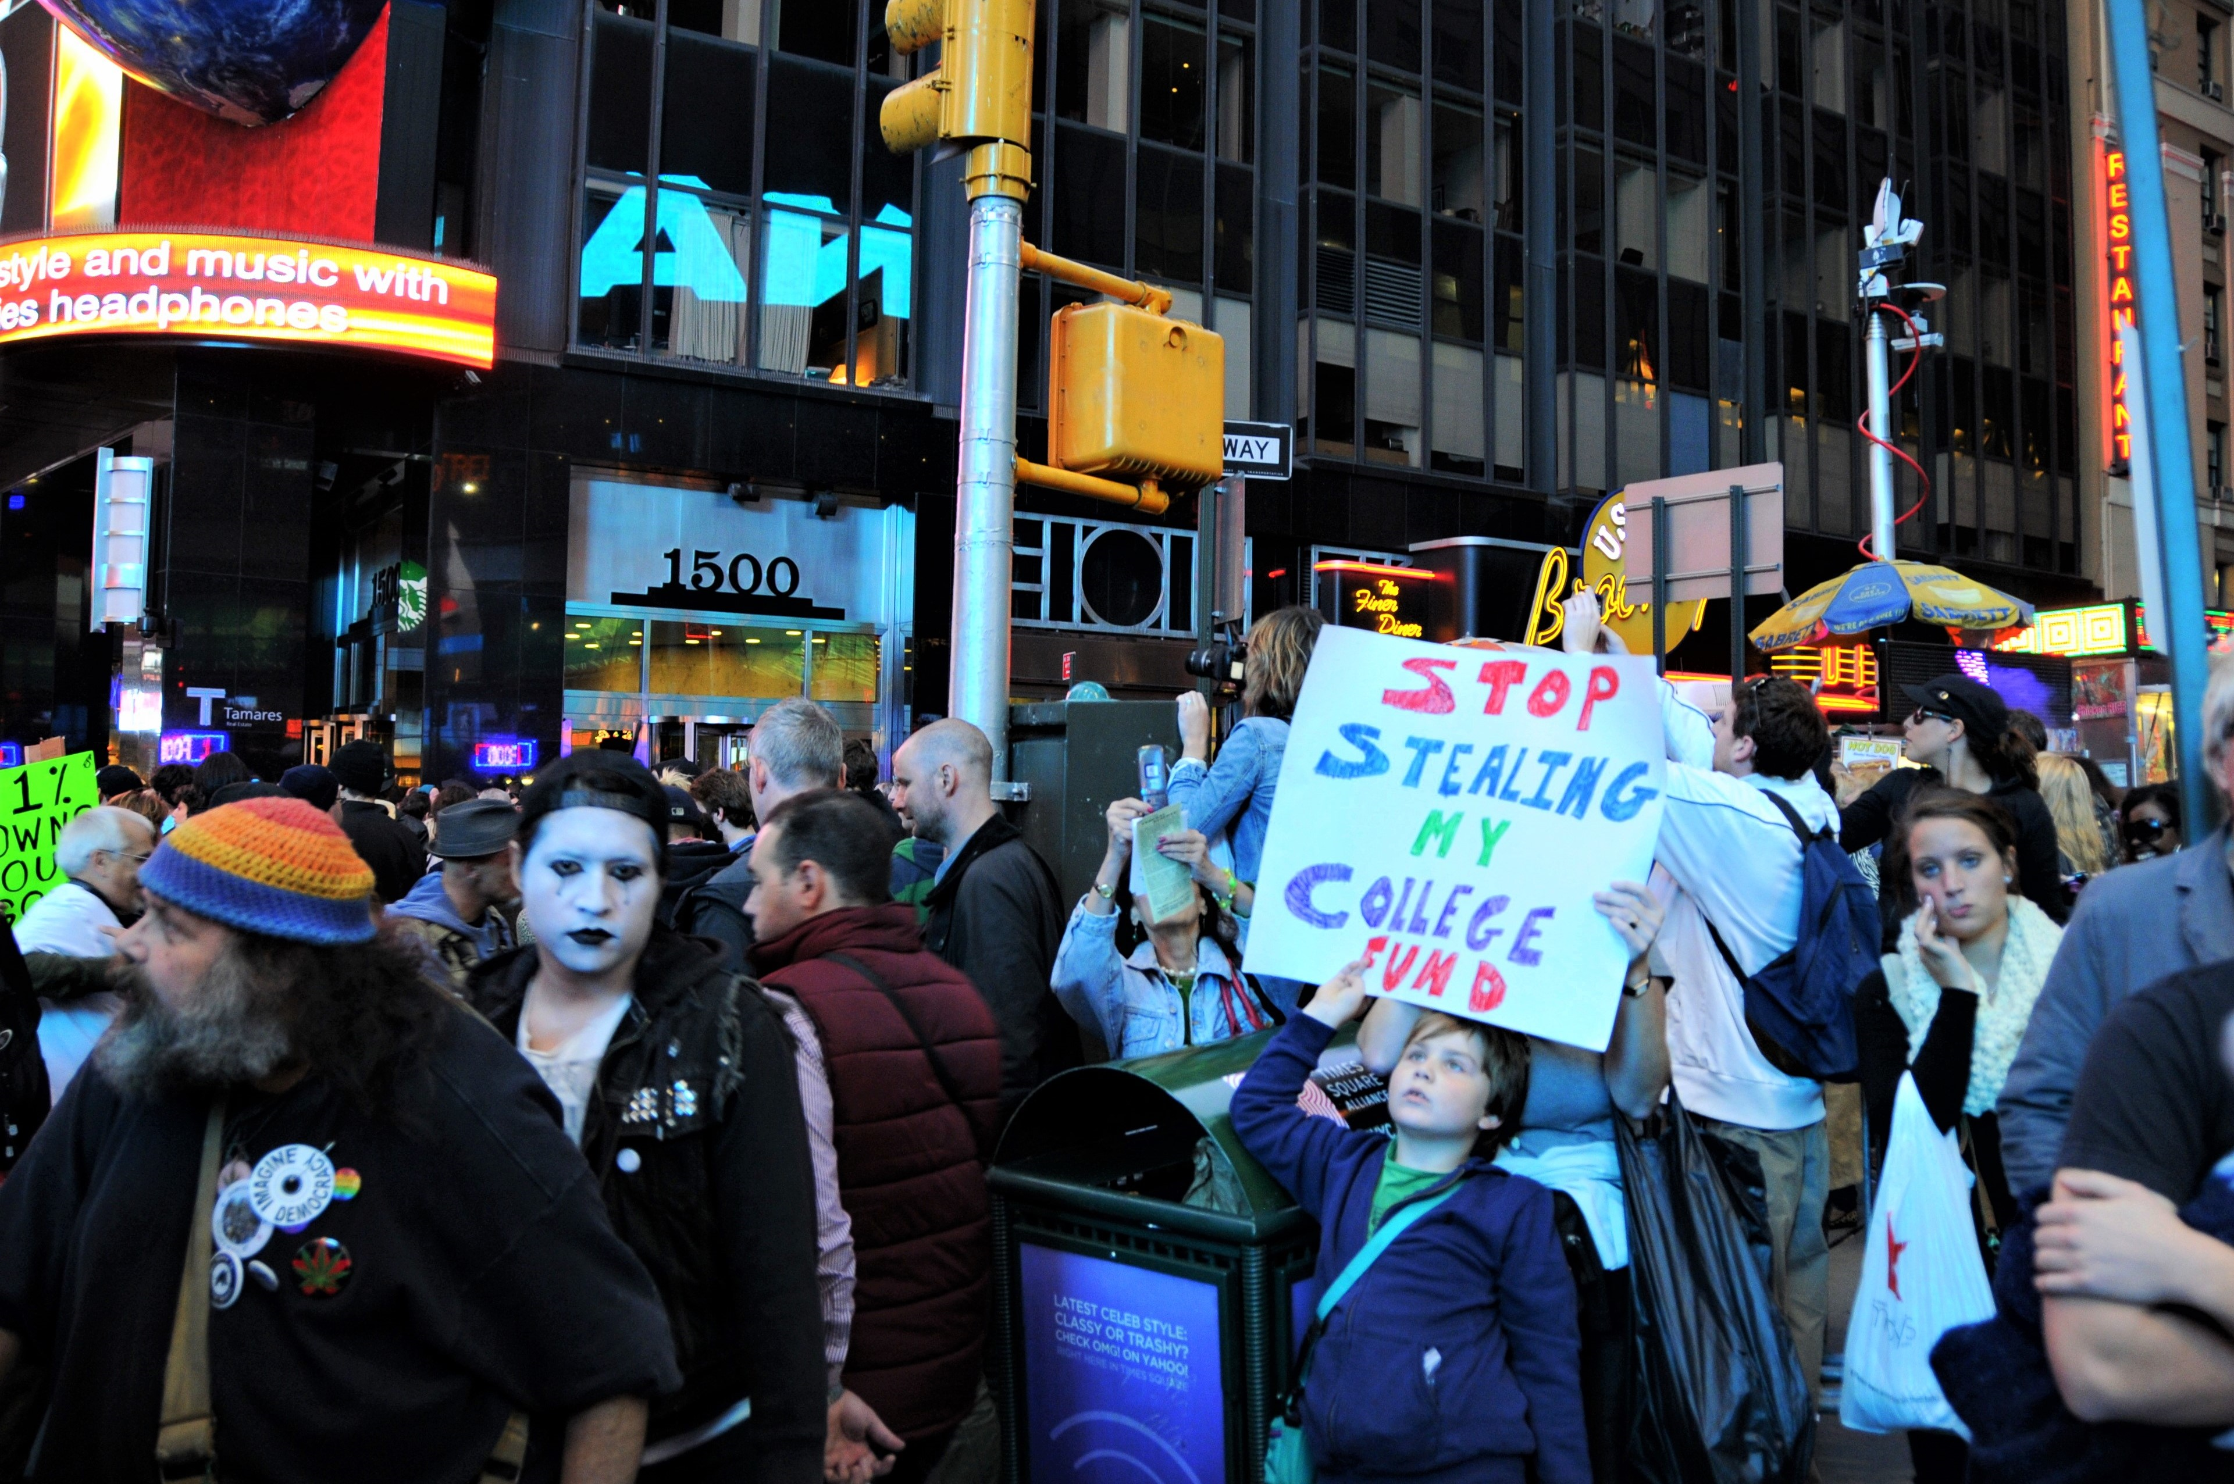
Financial Crisis
History, Causes, Responses
Notes:
NOTE:
To change the image on this slide, select the picture and delete it. Then click the Pictures icon in the placeholder to insert your own image.

Slide 2
Introductory Remarks
In the fall of 2011, at Times Square I took a picture of a young boy who was part of the Occupy Wall Street rally. I can safely say that almost the absolute majority of my class belong to the same generation of this boy. Then I have to say to all of you, your generation does not have good luck in terms of that in merely two decades, you have gone through several financial crises (the collapse of the financial market after the September 11th attack, the 2008 Financial Meltdown, and the befalling Great Depression triggered by the Global Pandemic).
What do all these mean? First, international finance and its crisis affect all of us, even you are living outside of New York—the financial center of the world; second, it is important to learn about IPE, so as I quoted James Bryce before, “s/he who is forewarned is forearmed”; third, people who do not have global sense and an understanding of finance can mess up financial world therefore our daily life.
The warning: “Fool me once, shame on you; fool me twice, shame on me! “

Slide 3
Define Financial Crisis
Financial crisis is the malfunction or collapse of financial system. So what is financial system?
“The Financial system is a set of institutions and markets provided financial intermediation by transferring savings into productive investment.” In developing countries, financial intermediation has been done via banking system; in advanced countries, stock markets also have gained importance in addition to the banking system.
“Financial crisis refers to a rapid financial disintermediation due to financial panic. In practice, this involves a ‘flight to quality’, where savers attempt to liquidate assets in financial institutions due to a sudden increase in their perceived risk, moving their savings to safer assets, such as foreign currency and foreign bonds in open economies, or currency, gold, and government bonds in closed economies. The ultimate manifestation of financial crises includes bank failures, stock market crashes, and currency crises, occasionally leading to deep recession.” (The Princeton Encyclopedia of the World Economy, p. 424)

Slide 4
Causes of Financial Crisis
Since financial intermediation is about transforming short-term saving into long-term tangible investment, this maturity transformation entails a risk of “maturity mismatch”: for example, the banks use short-term savings for 15-year or 30-year mortgage lending, it exposes the banks to financial fragility. If there is heightened perceived risk, savers and investors would change their behavior (reallocating funds, sell-out, etc.) , causing liquidation (a shortage of cash flow can happen to financial institutions) and putting the financial system in risk.
Barry Eichengreen’s explanation: The Incompatibility Thesis
“The combined effect of these two trends—financial liberalization and political democratization—has thus been twin crises at rates witnessed previously only during the disastrously unstable interwar years.” (2002, p. 6)
Caused by Investor Panic (temporary liquidity crisis and “animal instincts”) or by Fundamentals (Root factors, institutions)

Slide 5
Peter Isard: Five Causal Factors
Peter Isard worked for IMF as its senior advisor, identified the following causes in his book, Globalization and the International Financial System: (Cambridge 2005) :
Weakness in the Monetary and Fiscal Policies (Recall: in discussion on “the unholy trinity”, some countries had pegged their currencies to U.S. dollar, the rising value of U.S. dollar could slow down their exports, e.g., Thailand in 1990 and Argentina in the early years of this century)
Weakness in Other Macroeconomic Fundamentals of the Crisis-stricken Countries (Recall our discussion on the ISI strategy and the balance of payments crisis in Latin American countries and its relationship with the 1980’s debt crisis)
Adverse Economic or Political Shocks (For example, political assassination in 1994 Mexican financial crisis; September 11th attack)
Imperfections in International Capital Markets (MNCs’ long term investment vs. Portfolio investment in stock market)
Deficiencies in the Policy Advice or persuasiveness of the IMF (Structural adjustment for the Third World and austerity for Asian countries in 1997).

Slide 6
Hyman Minsky: Seven Stages of Financial Crisis
Displacement: External shock or some breakthrough news that fundamentally altered the economic outlook in a market, shifting expectations concerning future profits in some significant way. For example, the Tulipomania in history, the South Sea investment in the 18th century, the internet, AI/Big Data, etc. Often a speculation and a mania of the crowd can ensue.
Expansion: A boom can happen as a result of technological breakthrough (in financial engineering, derivative is one example, too), it is going to be fed by increase in liquidity; more investment and speculation can bring more booming countries and larger-scale growth.
Euphoria: Many people become millionaires even within your circle of friends/relatives/acquittances or whom you have known through reading/watching news media. Many people put their money into stock market or flip-flopping house, including some grandmas. More young people in their twenties had the hope of becoming “filthy wealthy” and retire in their thirties. You know it is an euphoria. The feeling is like intoxication of alcohol or drugs, I guess, so the 1994 Mexican financial crisis is also called Tequila Crisis! (I am half joking here, so you will not be bored).
Distress: At certain point, people start to worry about whether I should make more money by staying longer in stock market, or I should move assets to a safer place. Anxiety and concerns arise.
Revulsion: If one thing happens or a rumor kicks in, many people have sharp shift in action and get into “gate-shut panic”: Is the gate going to shut before I get out? Should I get all my cash from the stock market or bank? So a “Bank run” can happen (Recollect the movie Mary Poppins: the boy, the son of Mr. Bank,s shouted in the hall of the bank: “Give me back my tuppence!” It caused a bank-run.)
Crisis: You see a fire sale. The Lehmann Brothers collapsed and sell-out on Stock market.
Contagion: More industries are infected, more regions are infected, and more countries are infected. Financial crises can be like COVID-19 virus. Actually before the COVID-19 breakout, in U.S. we did not have financial crisis because the banks were sound, but the pathogen has caused a great depression which may cause a financial crisis.

Slide 7
Mary Poppins and the Bank Run

Slide 8
Major Financial Crises
The 1929 Crash and Great Depression
The Debt Crisis in 1980s
1994 Mexican Financial Crisis
The 1997 Asian Financial Crisis
The Global Financial Panic in the late 1990s: Russia (1998), LTCM in Wall Street, Argentina (1998-2010)
The Great Recession of 2008
The Great Depression of 2020?

Slide 9
Contributing Factors for Financial Crises by Peter Isard
Precondition: significant involvement in international capital market
Major Vulnerabilities:
Fixed but adjustable exchange rate arrangements
High levels of short-term foreign-currency-denominated debt
Weak banking and financial sectors
Large fiscal deficits
High levels of short-term government debt
Large current account deficits
Poor general governance
Speculative attack

Slide 10
The Krugman Model
In international political economy, we can find that financial speculators (Financer George Soros has been a notorious and successful one since the 1990s) are like shark capable of smelling the blood from wounded species. The weakest link in global economy invites speculative attack.
Leading indicators of speculative attacks
Fiscal deficits: government has less resources—ammunition to defend or even to stand steady.
Current account deficits: the country has difficulty to earn foreign currency reserve to build confidence among the capital world.
Dwindling international reserve: the government would have difficulty to sustain its defense against the speculative attack.

Slide 11
Marxist Explanations
After the 2008 Financial Crisis, Karl Marx’s Magnum Opus, Das Kapital (On Capital) sold out more new copies. Marxist thinkers have contributed some enlightening ideas on understanding the nature of finance capital and the chronic economic/financial crisis.
Rudolf Hilferding: Finance Capital: A study of the latest phase of capitalist development (1910), offers an early explanation about how capitalism entered the phase of finance capital, presaging the coming of financialization of American economy and the ascent of money to dominate the economy and society.
Lenin: From domination of capital to the domination of finance capital. In his book, Imperialism, the Highest Stage of Capitalism, Lenin offered his critiques of financial capitalism, in his words, the parasitical nature of finance capital. His coinage and usage of the following words are very contemporary:
Financial Oligarchy, the bondholder state, the usurer state, the creditor state vs. debtor state; aggressive imperialism, imperialist parasitism, “terrorism of the banks”
John Bellamy Foster and Fred Magdoff, The Great Financial Crisis: Causes and Consequences (2009, Monthly Review)
They offer “monopoly-finance capital” as a key explanation to financial crisis.
The five phases of a bubble: novel offering; credit expansion; speculative mania; distress; crash and panic.

Slide 12
What Can be Done by Individual Countries to Prevent Financial Crisis?
Devise a sensitive strategy for liberalizing domestic financial markets and international capital flows. Countries often face a problem of a surge in capital inflow or a sharp reversal or a sudden stop of capital flow. Capital flow can be banking flows, direct investment and portfolio flows; they can be long term or short term.
Strengthen institutions, infrastructure and the financial and corporate sectors; improve their standards of management, supervision, transparency, accountability and control of corruption. The different nature of capital flow also offers justification for some kind of capital control and prudential regulation so that countries can establish and maintain macro-economic stability.
Adopt sustainable exchange rate arrangements, for example, to think about whether a strong or weak currency, a fixed or flexible exchange rate, a foreign currency reserve enough or not available.
Maintain debt discipline, sound macroeconomic policies and market confidence. Often political corruption and incompetence work against all these goals.
Open the economy to trade and FDI in a manner that results in growth enhancing activities. For example, many lessons and experiences can be learned from East Asian developmental states regarding long-term investment or portfolio investment, etc.

Slide 13
Financial Crisis and Its Social and Political Consequences
As an old English saying goes, “Misfortune seldom come singly (or alone).” Or, “One misfortune comes on the neck of another.” Disaster (calamity, crisis or bad luck) always travels in twins or triplets. Political crises, military crises, social crises, financial/economic crises often are simultaneously constituting causes and consequences to each other. Recall: the episode of WWI/Weimar/German Nazism/WWII. We have identified some political causes for financial crises, here we focus on how financial crisis causes social, political crisis and military conflict, sometimes even world war.
In the aftermath of a financial crisis, we see unemployment, bankruptcy, hunger, suicide (in April alone there have been at least four reports on Staten Islanders jumping off our bridges) divorce/dissolution of family, decay of community, and social uprisings and movements. Occupy Wall Street, and its inspired variants of Occupy London in UK or Occupy the Central Hong Kong etc. were the results of 2008 Financial Crises. and the Social Crises
Political Crises: The New Deal after the Great Depression, the collapse of Military juntas in Latin America in the 1980s, the collapse of Polish Communist Regime, the Jasmine Revolutions in the Middle East, the Velvet Revolutions or Color Revolutions in the former Soviet Republics in Central Asia, the failure of the Republican Party in U.S. 2008 elections, etc. all can attributed wholly or partially to financial crises preceding them.
World War: World War II was partially triggered by the Great Depression which was responsible for the ascent of Nazism in Germany and the popularity of Communism in the Soviet Union and some other parts of the world. A big question facing all of us: Is the current crisis going to cause financial crisis (bank failures, dry-up of capital, collapse of financial system—Is the 25% loss of the stock market a financial crisis already?)? If a Great Depression is possible, is the World war III imminent? This is a big question.

Slide 14
This Time Is Different: Eight Centuries of Financial Folly by Carmen M. Reinhart and Kenneth S. Rogoff, 2009, Princeton University Press
In this most important book on financial crisis published after 2008 financial crisis, the two economists made the following conclusions:
“An examination of the aftermath of severe postwar financial crises shows that these crises have had a deep and lasting effect on asset prices, output, and employment. Unemployment increases and housing price declines have extended for five and six years, respectively. Real government debt has increased by an average of 86 percent after three year.
In the Depression, it took countries in crisis an average of ten years for real per capita GDP to reach its precrisis level. Still, in the postwar crises it has taken almost four and a half years for output to reach its precrisis level (although growth has resumes much more quickly, it has still taken time for the economy to return to its starting point).” (p. 239)
So, will this time be different? The authors cautioned us that based upon a study of eight centuries of financial folly, we should be able to not to fall into the trap of “This Time Is Different”.

Slide 15
Reform Proposals
Tobin tax: Capital movement should be taxed and collected by a Global Fund to slow down the capital movement, especially the short-term portfolio investment and to generate fund to help countries in financial crisis.
Reserve requirement of fixed duration on all capital flows
Anne Krueger: Bankruptcy Court. Can a country declare bankruptcy?
The Lender of Last Resort: Moral hazard? Whether IMF/World bank or U.S. should bail out a country in crisis as the last resort? Whether this will encourage individuals and countries behave even more irresponsibly?
CACs (Collective Action Clauses): allows a supermajority of bondholders to agree to a debt restructuring that is legally binding on all holders of the bond, including those who vote against the restructuring.
IMF Reforms (Governance Matters): Political stability, control of corruption, political accountability, rule of law, transparency, etc.
Calling for the reinstatement of the Glass-Steagall Act (1933) which separated commercial and investment banking.
Volcker Rule: a ban on proprietary trading by commercial banks, whereby deposits are used to trade on the bank's own accounts

Slide 16
Paul Volcker (A Perspective on Financial Crises, 1999)
International financial crises…are built into the human genome. When we map the whole thing, we will find something called greed and something called fear and something called hubris. This is all you need to produce international financial crises in the future.

Slide 17
An Optimistic Note
Here I quote another old English proverb: “An optimist sees an opportunity in every calamity; a pessimist sees a calamity in every opportunity.”
As I have been abiding by “shelter in place” advice, I am grateful to the fact that I do have a shelter to stay and to seek refugee. Have you thought about how many people have no shelter, or no shelter nearby so they have to run away from fear and xenophobia and to go home thousand miles away? Think about millions of Indian workers had to go home after losing their work in city, sometimes by foot to walk hundred miles? Think about that one study-abroad student in our class had to go home. Think about a million foreign students in the U.S. who are not allowed to work, not eligible for any assistance from the U.S. government, whose study in the most expensive universities in the world has already strained many families back home countries, and who are living in fear of xenophobia that some politicians tend to stoke up for scapegoating!
Stay strong, this is the moment to define your future and to build your character!

Slide 18
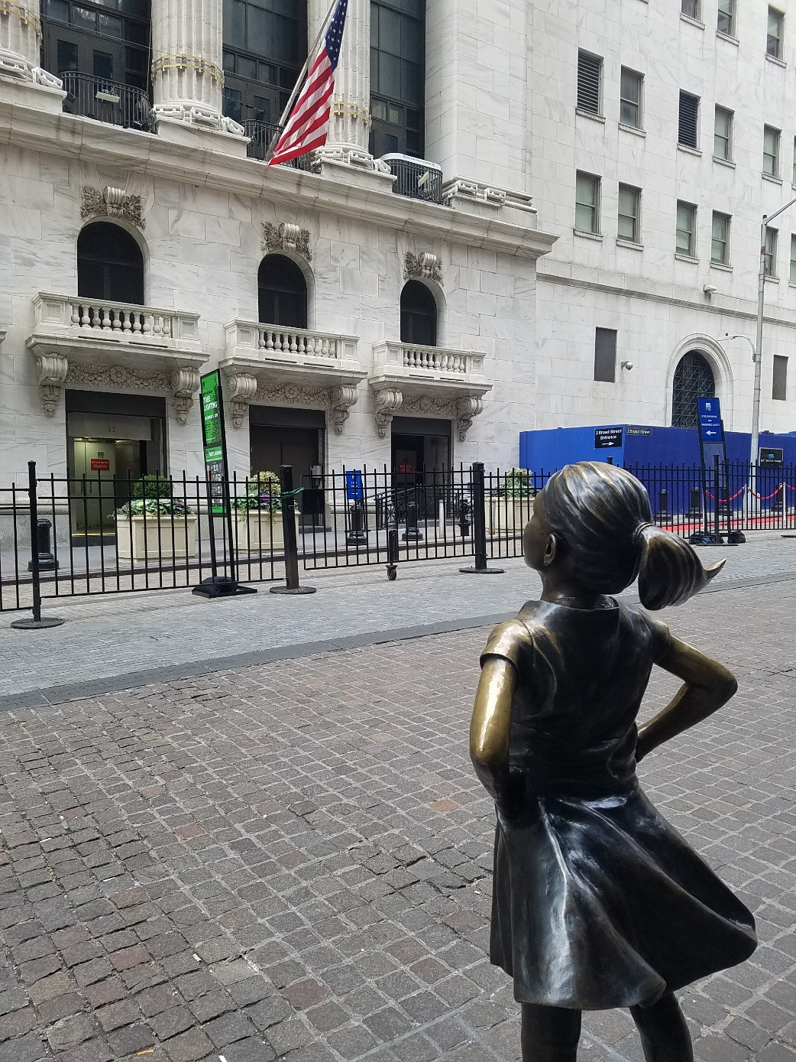
Fearless girl in front of NY Stock Exchange in Wall Street. Taken in 2019 as I was recovering from a surgery.

