Slide 1
Ecological Issues in IPE:
Climate Change and Pandemics
Notes:
NOTE:
To change the image on this slide, select the picture and delete it. Then click the Pictures icon in the placeholder to insert your own image.

Slide 2
Introductory Remarks
As we are living under the market economy in U.S. (the One Big Market in Polanyi’s words), we often believe that the market is natural and omnipotent as if the invisible hand of divine intervention). In my college and graduate programs, I had taken four courses from the political economist Chen Qiren at Fudan University. The reasons why I liked him so much were that first, he published many books, second, he was a student of Wang Ya’nan and Guo Dali, two economists who translated Karl Marx’s Das Kapital (On Capital) into Chinese. He once raised a rhetorical question in my class: Why modern sculptures are not as valuable as Ancient Greek/Roman ones? His explanation is this: Greek/Roman artists were producing art not for the market; since creators of art were part of noble/leisure class, they created art for the sake of the intrinsic value of beauty and joy. Today, artists are producing for the market, therefore, focus on the value for use and value in exchange in order to cash in the market for the market value. The intrinsic, eternal value of art is lost in modern capitalism.
Believe or not, my professor’s remarks remind me of these points: First, political economy can be cool and “artistic”; second, the market can create best technology and most wealth, but not necessarily the highest value; third, market has unintended consequences.

Slide 3
Karl Polanyi on “Market and Nature”
“What we call land is an element of nature inextricably interwoven with man’s institutions. To isolate it and form a market out of it was perhaps the weirdest of all undertakings of our ancestors.
Traditionally, land and labor are not separated; labor forms part of life, land remains part of nature, life and nature form an articulate whole. Land is thus tied up with the organizations of kinship, neighborhood, craft, and creed—with tribe and temple, village, gild, and church. One Big Market, on the other hand, is an arrangement of economic life which included markets for the factors of production. Since these factors happen to be indistinguishable from the elements of human institutions, man and nature, it can be readily seen that market economy involves a society the institutions of which are subordinated to the requirements of the market mechanism.
The proposition is as utopian in respect to land as in respect to labor. The economic function is but one of many vital functions of land. It invests man’s life with stability; it is the site of his habitation; it is a condition of his physical safety; it is the landscape and the seasons. We might as well imagine his being born without hands and feet as carrying on his life without land. And yet to separate land from man and organize society in such a way as to satisfy the requirements of a real-estate market was a vital part of the utopian concept of a market economy.”
The Great Transformation, New York: Beacon Press, 1957 [1944], p. 178)

Slide 4
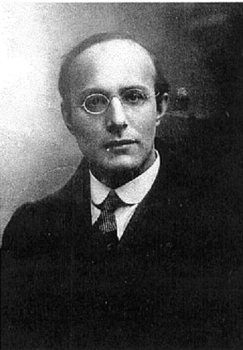
From the above quote, I am introducing to the class one of the giants in IPE who were not discussed in our theoretical part (he was mentioned once in Paquin’s book, p. 9): Karl Polanyi. He reminds us the artificial or “utopian” aspects of the One Big Market and highlights the importance of examining the relationship between nature and market, man/woman and market. This message, articulated at the darkest moment of the West four score years ago, is extremely timely for us as we are facing the double challenges—the climate change and global pandemic—that could bring the West we know to an end.
From Wikipedia Entry:
Karl Paul Polanyi (October 25, 1886 – April 23, 1964) was an Austro-Hungarian economic historian, economic sociologist, political economist, and social philosopher. His book, The Great Transformation, argued that the emergence of market-based societies in modern Europe was not inevitable but historically contingent. Polanyi emphasized the way economies are embedded in society and culture. This view ran counter to mainstream economics but is popular in anthropology, economic history, economic sociology and political science.
Capitalism - Karl Polanyi The Human Factor scene 1 and 2
https://www.youtube.com/watch?v=DrubI8FTuuA;
https://www.youtube.com/watch?v=bpdkuf1y4h0.

Slide 5
Production circuits and the environment Source: based, in part, on Turner et al., 1994: Box 1.2, Peter Dicken, Global Shift.
Modern capitalist economy, or market economy tend to ignore the interactive process of production and nature, often assumes the nature and people are there to be utilized by the market. Their supplies seem to be infinite. The market does not internalize, but externalize social costs in production process.

Slide 6
Material flows in the process of production Source: based on Turner et al., 1994: Box 1.3; Peter Dicken, Global Shift.
As a matter of fact, both production and consumption, the core of modern market economy, squander and pollute the environment, exhaust the human habitat, and without careful regulation and plan, could bring the human civilization to a suicidal mission.

Slide 7
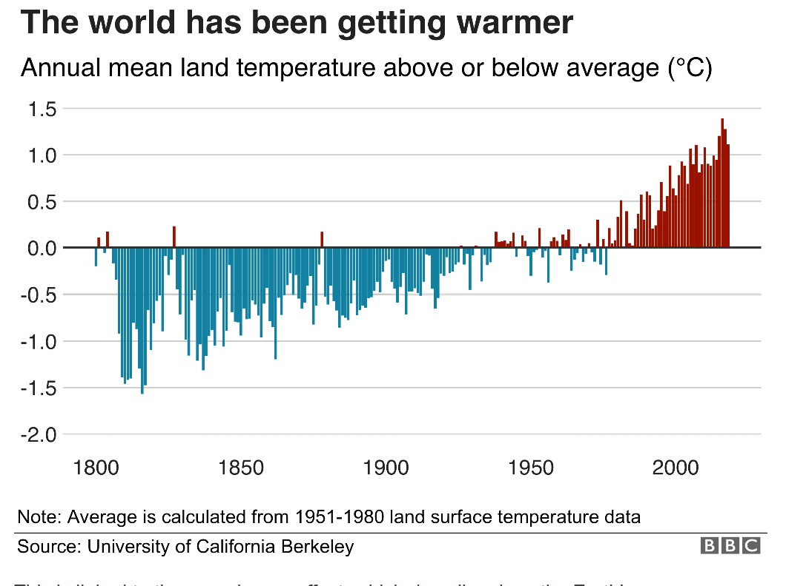
What is climate change? A really simple guide
https://www.bbc.com/news/science-environment-24021772
This BBC site (with articles and videos) is a clear and interesting introduction on climate change. I list here for your information in case you want to explore more on your own.

Slide 8
An Inconvenient Sequel Truth to Power 2017
To have a good understanding of global warming and climate change, Al Gore, former president and an Oscar winner, and his documentary, An Inconvenient Sequel: Truth to Power (2017) can be a start.
The full movie at the following site:
https://www.documentaryarea.tv/player.php?title=An%20Inconvenient%20Sequel%20Truth%20to%20Power

Slide 9
Challenge of Ecological Crisis
The first challenge to discuss about climate change is that many denialists either do not believe in science or some dogmatic intellectuals insist that you must offer a scientific proof with confidence level ≥ 95%. Unfortunately many dangers are “beyond measure”, especially in its early stage or before its first time. But remember when people remind you about the danger of death, not because it has not happened to you personally yet, so you ignore it and believe that it will not happy.
In market mechanism, it has no incentive to offer public good (we discussed before, recall free-rider’s option and global commons), but has every incentive to externalize its costs to the society (here “bad externality” such as dumping waste or emitting smoke, in contrast to “good externality” such as my garden with trees and blooming flowers that attract butterfly, snake, cat, dragonfly, and birds. The title picture is a proof.).
If public goods are difficult to be priced into the internal accounting system of the business, the state has to step in to offer and maintain public good.
At the international level, nation-states under an anarchy tend to behave in selfish way and to externalize pollution to the earth. Big countries tend to be big polluters, so they behave badly (U.S. and China are two examples, as a Chinese-American I feel doubly bad), so we need global institution to maintain public good.
The global effort to create global regime in climate change, such as the Paris Accord, has met serious setbacks, for example, U.S. president Trump believes that climate change is fake news and a liberal hoax.

Slide 10
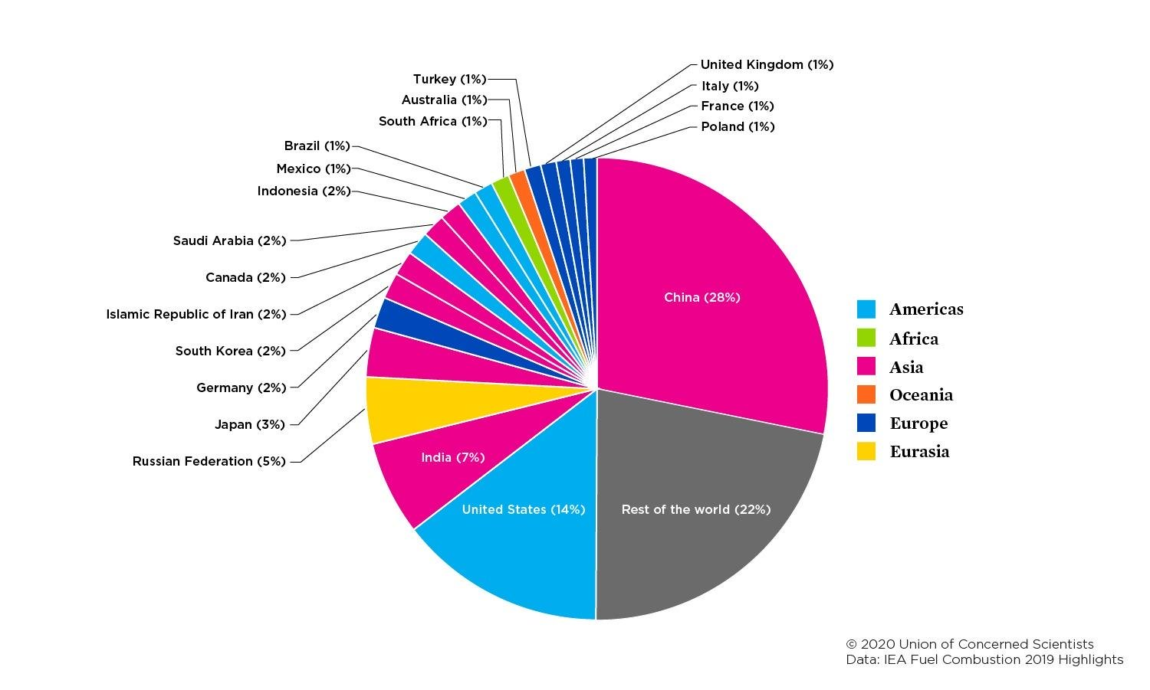
In absolute volume, China is the biggest polluter at this moment; in per capita, U.S. is. I got the worst of two worlds!
https://www.ucsusa.org/resources/each-countrys-share-co2-emissions

Slide 11
Regional/National Contributions to Global Warming since 1890 (http://euanmearns.com/attributing-the-blame-for-global-warming/)
Since CO2 has been accumulating in the process of industrialization, so the current pollution cannot be blamed on the current level of pollutant emission, we have to have a historical perspective. This contextualizes which country or countries should take equal share in cleaning up the environment, this is also part of environmental justice (although we think more about how environmental damage hurts the poor and the ethnic minority residents in U.S. more).

Slide 12
China’s CO2 emissions, 1965-2015 http://euanmearns.com/attributing-the-blame-for-global-warming
China has become the biggest polluter in this century, especially you can see from the year I was born to the year I left China for U.S. (1991), not only I got freedom, more importantly I escaped being choking up in the China Economic Miracle. But China is changing too, due to: Its production will plateau or even shrink; its leaders and people want to live longer once they became richer. So we get into another topic: As countries become richer/more developed, whether they will take care of pollution and take care of the environment?

Slide 13
The Environmental Kuznets Curve
The Kuznets Curve offers some comfort to the world if the rich countries and rich people would want a higher quality of life, so a clean environment is in their interest. Once poor countries become rich, they will be less polluting. The question is: If U.S. with roughly 5% of global population but consuming almost half of global oil, how many countries can be allowed to work and live as the U.S.? If we wait, how long will it take? Do we have enough time? If pollution is killing people, whether GDP in terms of Green GDP is positive?
https://ars.els-cdn.com/content/image/1-s2.0-S0959652618323722-fx1_lrg.jpg

Slide 14
The Green IPE
Since the 1960s, Rachel Carson’s The Silent Spring (1992) as a milestone, environmental concerns were raised; in the 1970s, the environmentalist movement (the Green Parties were a result and a driving force in Europe) attracted more people’s attention, especially among the youth in the West.
Since the mid-1990s the environmental political economy has become increasing important both at national and global levels.
Multilateral Environmental Agreements (MEAs), Conferences and Regimes have been created.
Between 1857 and 2012, a total of 747 MEAs have been concluded. The Stockholm Intergovernmental Conference in 1972 and the Rio de Janeiro Earth Summit in 1992 were major milestones. The United Nations and the World Trade Organization are also key intergovernmental organizations (The UN Intergovernmental Panel on Climate Change, IPCC, is the most visible actor) for forging and implementing the agreements.
The WTO has also incorporate sustainable development and environmental protection into its mission, such as adopting trade-related measures aimed at protecting the environment, e.g., considering the process and production methods (PPMs) in trade dispute.

Slide 15
The Green IPE--continued
Since 2019 the Green New Deal movement has been pushed by people both within U.S. and all over the world. Two visible icons are Greta Thunberg from Sweden in the Sunrise Movement and AOC (Alexandria Ocasio-Cortez, the banner-bearer of the Green New Deal in the U.S. Congress after the 2016 midterm elections.
Essential elements of Green New Deal (Full Text: House Resolution 109) : It is a mixed concern of environmental protection, economic revitalization, technological innovation, and social justice, and the long-term standing of U.S. in the world:
the entire world needs to get to net-zero emissions by 2050, the United States must take a “leading role” in achieving that.
The federal government to dramatically reduce greenhouse gas emissions, create high-paying jobs, ensure that clean air, clean water and healthy food are basic human rights, and end all forms of oppression.
The launch of a “10-year mobilization” to reduce carbon emissions in the United States: sourcing 100 percent of the country’s electricity from renewable and zero-emissions power, digitizing the nation’s power grid, upgrading every building in the country to be more energy-efficient, and overhauling the nation’s transportation system by investing in electric vehicles and high-speed rail.
The duty of the government to provide job training and new economic development, particularly to communities that currently rely on jobs in fossil fuel industries.

Slide 16
Global Pandemics
Global pandemics are nothing new and have been on the radar of researchers and politicians for a long time. In my 2008 Paper (Later was published as a book chapter, "Globalization and Global Issues" in Wang Jianwei, ed., Theory of International Relations, Beijing: Renmin University Press, 2010), I wrote the following:
“Regarding global pandemic: Human history has experienced the Black Death (which claimed the lives of 30% of the population in medieval Europe) and the Spanish flu of 1918 (25 to 50 million deaths worldwide); in the past one hundred years, influenza, typhoid and cholera have become the main killers of human beings. Globalization has enabled viruses, bacteria, parasites and malignant pathogens to cross national borders frequently with fast speed. AIDS has become a global threat, and at least 40 million people now carry the HIV virus. The outbreak of SARS and bird flu in the past few years has once again warned humans of a global pandemic. The World Health Organization (WHO) issued a warning in 2005 that if avian influenza broke out among humans (the H5N1 virus had killed at least 150 million birds), two to three hundred million people would become victims.”

Slide 17
Warning Signs
President George W. Bush discussed how to deal with a possible global pandemic in 2005.
Swine flu or H1N1 broke out in 2009 starting from California, ultimately there were about 60.8 million cases in the United States, along with 274,304 hospitalizations and 12,469 deaths associated with H1N1
In 2014 Ebola broke out in West Africa and killed 11,000 people in Africa. The United States sent nearly 3,000 troops to Africa to help keep the disease from spreading. President Obama warned Americans in 2014 on global pandemics such as Ebola, SARs, Swine flu, etc.
In 2016, the Obama administration produced a comprehensive report on the lessons learned by the government from battling Ebola. In January 2017, outgoing Obama administration officials ran an extensive exercise on responding to a pandemic for incoming senior officials of the Trump administration.
The Trump Administration conducted a drill, The Crimson Contagion, which was a simulation administered by the U.S. Department of Health and Human Services from January to August 2019 and tested the capacity of the U.S. federal government and twelve U.S. states to respond to a severe influenza pandemic originating in China.
Four long-form analysis reports released by the US National Intelligence Agency over the past 20 years (all in my http://dr-ming-xia.org The "Teaching" section on the webpage) continuously sent alarms to the American public and the global community.

Slide 18
Discussion of Global Pandemics in the Context of IPE
Global pandemics, such as the ongoing COVID-19, could wreak havoc to global economy, national economy, family and individual. As of today (05/06/2020), the coronavirus COVID-19 is affecting 212 countries and territories around the world and 2 international conveyances. Coronavirus Cases worldwide are 3,802,466; Deaths: 263,096.
The mightiest economic and military power in the world, U.S., is hit hardest: Coronavirus Cases reached 1,252,689; Deaths: 73,797 (as of 05/06/2020), which has surpassed the total death tolls of Americans in the Korea War or Vietnam War. At this moment, the daily death toll has been higher that the total Sept. 11th terrorist attack. See the graphs below.
The economic losses in U.S. and the whole world are astronomical! (You can follow daily updating reports on the unemployment, bankruptcy, food supply crisis, and hunger!)
The pandemics such as 2003 SARS and COVID-2019 should be understood in the context of big-power geopolitical rivalry and their projects for ABC weapons (Atomic, biological and chemical). I can safely say that China has been aiming at American hegemony for a possible takeover and covertly developing “unconventional weapons/warfare (such as cyber war, currency war) against the U.S. The value chains without “common value” have exposed the threat to American national interest (think bout PPEs).
The failure of the U.S. in preparing for and winning in global pandemic crisis could be devastating to American interest in every category: political, economic, military, technological, and cultural.
As I have discussed with the class before, Oreskes and Conway warned in their The Collapse of Western Civilization (2014), if the West failed to respond both the climate change and global pandemics, but China had succeeded (Looks likely if you judge by the current COVID-19 crisis?), then you or your posterity would live under the “Second People’s Republic of China” of neo-communism with the Chinese characteristics! Probably then I will be gone, but I have to warn you if it is comfortable, I would not take trouble to come to New York.

Slide 19
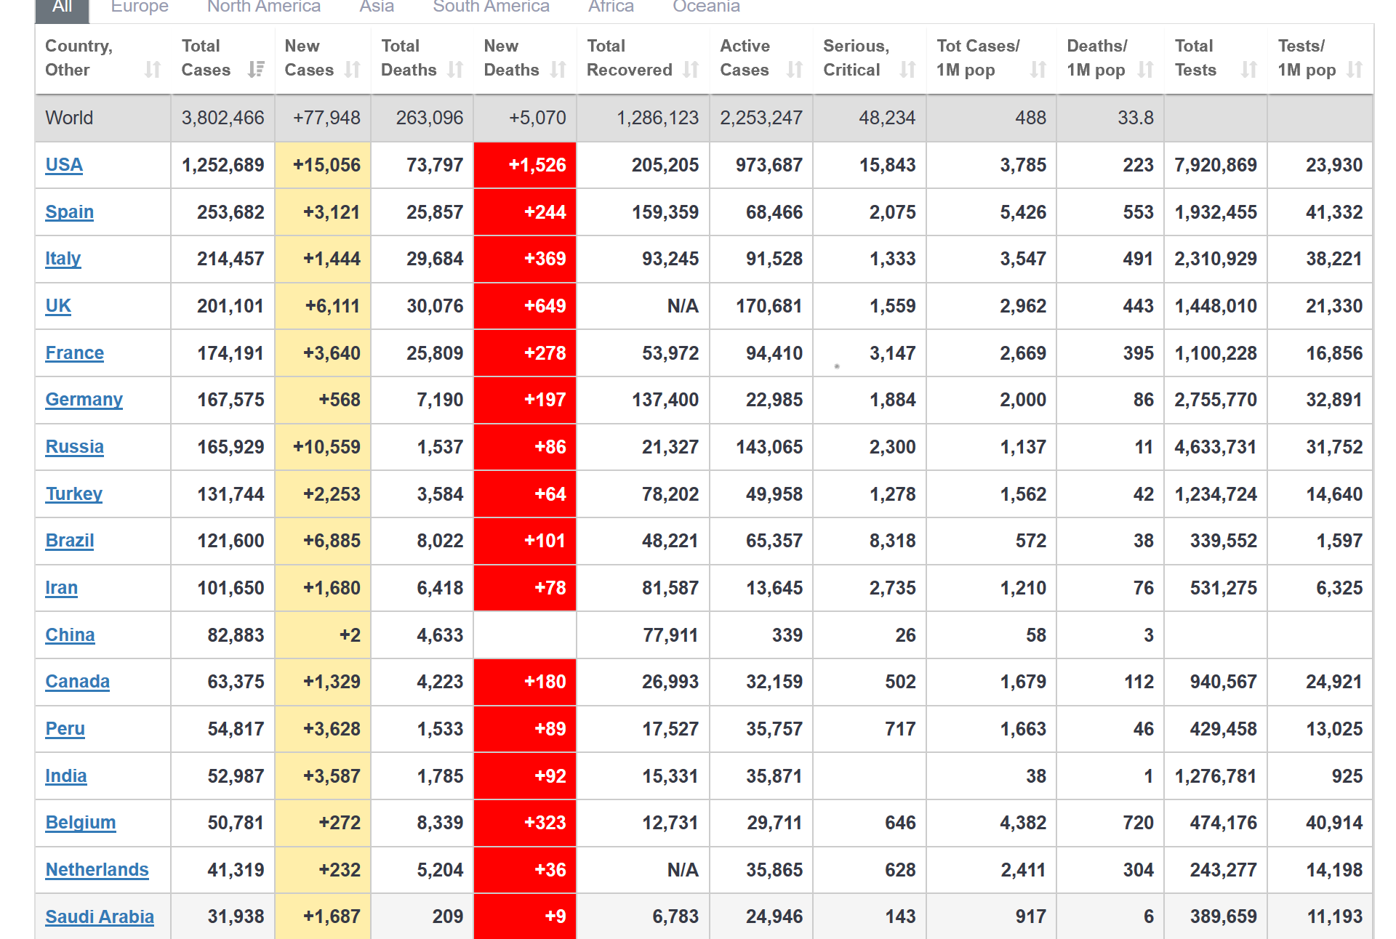
Data Source: https://www.worldometers.info/coronavirus/

Slide 20
Crisis Interviews: Looking Beyond the Pandemic
A documentary made by NHK, the best Japanese news service TV station, with three cutting-edge social thinkers in the world who are from three different parts of the world:
Guests: Yuval Noah Harari (Historian) Ian Bremmer (Political Scientist) Jacques Attali (Economist) Interviewer: Doden Aiko (NHK World Special Affairs Commentator)
https://www3.nhk.or.jp/nhkworld/en/ondemand/program/video/lookingbeyondthepandemic/
At this moment since you have already submitted your book review on Thank You for Being Late, probably you can remember what Thomas Friedman has said at the beginning of Chapter Six: Mother Nature:
“God always forgive. Man often forgives. Nature never forgives.”

Slide 21
Enjoy and Revere the Nature! (at Greenbelt, SINY)

Slide 22
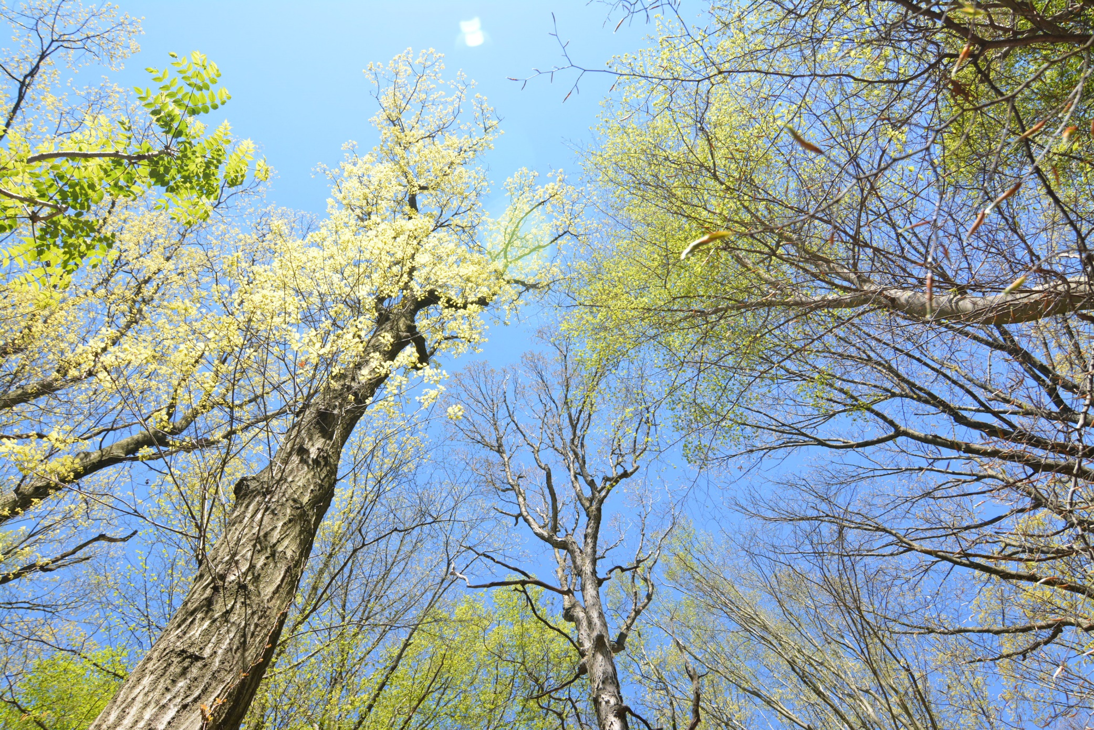

Slide 23
