Slide 1
Japan

Slide 2
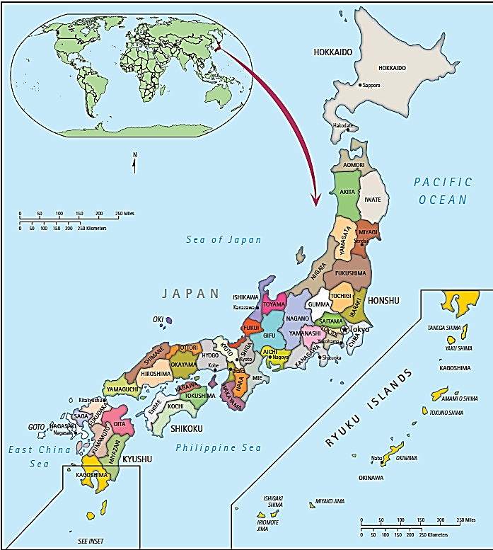
Copyright © 2012, 2010, 2008 Pearson Education, Inc. All rights reserved.

Slide 3
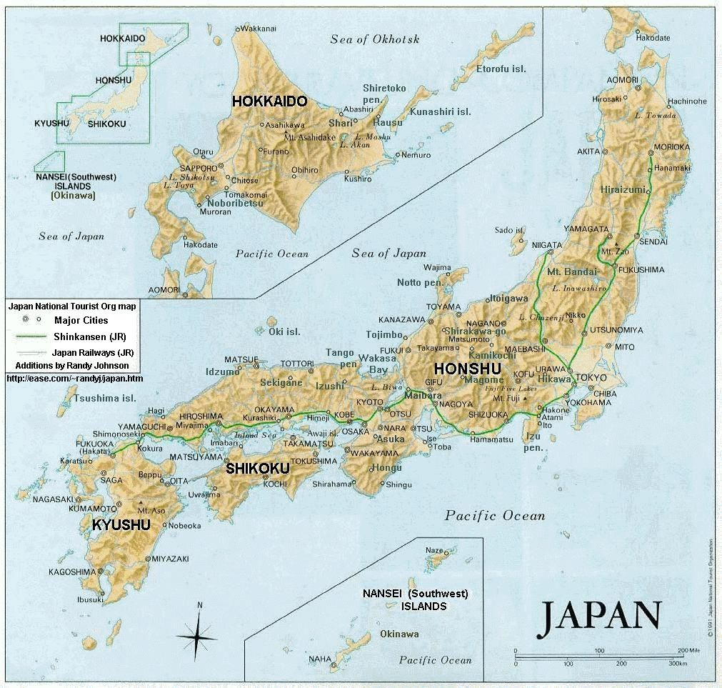

Slide 4
Country Bio: Japan
/Shinzo Abe

Slide 5
Chronological Development
Early Japanese：Migrants from Asian Continent (China and Korea) and South Pacific Islands (Ainu)
Yamatakoku (Early 3rd Century)
Early 3rd Century: Yamata Koku (Yamato State)
604 a.d.: Shotoku Taishi (Prince Shotoku) and his Reformation: Code of Seventeen Articles
645: The Taika (“Great Change”) Reform
1192: The Minamoto Family (源 頼朝) Ascended: Its Leader, Minamoto Yoritomo (Sei’itai Shogan)

Slide 6
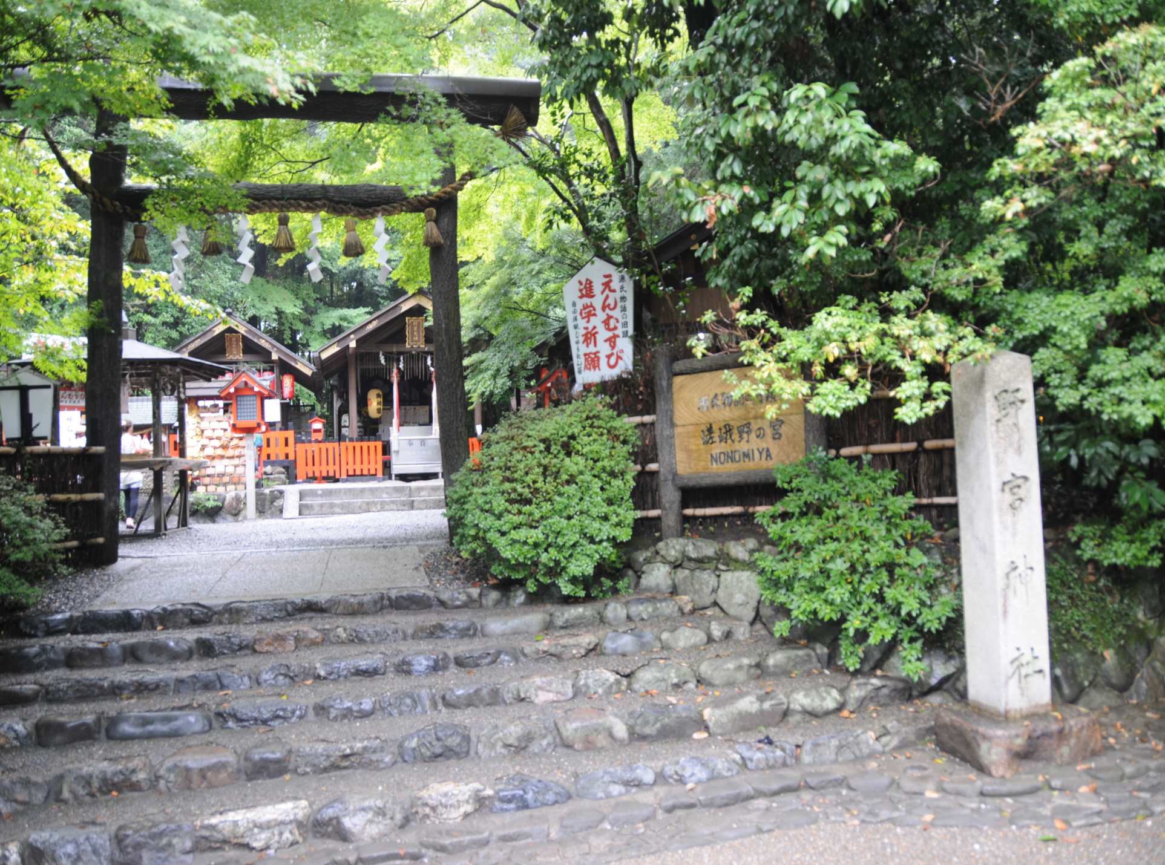
Nononiya Shrine, Kyoto, the Place appears in The Tale of Genji.

Slide 7
The Kamakura Period (1183-1333,镰仓时代)
The Ashikaga (or Muromachi) Period (1338-1573, 足利时代 or 室町时代)
Oda Nobunaga (1534-1582): Toyotomi and Tokugawa were two loyal followers of Oda Nobunaga.
Toyotomi Hideyoshi (1536-1598) unified Japan in 1590, invaded Korea in 1592 and 1597.
The Tokugawa Period (1603-1867, 德川幕府)

Slide 8
Tokugawa Shogunate
1603-1867: Tokugawa Shogunate
Tokugawa Ieyasu founded Tokugawa Shogunate
1614: Toyotomi Hideyori was supported by his father’s followers.
Burned down Osaka
1615: Toyotomi Hideyori was defeated by Tokugawa and committed suicide with his mother.

Slide 9
Three Great Unifiers Oda Nobunaga (1534-1582, 织田信长)

Slide 10
Toyotomi Hideyoshi (1536-1598，丰臣秀吉)

Slide 11
Tokugawa Ieyasu (1542-1616，德川家康 )

Slide 12
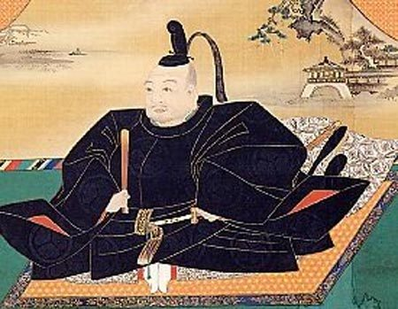

Slide 13
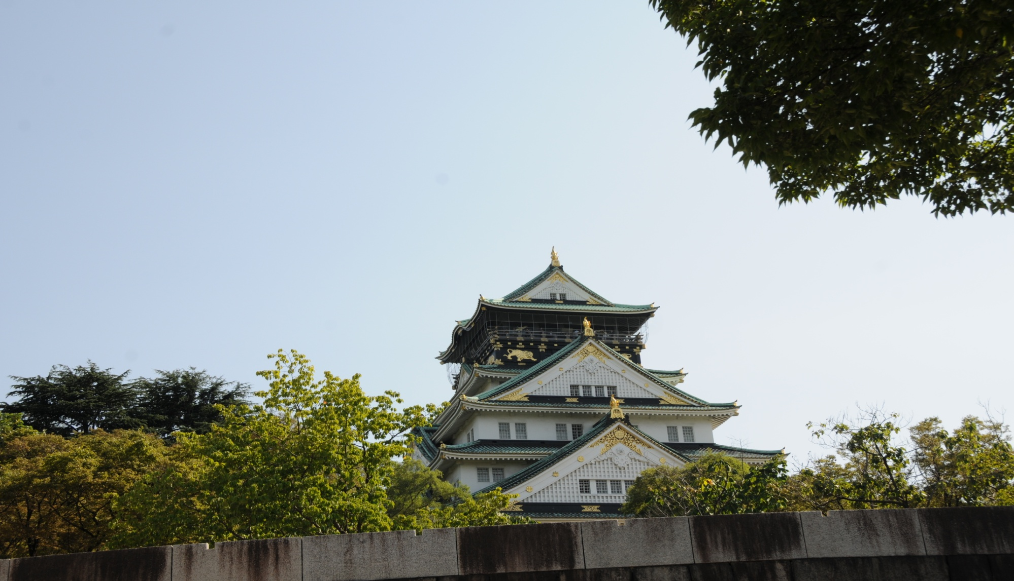
Osaka Castle: Rebuilt Many Times

Slide 14
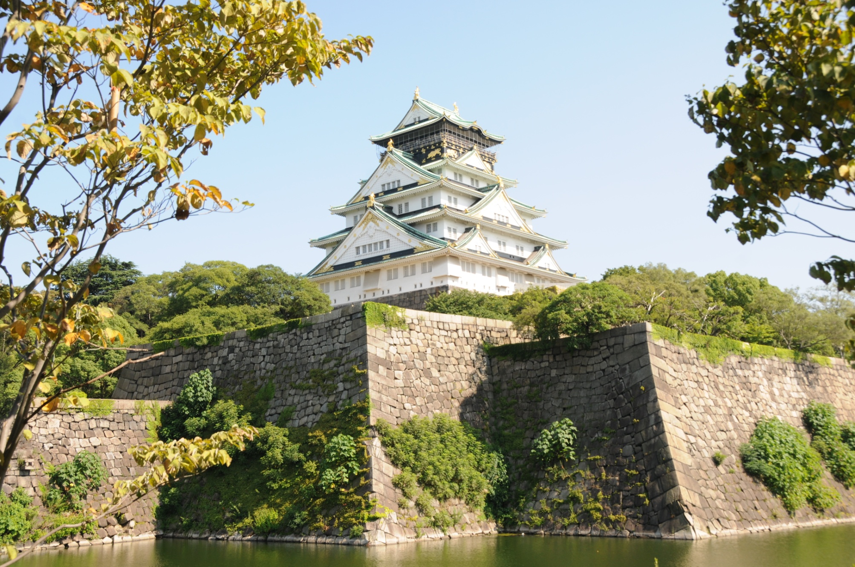
Osaka Castle

Slide 15
Tokugawa Mausoleums, Koyasan

Slide 16
Unification of Japan: Three Great Unifiers
Relationship between Tenno and Shogun
Clans (Family Domains), Daimyo, Samurai (Warriors), Peasants, Merchants and Artisans
Conflicts between Kansi (West) and Kanto (East): Trade and Power, the Eastward Shift of Power

Slide 17
Nijo-jo Castle, Headquarters for the Tokugawa Shogunate

Slide 18
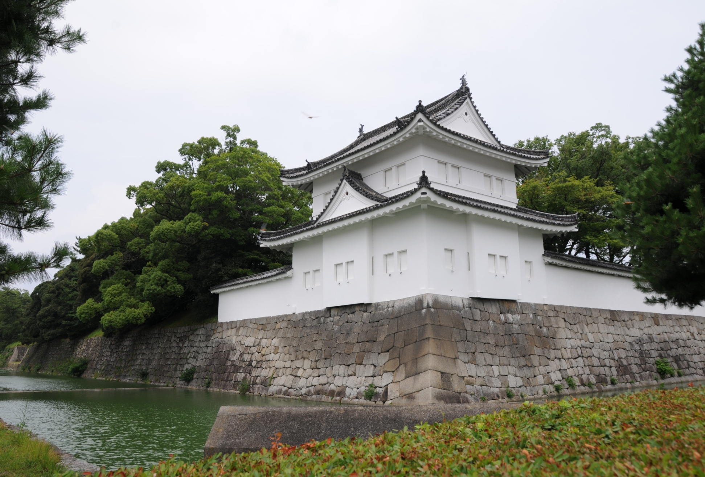

Slide 19
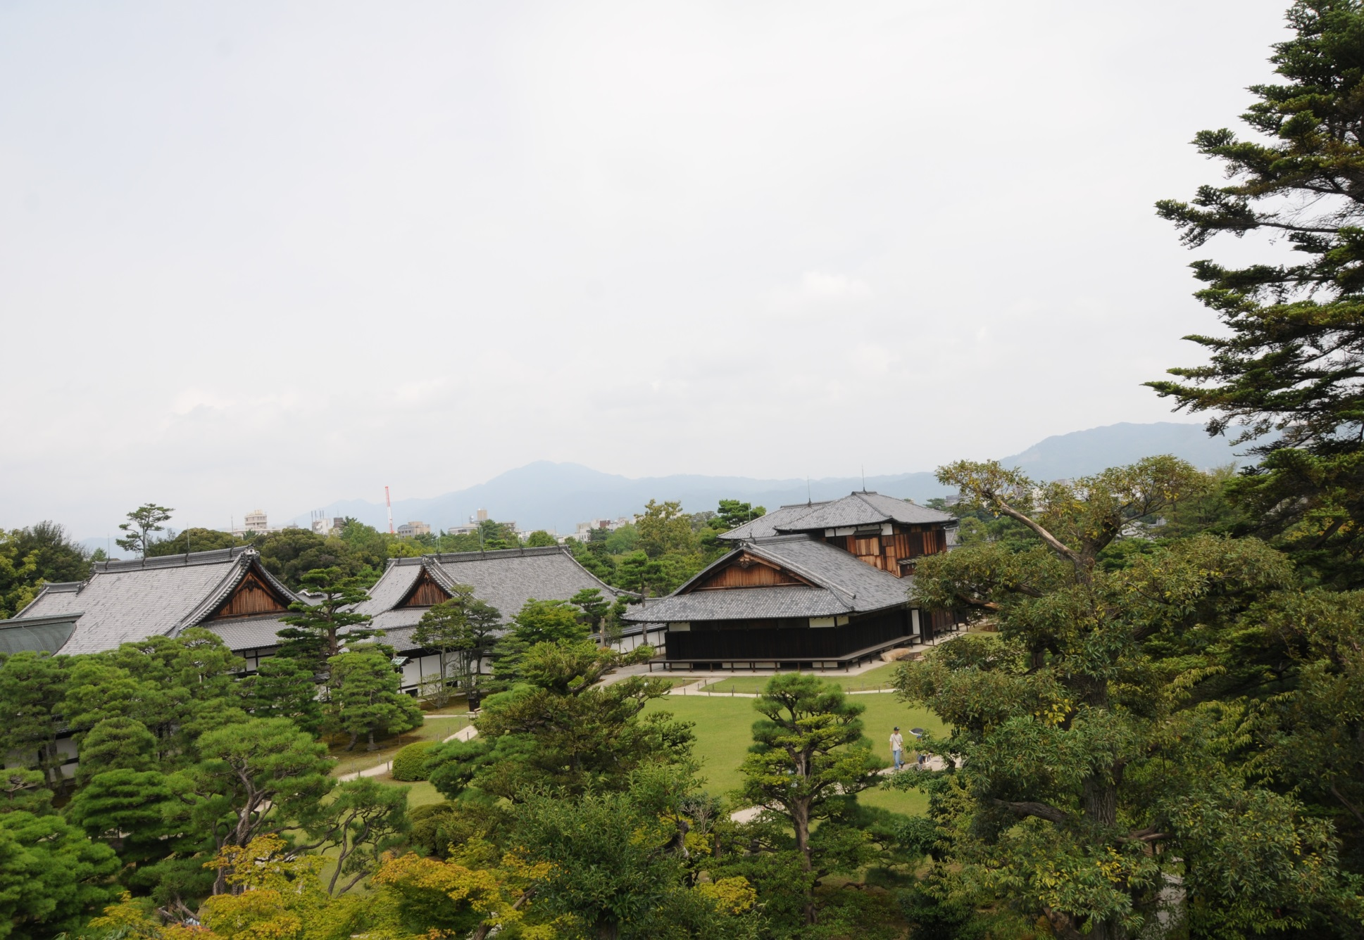

Slide 20
Meiji Restoration (明治維新 Meiji Ishin)
1853: Matthew Perry came to Tokyo Bay
1854: Perry Returned
Satsuma (萨摩藩) and Choshu (长佐藩) Alliance
1860-1862: Mission to Overseas
On February 3, 1867, Emperor Meiji ascended the throne
1868：Emperor Mutsuhito turned to Emperor Meiji—”Revere the emperor and repel the barbarians” (Sonno joi, 尊皇攘夷)
Slogan: “Enrich the country, strengthen the army” (Fukoku kyohei, 富国强兵)

Slide 21
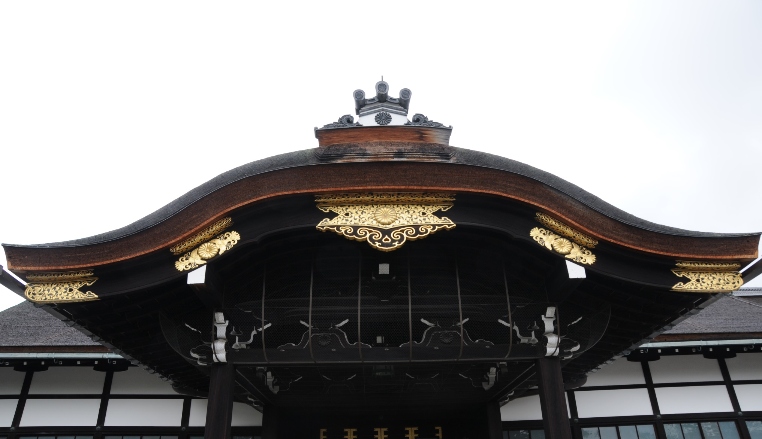
Royal Palace in Kyoto: Paled in Contrast to Nijo-jo

Slide 22
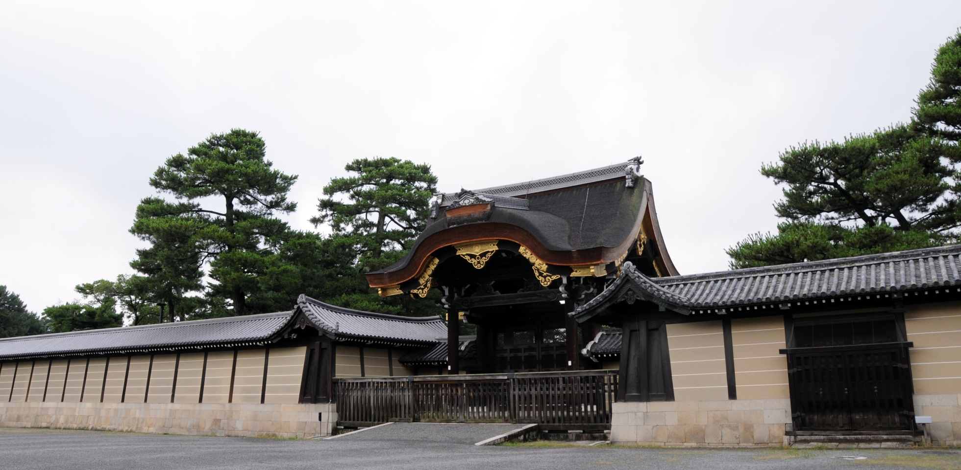

Slide 23
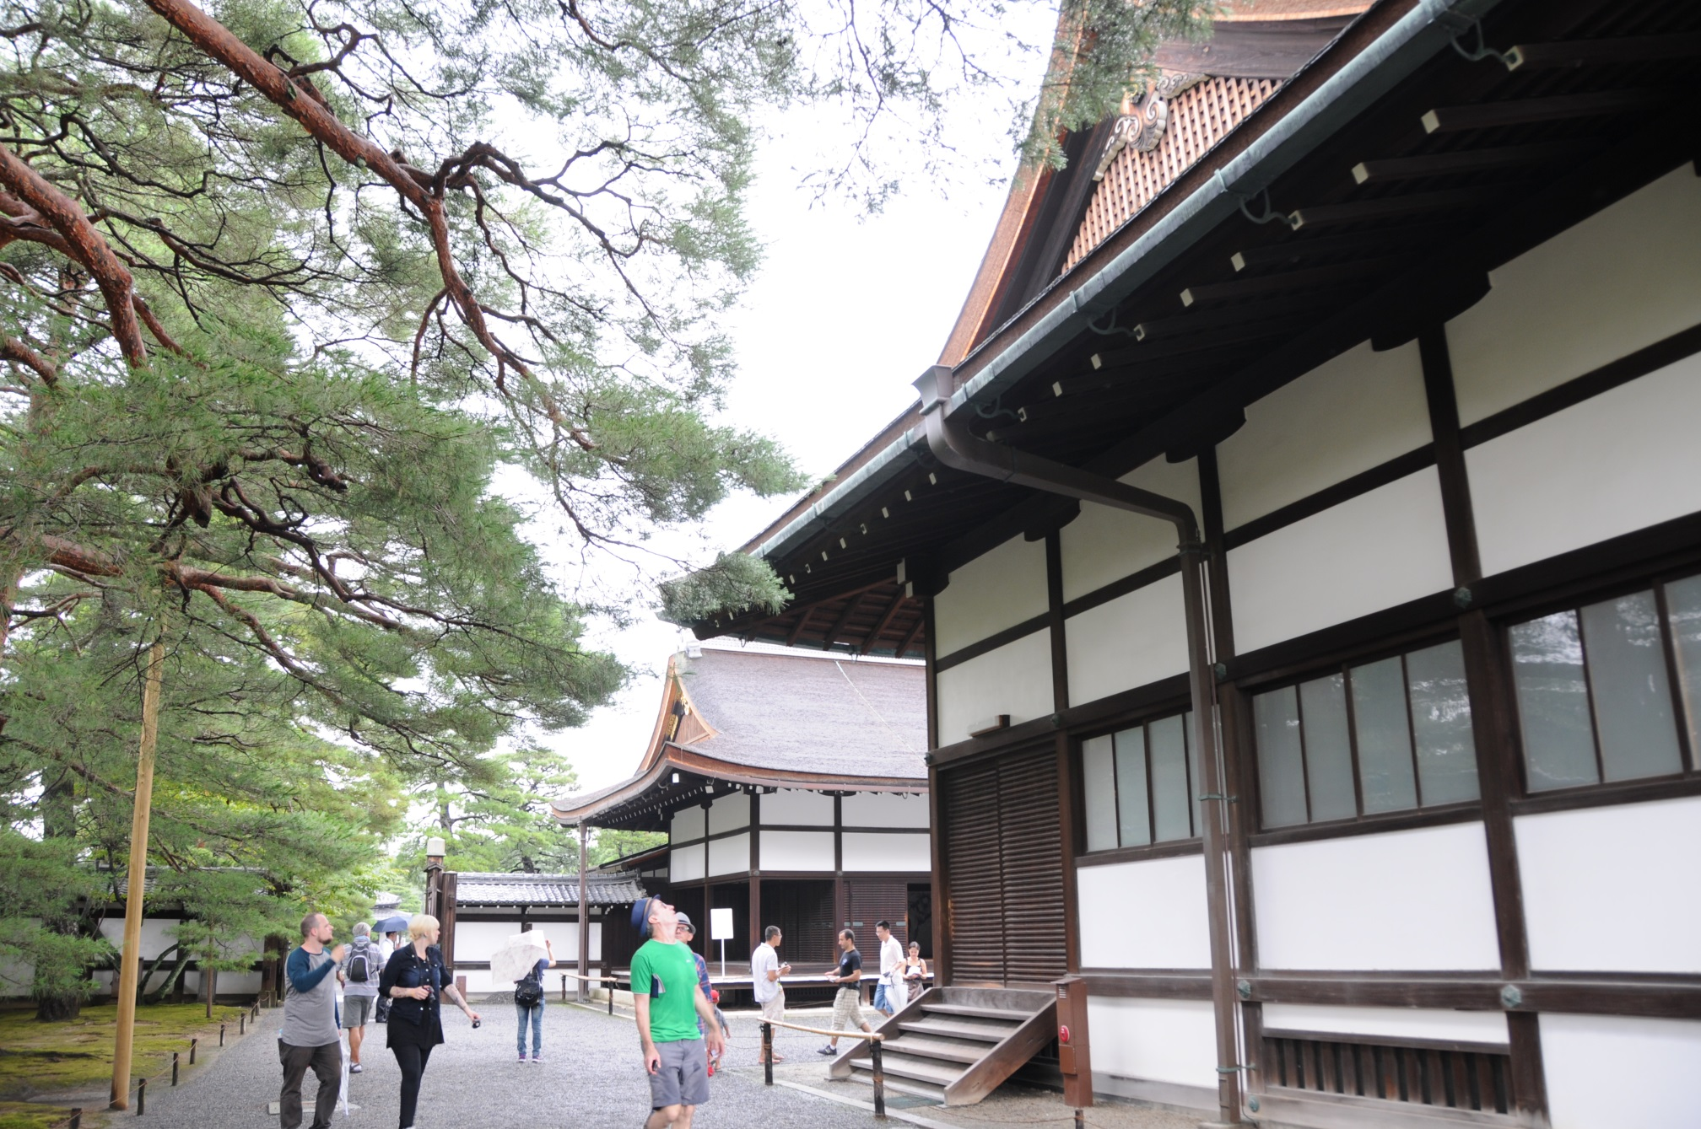

Slide 24
Emperor Meiji

Slide 25
Meiji Restoration
Talented Leaders
Fukuzawa Yukichi (1835-1901，福泽渝吉)
Saigo Takamori (西乡隆盛)
Okubo Toshimichi (1830-1878, 大久保利通)
Ito Hirobumi (1841-1909，伊藤博文)
Yamagata Aritomo (1838-1922,山县有朋)

Slide 26
Five Articles of the Charter Oath
By this oath, we set up as our aim the establishment of the national wealth on a broad basis and the framing of a constitution and laws.
Deliberative assemblies shall be widely established and all matters decided by open discussion.
All classes, high and low, shall be united in vigorously carrying out the administration of affairs of state.
The common people, no less than the civil and military officials, shall all be allowed to pursue their own calling so that there may be no discontent.
Evil customs of the past shall be broken off and everything based upon the just laws of Nature.
Knowledge shall be sought throughout the world so as to strengthen the foundation of imperial rule.

Slide 27
What Had Japan Learned?
Ito Hirobumi: Selecting a German (Prussian) Model: the Army, the General Staff
The Royal Navy in Great Britain
The Postal Service in the United States
Modern Schools from France
Census, Military Conscription, the Telegraph, Railways, Banks, Courts of Law, a Constitution (1889), and a Parliament (1890, based on German Parliament).

Slide 28
Rise of Nationalism and
1895: Taiwan ceded to Japan
1904-05: Russo-Japanese War
Paris Peace Conference: 1919
The 1921-22 Washington Conference (battleship ratio of 5:5:3 for the US, Britain, and Japan respectively); the London Naval Conference of 1930 (the same ratio for heavy cruisers).
Taisho Period (1912-1926)
Kita Ikki: An Outline Plan for the Reorganization of Japan (日本改造法案大綱 Nihon Kaizō Hōan Taikō), 1919, 1923

Slide 29
Militarism and Its Defeat
Shintoism and the Emperor as a Living God (1868-72)
1874: Japan Control Okinawa and the rest of Ryukyu Islands
1894-95: The Sino-Japanese War and the Treaty of Shimonoseki
1904-5: Russo-Japanese War
1910: Japan Control Korea
World War I and Japan’s Ambition in China
Kantô earthquake in 1923
The world Great Depression, 1929
Japan seized Manchuria in 1931
Sino-Japanese War: 1931-1945
The Pacific War: 1941-45 and Japan’s Unconditional Surrender

Slide 30
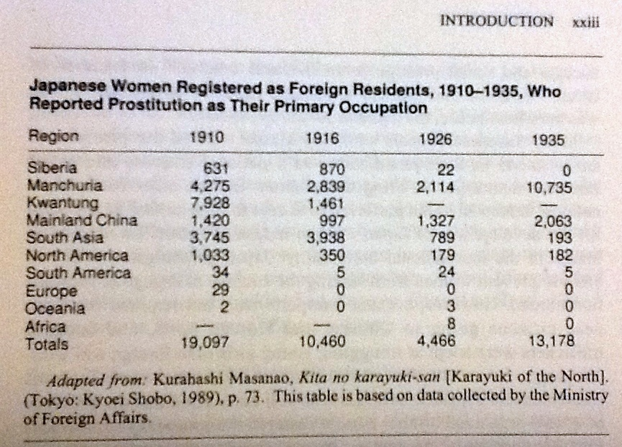
Yamazaki Tomoko: Sandakan Brothel No. 8:
an Episode in the history of lower-class Japanese women

Slide 31
Women in Japan and East Asian Developmental States
“Hard State, Soft Shoulders”: The Dark (Yin) Side of Japanese Economic Miracle
From Madam Butterfly, to Memoirs of a Geisha, to Miss Saigon, and on and on
From Geisha to Karayuki-san, to Comfort Women, then to Asian sex Tourism and “Selling Sex Overseas”
Androcentric States in Asia

