Slide 1
Mercantilism, Statism,Realism, Nationalism
Subtitle
This Photo by Unknown Author is licensed under CC BY-SA-NC
Notes:
NOTE:
To change the image on this slide, select the picture and delete it. Then click the Pictures icon in the placeholder to insert your own image.

Slide 2
Musical: Alexander Hamilton

Slide 7
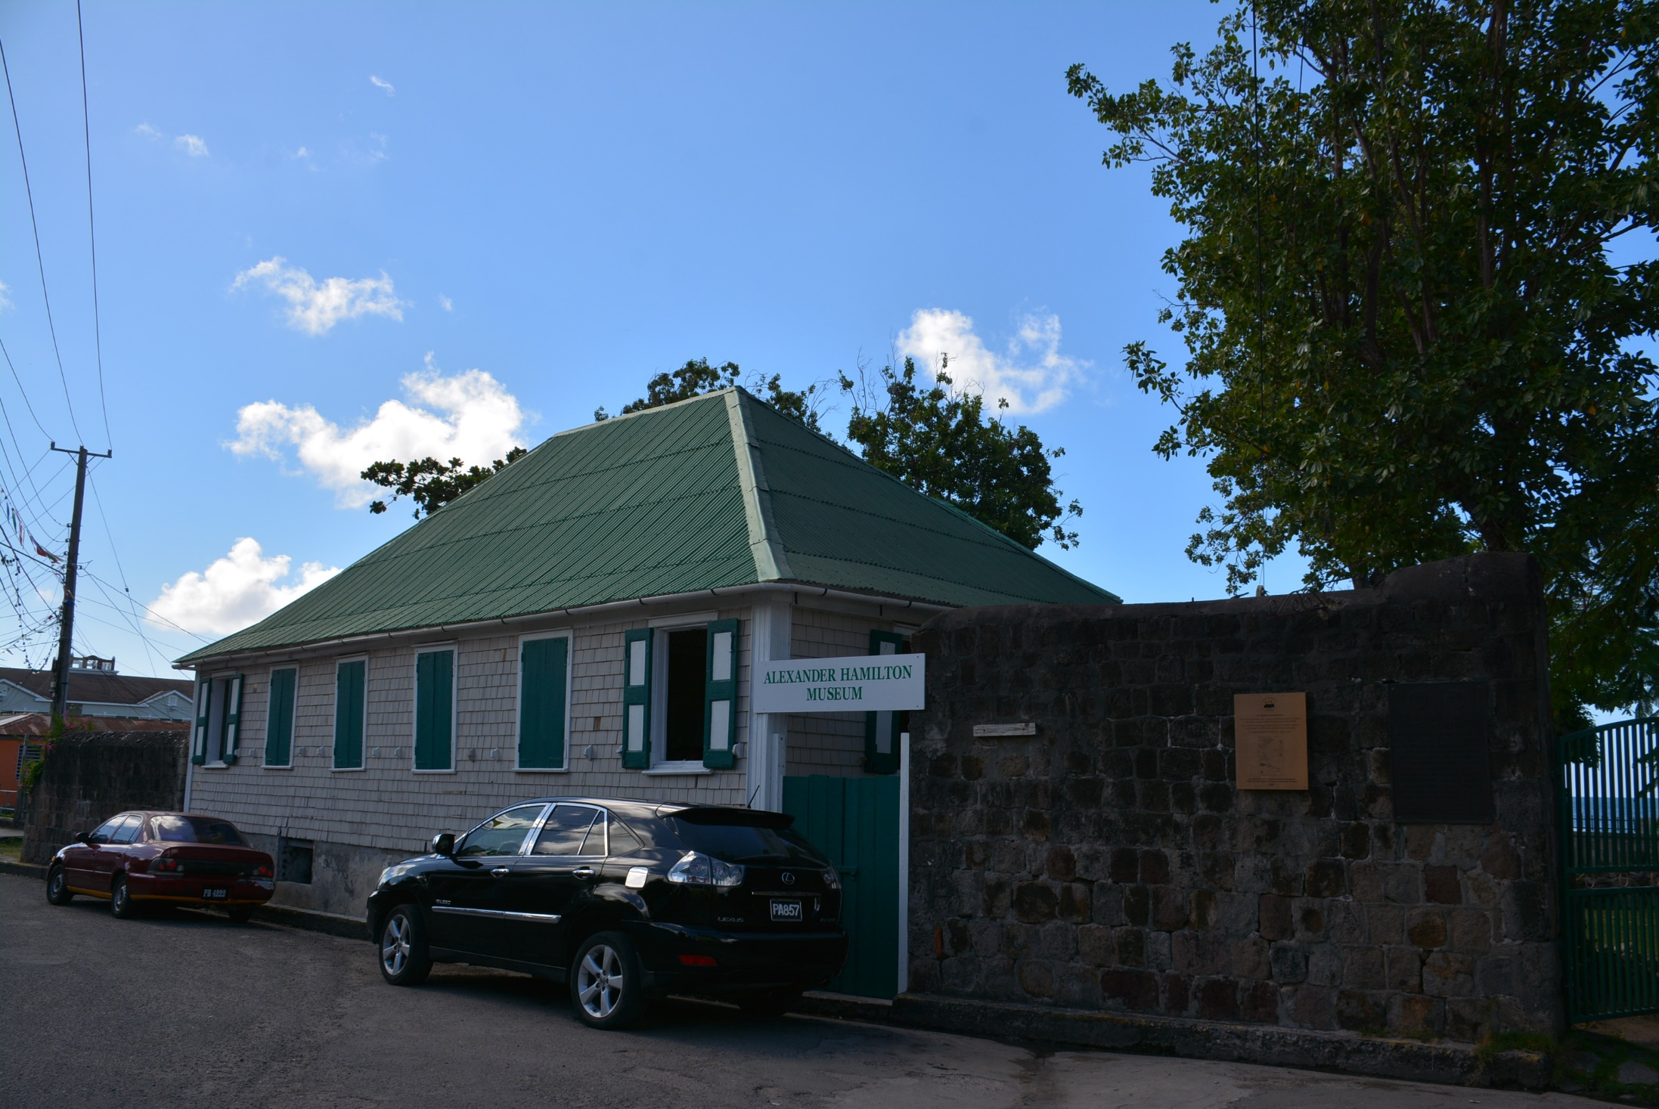

Slide 9
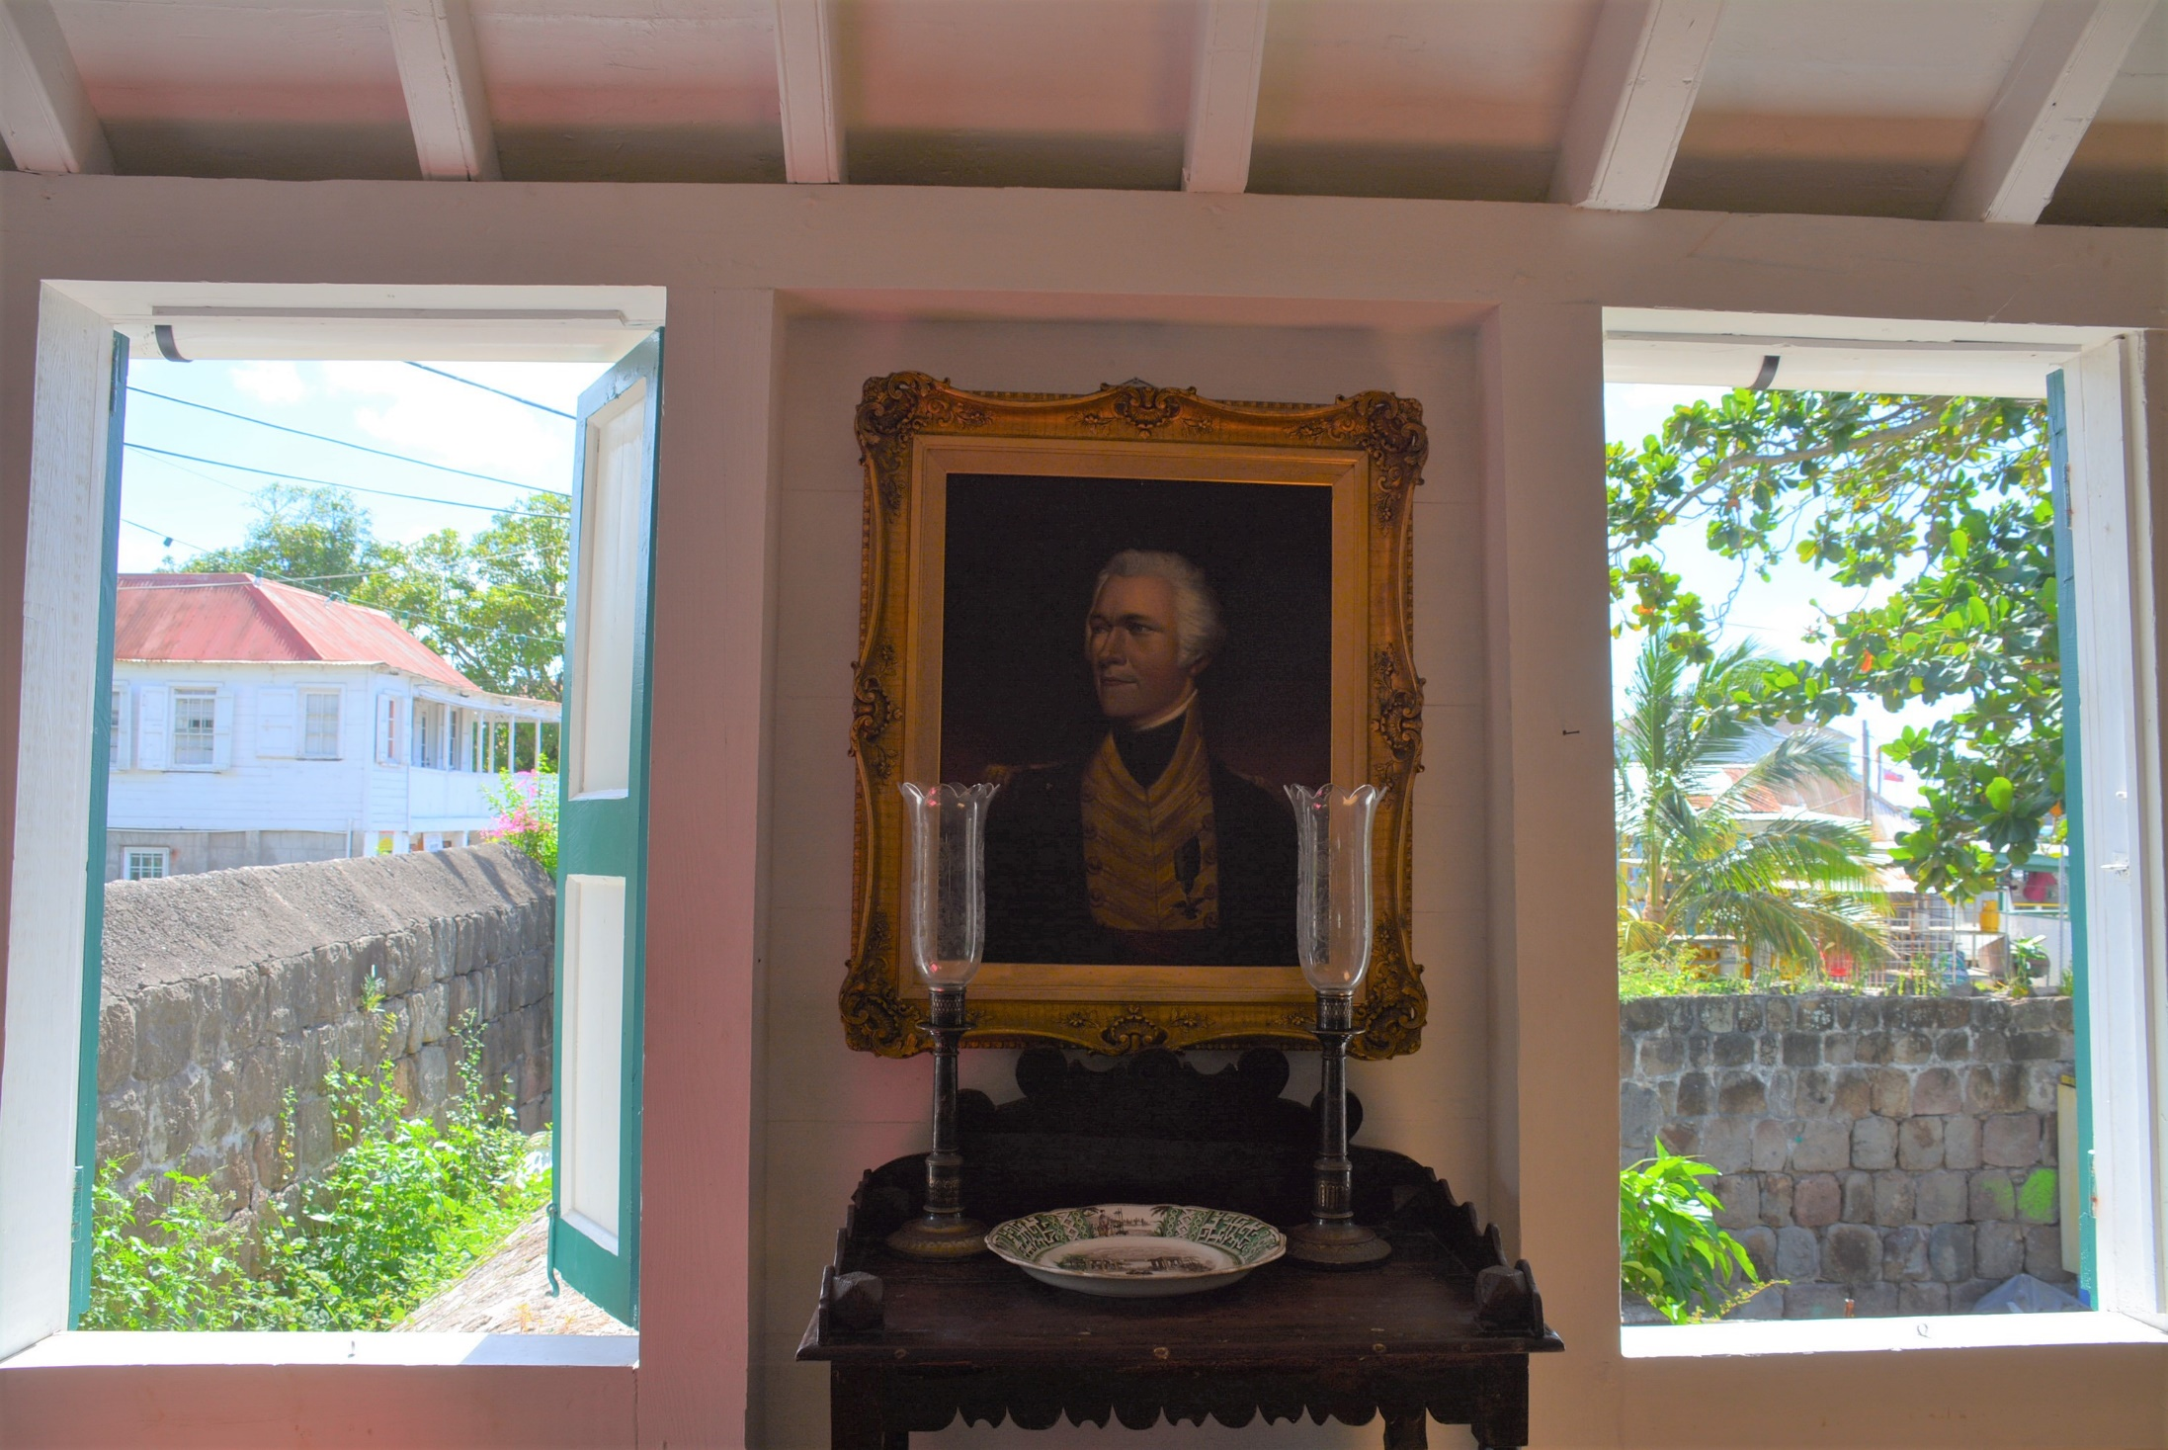

Slide 10
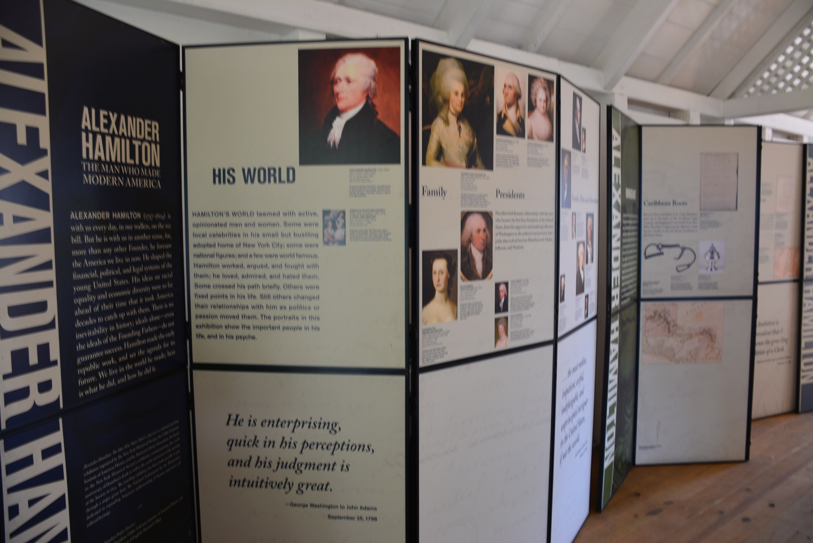

Slide 15
Friedrich List, 1789-1846

Slide 16
Best known for his book The National System of Political Economy (1841) in which he criticized the Smithian school of free trade as inimical to the economic development of the nation, in particular the less well-developed German national economy. In his view, protection was to be a temporary stage on the way to a true system of free trade between equal nation states. During the 1820s, he lived in Pennsylvania, where he contributed to the pro-tariff debates in the United States.

