Slide 1
Conclusion: East and Southeast Asia

Slide 2
Three Dominant Issues in the Region
Autocracy vs. Democracy: Challenges to Democratization
Poverty vs. Development: From Miracle to Mirage and Coming back
Asian-style capitalism and developmental state model
3. Diversity vs. Racial and Ethnic Domination

Slide 3
The Zomia Studies

Slide 4
Zomia
The term was first proposed in 2002 by the Dutch historian Willem van Schendel, who derived the term from the word “zomi,” meaning “highlander” in many of the languages of the people who populate this area.
According to Van Schendel’s original definition, Zomia includes Tibet and other southwestern parts of China, northern and northeastern parts of India, most of Nepal and Myanmar, all of Bhutan and Laos, and bits of Thailand and Bangladesh. The term particularly refers to areas that are above 300 meters in altitude. Zomia covers more than 2.5 million square kilometers and is home to approximately 100 million people.
In 2007, Van Schendel broadened the geographical scope of Zomia to include large areas of Afghanistan, Pakistan, northern India (Kashmir), Tajikistan, Kyrgyzstan and western China (Xinjiang). This broadening of the scope of Zomia was intended to characterize the anti-government conflicts taking place in these regions as part of the anarchist tradition of Southeast Asian highland communities.

Slide 5
Korea Peninsula Crisis
The Dokdo/Takashima Island Between Japan and South Korea (also called Liancourt Rocks by some nations)
The Senkaku/Diaoyu Island in East China Sea
The Cross-strait Crisis between China and Taiwan
The Northern Territories (Four Northern Islands): Japan and Russia
The South China Sea Islands

Slide 6
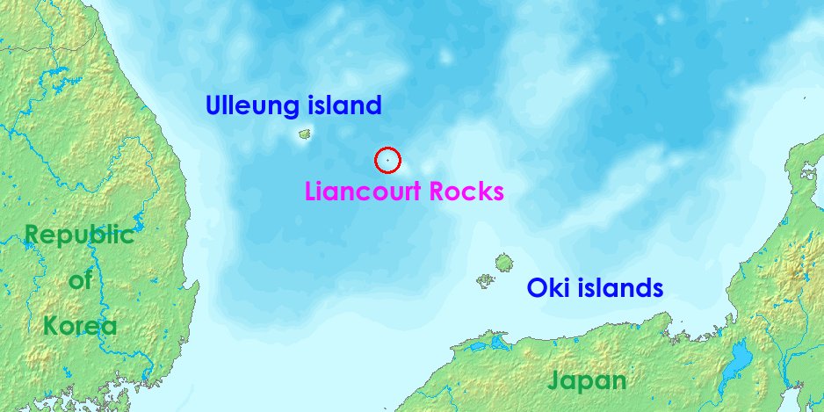

Slide 7
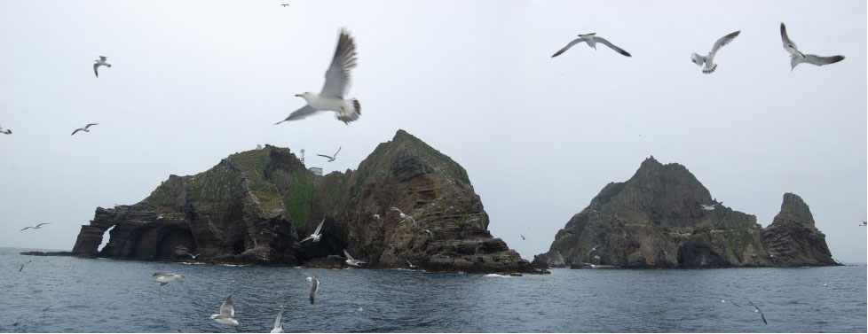

Slide 8
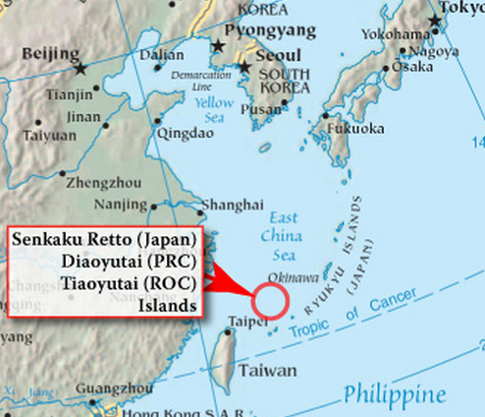

Slide 9
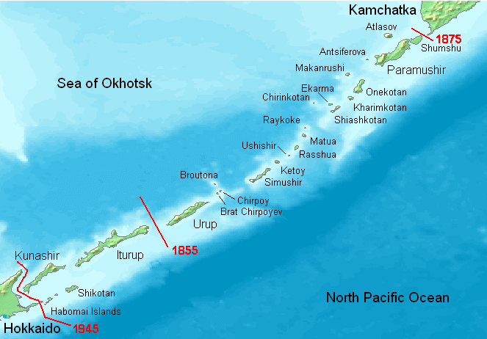
Northern Territories

Slide 10
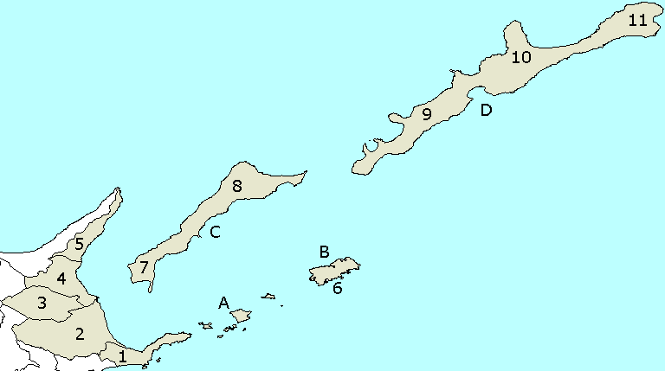
Disputed Islands in question: A. Habomai Islands B. Shikotan C. Kunashir Island D. Iturup

Slide 11
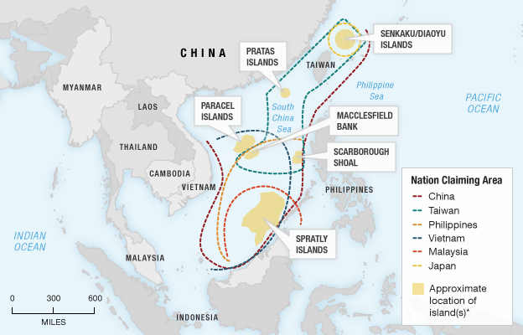
http://www.npr.org/2012/09/07/160745930/little-islands-are-big-trouble-in-the-south-china-sea, Credit: Stephanie d'Otreppe/NPR

Slide 12
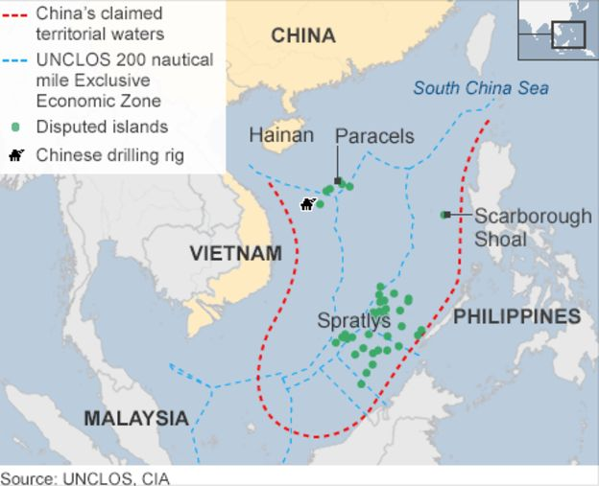

Slide 13
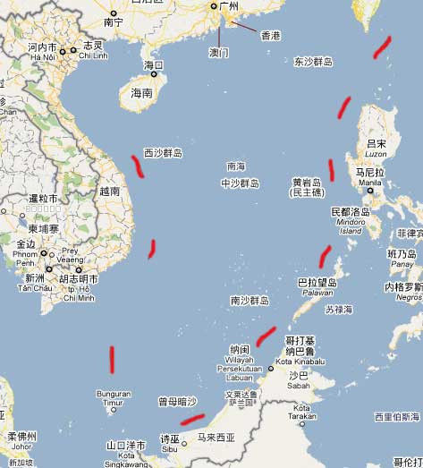
The Nine Dash Line by China

Slide 14
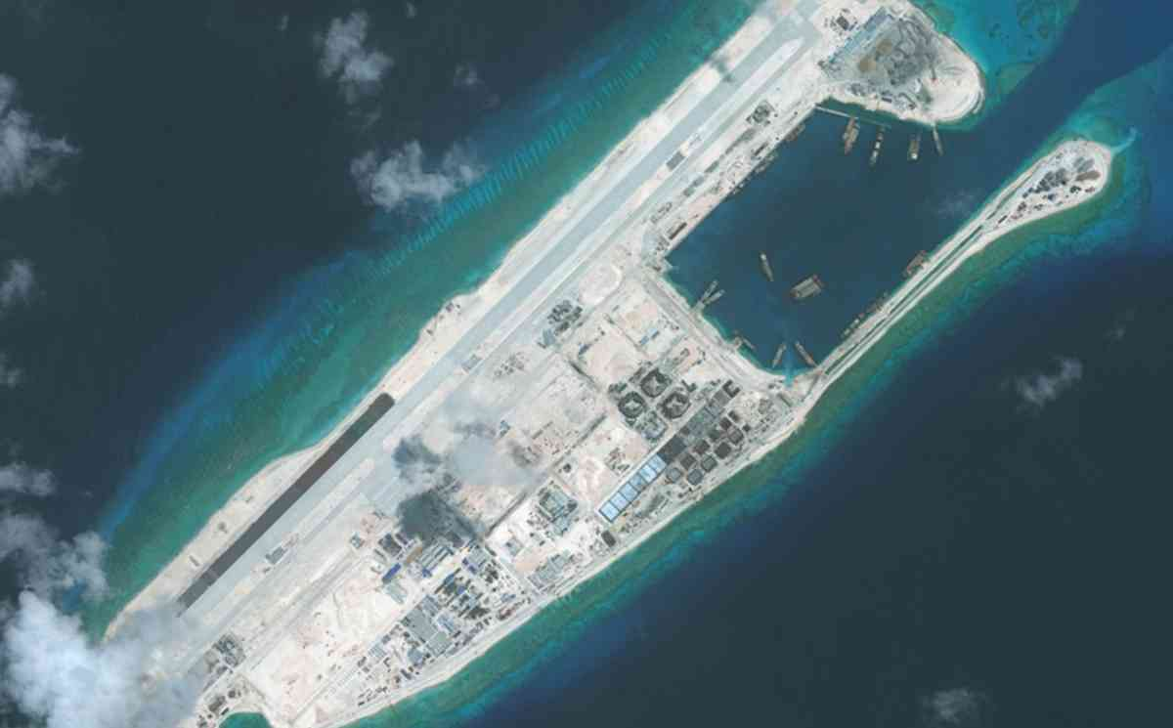

Slide 15
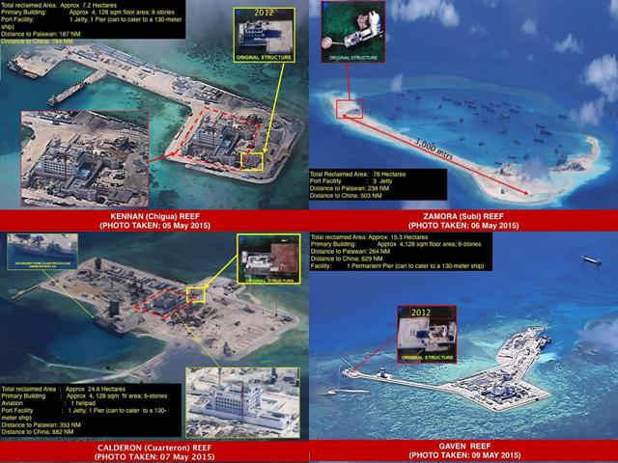

Slide 16
The ASEAN Way
ASEAN
ASEAN Regional Forum
AFTA (ASEAN Free Trade Area)
AEC (ASEAN Economic Community)

