Slide 1
Globalization and Anti-Globalization
Globalism and Globalization in Search of A Soul
Notes:
NOTE:
To change the image on this slide, select the picture and delete it. Then click the Pictures icon in the placeholder to insert your own image.

Slide 2
Introductory Remarks
We have discussed ideas in IPE, production, trade, development, finance, climate change and pandemics. All of them can be linked together under a common theme of globalization.
I define globalization as the rapid shrinking of spatial and temporal distances of human beings, countries, and societies in the world. We can see that in terms of the vector of space and the vector of time our world has become much smaller, we have lived much closer to each other.
Quote: “You know how the mirror on your car says ‘Objects in your rearview mirror are closer than they appear’? Well that now applies to what’s in your front windshield, because now it’s the future that is much closer than you think.” (Friedman, p. 103)
Globalization has many benefits, the most important one is the scale effect: in global production, division of labor, trade, we can see it most clearly. The problem is that as our economy, political and social activities become more intertwined, the whole world and its subsystems have turned into a complex system because of these interconnections and interdependency. As a result, chaos, turbulence, entropy, and collapse can happen at large scale. The so-called butterfly effect can turn into “the butterfly defect”—vulnerability ensues.
Amid a global pandemic, it is important for us to examine and reflect upon the systemic risks of globalization as well as to search for remedies.

Slide 3
Teaching IPE with Thomas Friedman
I dream of having a teaching assistant in classroom. My ideal teaching assistant is Thomas Friedman. If we divide globalization roughly into three phases: 1820-1914 (the Pax Britannica), 1960-1980 (the Pax Americana under the Bretton Woods system), and 1990-2020 (from the end of Cold War to the Global Pandemic), I can say that Friedman has been the most productive and observant reporter on globalization on the latest phase of globalization.
Putting all his books together, we can see that Friedman has a wide geographic coverage (Middle East, Eurasia and the U.S. are his best), a varieties of topics fitting well with our class: production chains, technology, trade and trade conflict, financial crisis, climate change, peace and war, global governance, U.S.-China relationship. His latest book, Thank You for Being Late, which I chose for this class and you have done a book review, has put all four important themes under one roof: technology, the market, Mother Nature, political/global Order and Chaos.
Most important of all, in this book, Friedman modified his harsh edge of hyper-globalist and returned to his hometown, metaphorically his tradition/root, to search for the soul of globalization.
His last chapter brings out the issue of ethics in our community (from the small to the big) which constitutes the foundation for globalization and the stabilizer for a dazzling progress of high speed.

Slide 4
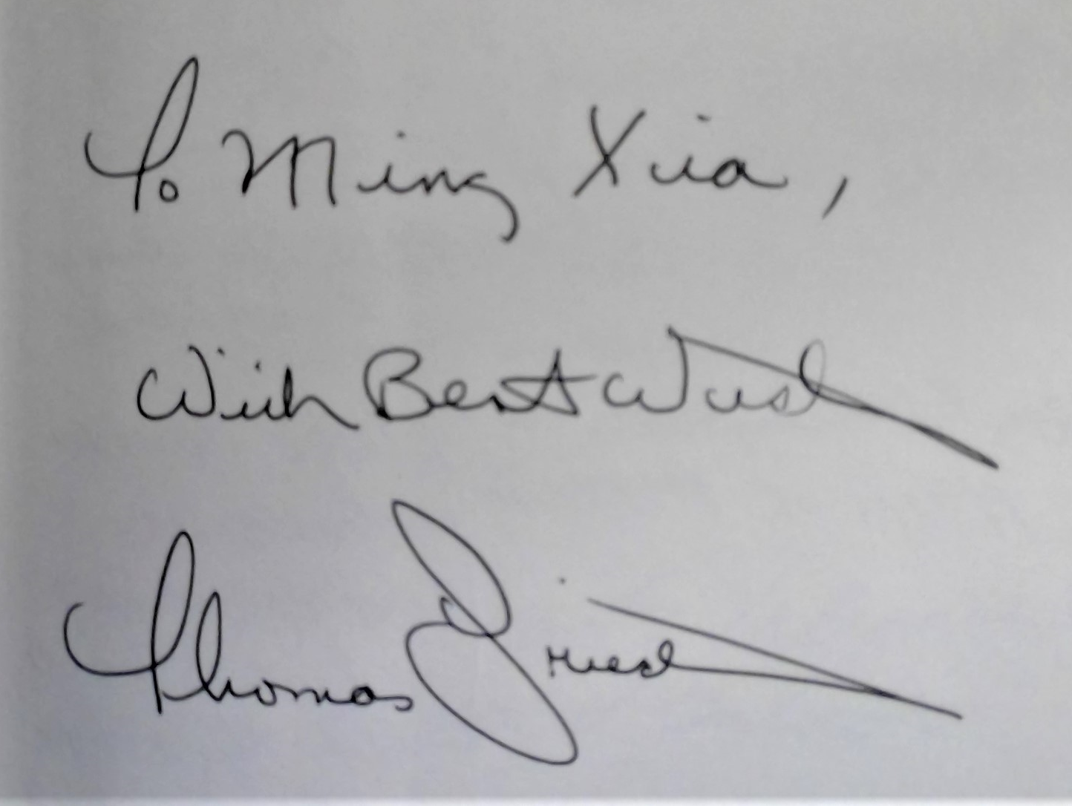
In March 2012 as I was hospitalized for a surgery, my niece, who was a business reporter on Wall Street, was about to meet Thomas Friedman. She saw I was reading Friedman’s book and took it with her to get his autograph.

Slide 5
Systemic Risks of Globalization
What dangers has Friedman detected?
Living through one of the greatest inflection point of history, we have witnessed that the three largest forces on the planet—technology, globalization, and climate change—are all accelerating at once (p. 3)
Mind the gap—a mismatch: between the change in the pace of change and our ability to develop the learning system, training systems, management systems, social safety nets, and government regulations that would enable citizens to get the most out of these accelerations and cushion their worst impact. (p. 28)
Disorientation: Turmoil rolling politics and society on both developed and developing countries, the most important governance challenge across the world.
The world of order vs. the world of disorder, control vs. chaos, and the rise of super-empowered breakers (terrorists, hackers, and all kinds of fanatics can always show us that destruction is much easier than construction).

Slide 6
Systemic Risks of Globalization from The Butterfly Defects (2014) by Ian Goldin and Mike Mariathasan
Finance: 2008 Financial Crisis is the first systemic risk in the 21st century.
Supply chain: the centrality of network, its disruption and unreliability.
Health: viruses and pandemics due to rising population density, urbanization, increasing use of /proximity to animals as food and pets, contagious diseases constructed synthetically in labs.
Infrastructure Risks: Transportation, Power Grid, and Energy.
The Internet: massive failure and cyber attack/hacking.
The environment: Natural mega-disasters.
Social risks: global inequality and poverty. Social incohesion: failure to create an inclusive system.
The governance: “The biggest systemic risk, however is not the collapse of any one of these individual systems but rather our lack of capacity to manage the growing complexities and interdependencies between them.” (p. 3)

Slide 7
Solutions from Friedman
Citing William McNeil, author of The Rise of the West: “The principal factor promoting historically significant social change is contact with strangers possessing new and unfamiliar skills.” (p. 147)
Facing compounding threats we need compounding commitment to stewardship in preserving the nature, compounding willingness to act collectively.
Necessary adaptations in the five areas—the workplace, geopolitics, politics, ethics, and community building—to help people feel more anchored, resilient and propelled in the age of accelerations. (p. 202)
To build deep connections and trust, to built voluntary communities, to love, to care to hope, to trust. (p. 6)

Slide 8
Friedman’s “Mother Nature’s Party” Platform
Single-payer universal health care system
Extend/expand the Earned Income Tax Credit (EITC) and the Child Tax Credit
Support free trade agreements
Make all postsecondary education fully tax deductible.
Roll-back the 2005 change of the bankruptcy law.
A very high wall but big gate to immigration
Ensure that next-generation Internet services are developed in America.
To upgrade ports, airports, and grids and to create jobs.
Ban the manufacture and the sale of all semiautomatic and other military-style guns in U.S.
Major tax reform.
Label all sugary drinks, fast food and offer warning of health risk.
Review regulation over financial and banking sector.
Create a Regulatory Improvement Commission.
Reform campaign and financing (English model).
End gerrymandering.
Ensure National Security Agency legal latitude to fight terrorism, etc.
Linking foreign aid to gender equity.
“Race to the top”

Slide 9
The Best from Thank You for Being Late (pp. 356-357)
A rabbi once asked his students: “How do we know when the night has ended and the day has begun?”
His students, all bright, gave four different answers: “When I look out at the fields and I can distinguish between my field and the field of my neighbor.” “When I look from the fields and I see a house, and I can tell that it’s my house and not the house of my neighbor.” “When I see an animal in the distance, and I can tell what kind of animal it is, whether a cow or a horse or a sheep.” “When I see a flower and I can make out the colors of the flower, whether they are red or yellow or blue.”
The rabbi became sadder and more frowned, upon hearing each answer, finally shouted: “No! None of you understands! You only divide! You divide your house from the house of your neighbor, your field from your neighbor’s field, you distinguish one kind of animal from another, you separate one color from all the others. Is that all we can do—dividing, separating, splitting the world into pieces? Isn’t the world broken enough? Isn’t the world splits into enough fragments? Is that what Torah is for? No, my dear students, it’s not that way, not that way at all.”
“When you look into the face of the person who is beside you, and you can see that person is your brother or your sister, then finally the night has ended and the day has begun.”

Slide 10
Critiques on Friedman
Values, priorities, and aspirations are the things we care about most and aspire to see implemented most intensely. He offers that some framework of values for us: “Are you a capitalist, a communist, a libertarian, a Keynesian, a conservative, a liberal, a neocon, or a Marxist?” Clearly so far I cannot tell how I can put a single and clear label to Friedman. I have the same trouble to describe myself. So I have kept reminding the class of the Carpenter’s toolbox!
Friedman likes to talk about the force or globalization as a natural force (in The World Is Flat) and think the world like the big Machine: big gears and pulleys. “The machine is being driven by simultaneous accelerations in technology, globalization, and climate change.” I would add the real driver to the chariot of globalization powered by the forces in technology, human desire, climate change, etc. The driver can be motivated by desire, but the desire has to be reigned by mental capacity– calm, patience, moralality, and wisdom.
Friedman says rightly at the end of his book: “The more the world demands that we branch out, the more we each need to be anchored in the topsoil of trust that is the foundation of all healthy communities. We must be enriched by that topsoil, and we must enrich it in return.” (p. 454) But I don’t think we have to “go home” or to be physically tethered to a place called “home”. The rabbi’s teaching echoes a Buddhist teaching from The Diamond Sutra: the heart and mind should not reside in matter. We should generate the “unresiding heart.” Should the heart reside in any place, it would be Mal-residing. Detachment from material world—a metaphysical teaching beyond this class!

Slide 11
Globalization in search of a Soul
Globalization during the past thirty years has created unprecedented wealth but also mind-boggling global poverty and the widening gap between rich and poor, rich countries and poor countries. The globalization failed to become inclusive and thus has become unsustainable.
Thomas Friedman uses this interesting term: “the ability to arbitrage across cultures” (p. 322). As we have seen in outsourcing in production, offshoring in banking/investment, tax-haven and corporate internal profit shifting, many MNCs, investors, and nations have used “cultural arbitrage” as well as “institutional, regulatory arbitrage” to evade regulation, and to sacrifice their social responsibility to profit. We have seen that the Wall Street-Washington corridor has been connected with the Chinese ruling elite residing at the Zhongnanhai Compound, an oligarchic partnership was created (some people envisioned a G-2 world for Chimerica!) at the cost of both Chinese people (extremely migrant workers) and American lower/middle classes. To some extent, such an intimate hugging made the COVID-19 more transmissible in the West, in particular in the United States.
As the Americans were desperate for PPEs, the trade war (high tariffs imposed by the Trump Administration) and the retaliatory withholding of these products by China have made the “supply chain” unreliable. The value chains were built upon a foundation without shared common universal values between the West and a Communist authoritarian China. It’s time to think about how globalization should be pursued in the next stage, probably among allies with common values and trust.

Slide 12
Globalization in search of a Soul--continued
Unfortunately as globalization has descended into a deep crisis, many politicians turned themselves into “institutional Luddites” (my term) to destroy the infrastructure for the previous globalization. Some U.S. senators have called on abolishing the WTO, some have attacked the WHO (World Health Organization), some advocated isolationism. Xenophobia, protectionism, and nationalism, have risen all over the world, because many people believe that these are the best ways to be insulated from the exogeneous threats and shocks. As Goldin and Mariathasan said: “When foreign is synonymous with threat, the case for collective action is made more difficult.” (p. 8) At this moment, you can see how the global COVID-19 pandemic has been made worse by the collapse of global collective action and governance, in which the American leadership (or absence of it) played a big part!
Globalization, globality and globalism are three different things. They respectively correspond to a process, a condition and the spirit of the first two. Without globalism, we cannot push forward the process of globalization and will not be able to achieve sustainable globality which can benefit the world.

Slide 13
Globalization in search of a Soul--continued
The great sociologist Pitirim Sorokin observed in his Man and Society in Calamity (1942) that the dissonance, polarization, turbulence and disorder in value system of a society are both an antecedent cause and a consequent result of calamities, namely pestilence, plague, pandemic, famine, War and violent revolution.
The disintegration of the system of values and norms are the necessary cause for all calamities (p. 294). In his forgotten “masterpiece”, Sorokin deplored the dark age in U.S. Four score years ago, “when all the Horses of Apocalypse are rampaging on the planet as never before,” the “pseudo-realists” leaders and their practical and “scientific” advisors talked about “anything but the system of values; they still plan the future society on any basis but that of a reintegrated normative pattern system.” (p. 306) The disintegration of value system can be the death of it, the abandonment by the elite, or the unbridgeable gap of faith by elite and the masses.
U.S. elites, especially those with conservative leaning in ideology, would like to talk about “a return to Adam Smith”. As I have emphasized again and again in this class, Adam Smith, the intellectual founding father of International Political Economy (in which he was accused as the advocate for a cosmopolitical economy—I like this term), has an book and an idea to offer to the current time: The Theory of Moral Sentiments (1759) and its core concept of sympathy.

Slide 14
Keep the Best to the Last: Quote from the last sentence of the Textbook by Oatley
“The United States remains the world’s largest economy; as a consequence, there can be no globalization without American participation in, and support for, the global economic system. Yet, the U.S. government’s support for globalization requires American voters to support globalization, and they seem to be unenthusiastic and perhaps even increasingly skeptical. Thus, the fate of the world’s poor is in the hands of rather poorly informed American voters. I would ask that you to keep this in mind as you debate, discuss, and make decisions about how the global economy should be organized.” (p. 368)

Slide 15
Beautiful Faces I Saw on My Journeys in India

Slide 16
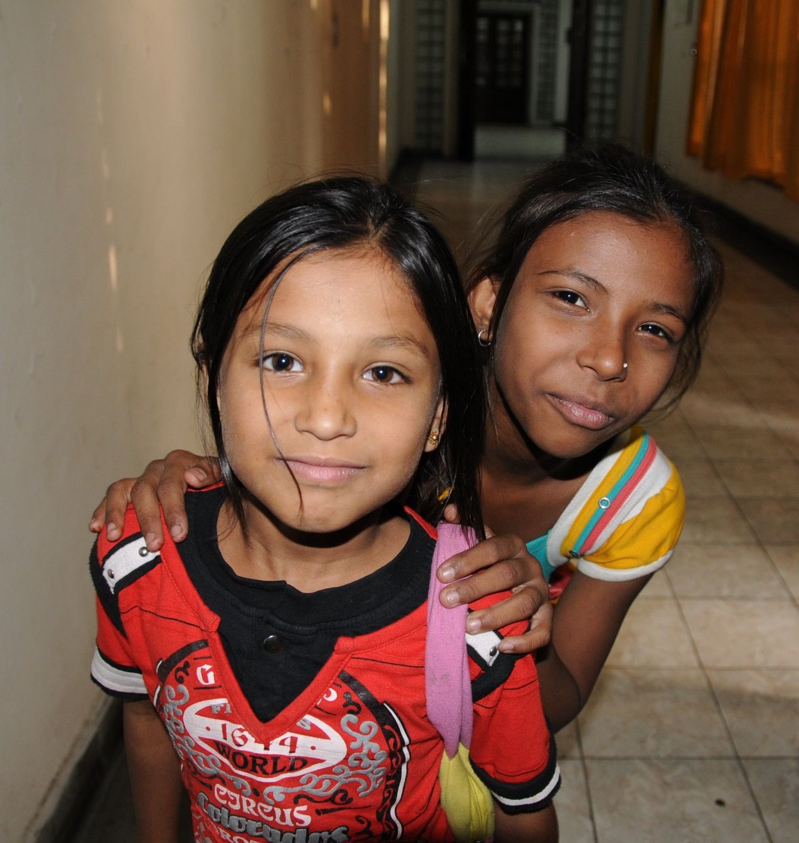

Slide 17
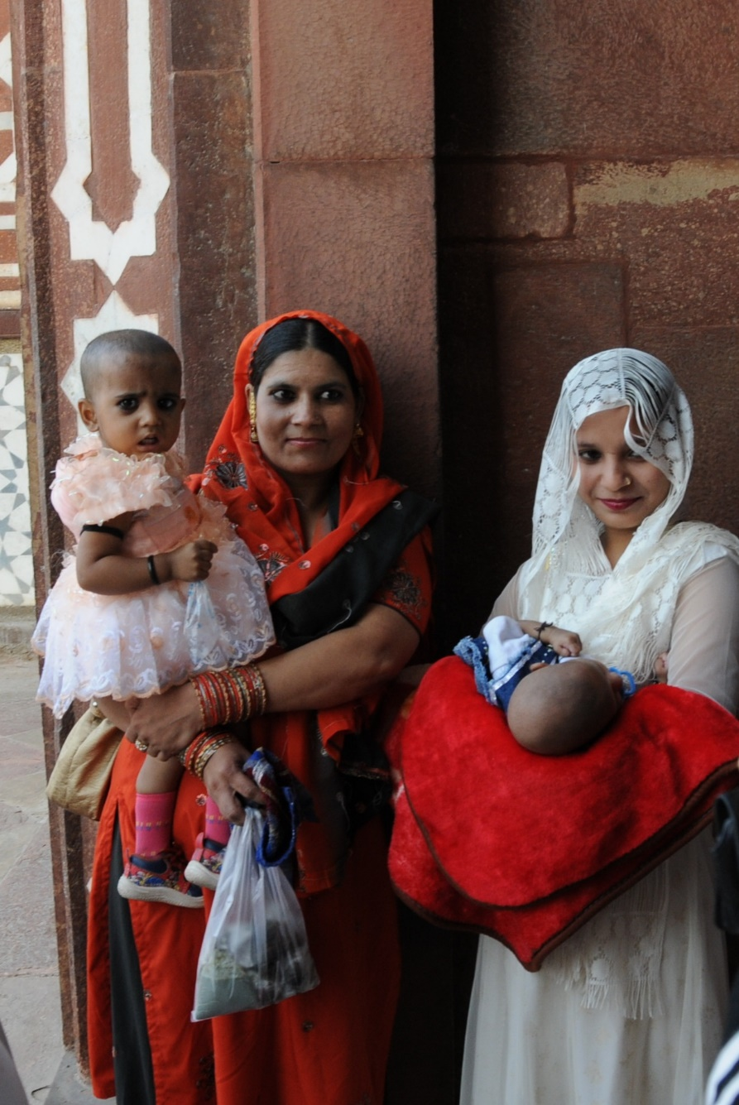

Slide 18
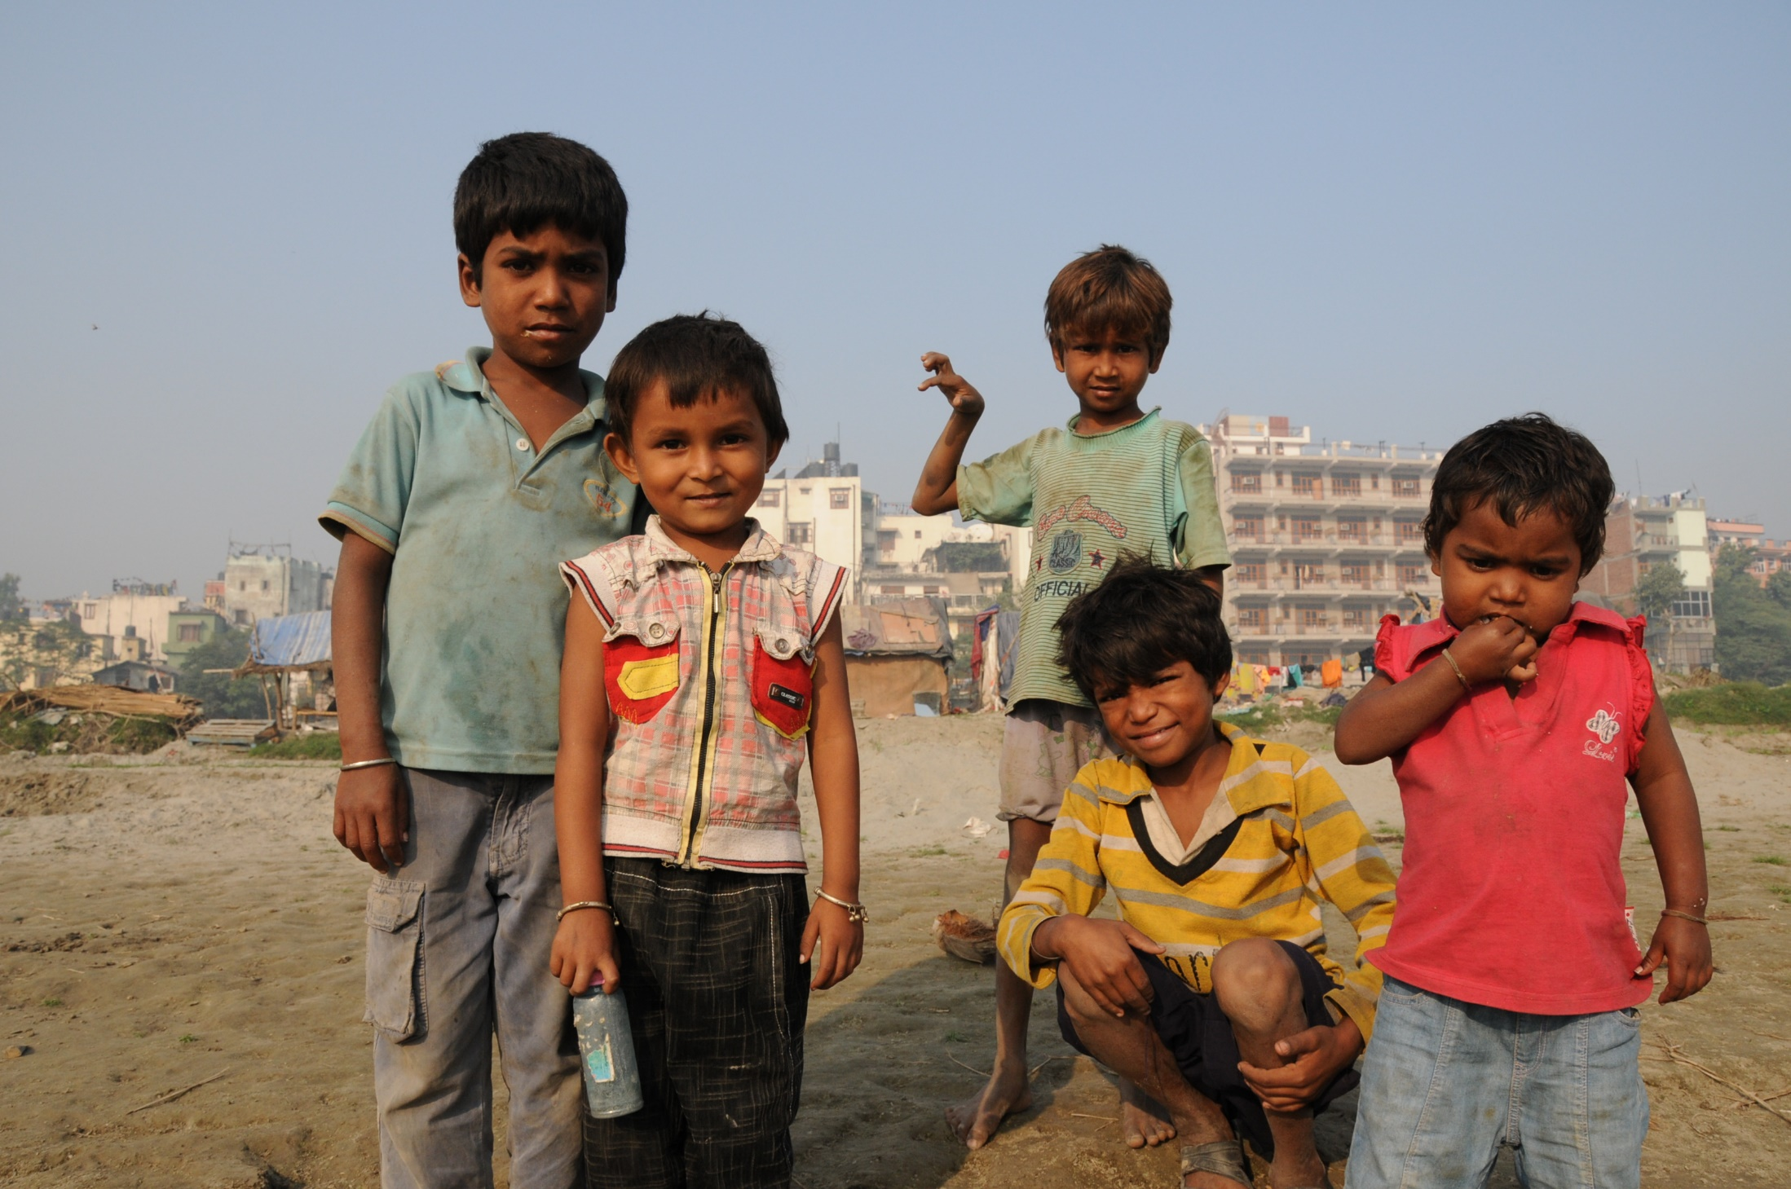
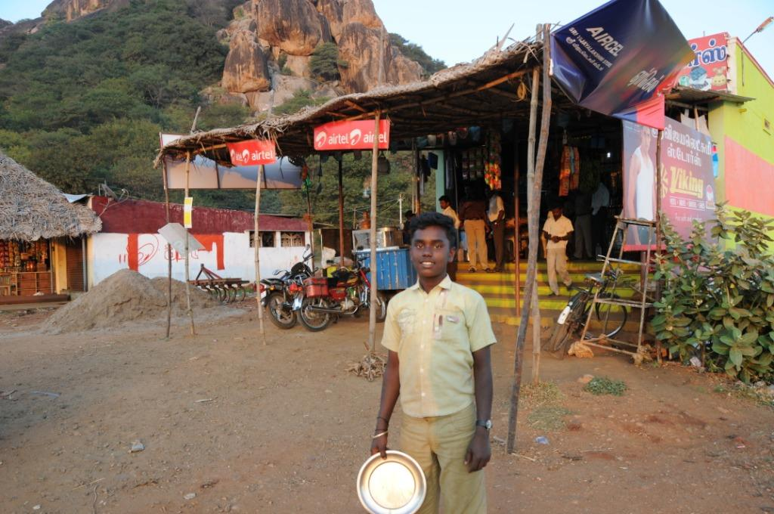

Slide 19
