Slide 1
Economics & STATE Choices in Int’l Finance
Notes:
NOTE:
To change the image on this slide, select the picture and delete it. Then click the Pictures icon in the placeholder to insert your own image.

Slide 2
Introductory Remarks
If the post-WWII arrangement, namely the Bretton Woods system, had helped the recovery of American allies in Europe and Asia, why did the U.S. feel more burdened by it in the 1960s? Why did the Nixon Administration finally abandon it in 1973?
Why has the U.S. been perceived to have changed from a benign hegemon to a predatory hegemon?
The liberalization of capital flow has been a major policy advocated by the U.S., especially since the Clinton Administration. Why did the U.S. actively push for such a liberalization as an important part of globalization? How has this policy caused the outsourcing and off-shoring in the U.S.?
As the picture in my title page indicates, Occupy Wall Street movement targeted U.S. financers and global bankers after the 2008 Financial Meltdown. How can we relate the major principles and mechanisms discussed in this section to financial crisis?

Slide 3
Bretton Woods system of fixed currency exchange rates.
Now we have known that under the Bretton Woods system, the U.S. acted as the global hegemon and used U.S. dollar (at $35 per ounce fixed rate) to create a fixed currency exchange, although not a gold standard, but as good as the gold standard.
But this system had an intrinsic contradiction that was pointed by the economist Robert Triffin in 1959 at a congressional hearing.

Slide 4
Triffin Dilemma (Triffin Paradox)
Robert Triffin, a Belgian-American economist (1911-1993)
In October 1959, Triffin, then a Yale professor, testified in front of Congressional Joint Economic Committee and announced that the U.S. dollar could not survive as the world's reserve currency without requiring the United States to run ever-growing deficits.
A popular reserve currency lifts its exchange rate, which hurts the currency-issuing country's exports, leading to a trade deficit.
The difficulty of exporting for U.S. hurts the American economy and causes long-term decline of U.S. economy.
As trade deficit persists, it creates the dollar glut--the accumulation of the United States dollar outside the US exploded.
If countries that hold U.S. dollars start worrying about the long-term health of U.S. economy and the value of U.S. dollar, they might want to redeem dollar for gold.

Slide 5
The Dollar Overhang
Due to money flowing out of the country through the Marshall Plan, U.S. military budget (especially the Korean War) and Americans buying foreign goods, the number of U.S. dollars in circulation exceeded the amount of gold that was backing them up in 1959.
In the 1960s, West Germany and Japan became two economic powerhouses in the world and kept exporting to U.S. Fortunately these two countries were U.S. allies that owed their economic successes to American strategic protection and market access, so they carefully helped the U.S. by keeping U.S. dollars.
However, by the early 1960s, the glut had caused more dollars to be available outside the US than gold was in its Treasury. If foreign countries started redeeming their dollar for gold, that could deplete U.S. gold reserve.
Actually a black market for U.S. dollar was formed, where U.S. dollar was sold below the official value under the fixed exchange rate within the Bretton Woods system. This led many speculative attacks on U.S. dollar.

Slide 6
Dollar Glut and Dollar Overhang, Oatley, p. 217
“The progression of dollar overhand can be seen in the evolution of foreign dollar holdings and the U.S. gold stock during the 1950s and 1960s. In 1948, foreigners held a total of $7.3 billion against U.S. gold holding of $24.8 billion. In this period, there was no uncertainty regarding the American ability to redeem all outstanding foreign claims on U.S. gold. By 1959, foreign dollar holdings had increased to $19.4 billion, but U.S. gold holdings had fallen to $19.5 billion. By 1970, American gold holdings had fallen to $11 billion, while foreign claims against this gold had risen to $47 billion. Thus, persistent balance of payments deficits reduced the ability of the United States to meet foreign claims on American gold reserves at the official price of $35 an once.”
As we are going to see very soon, the 1973 Oil Crisis created a huge amount of “Petro-dollar” held by OPEC countries, many were hostile to the U.S. and the West. This turned the dollar overhang a huge national security issue for the U.S.

Slide 7
The Stagflation and Double Deficits
Expansionary and Inflationary Economy
In the 1960s, the U.S. not only escalated its involvement in Vietnam where huge amount of money was poured in, the Great Society program at home was also very expensive. Inflation became a big issue.
Double Deficits: Budget Deficit and Trade Deficit
A vicious circle appeared: the Federal government ran budget deficit, it had to borrow money from the money market. Uncle Sam’s size and its good credibility made it become an attractive borrower. Foreign capital flow into the U.S. created an upward pressure upon the U.S. dollar, a strong dollar further hamper the U.S. exports.
Now we come back to our discussion before on the crisis of Keynesianism in U.S.: the phenomenon of Stagflation: economic stagnation going hand in hand with the monetary inflation.
U.S. had to find a way out. But an exit strategy is constrained by a famous trilemma.

Slide 8
Mundell Trilemma: The Unholy Trinity
Robert Mundell: 1999 Nobel Prize Winner in Economics
Also The Mundell-Fleming Model
Content:
Fixed exchange rate
Autonomy of monetary policy
Free flow of capital (capital mobility)
The Impossible Trinity: Mundell explained that among all the above three desiderata, you can get only two at the cost of the third. Think about all different combinations.
The Post WWII Arrangement under Bretton Woods system
As we have discussed before, the U.S. dollar fixed with gold offered the fixed exchange rate, the embedded liberalism gave countries autonomy in monetary policy, so the capital mobility was restricted. This is the foundation for the stability of the Bretton Woods system.

Slide 9
Crisis of U.S. Economy and the Collapse of the Bretton Woods System
On August 15, 1971, the United States under the Nixon Administration unilaterally pulled out of the Bretton Woods Accord (the Nixon Shock). The US abandoned the Gold Exchange Standard and left U.S. dollar to "float" (rise and fall according to market demand).
The 1973 oil crisis became the last straw to trigger an American economic crisis.
In October 1973, the members of the Organization of Arab Petroleum Exporting Countries (OPEC, as we have discussed in NIEO) proclaimed an oil embargo. By the end of the embargo in March 1974, the price of oil had risen nearly 400%, from US$3 per barrel to nearly $12 globally.
The Midas touch of oil: See the table below, this might be the first time that a huge amount of wealth (the estimated $1 trillion for the decade of 1971-1981) had been transferred from the developed countries to the developing countries, a reversal of long-term process of colonialism and neo-colonialism.

Slide 10
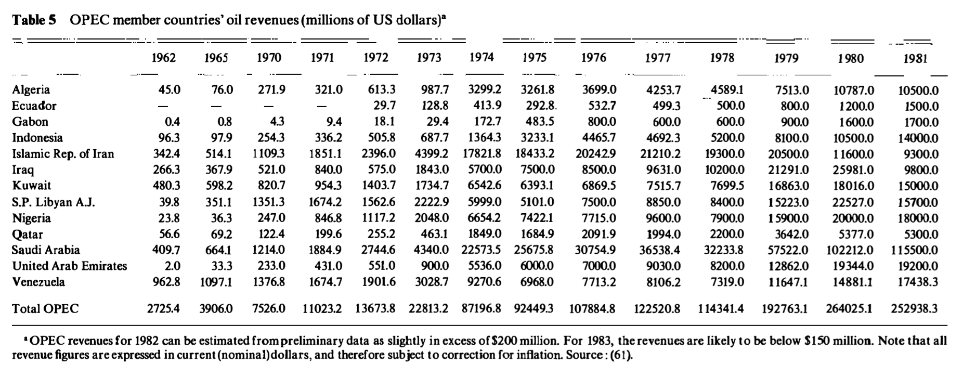
Table 5 shows the revenues received by OPEC members during the decade of 1960s and 1970s; the transfer of wealth for the decade of 1970s is approximately $1 trillion.
Source: THE PRICE OF WORLD OIL by S. Fred Singert, Ann. Rev. Energy 1983. 8 :451-508 , at: https://www.annualreviews.org/doi/pdf/10.1146/annurev.eg.08.110183.002315

Slide 11
The Collapse of Bretton Woods System
In December 1971 at the Smithsonian Institution in Washington D.C., the Group of Ten (Belgium, Canada, France, Italy, Japan, the Netherlands, the United Kingdom, the United States, Germany and Sweden) signed the Smithsonian Agreement in an attempt to stabilize the global exchange rate. The U.S. pledged to peg the dollar at $38/ounce with 2.25% trading bands, and other countries agreed to appreciate their currencies versus the dollar.
The group also planned to balance the world financial system using special drawing rights alone.
However, the U.S., under the pressure of unemployment, continued to lower interest, the dropping dollar price in the gold free market continued to cause pressure on its official rate; soon a 10% devaluation was announced in February 1973. By devaluing its currency, U.S. could abuse its exorbitant privilege in printing more money and to export its inflation to other countries. Many countries believe that U.S. had shifted from a benign hegemon to a predatory hegemon who took advantage of the world.
Japan and the EEC countries decided to let their currencies float. The floating exchange system ended the last attempt to rescue the fixed or managed floating exchange system under the Bretton Woods system.

Slide 12
Special Drawing Right (SDR)
As U.S. had increasing difficulty to maintain the fixed exchange rate under the Bretton Woods system, the SDR was created as a supplementary international reserve asset within the IMF.
According to IMF, the SDR serves as the unit of account of the IMF and some other international organizations.
The SDR is neither a currency nor a claim on the IMF. Rather, it is a potential claim on the freely usable currencies of IMF members. SDRs can be exchanged for these currencies.
SDR has been pushed by China to weaken reliance upon U.S. dollar and to strengthen Chinese RMB’s position in the world.
The 2015 Formula to determine the weights of currencies in the SDR basket
Currency | Weights determined in the 2015 Review | Fixed Number of Units of Currency for a 5-year period Starting Oct 1, 2016
U.S. Dollar | 41.73 | 0.58252
Euro | 30.93 | 0.38671
Chinese Yuan | 10.92 | 1.0174
Japanese Yen | 8.33 | 11.900
Pound Sterling | 8.09 | 0.085946

Slide 13
Different Arrangements for Exchange Rate and Capital Flow
U.S.:
Independent and Autonomous Monetary Policy
Free Capital Flow
Flexible exchange rate
China
Independent and Autonomous Monetary Policy
Fixed Exchange Rate
Control of Capital Flow
Mexico, Thailand, and Argentina under Financial Crisis
Fixed Exchange Rate
Free Capital Flow
Dependence of Monetary Policy

Slide 14
Conclusion
The Bretton Woods system, which stabilized the global financial situation for more than two decades through a fixed exchange system, collapsed. Under the floating exchange rate regime, different countries have created a variety of policy combinations to manage their economy in an increasingly volatile environment.
To manage or manipulate the exchange rate is related to the management of the value of different currencies by respective governments. Some countries want to have a stronger currency, some a weaker currency, depending on their different needs and development agendas.
The floating exchange rate depends more on the foreign exchange market, which created a huge incentive for foreign exchange speculative and speculative attacks on certain currencies, especially the weak link in international finance.
Why some countries want to have flexible or fixed exchange rate, free flow of capital or capital control, stronger (hard) currency or weaker (soft) currency, we have to look into both society-centered and state-centered approaches for explanation.

Slide 15
My Shots During Occupy Wall Street Movements in 2011

Slide 19
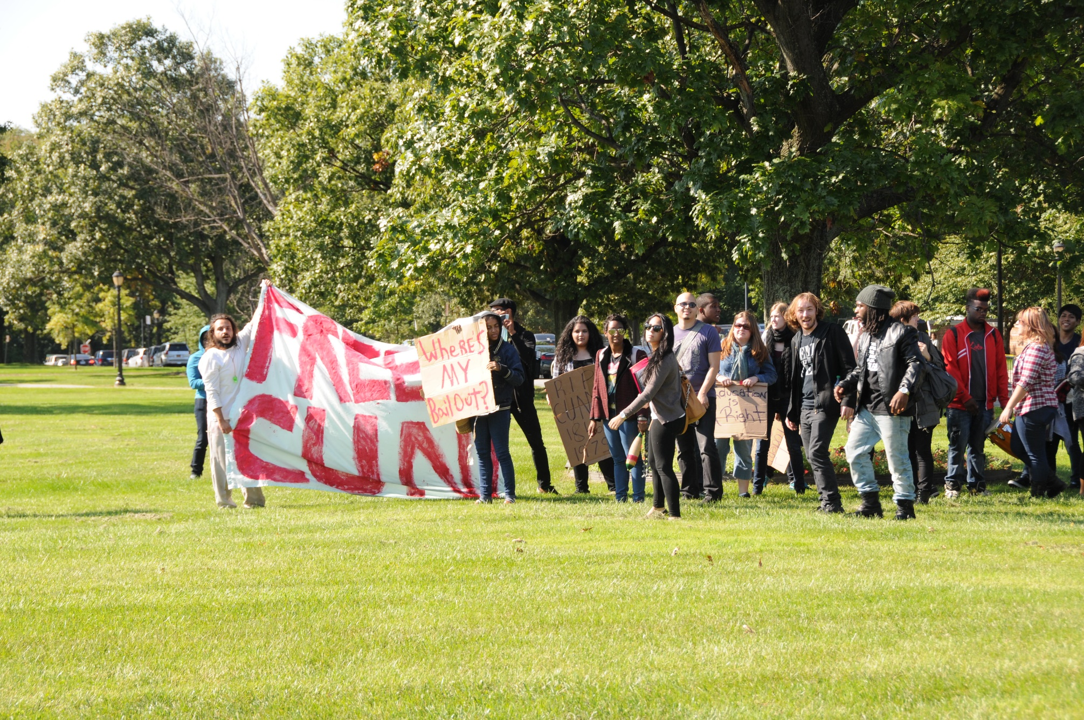

Slide 27
The philosophers have only interpreted the world in various ways; the point, however, is to change it.
--Karl Marx

