Slide 1
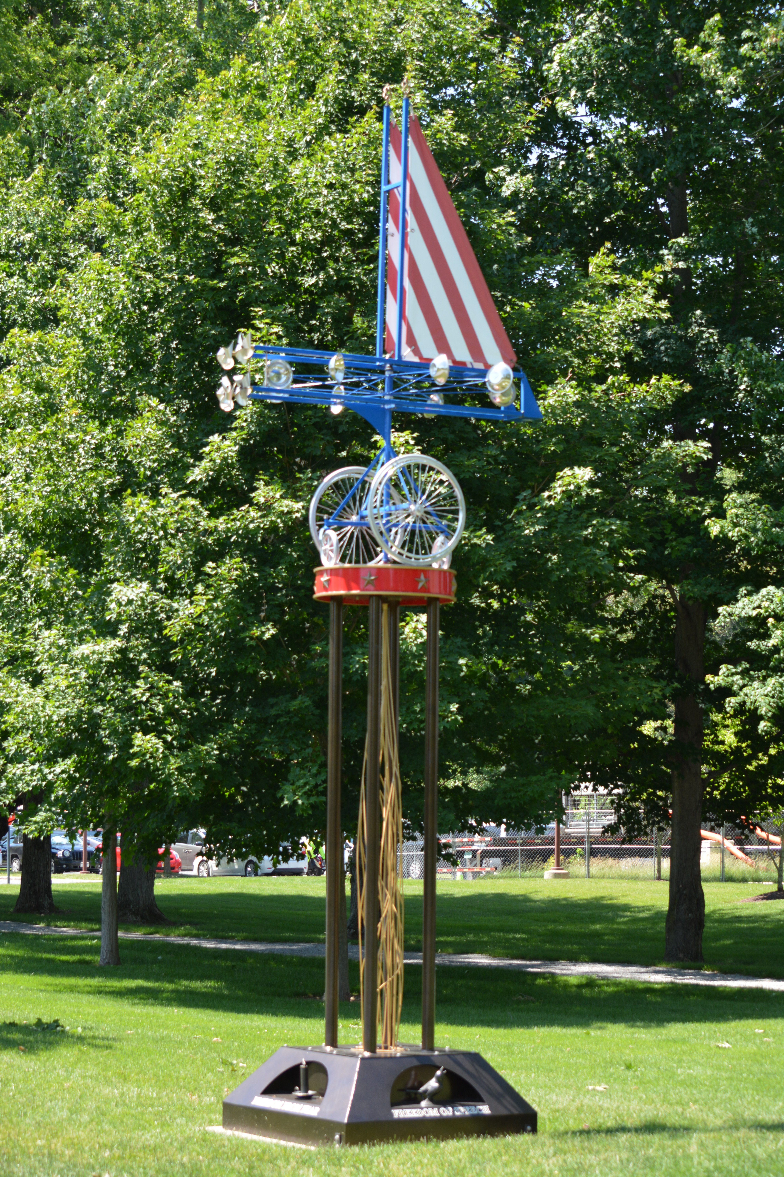
The Birth and Evolution of IPE
From Nativity to Maturity

Slide 2
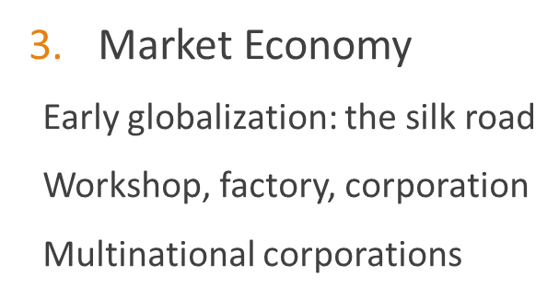
The Birth of Market and Capitalism
Brief History of Economic Systems
Primitive Economy
Command economy
Slavery system
Feudal system
Socialist/communist system

Slide 3
Creation and Evolution of World Capitalist System
Traditional System
Command System
Market System: Factors for Production
From Artisans and Merchants under Guilds to Entrepreneurs
From Manorial System to Landlords
From Serfs to Free Labor

Slide 4
The Emergence of Capitalism
Market System
Commercialization and Monetization of Life
The Crusade and Value Changes
Great Explorations
Enclosure Movement
Scientific Revolution and Industrial Revolutions
Political System
Marxist analysis: from the Force of Production to the Relationship of Production (Superstructure)
Rationalist Analysis: Landed Property and Mobile Assets

Slide 5
Modern Society: Capitalism
Two H’s Pillars (Hellenistic and Hebrew) in the West: Mathew Arnold
Three R’s Movements: Renaissance, Reformation and Revolution
The “Discovery of the New World”
Industrialization, colonization and imperialism
Technological revolutions

Slide 6
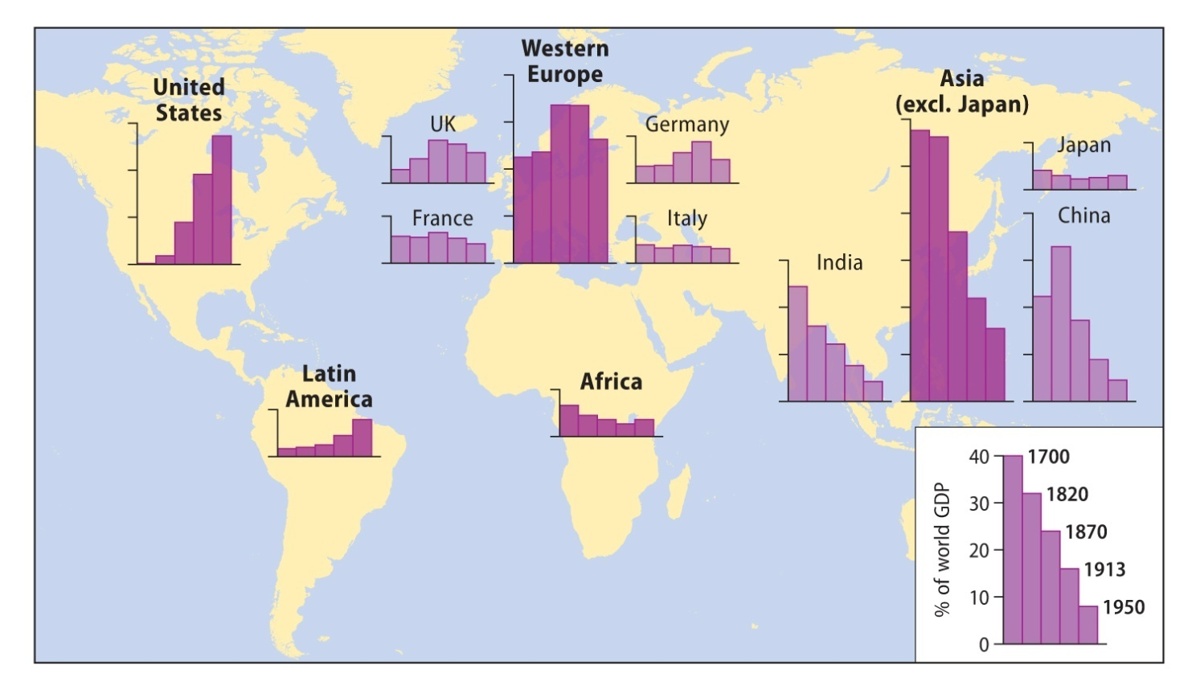
Figure 2.2 Global shifts in GDP, 1700–1950 Source: calculated from Maddison, 2001: Table B-20

Slide 7
Evolution
mercantilism
liberalism
Socialism/communism
Louis XIV and Jean Baptiste Colbert (17th century)
The physiocrats
Francois Quesnay，1694—1774
Britain’s corn law (1815-1846)
Friedrich List (1789-1846)
List, The National System of Political Economy, 1841
Alexander Hamilton: economic nationalism
Adam smith
Smith, On the Wealth of Nations, 1776
The independence of the 13 American states
David Ricardo (1772-1823), Principles of Political Economy and Taxation, 1817
Law of diminishing return, comparative advantage
Is Jesus Christ the first socialist?

Slide 8
Evolution--continued
mercantilism
liberalism
socialism
1930s: challenges from Fascism and Nazism in Europe
Hitler’s economist: Hjalmar Schacht
Militarist economy in Japan
Korekiyo Takahashi
Landed ownership in UK: primogeniture
The parliamentary reform act of 1832
The potato famines (1840)
The repeal of corn laws (1846)
The triumph of liberalism in U.K.
Pax Britannica
Karl Marx and The Communist Manifesto, 1848
Das Kapital (On Capital), 1867, 1865, 1894, 1904-10
Lenin, on colonialism and imperialism
1917: October Revolution
USSR

Slide 9
Evolution: a new synthesis
John Maynard Keynes
General Theory of Employment, Interest and Money, 1936
Keynesianism
FDR and his “Four Freedoms” speech in 1941
Defeat of Fascism and Nazism
Welfare state and embedded liberalism
Communist bloc
The victory of communist revolution in China, 1949
China, North Korea, Cuba, etc.
Reforms in 1980s
Collapse of communism in USSR and Eastern Europe

Slide 10
Evolution—post-WWII
The Bretton Woods system
The Keynesian compromise
The Rhine Miracle: the German challenge
The Tokyo Miracle: Japan's challenge
Neo-mercantilism, statism, state-guided capitalism, developmental state
Stagflation: 1970s, crisis of big government and Keynesian liberalism

Slide 11
Evolution—post-WWII, continued
The conservative challenge
Milton Friedman
Friedrich von Hayek
1979: The Thatcher Revolution
1980, the Reagan Revolution/Reaganomics
End of history and the Washington Consensus
The New 21st Century
Reform and Opening-up in China: 1979
Post-cold war era
The China Miracle
The China Model and the Rise of China
Xi Jinping’s Totalitarian Turn
The Reversal of Fortune

Slide 12
The Square of Power
The Foundation for Great Power
The Square of Power: Niall Ferguson, The Cash Nexus.
Tax Bureaucracy
Parliament
National Debt (Bond)
Central Bank
Explaining France-England Rivalry, Pax-Britanica and Pax Americana
Explaining Americhina

Slide 13
Nativity of IPE
1970s?
Founding Moment: 15 August, 1971, Nixon Suspended the Dollar-Gold Pegging
“International Economics and International Relations: A Case of Mutual Neglect”
June 1971, Joseph Nye and Robert Keohane, special issue of International Organization
1776?
Adam Smith, On the Wealth of Nations, Commerce, Liberty, Pacifism
The Independence of the 13 states
1940s
1941, Franklin Delano Roosevelt, “Four Freedoms” Speech

Slide 14
January 6, 1941, The State of the Union speech before Congress
For there is nothing mysterious about the foundations of a healthy and strong democracy. The basic things expected by our people of their political and economic systems are simple. They are:
Equality of opportunity for youth and for others.
Jobs for those who can work.
Security for those who need it.
The ending of special privilege for the few.
The preservation of civil liberties for all.
The enjoyment of the fruits of scientific progress in a wider and constantly rising standard of living.

Slide 15
These are the simple, the basic things that must never be lost sight of in the turmoil and unbelievable complexity of our modern world. The inner and abiding strength of our economic and political systems is dependent upon the degree to which they fulfill these expectations.
Many subjects connected with our social economy call for immediate improvement. As examples:
We should bring more citizens under the coverage of old-age pensions and unemployment insurance.
We should widen the opportunities for adequate medical care.
We should plan a better system by which persons deserving or needing gainful employment may obtain it.

Slide 16
I have called for personal sacrifice. And I am assured of the willingness of almost all Americans to respond to that call.
A part of the sacrifice means the payment of more money in taxes. In my Budget Message I will recommend that a greater portion of this great defense program be paid for from taxation than we are paying for today. No person should try, or be allowed, to get rich out of the program; and the principle of tax payments in accordance with ability to pay should be constantly before our eyes to guide our legislation.
If the Congress maintains these principles, the voters, putting patriotism ahead of pocketbooks, will give you their applause.

Slide 17
In the future days, which we seek to make secure, we look forward to a world founded upon four essential human freedoms.
The first is freedom of speech and expression–everywhere in the world.
The second is freedom of every person to worship God in his own way–everywhere in the world.

Slide 18
The third is freedom from want–which, translated into world terms, means economic understandings which will secure to every nation a healthy peacetime life for its inhabitants-everywhere in the world.
The fourth is freedom from fear–which, translated into world terms, means a world-wide reduction of armaments to such a point and in such a thorough fashion that no nation will be in a position to commit an act of physical aggression against any neighbor–anywhere in the world.

Slide 19
That is no vision of a distant millennium. It is a definite basis for a kind of world attainable in our own time and generation. That kind of world is the very antithesis of the so-called new order of tyranny which the dictators seek to create with the crash of a bomb.
To that new order we oppose the greater conception–the moral order. A good society is able to face schemes of world domination and foreign revolutions alike without fear.

Slide 20
Since the beginning of our American history, we have been engaged in change–in a perpetual peaceful revolution–a revolution which goes on steadily, quietly adjusting itself to changing conditions–without the concentration camp or the quick-lime in the ditch. The world order which we seek is the cooperation of free countries, working together in a friendly, civilized society.

Slide 21
This nation has placed its destiny in the hands and heads and hearts of its millions of free men and women; and its faith in freedom under the guidance of God. Freedom means the supremacy of human rights everywhere. Our support goes to those who struggle to gain those rights and keep them. Our strength is our unity of purpose.
To that high concept there can be no end save victory.

