Slide 1
Geographic Defines
Evolution of Asian Continent

Slide 2
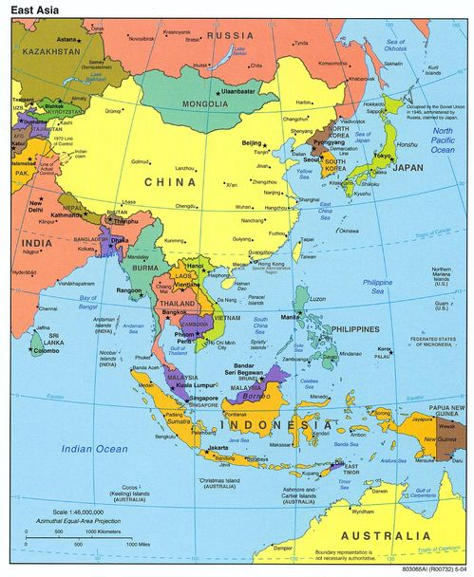

Slide 3
Supercontinent: Pangaea, the name given to the supercontinent, existed 300 m. years ago before tectonic shift separated them into different continents Source: (http://www.dailymail.co.uk/sciencetech/article-1334045/Global-warming-triggered-arrival-dinosaurs.html

Slide 4
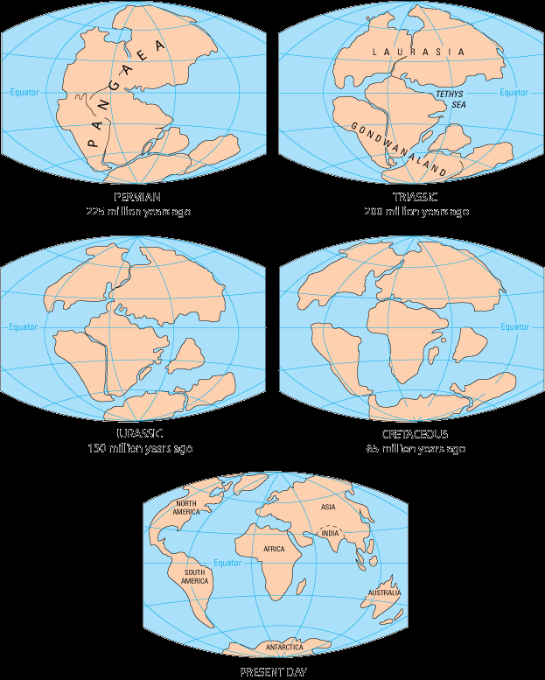

Slide 5
East Asia: Broader Meaning—East Asia and Southeast Asia
Narrow Meaning: Northeast Asia—China (and Taiwan, Hong Kong, Macao), Japan and two Koreas
Continental Asia vs.
Insular (Maritime) Asia

Slide 6
Cultural Traditions
Chinese Influence
Indian Influence
Islamic Influence
Western Influence
Japanese Influence

Slide 7
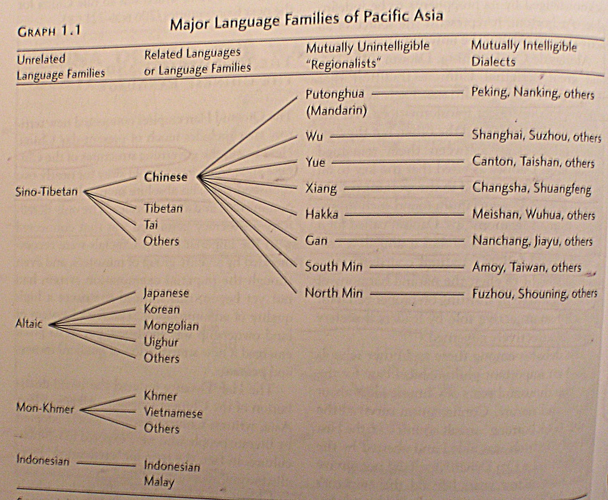

Slide 8
Ethnic Background: CIA’s The World Factbook, accessed 2012.08.29
Brunei: Malay 66.3%, Chinese 11.2%, indigenous 3.4%, other 19.1% (2004 est.)
Burma/Myanmar: Burman 68%, Shan 9%, Karen 7%, Rakhine 4%, Chinese 3%, Indian 2%, Mon 2%, other 5%
Cambodia: Khmer 90%, Vietnamese 5%, Chinese 1%, other 4%

Slide 9
Ethnic Groups--continued
China: Han Chinese 91.5%, Zhuang, Manchu, Hui, Miao, Uighur, Tujia, Yi, Mongol, Tibetan, Buyi, Dong, Yao, Korean, and other nationalities 8.5% (2000 census)
Indonesia: Javanese 40.6%, Sundanese 15%, Madurese 3.3%, Minangkabau 2.7%, Betawi 2.4%, Bugis 2.4%, Banten 2%, Banjar 1.7%, other or unspecified 29.9% (2000 census)

Slide 10
Ethnic Groups--continued
Japan: Japanese 98.5%, Koreans 0.5%, Chinese 0.4%, other 0.6% [note: up to 230,000 Brazilians of Japanese origin migrated to Japan in the 1990s to work in industries; some have returned to Brazil (2004)]
Korea, North: racially homogeneous; there is a small Chinese community and a few ethnic Japanese
Korea, South: homogeneous (except for about 20,000 Chinese)

Slide 11
Ethnic Groups--continued
Laos: Lao 55%, Khmou 11%, Hmong 8%, other (over 100 minor ethnic groups) 26% (2005 census)
Malaysia: Malay 50.4%, Chinese 23.7%, indigenous 11%, Indian 7.1%, others 7.8% (2004 est.)
Philippines: Tagalog 28.1%, Cebuano 13.1%, Ilocano 9%, Bisaya/Binisaya 7.6%, Hiligaynon Ilonggo 7.5%, Bikol 6%, Waray 3.4%, other 25.3% (2000 census)

Slide 12
Ethnic Group--continued
Singapore: Chinese 76.8%, Malay 13.9%, Indian 7.9%, other 1.4% (2000 census)
Taiwan: Taiwanese (including Hakka) 84%, mainland Chinese 14%, indigenous 2%
Thailand: Thai 75%, Chinese 14%, other 11%

Slide 13
Ethnic Groups--continued
Timor-Leste (East Timor): Austronesian (Malayo-Polynesian), Papuan, small Chinese minority
Vietnam: Kinh (Viet) 85.7%, Tay 1.9%, Thai 1.8%, Muong 1.5%, Khmer 1.5%, Mong 1.2%, Nung 1.1%, others 5.3% (1999 census)

Slide 14
Similarities
1. China and Its Influence:
Korea, Japan, Singapore and Vietnam—language, religion, writing system, bureaucracy, law, family system, moral system and ethics.
Other Areas: Chinese Immigrants (Diaspora), Confucianism, Family Tie.

Slide 15
2. Rice planting society
Water and Irrigation System: Hydraulic Society, Monsoon Season 3. Overpopulation: High Density, High Growth
See: Tables in the next pages. 4. Patron-Client Relationship
Respect for Family and Community Interest
Personal Relationship, Instead of Laws and Universal Values

Slide 16
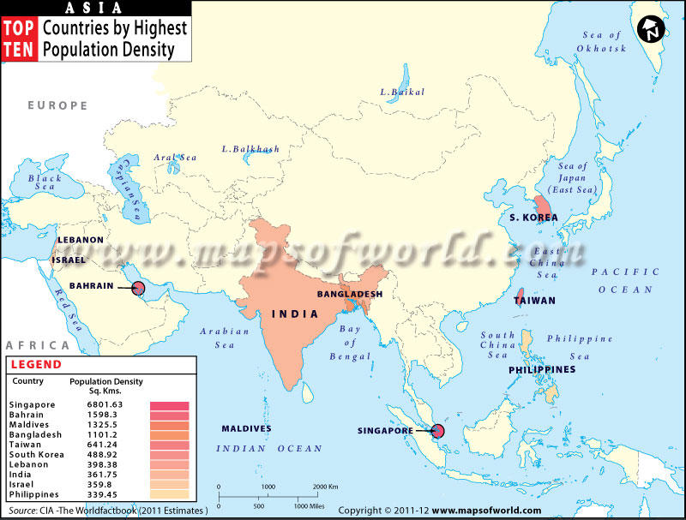

Slide 17
S.no 1 2 3 4 5 6 7 8 9 10 11 12 13 14 15 16 17 18 19 20 21 22 23 24 25 | Country Singapore Bahrain Maldives Bangladesh Taiwan South Korea Lebanon India Israel Philippines Japan Sri Lanka Vietnam Pakistan North Korea Nepal Kuwait China Thailand Indonesia Syria Cyprus Turkey Armenia Azerbaijan | Density in sq. km 6801.63 1598.3 1325.5 1101.2 641.24 488.92 398.38 361.75 359.8 339.45 334.67 324.4 273.39 235.33 202.9 199.7 145.67 139.29 130.03 128.96 121.6 121.12 100.55 99.79 96.68

Slide 18
S.no 26 27 28 29 30 31 32 33 34 35 36 37 38 39 40 41 42 43 44 45 46 47 48 49 Comp | Country Malaysia Cambodia Burma (Myanmar) Qatar Jordan Brunei Iraq Georgia Uzbekistan United Arab Emirates Tajikistan Iran Afghanistan Yemen East Timor Kyrgyzstan Laos Bhutan Saudi Arabia Turkmenistan Oman Russia Kazakhstan Mongolia New York US | Density in sq. km 87.1 81.21 79.81 73.19 72.85 69.71 69.36 65.79 62.87 61.59 53.3 47.26 45.74 45.71 28.37 27.94 27.35 18.45 12.16 10.24 9.78 8.11 5.7 2 159.2 34.01

Slide 19
5. Authoritarian Tradition
Empire Building
Authoritarian Development Model
6. Rapid Economic Development
See: Tables 1.2, 1.3, and 1.4 in Ferdinand (pp. 6-8; see next three pages)
7. Japan and Its Influence in the Region
8. Experience of Colonization

Slide 20
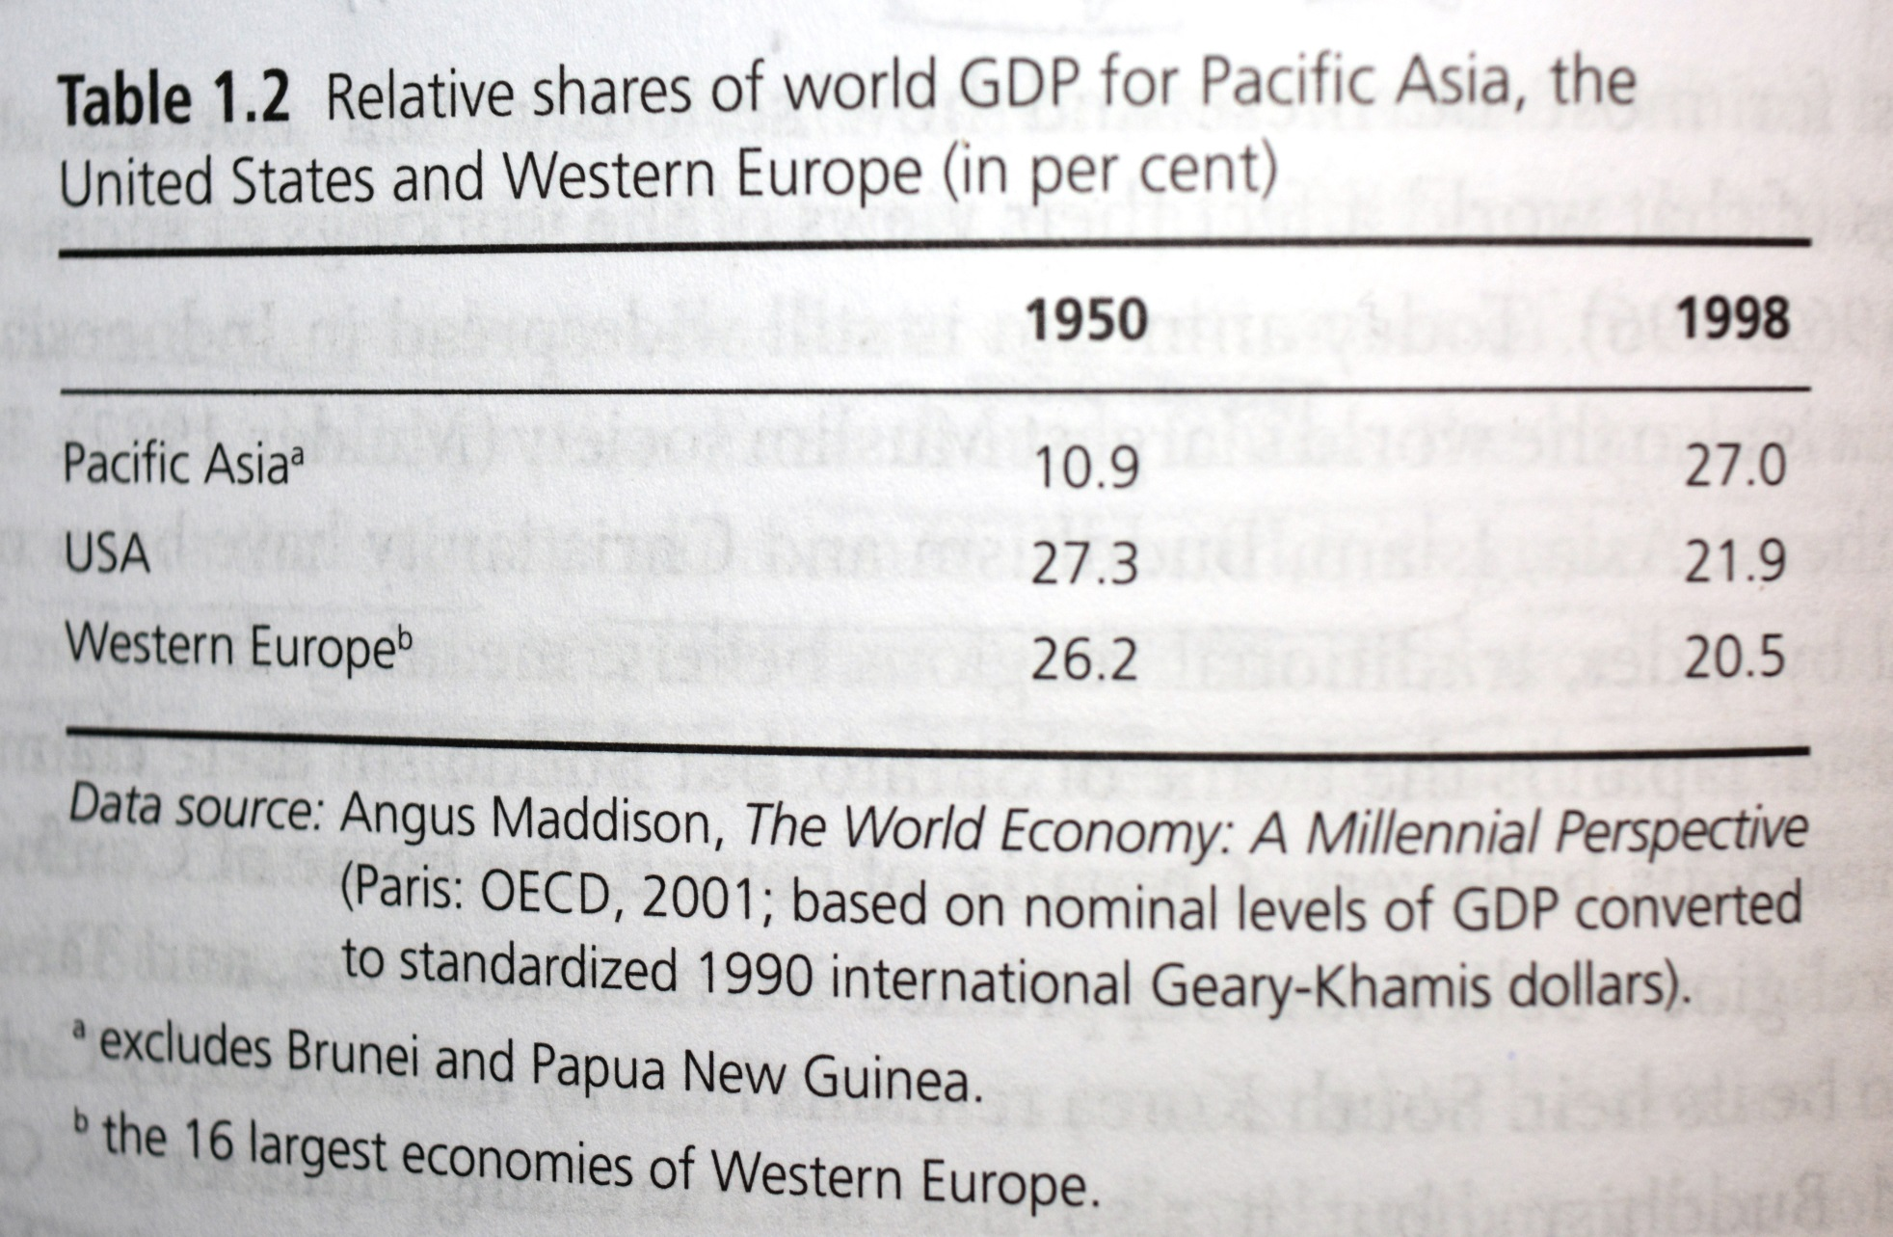

Slide 21
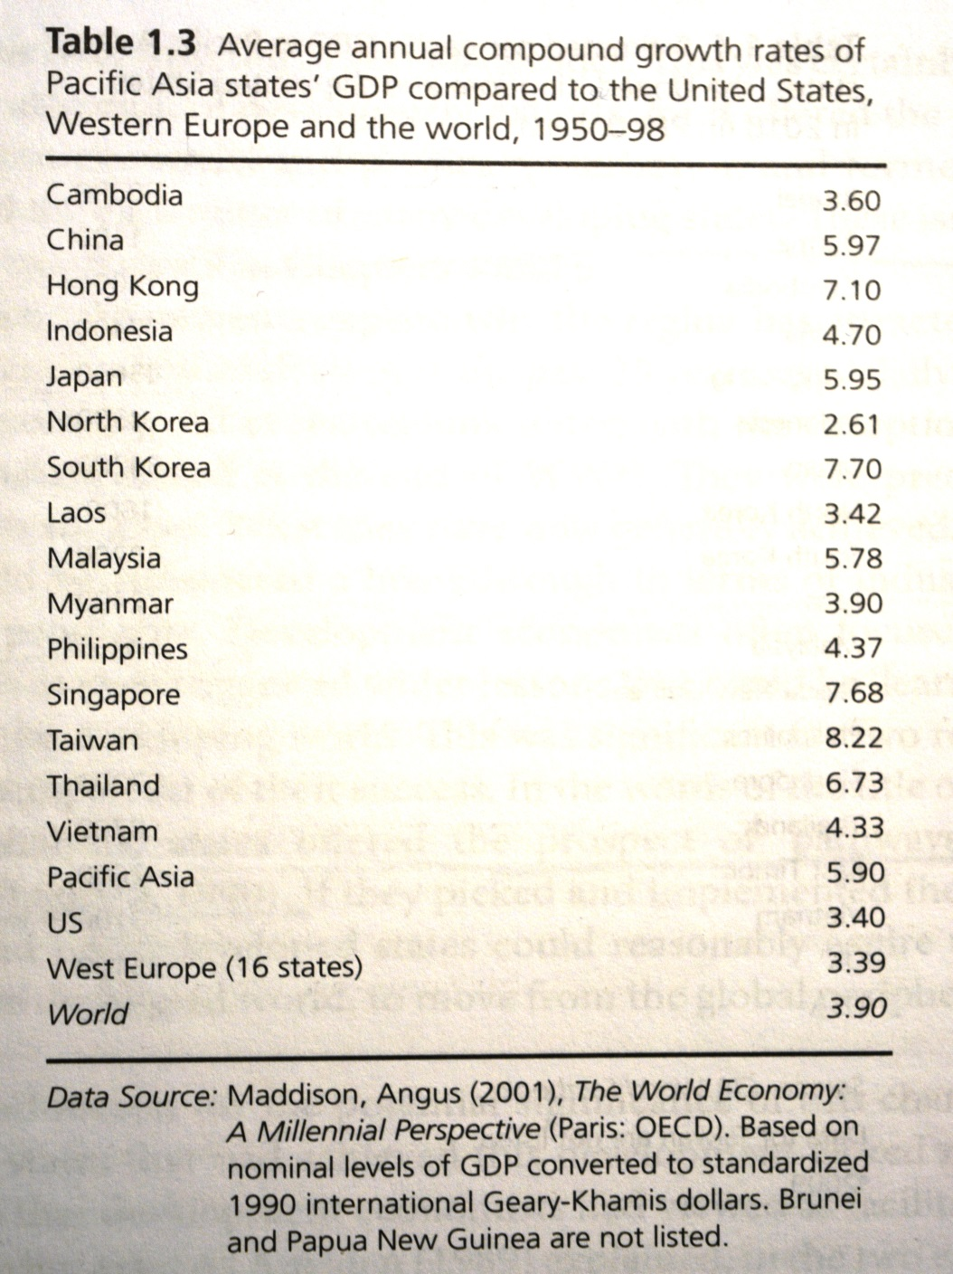

Slide 22
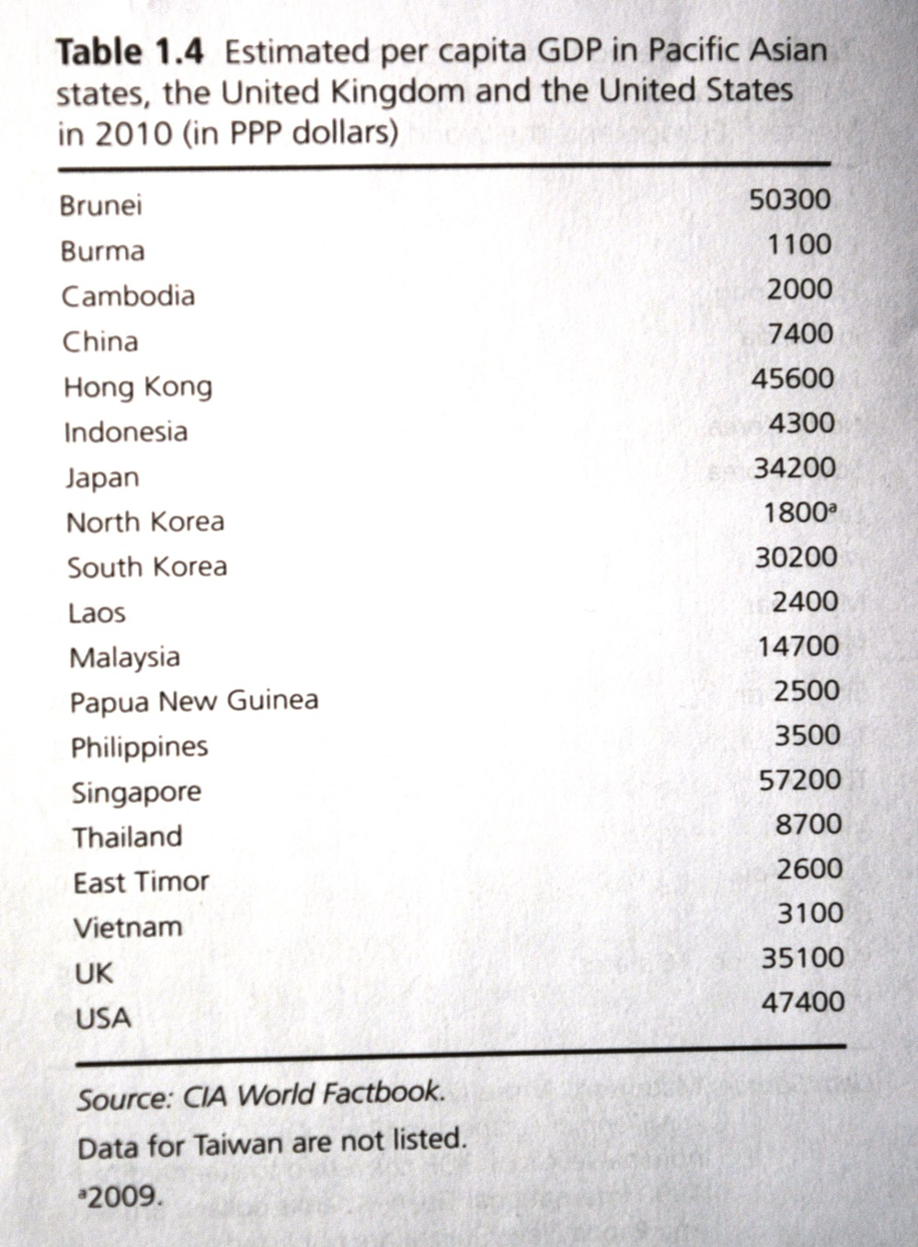

Slide 23
Diversities
Size and Population: e.g.: China’s territory is more than eighteen times larger, and its population is almost six times greater than the “Four Little Dragons” and Japan combined. See: Table 1.1 in Ferdinand, p. 3)
Economic Development Levels
Japan as the Economic Superpower
Tiger Economies (Four Little Dragons, NICs or NIEs)
NECs (Newly Exporting Countries, the Cubs)
Marxist-Leninist Countries (most are less developed countries)

Slide 24
3. Democratic Development
Japan, South Korea, and Taiwan: Mature and Stable Democracy
Indonesia, Thailand, and Philippines: Unstable Democracy
Singapore: Authoritarian Parliamentary System
Malaysia: Illiberal Democracy
Burma (Myanmar): Military Dictatorship
China, North Korea, Vietnam, and Laos: Communist Dictatorships

