Slide 2
1. Introducing the Ancient Debate: The Ideal Versus the Real

Slide 3
The Ideal Versus the Real
The clash drives many fictional plots:
Batman
The Untouchables
Game of Thrones
Star Wars
My Fair Lady
The Hunger Games
The Ballad of Songbirds and Snakes

Slide 4
The Ideal Versus the Real
IDEALISM
What we would like to do
Luke Skywalker/Forrest Gump/Dr. Zhivago
Campaigning for political office
REALISM
What we can and must do
Han Solo/Dr. Strangelove/Coriolanus
Holding political office
Politics must balance:
The tension between the real and the ideal, normative and positive
Between the dreams of what could be and real-world limitations

Slide 5
Classical Theory, Modern Reality, and Stuff
Thrasymachus is a realist:
Concerned with tangible personal gains
Little regard for ethics or the good of society
Socrates is an idealist:
The purpose of politics is the happiness of the citizenry
Who has the stronger point?
The Nature vs. Nurture debate: the malleability of human nature?
Notes:
If we ignore reality, we may be manipulated.
If we fail to challenge reality, we fail to make the world a better place.

Slide 6
You’re Just a Mime Trapped in an Invisible Box
Conceptual frameworks are what we use to make sense of the world.
Our conceptual frameworks include:
personal experiences
preferences
expectations.
They are important when we interpret political phenomena.
Everyone uses a unique conceptual framework.

Slide 7
Fiction as a Tool for Exploring Politics
Fiction can help transcend our conceptual frameworks
Why might fiction be useful for examining politics?
It offers a model—a perfect scene and typical characters.
It can give us a taste for political situations.
It exaggerates political phenomena.
It is engaging and interesting.
It encourages an active exploration of the material.
Fictional writers are imaginative; imagination is one important component of genius.

Slide 8
Utopias in Fiction and Politics
Utopias are subjective interpretations of the perfect world.
Utopias are useful for:
examining the flaws of political ideas
envisioning a path toward a better future
Marx extended capitalist ideas to point out inherent fundamental flaws and provided an alternative vision of utopian communism.

Slide 9
Utopias in Fiction and Politics
Utopian theorizing reached a pinnacle during the idealist period (following World War I)
President Wilson proposed the League of Nations:
The proposal was built on the hope of spreading liberal democracy across the globe.
The idea was not supported, even in the United States.
Dystopia (anti-utopia): Magnifying flaws to warn the humanity
--George Orwell’s 1984 and Animal Farm;
--Suzanne Collins: The Hunger Games Trilogy, The Ballads of Songbirds and Snakes

Slide 10
What Is Politics?
Politics: from “Polis”—city-state.
Defined here as goal-directed actions with public consequences.
Political tools, actors, tactics, and goals are always changing
Even not participating can be political

Slide 11
What Is Political Science?
Political Science is hard to define, political scientists do not agree on a single definition
Much debate and controversy surrounds how the discipline defines the Science of Political Science
Hard science vs. Soft science
The controlled context: laboratory?
Repeatability?
Small-N vs. Large-N research
Quantifiable or not?
Comparison—Comparative method in politics
Deterministic vs. Probabilistic, Monocausal vs. multicausal

Slide 12
What Is Political Science?
All science depends on fully documented and published research that is done openly and transparently so that it can be replicated, critiqued, and possibly even falsified
Creates an agreement reality (Babbie) in which we can accept the validity of findings without experiencing them directly (experiential reality).

Slide 13
What Is Political Science?
There are a variety of reasonable and effective methods for pursuing an understanding of politics
Qualitative versus Quantitative Methodologies
Positivism, interpretivism, behavioralism, structuralism, realism, institutionalism, pluralism
Statistical analysis, case studies, longitudinal studies, content analysis

Slide 14
“Laws” in Political Science
Lord Acton: Power corrupts, absolute power corrupts absolutely.
Robert Michels: Iron Law of Oligarchy
Duverger’s Law: Electoral system determines party system. (Maurice Duverger)

Slide 15
A Framework for Political Analysis: Structural- Functional Approach

Slide 16
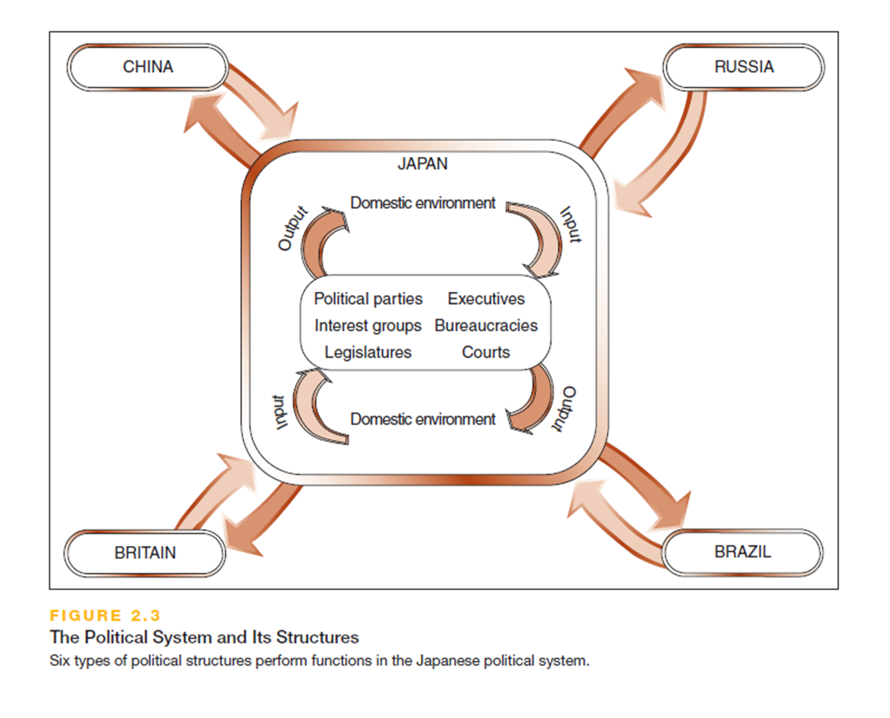

Slide 17
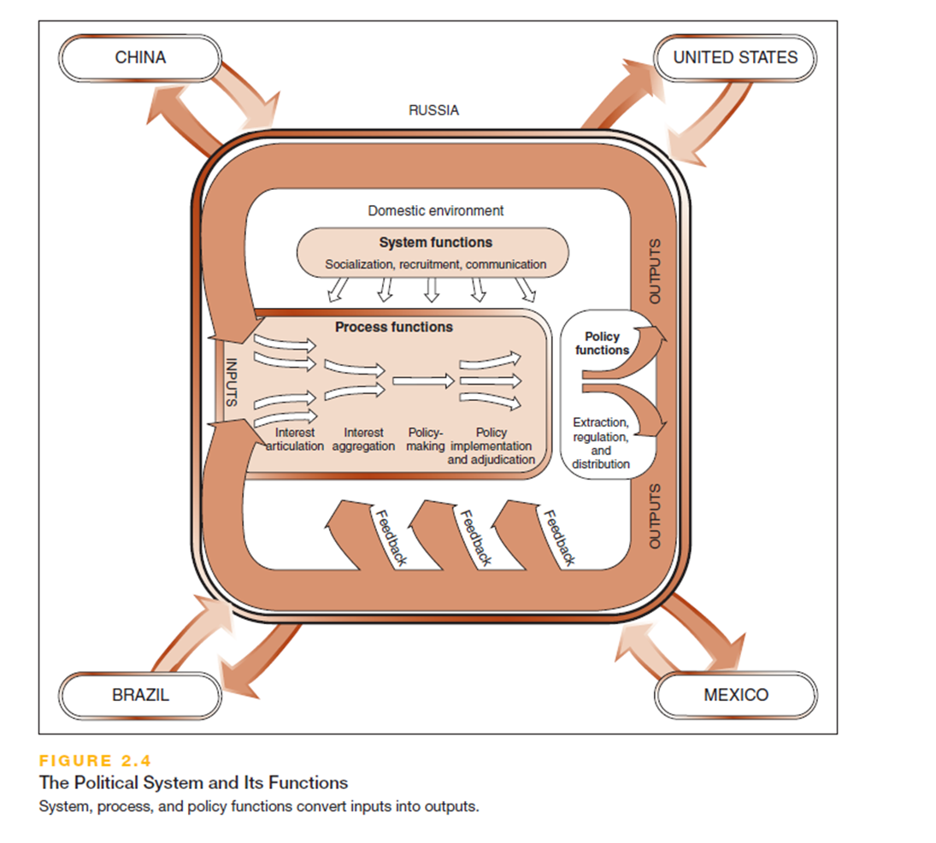

Slide 18
Political Theories and Ideologies
Political theories are aimed at developing knowledge
Complex and logically robust
Written for a select audience
Political ideologies are about organizing and directing action
Simple and dramatic calls to action
Written for the masses
Normative vs. Positive/Empirical
Notes:
Ideologies can be placed on a political spectrum ranging from the most Liberal to the most Conservative (Left to Right)

Slide 19
Classical Liberalism
Based on the theories of Thomas Hobbes and John Locke
Individuals should be largely free from governmental constraints
Very influential for the American insurrection from Great Britain
Thomas Jefferson said, “The government that governs best, governs least”
Adam Smith added economic freedom as a key variable

Slide 20
Classical Conservatism
Associated with 18th-century parliamentarian Edmund Burke
Reaction to excesses of the French Revolution
Social institutions embody a wealth of knowledge that has evolved and endured over centuries
Objects the idea that individual human reason could know better
Asserts that it is dangerous to change or eliminate treasured institutions carelessly

Slide 21
Communism
Based on the ideas of Karl Marx
Key problem is class divisions
The bourgeois class controls the machinery of the state and exploits the labor of the proletariat
The proletarian class is paid only a fraction of the worth of the goods it creates
Intended to apply to industrial capitalist societies

Slide 22
Democratic Socialism
Shares communist vision of social, political, and economic equality
Believes this can be achieved by democratic means
Advocated by Eduard Bernstein (1850–1932)
Notes:
Social Democrats seek to modify capitalism with the infusion of some elements of socialism

Slide 23
Reform Liberalism
Believes government should remove obstacles to individual competition:
Negative freedom
Believes government should also provide basic necessities (education, health care, safety net) to ensure all can compete equally:
Positive freedom

Slide 24
Fascism
Twentieth-century ideology
Emphasis on the superiority of a particular group
Democracy discouraged
Public spectacles reinforce traditions and motivate support
Nationalism is important, along with a strong military rule and vigilance against enemies
Notes:
Charismatic leader comes to power during hard times with promises for recovery

Slide 25
Theories
Contractual enlightenment model
Marxism
Institutionalism
Behavioralism
Rational Choice/Game theory
Modernization theory

Slide 26
Ideological Spectrum or Diamond in Motion?
Temporal Dimension: Nostalgic/Conservative==Status Quo==Progressive/Forward Looking
Globalism
Collective
Spatial Dimension:
State
Market
Individualistic
Nationalism

Slide 27
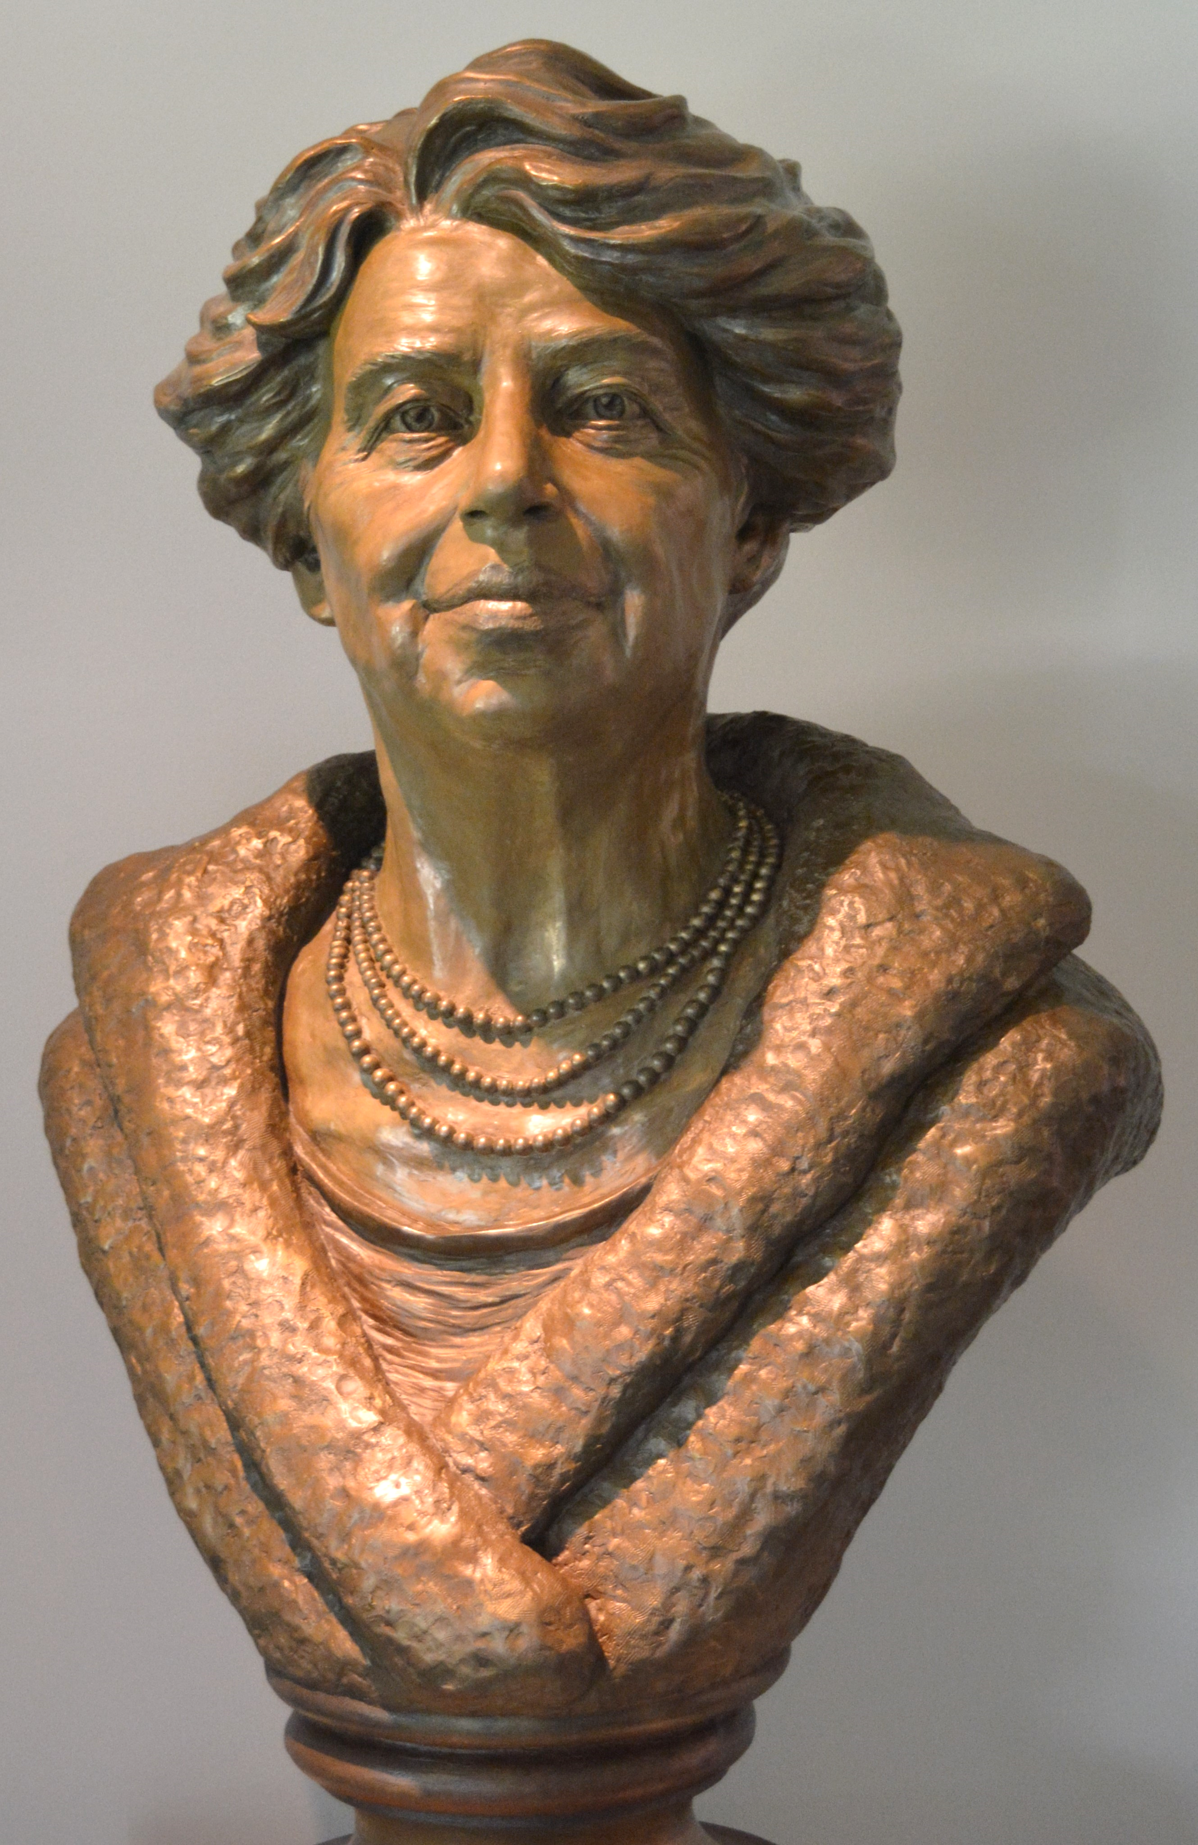
Pictures at FDR’s Hyde Park

Slide 28
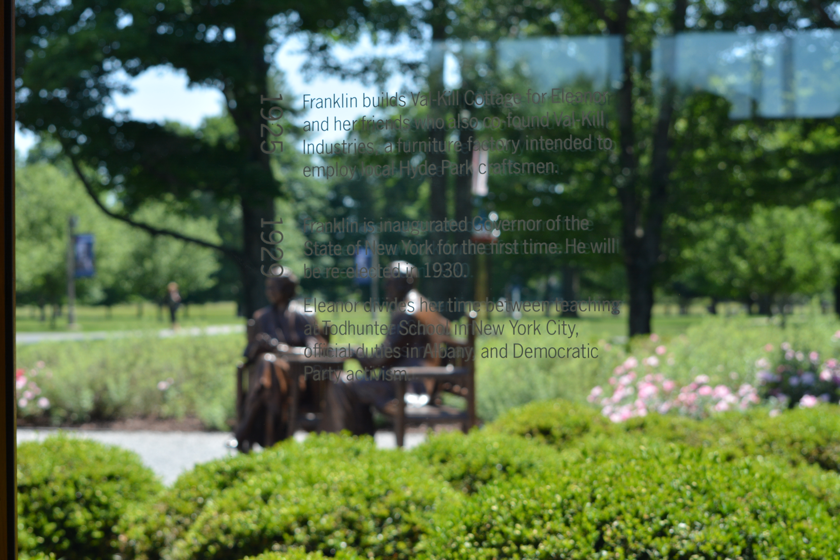

Slide 29
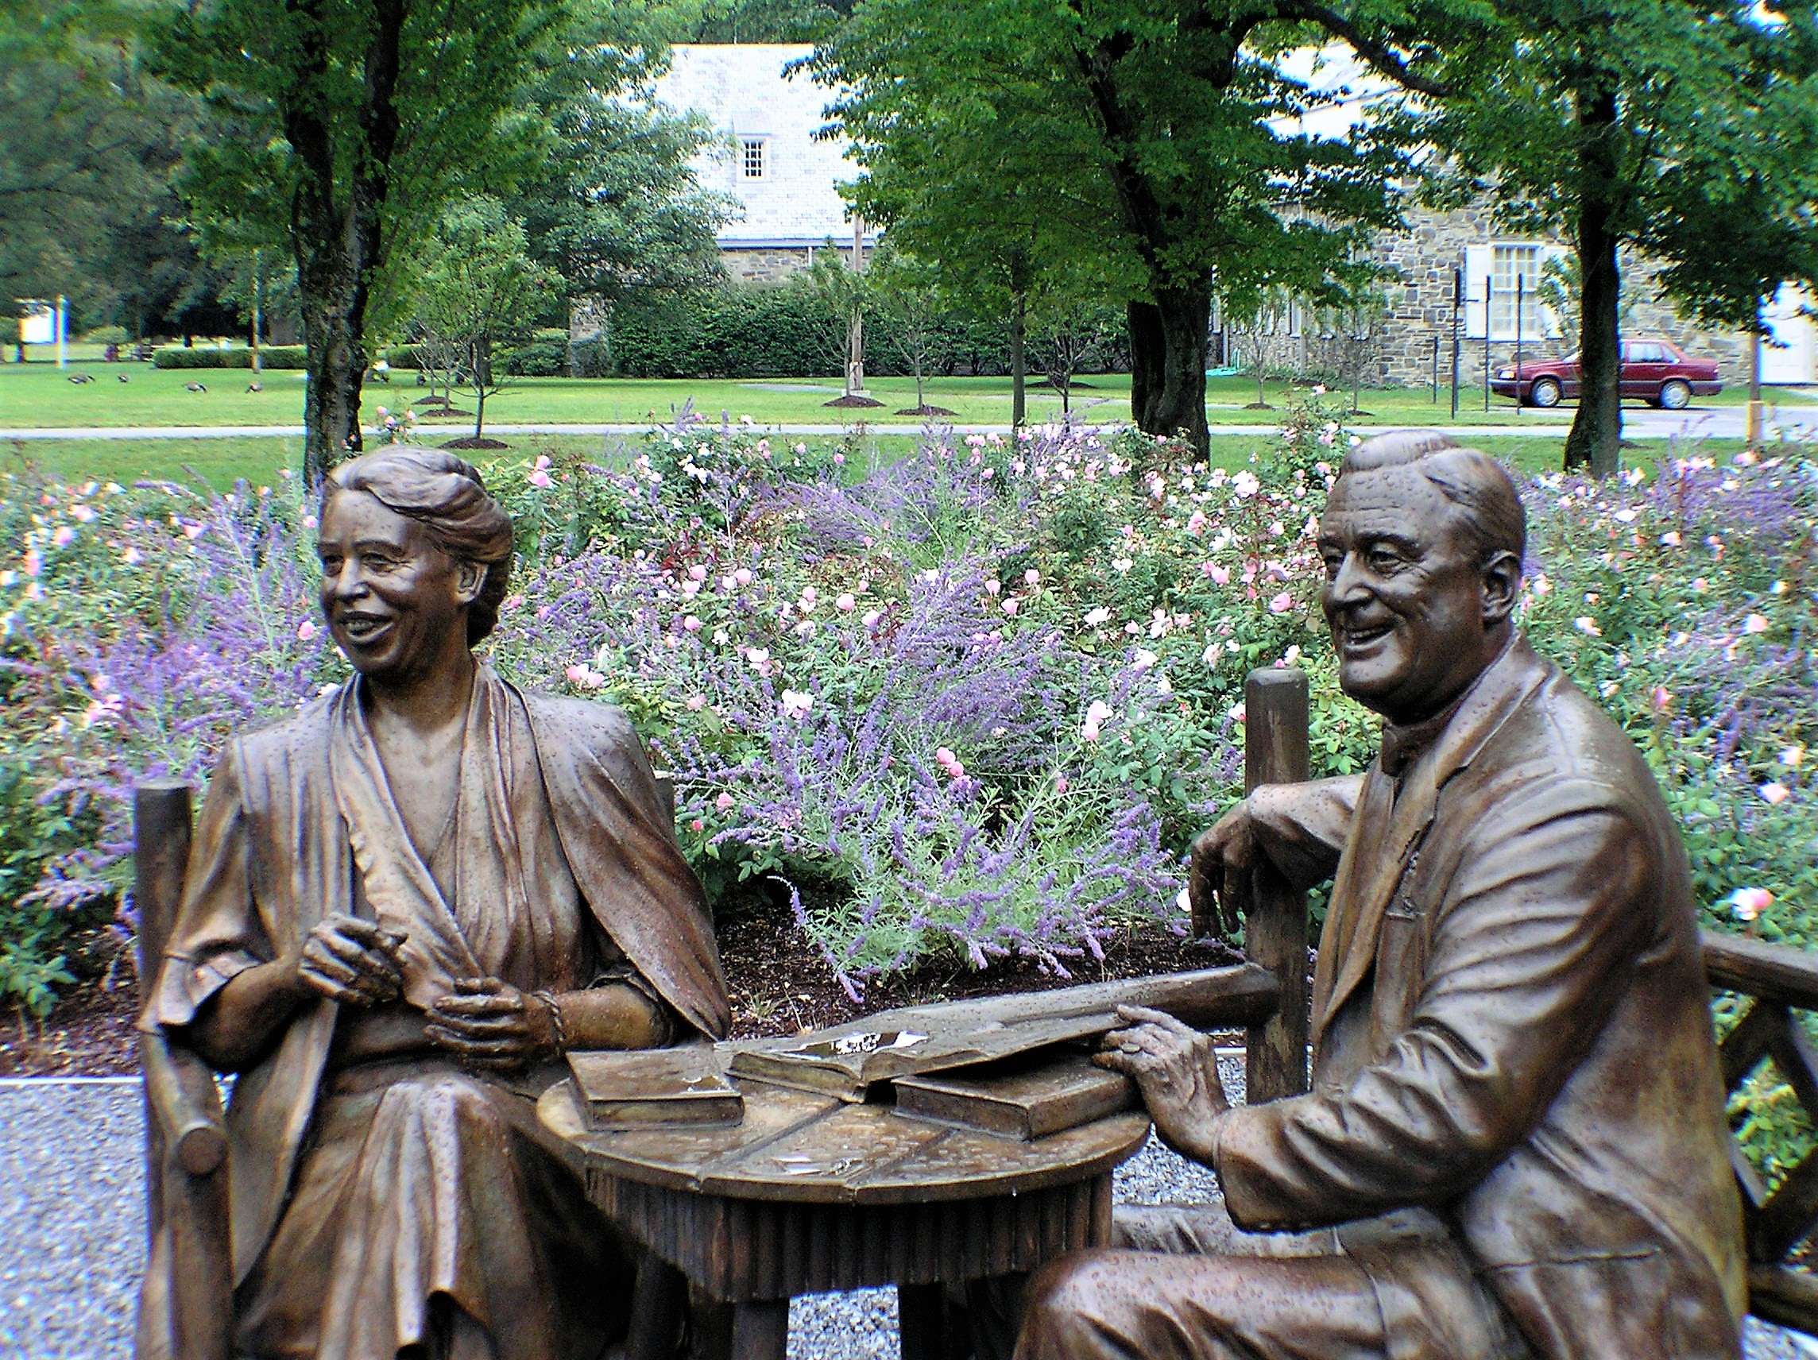

Slide 30
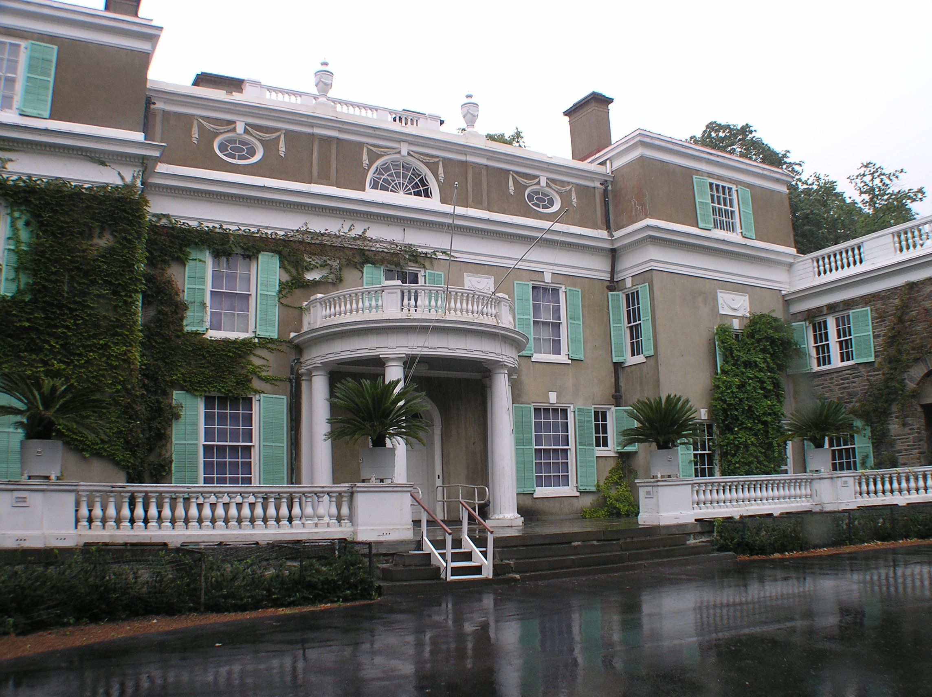

Slide 31
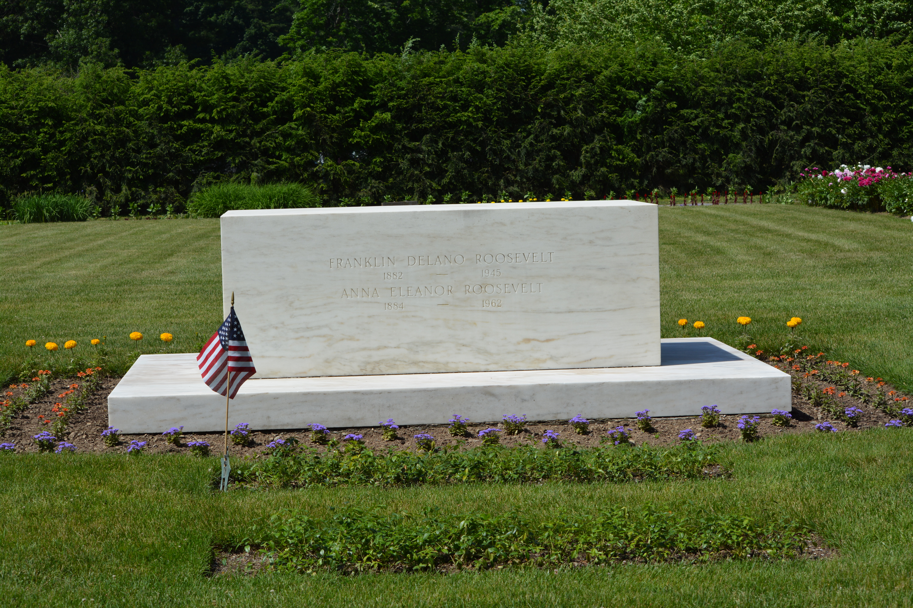

Slide 32
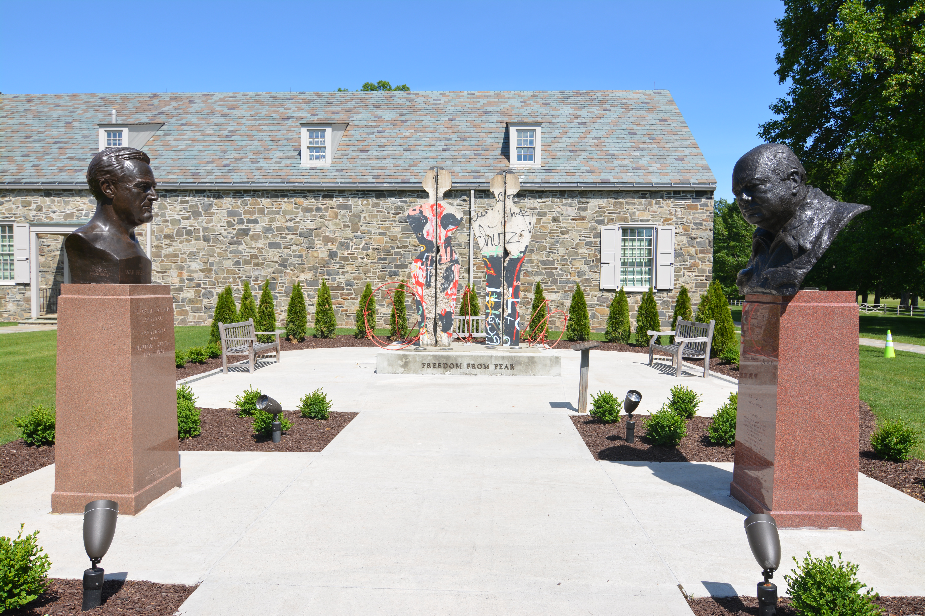

Slide 33
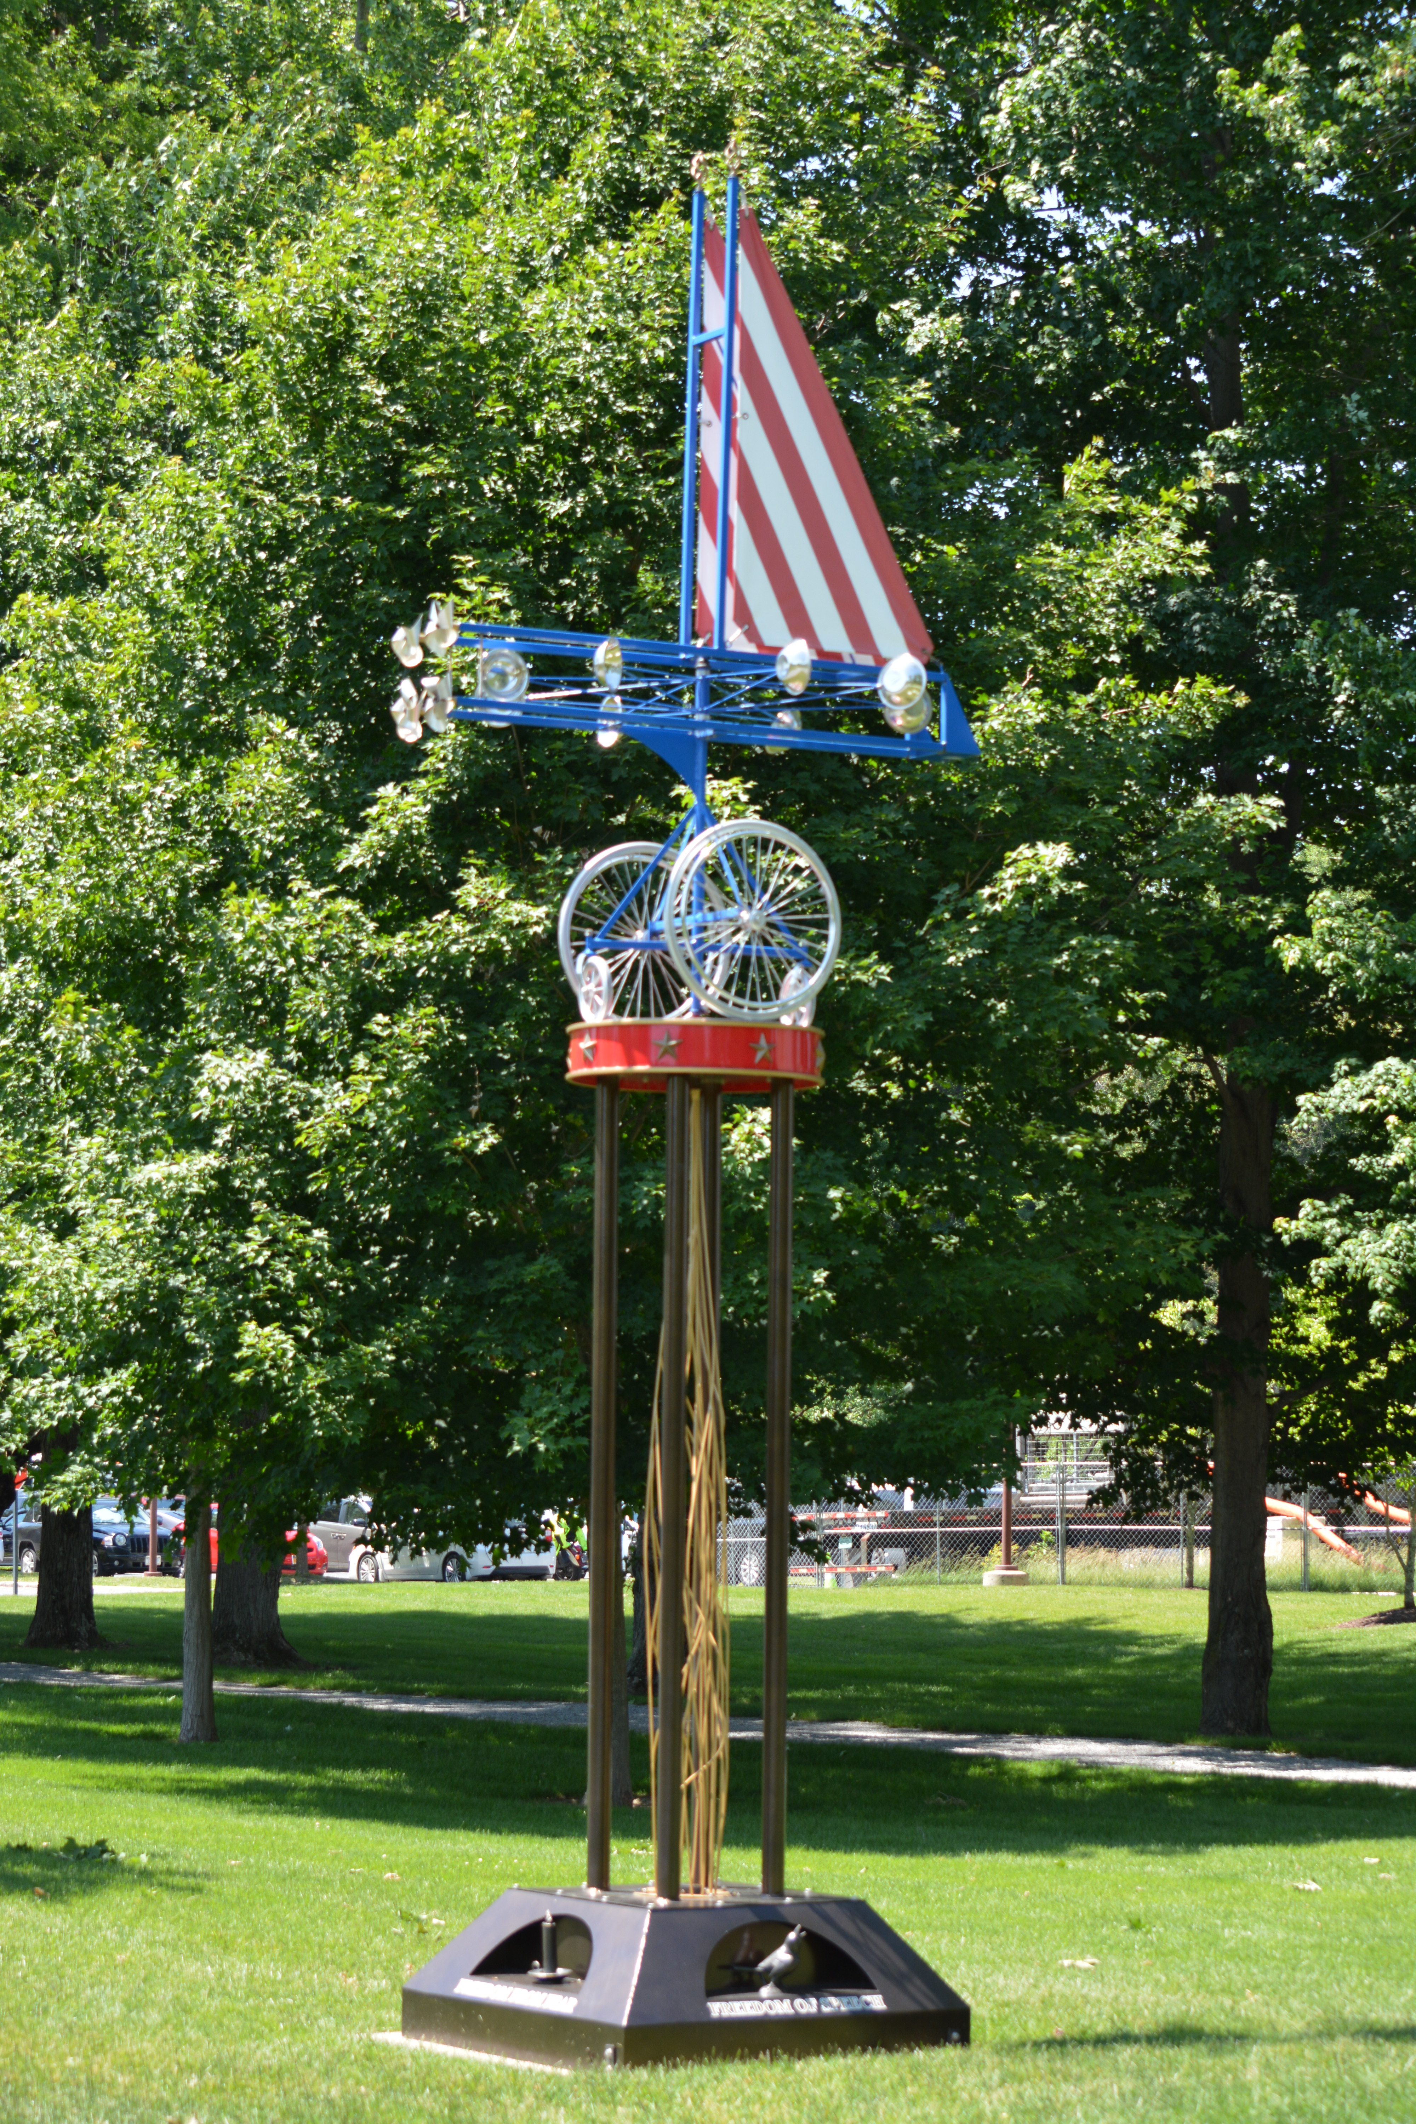

Slide 34
