Slide 1
Rise and Fall, and Rise Again of Asia

Slide 2
Significance of History in East Asia
Linear View vs. Cyclic view (cycles of change) of History, or a Process of Decline (Degeneration view)
Source of Moral Values
Legitimacy for Rulers
Community Life, Identity and Solidarity
Nationalism, Nation-building
Uniqueness of Asia? Asian way?

Slide 3
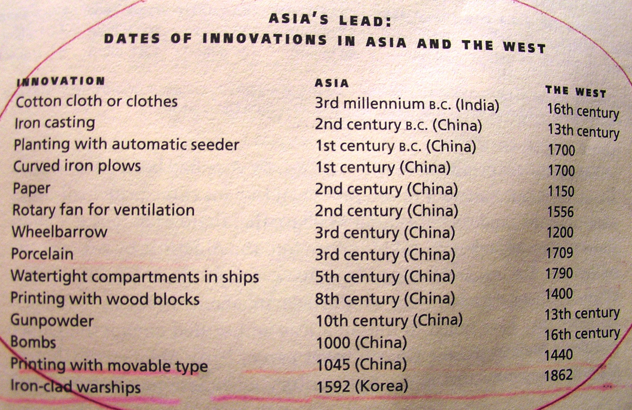
Kristof & WuDunn, Thunder from the East (2000), p. 29.

Slide 4
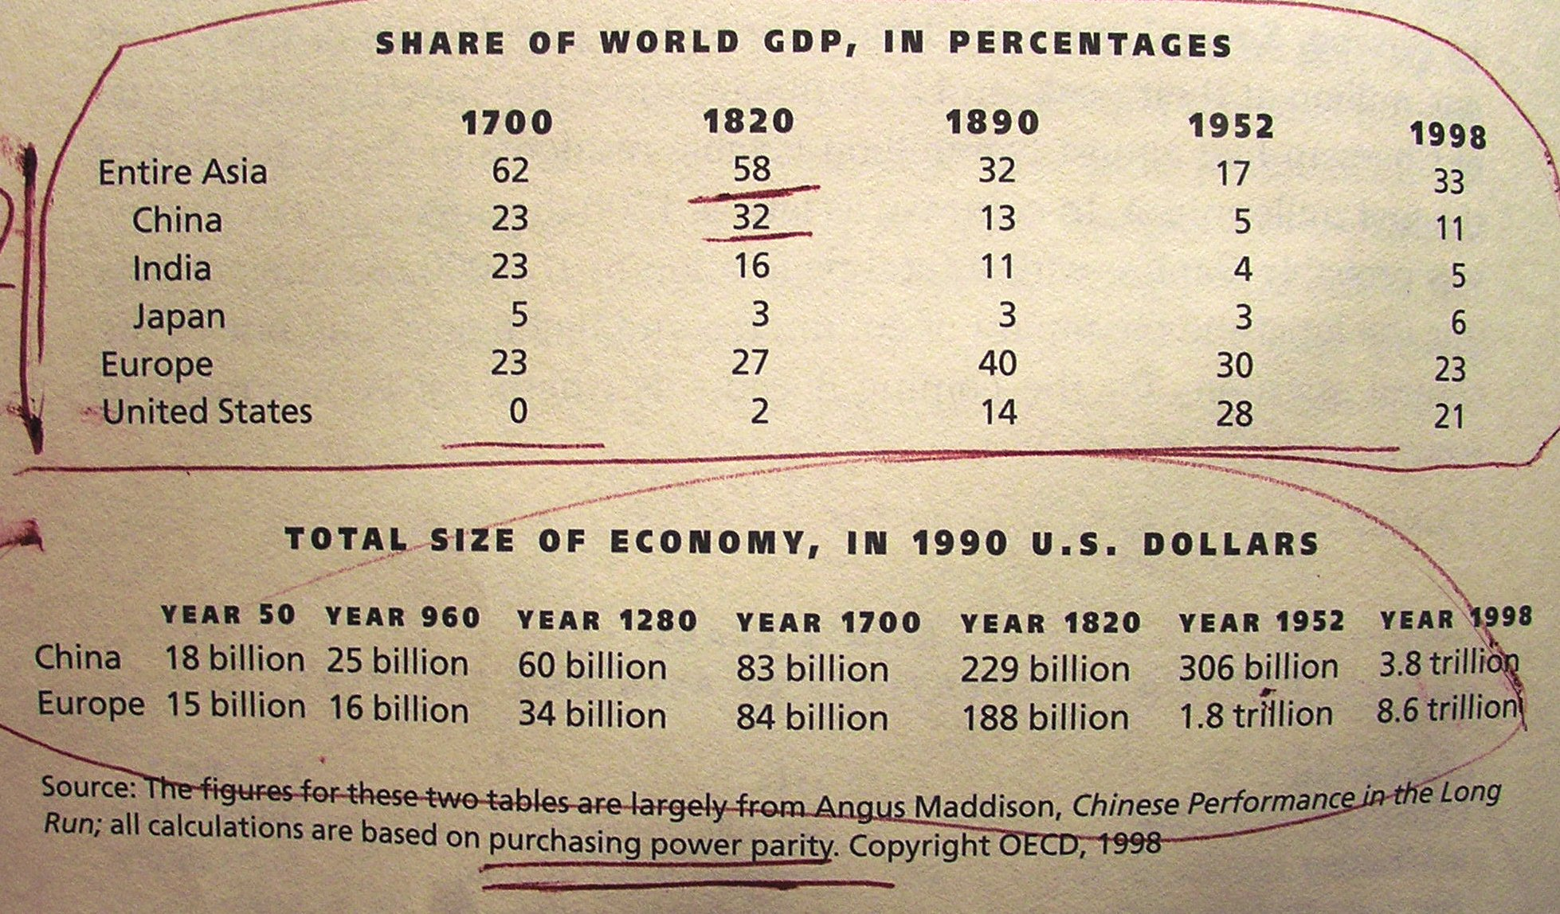
Kristof & WuDunn, Thunder from the East (2000), p. 30.

Slide 5
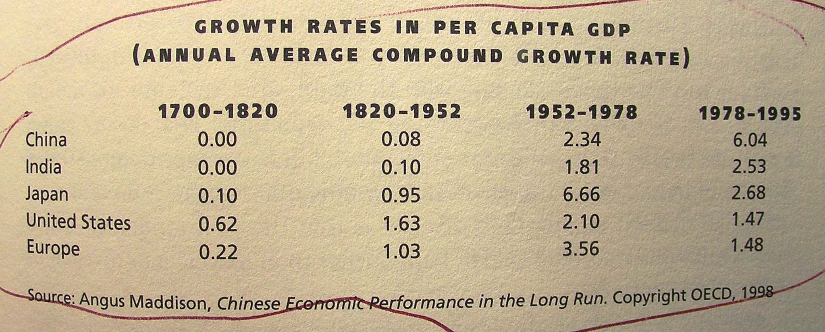
Kristof & WuDunn, Thunder from the East (2000), p. 41.

Slide 6
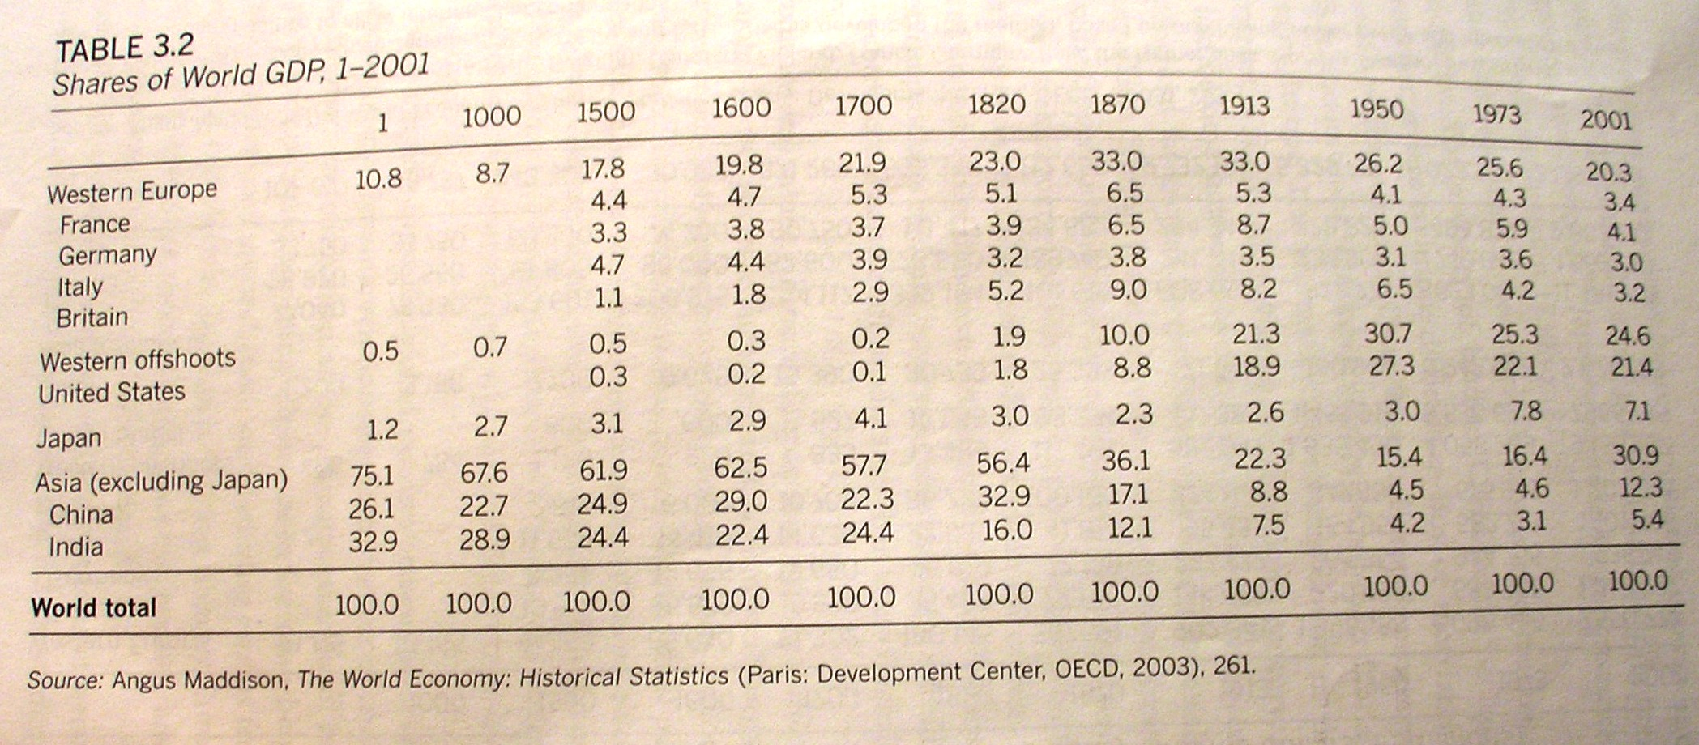
Wan, The Political Economy of East Asia (2008), p. 82

Slide 7
East Asia: The Era of China’s Supremacy
China as one of the Four Ancient Civilizations
The Axial Age in China
The Unification under Qin and Han Dynasties
The Dynastic Cycles
The Tributary System
The Tianxia (All under Heaven) Order
China’s Impact upon the World

Slide 8
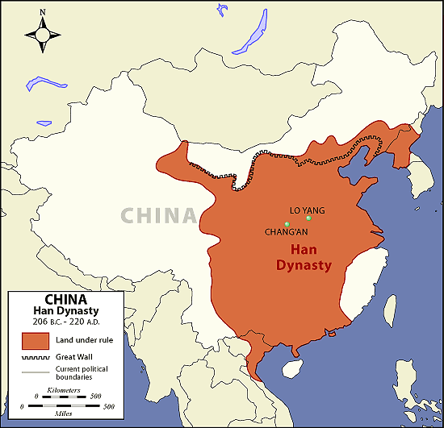
China’s Territories in History

Slide 9
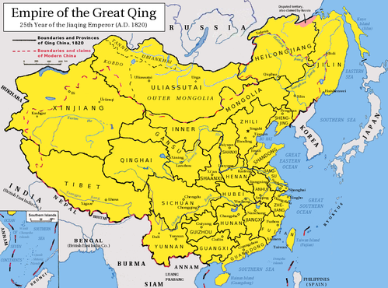

Slide 10
Kingdoms and Empires in the Pacific Asia
In Java: Mataram (8th-9th Century in Central Java); Kediri (12th-13th Century); Singasari (13th Century); Majapahit (13th-16th Century)
Melaka (1400-1511, in Malaysia)
Pasai (?-13th and 15th Century, in Sumatra, Indonesia )
Funan (1st Century to 8th Century), Cambodia
Cambodia (9th-14th Century)
Champa (510-1167), Today’s Vietnam
Burma (Bagan since the 2nd Century, Sagaing, Inwa, Toungoo, and Arakan until the 18th century)

Slide 11
Kingdoms and Empires in the Pacific Asia--continued
Vijaya (12th Century, in Vietnam)
Pandurangga (12th-13th Century, in Vietnam)
Champa Reunited (14th-15th Century)
Lan Xang (14th-16th Century, in Laos)
Ayutthaya (14th-16th Century, in Thailand)
Sukhothai (13th-15th Century, in Cambodia)
Lan Na (13th – 16th Century, in Thailand)
Vietnam (since Ngo Dynasty in the 10th Century)

Slide 12
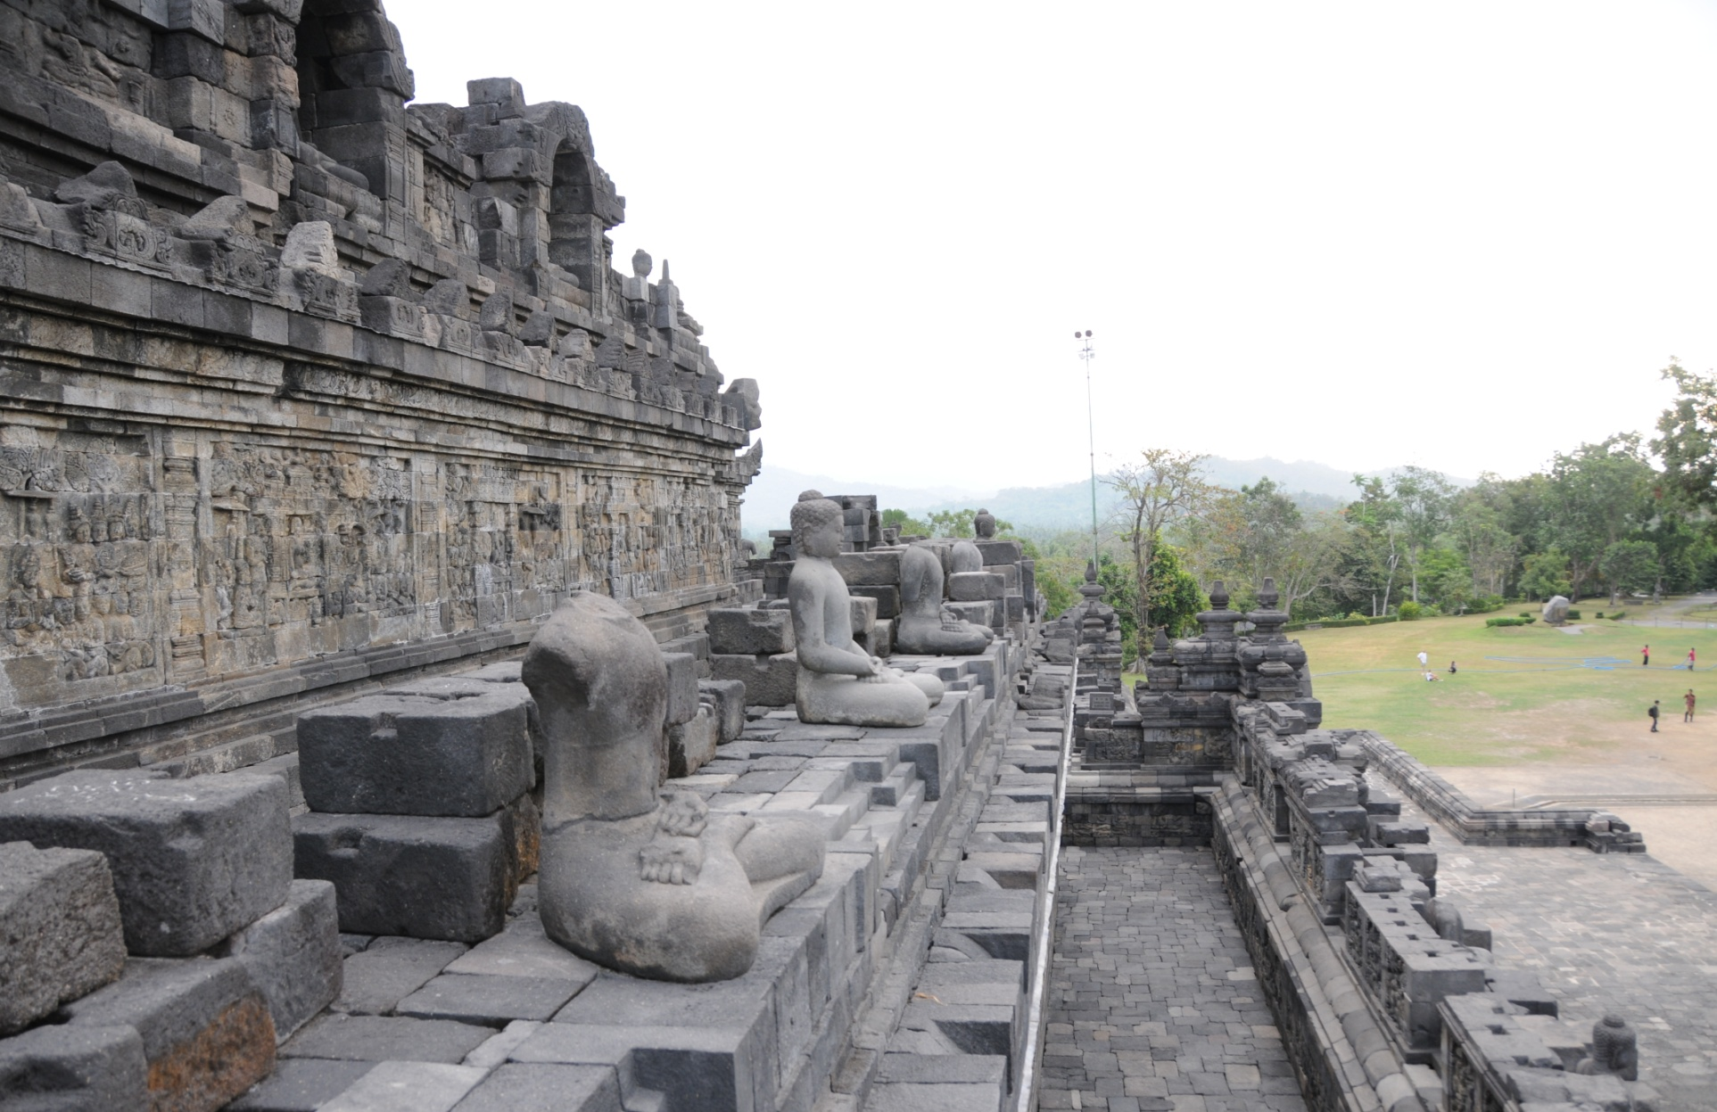
Buddhist Temples, in Borodudur, Java, built during the 9th Century

Slide 13
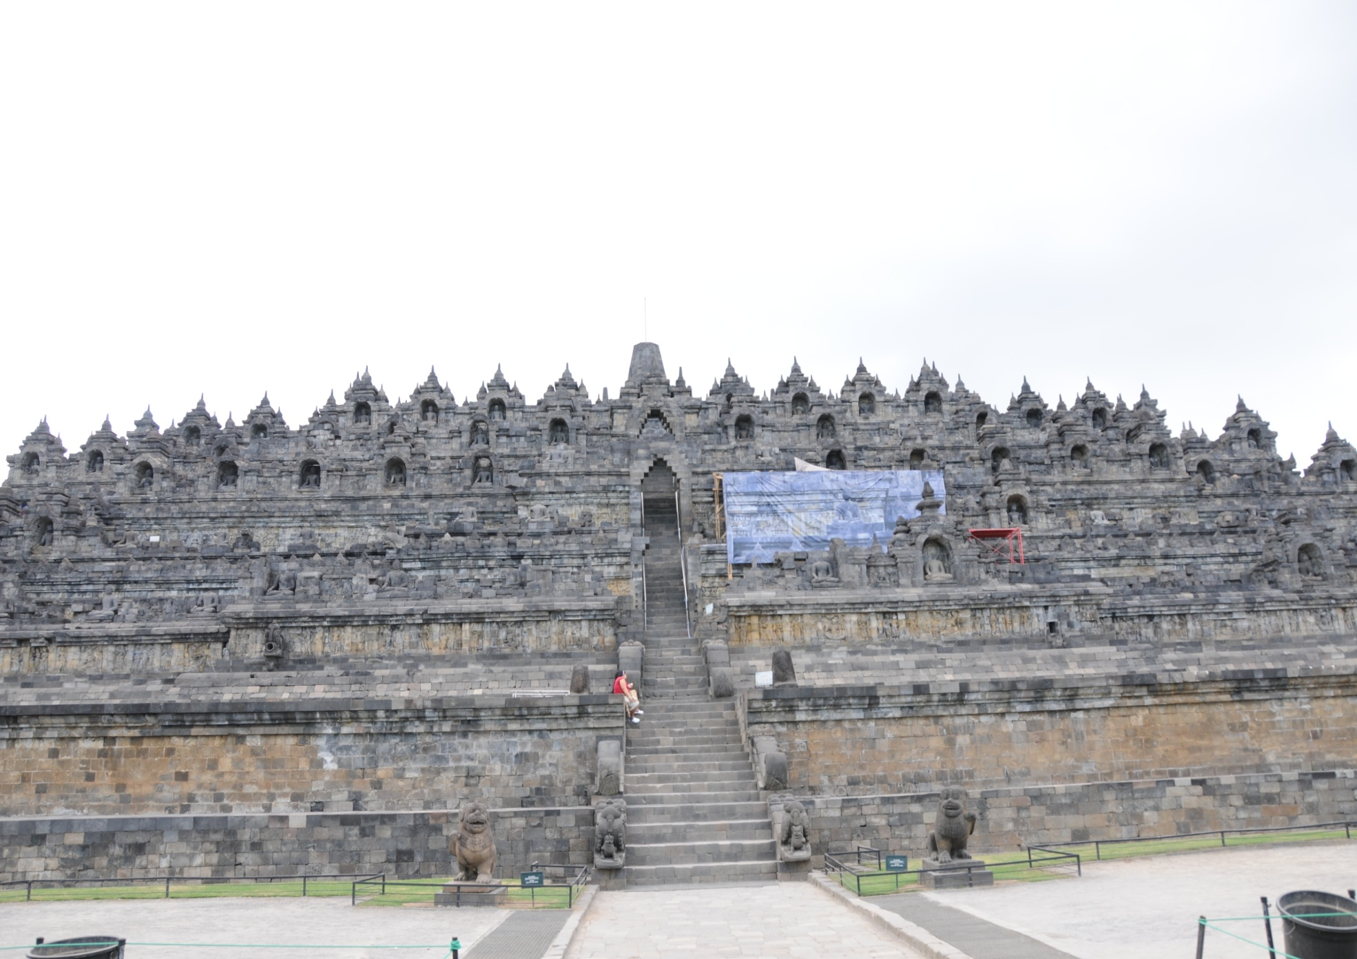

Slide 14
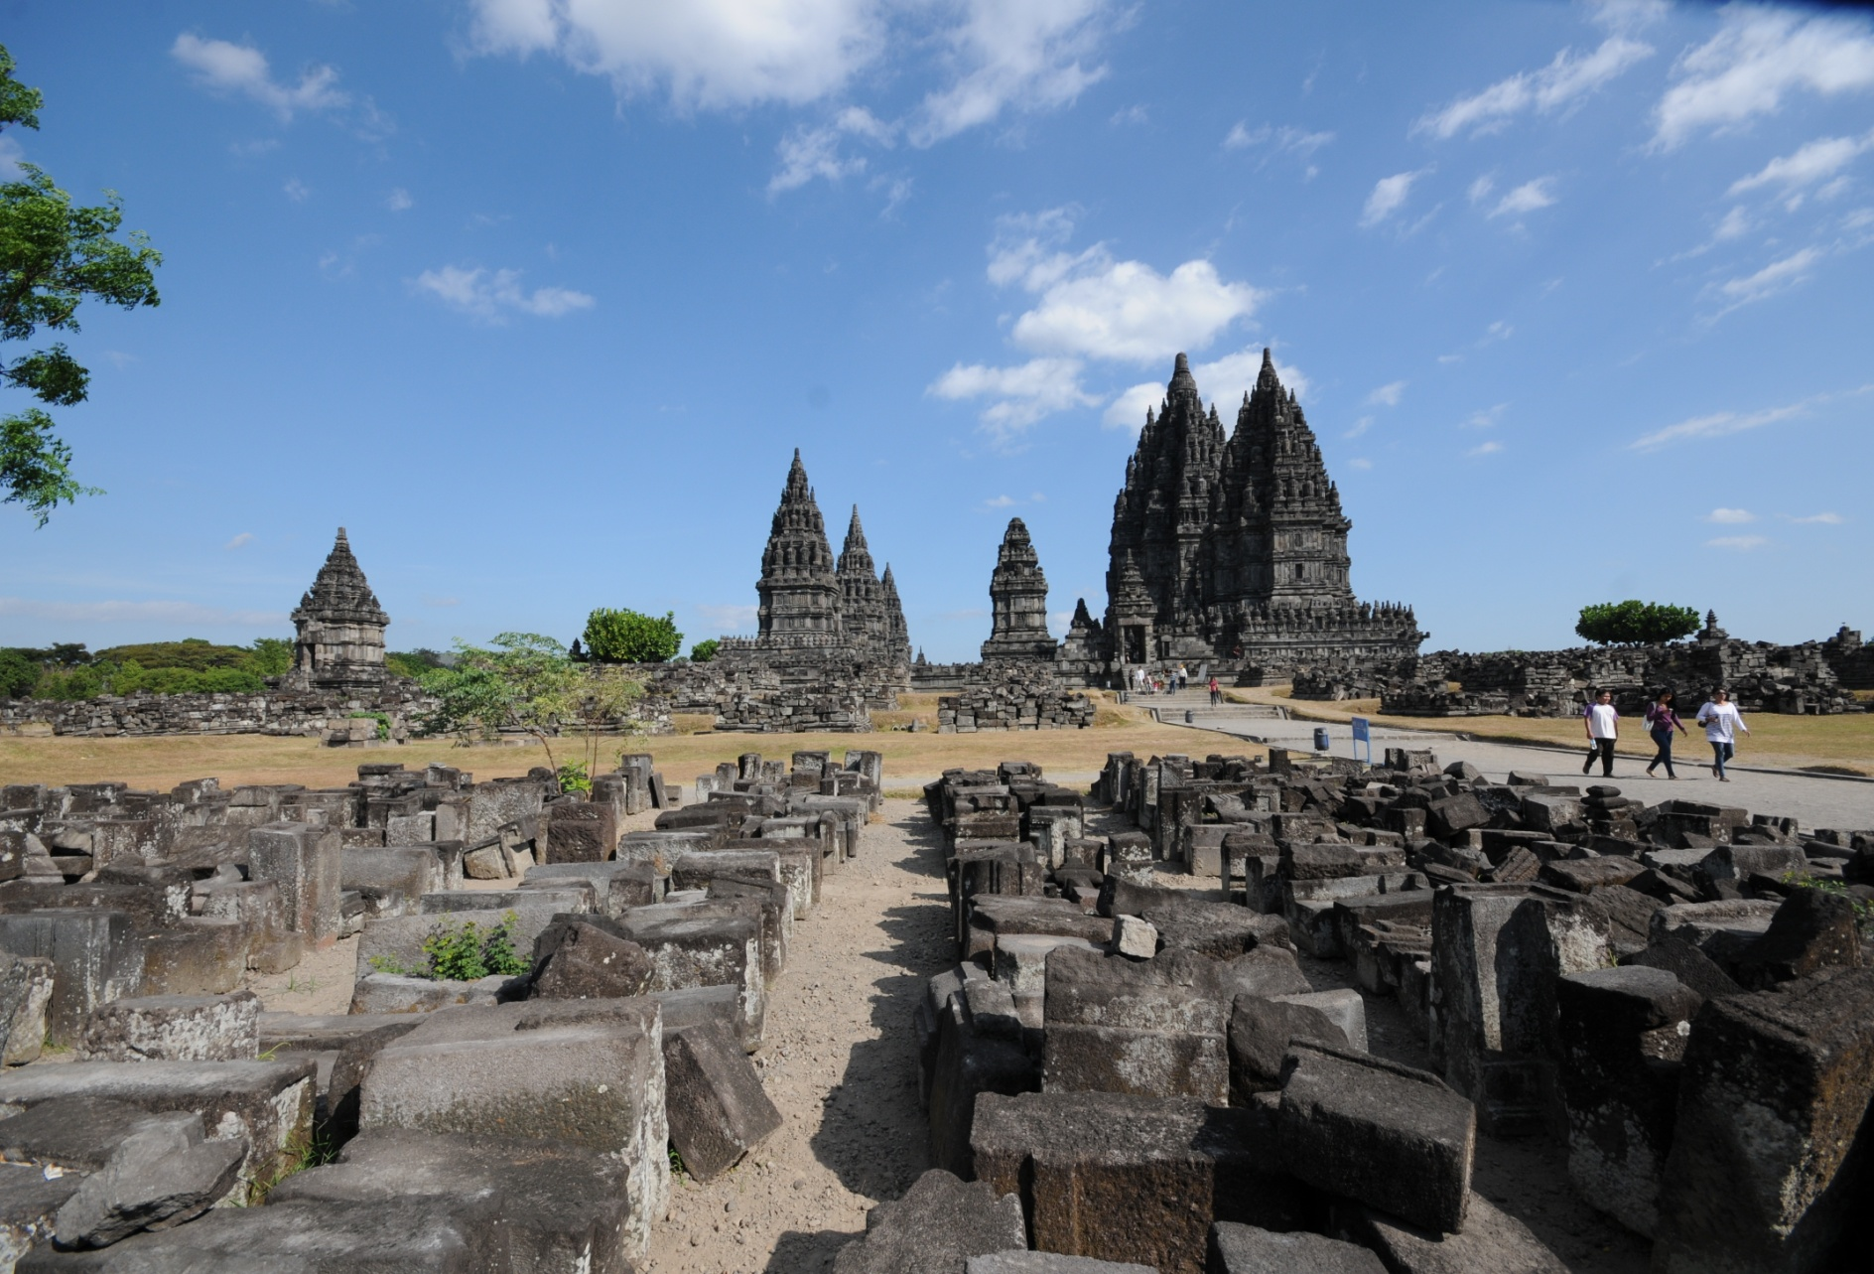
Hindu Temples in Prambanan, Java, built during the 9th Century

Slide 15
East Asia Facing the Challenge of the West
Why Did Westerners Come to Asia?
The Closure of the Silk Road
Search for New Routes for Spices Trade
Search for Gold
The Chronology of Western Colonialism in East Asia

Slide 16
Key Years
Portugal
Captured Malacca in 1511, holding it until the Dutch seized it in 1641. The island of Timor.
Spain
Conquest of Cebu in 1565 and Manila in 1571 until its defeat in the Spanish-American War in 1898.
The Netherlands
Dutch East India Company, lasted from 1605 to 1799.
Dutch government took control of the Indonesian archipelago, completed during the 1930s.
Great Britain
Three Anglo-Burmese Wars in 1824-26, 1852, and 1885-86. In 1935 the British agreed to separate Burma from India (into effect in 1937), Burma’s independence in 1948.
Penang (acquired in 1786), Singapore (founded by Raffles in 1819), and Malacca (Melaka, acquired in 1824), were governed by Britain as the Straits Settlements. British expansion into the Malay Peninsula between 1874 and 1914.
France
France moved into Vietnam in 1858, capturing Saigon in 1859. After Dien Bien Phu, independence at the Geneva Conference in 1954.
The United States
The peace settlement with Spain in 1898. A Commonwealth (internal autonomy) government in 1935, independence in 1946.

Slide 17
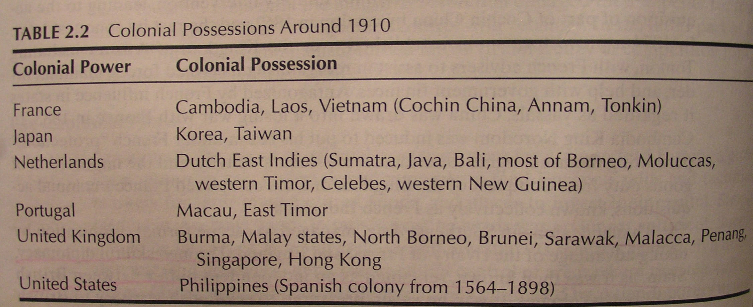
Simone, The Asian Pacific (2001), p. 40

Slide 18
Western Influence: Colonialism
Purpose of Ruling
Authority of Government
Nation-state
Nationalism
European International System

Slide 19
Nationalism in East Asia
Three Sources of Nationalism: primordial origins, modernization and industrialization, the (re)imagining of communities
Nationalist Movements in Japan, China, Korea and Southeast Asian countries
Nationalist Leaders: From Emperor Meiji to Chairman Mao, From Uncle Ho to Grandpa Lee
Simmering Nationalism: the Case of Disputed Inlands (South China Sea, Takeshima/Dokdo, Diaoyu or Senkaku islands)

Slide 20
Significance of East Asia in Civilization
From the Past to the Present
An Asian Renaissance?
U.S. in Pacific Asia: Some Successes, Tragedies and Failures in the Twentieth Century
U.S. in Asia in the 21st Century: A Return or a Reaffirmation?

